Slide 1
Harlem 100-year Timeline & Personal Experience
By Kyle, Neeraj and Violet

Slide 2
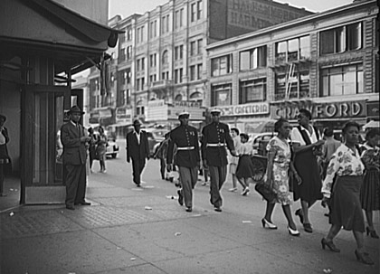
1900 - 1920
1900 – Black Population increase in Harlem, tens of thousands
1907-1915 – White residents of Harlem resisted black
1910 – Central Harlem 10% black (by 1930 it was 70% black)
Beveridge, A. (2015). An Affluent, White Harlem?. [online] Gotham Gazette: The Place for New York Policy and Politics. Available at: http://www.gothamgazette.com/index.php/demographics/4062-an-affluent-white-harlem [Accessed 24 Nov. 2015].

Slide 3
1921 - 1940
1921 – Fabric organisations (even today Harlem quality fabric stores)
1929 – Reported that whites owned (approximately) 82% of businesses
1930 – Great depression, 25% of Harlem residents were out of work
1934 – Hiring practices changes (forcing businesses to hire more blacks)

Slide 4
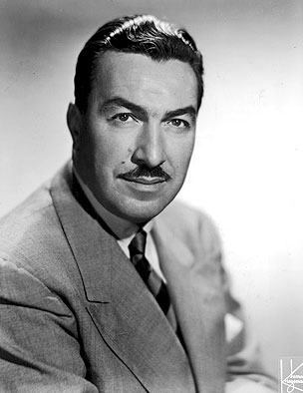
1941 - 1960
1941 – Adam Clayton Powell Jr. elected to the city council (first black to be elected in New York)
1943 – Harlem riot took place as a black soldier was shot by a police officer
1950s-60s – Rent strikes, landlords were over-charging for non-proper housing (rat infested, no heating during winter etc.)
Likesuccess.com, (2015). Quotes by Adam Clayton Powell, Jr. @ Like Success. [online] Available at: http://likesuccess.com/author/adam-clayton-powell-jr [Accessed 24 Nov. 2015].

Slide 5
1961 - 1990
1970s – Major poverty, the government spent $100 mil on numerous projects but Harlem should no results
1976-1978 – People leaving the neighbourhood (around one-third of the population), the district no longer had a functioning economy
1985 – City auctioned Harlem’s property to the public
1990 – Percentage of blacks decreasing from 88% – 69%

Slide 6
1991 - Present
1998 – Blacks ceased to be the majority of the population due to the arrival of new white and Hispanic residents
2008 – Real-estate prices dropped but recovered rapidly
2014 – Buildings in East Harlem were destroyed in a gas explosion

Slide 7
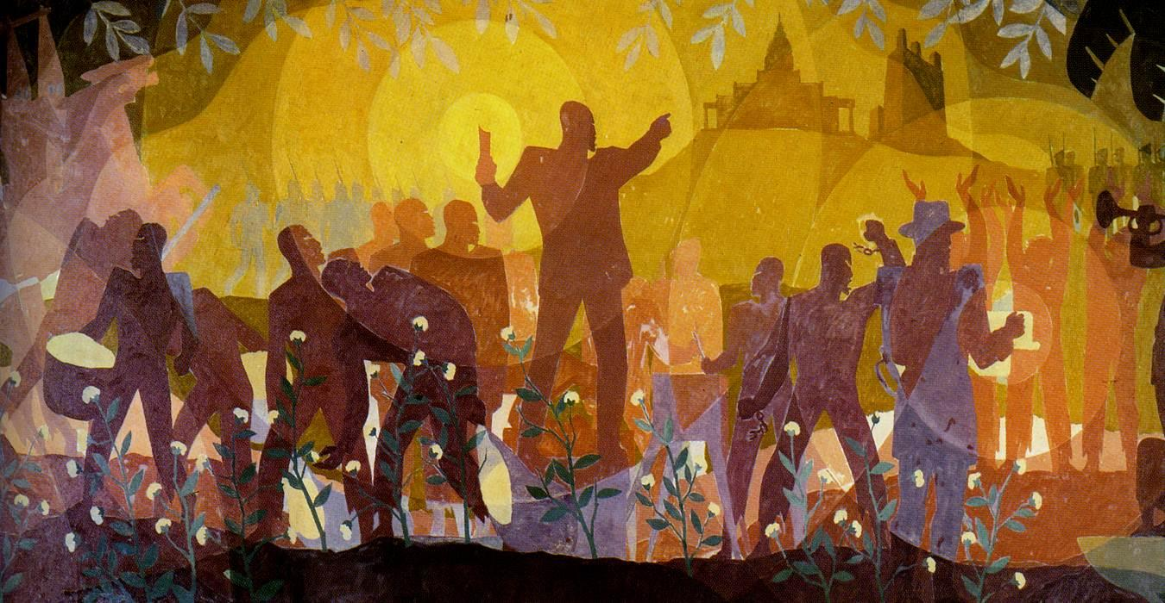
Harlem Renaissance – Aaron Douglas
Harlem Hidden History, (2015). Lab. [online] Available at: http://www.harlemhiddenhistory.org/lab.html [Accessed 24 Nov. 2015].
The Charnel-House, (2014). Aspects of Negro Life - From Slavery Through Reconstruction, 1934. Aaron Douglas. [online] Available at: http://thecharnelhouse.org/2014/08/03/afrofuturism-aaron-douglas-and-w-e-b-du-bois-1920s-1930s/aspects-of-negro-life-from-slavery-through-reconstruction-1934-aaron-douglas/ [Accessed 24 Nov. 2015].

Slide 8
Current Demographics (2012)
CLRSearch, (2015). Harlem, GA Population by Race and Ethnicity - CLRSearch. [online] Available at: http://www.clrsearch.com/Harlem-Demographics/GA/Population-by-Race-and-Ethnicity [Accessed 24 Nov. 2015].

Slide 9
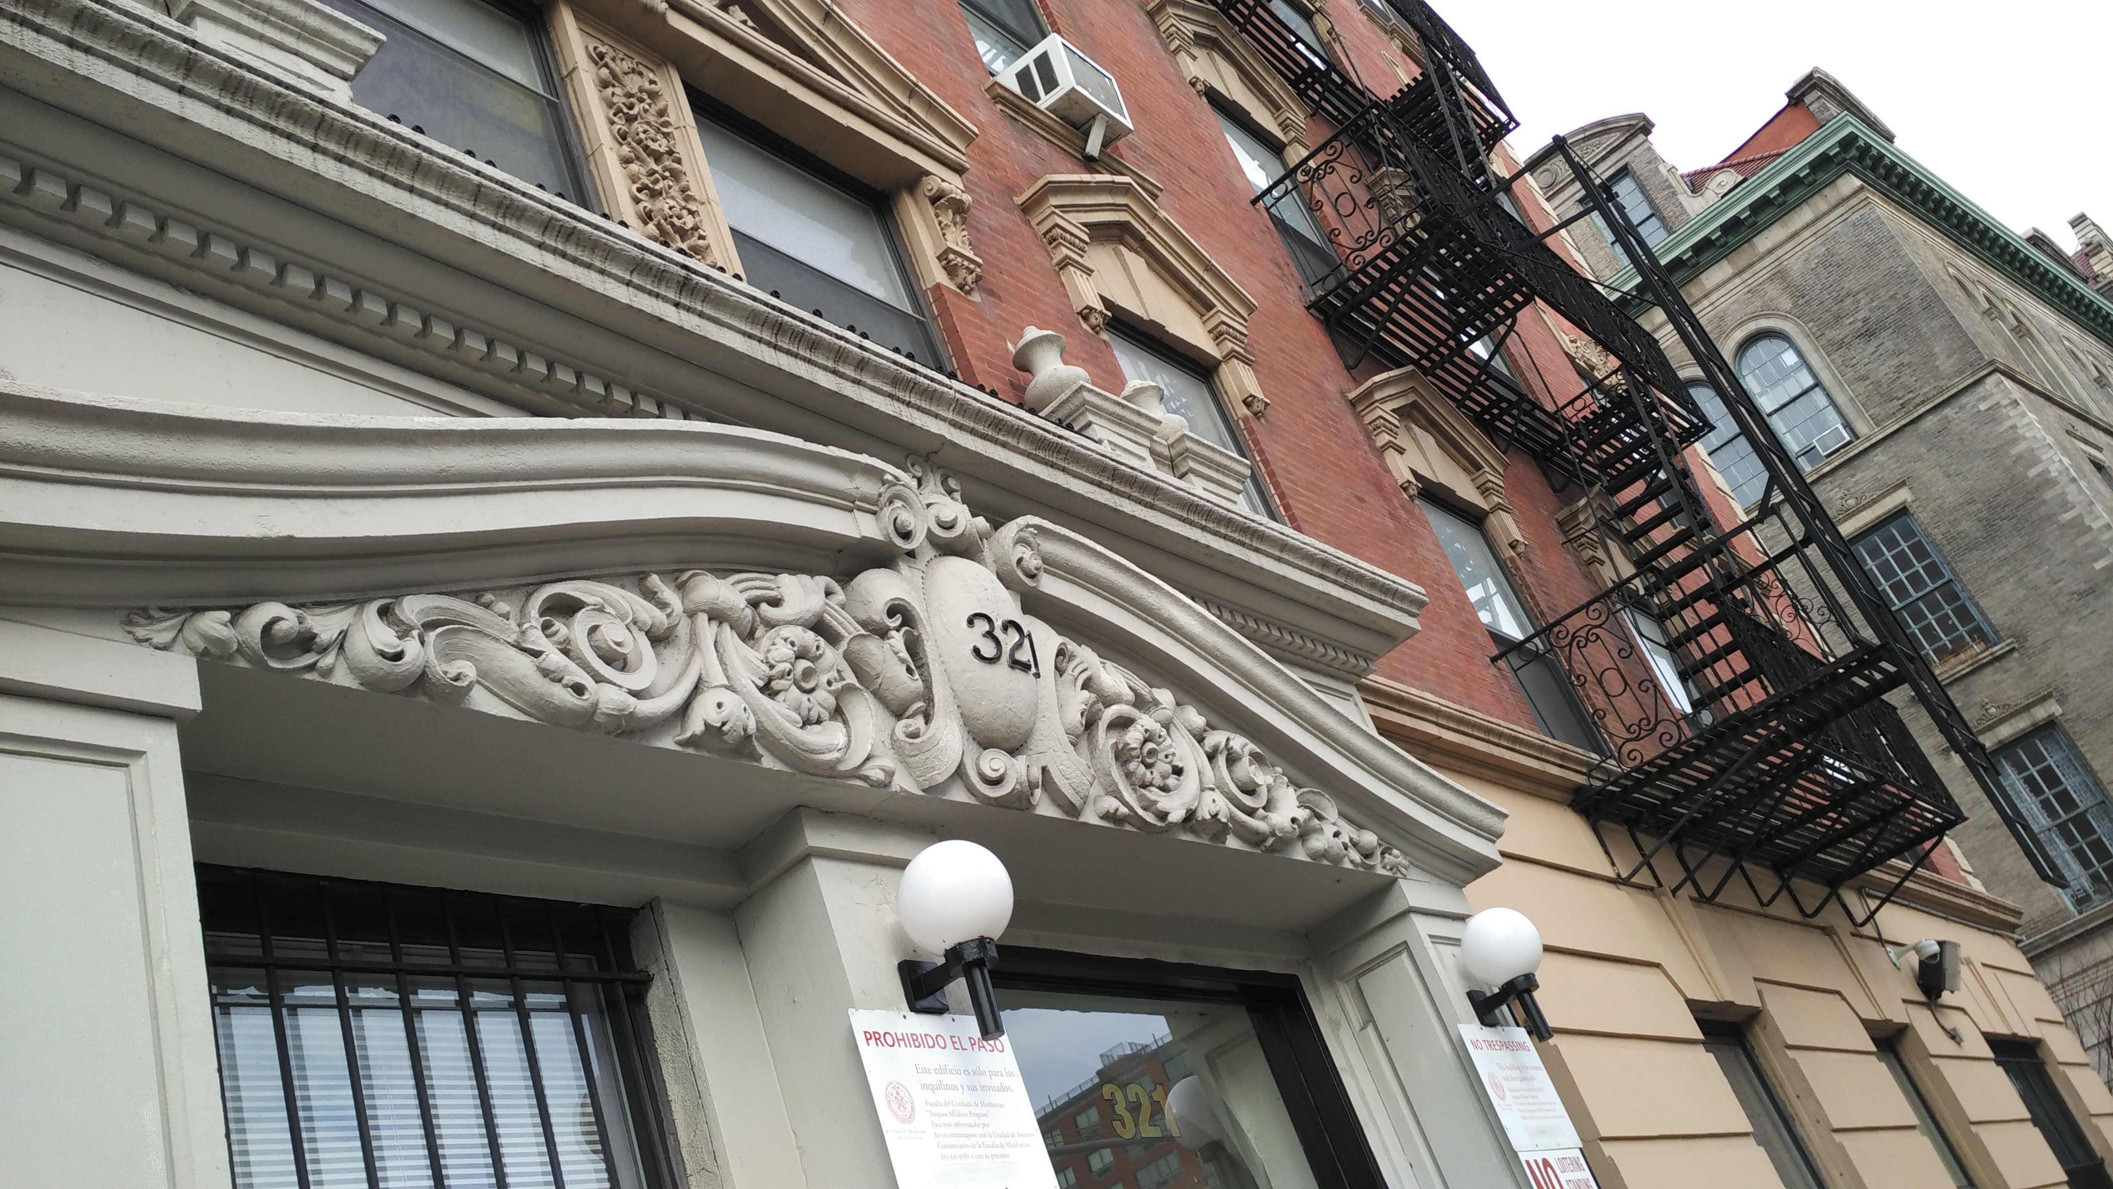
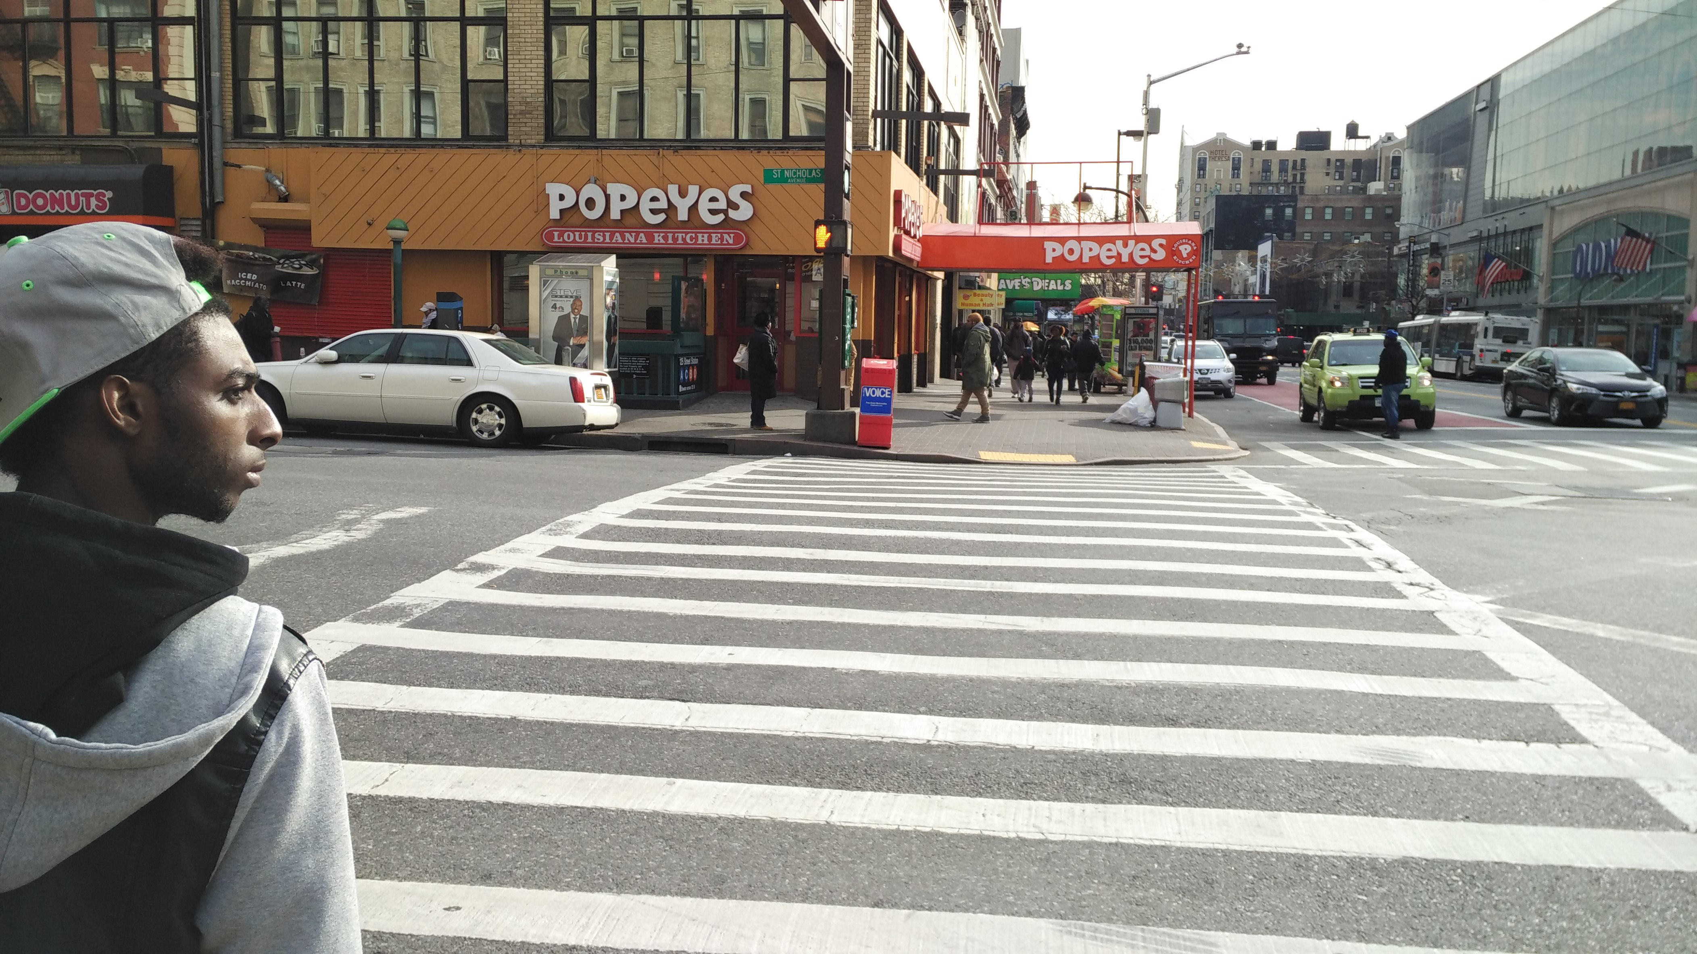
My Personal Experience
Very spacious
Beautiful architecture
Blacks does appear to be the prominent race (the demographics chart doesn’t seem to hold up for me)

Slide 10
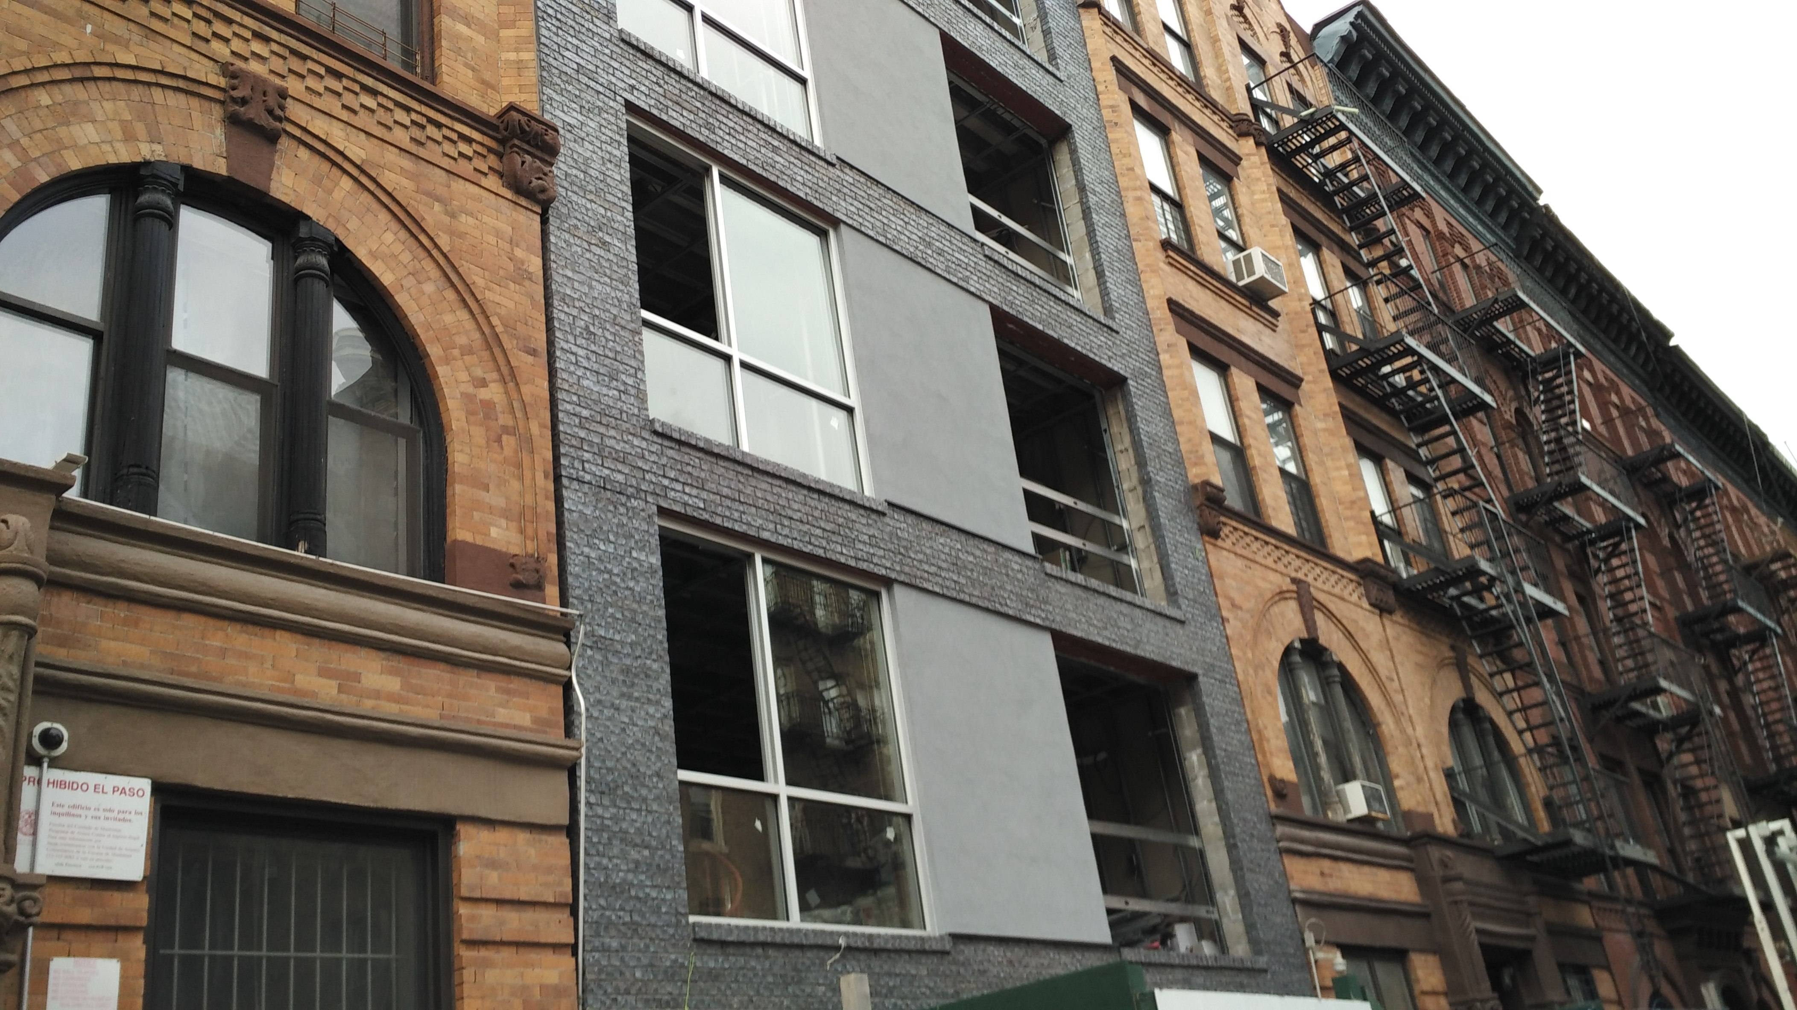
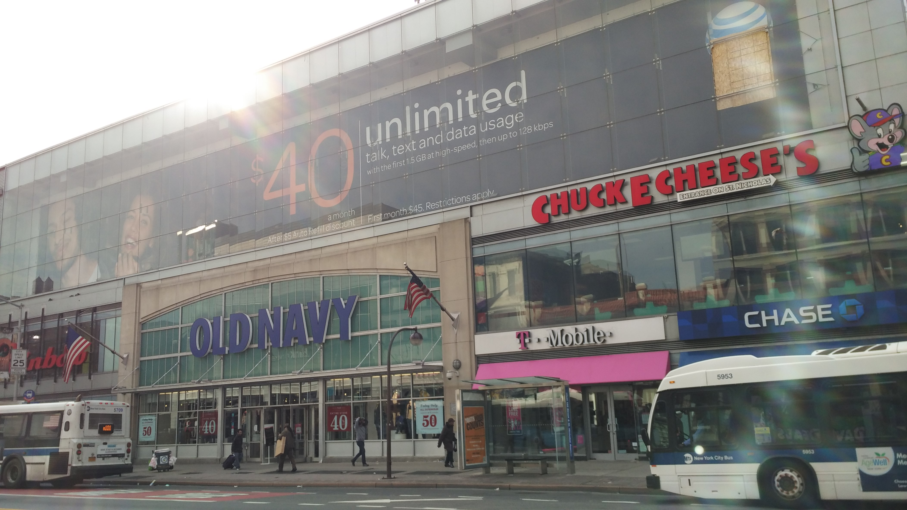
Recordings
Two fails – People from the Bronx (they were African)
One success – Dominican person told me about the shifts in Harlem
He told me about growing up in Harlem
About new buildings
And about Old Navy (which I tracked down)

Slide 11
An Observation
The blacks I interacted with weren’t always African-American
They seemed to come from Africa
It can be seen by their colourful hair scarfs and accents (as seen in the failed recordings)

