Slide 1
Cultural Appropriation Integrated Seminar and Studio
Sydney Loew

Slide 2
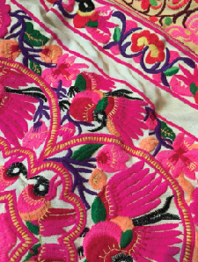
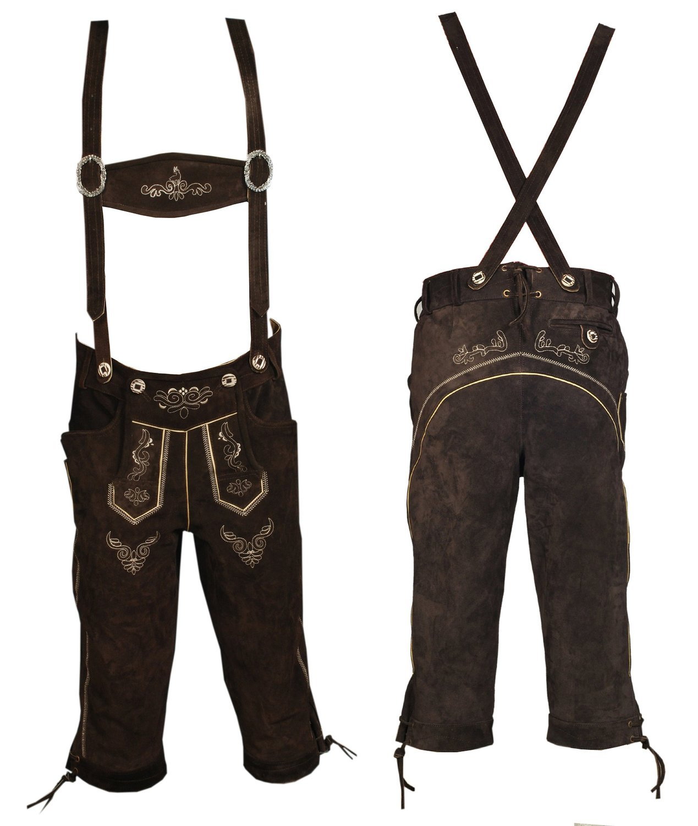
Original Understanding
Textile from personal bag (Made in Nepal)
Bavarian German Lederhosen Amazon.com
Notes:
-I originally understood my paper to be advocating the benefits of cultural appropriation because it is so widely used in fashion
-I was drawn to the mixing of different cultures because of the similar yet different elements
-I knew that the popular side of the debate on cultural appropriation in fashion is that it is negative, however, I think this is false
-At first, in studio, I wanted to show this by created an ethnically embroidered lederhosen based off of the embroidery from my Nepalese bag. -This would raise awareness of outside cultures and meld the two together, which is, in my opinion and paper, the positive side of the debate
-In seminar, I knew that I wanted to prove cultural appropriation in fashion to be positive, but I also had to be careful not to overstep the boundaries and copy a culture in my studio garment.

Slide 3
Research
Notes:
Through my research, my original understanding of the relationship between my projects changed because I learned from the research in each class and was able to refine my ideas for my studio garment based off of my research in both classes.

Slide 4
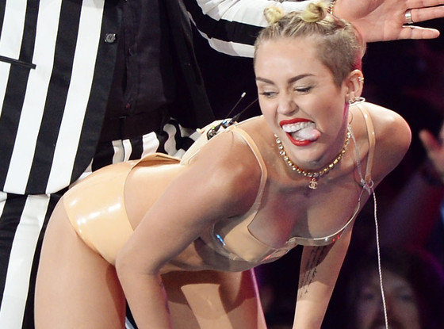
Studio Research: Cultural Appropriation Controversy
Miley Twerking at the 2013 MTV Video Music Awards
(Andrew H. Walker Getty Images)
Karlie Kloss 2012 Victoria’s Secret Fashion Show
(Getty Images)
Notes:
Through my studio research, I was able to find many examples of cultural appropriation in fashion, in museums, and in pop culture
-the pop culture aspect stood out to me because it contrasted my paper topic that cultural appropriation is beneficial
-it paints cultures in a bad light, which is not my objective
-this research influenced my paper because I made it my goal to focus on runway fashion and designer brands that successfully appropriate from other cultures
-I think that the controversies stem from the fact that the celebrities wearing these over the top garments are a part of a theatrical show
-these do play a part in the debate on cultural appropriation, but I wanted to focus on high end designers because they often set the trends that everyone follows or gets inspired by

Slide 5
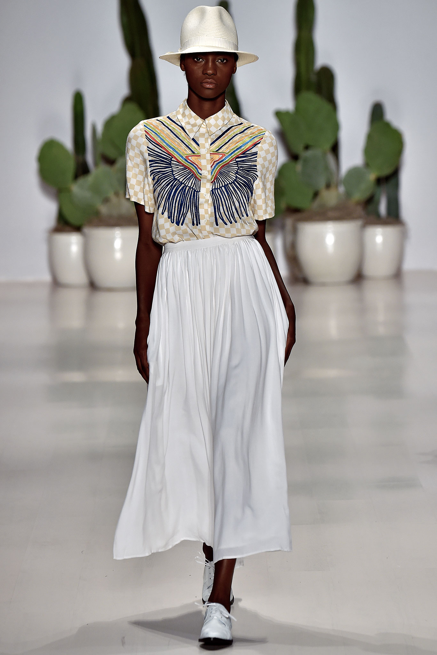
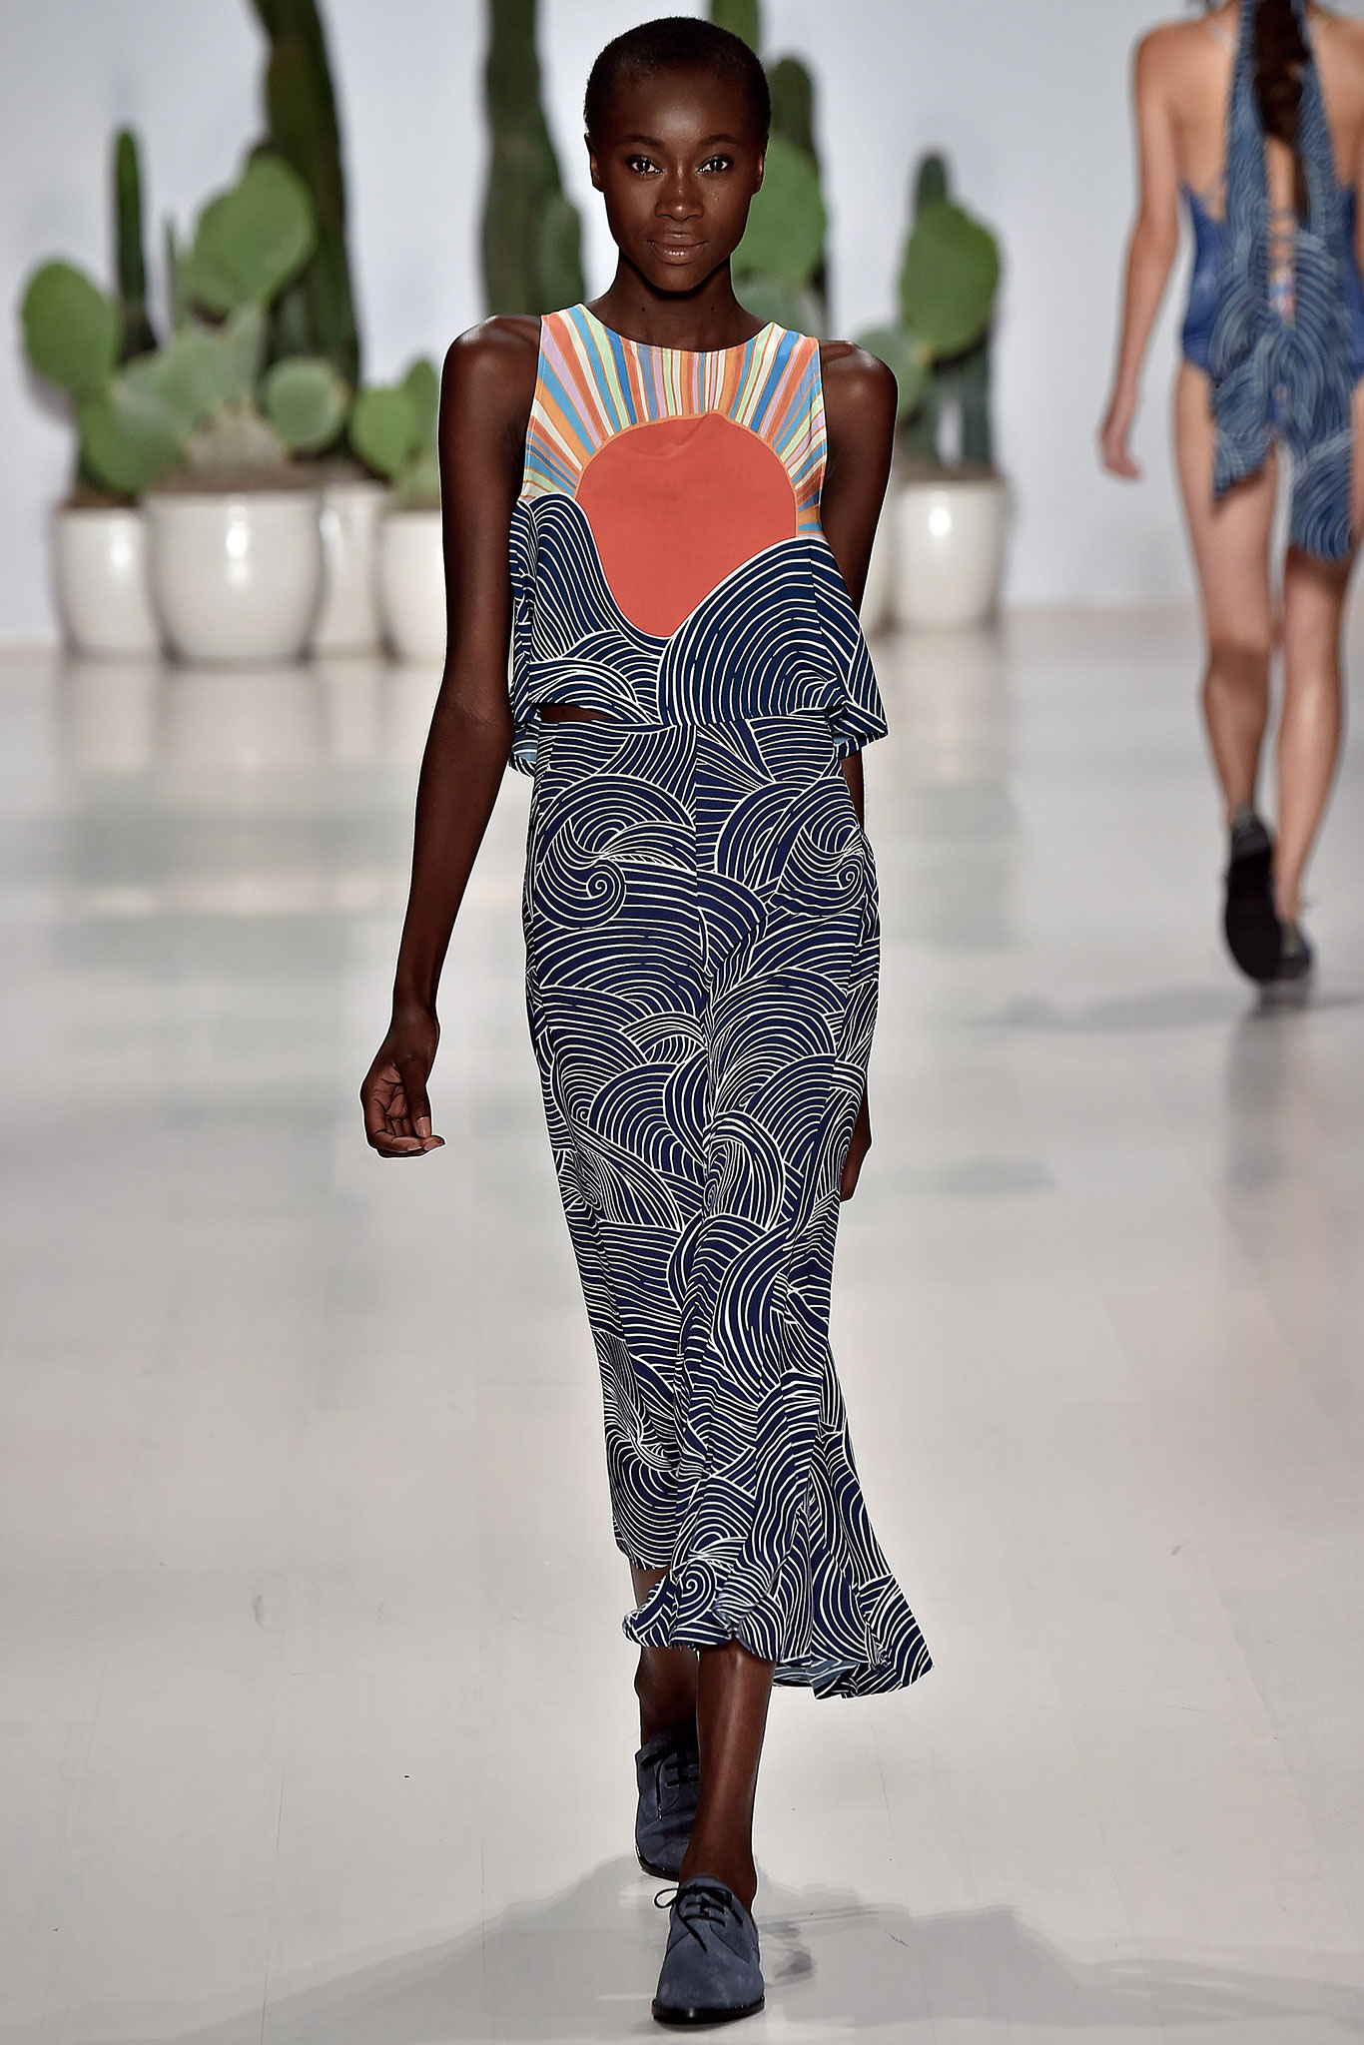
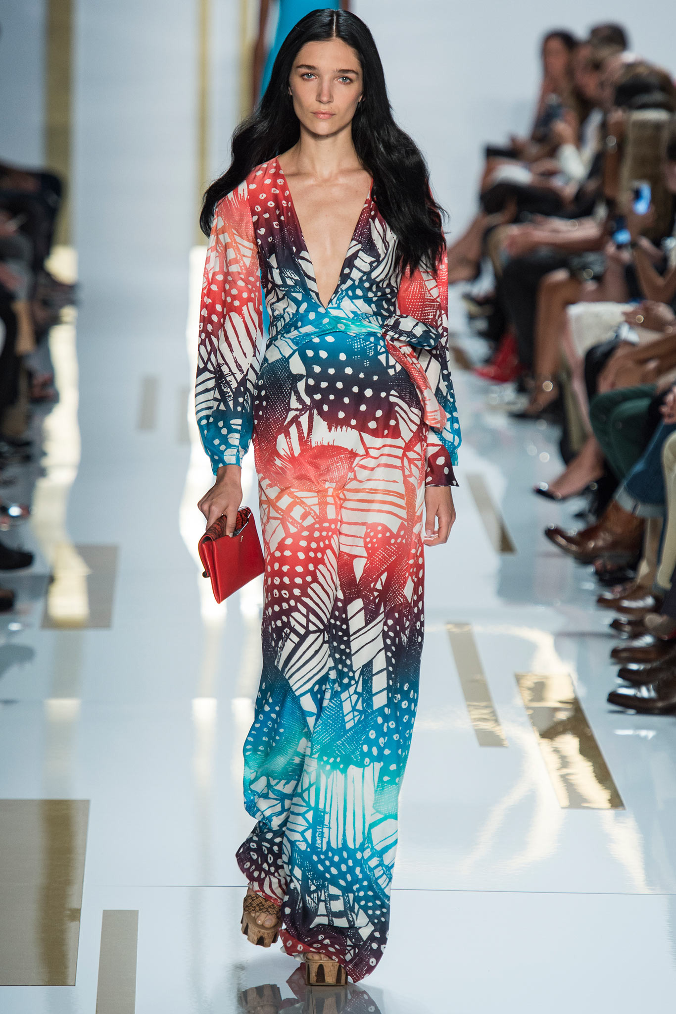
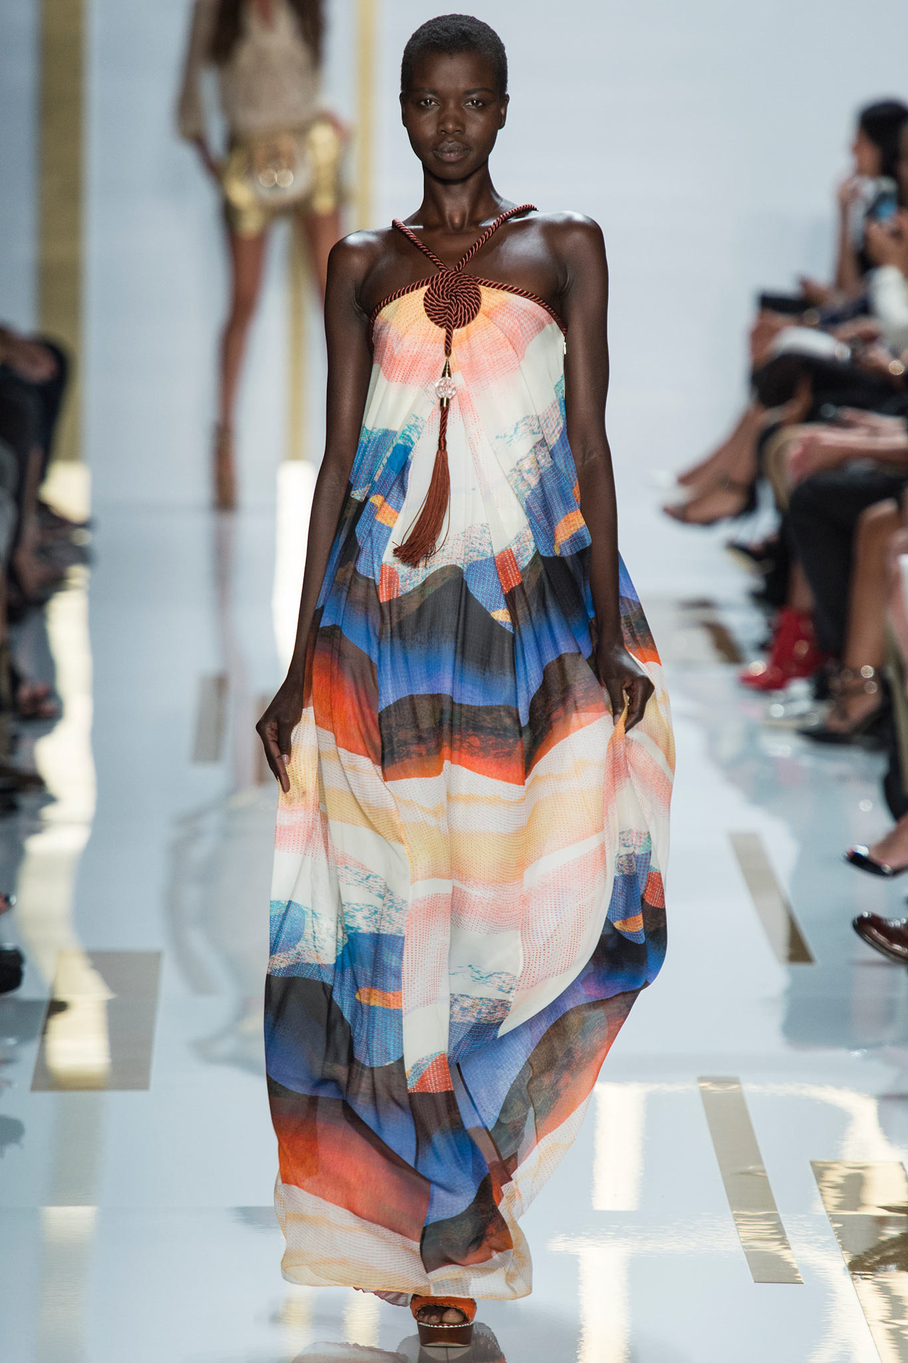
Seminar Research: Successful Cultural Appropriation on the Runway
“If clothes don't have the power to instigate change, they can at least herald it--not simply in hem lengths and silhouettes but in political movements and social attitudes.” - Aubry Kaplan Erin, Los Angeles Times
Mara Hoffman SS 15, Style.com
Kim Weston Arnold
DVF SS 14, Style.com
Yannis Vlamos

Slide 6
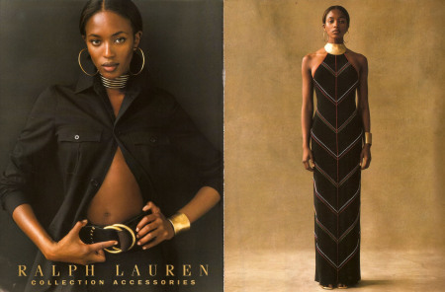
Seminar Research: Successful Cultural Appropriation on the Runway
Ralph Lauren Spring 1997
Peter Pilotto Resort 2013
Notes:
Ralph Lauren- African inspiration in textiles
Peter Pilotto- inspiration from centuries-old illuminated manuscripts in London’s Royal Library
-These cultures acted as the inspiration and bring the cultures together. For Ralph Lauren, he brought Africa into America by clashing the two cultures and raising an awareness of Africa through textile.
-Peter Pilotto did the same by educating about and raising awareness of the illuminated manuscript and stained glass motifs in England.

Slide 7
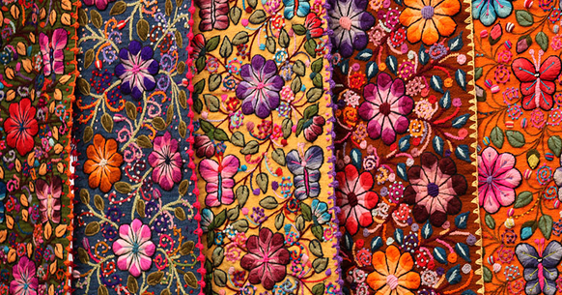
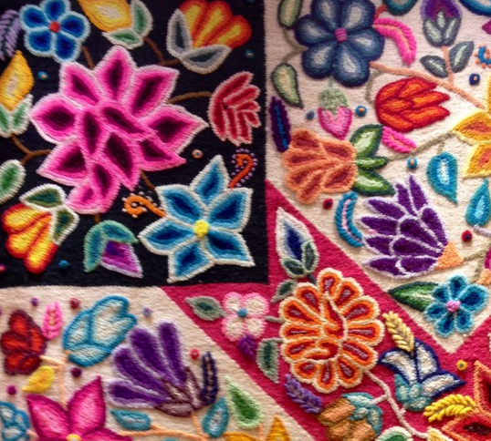
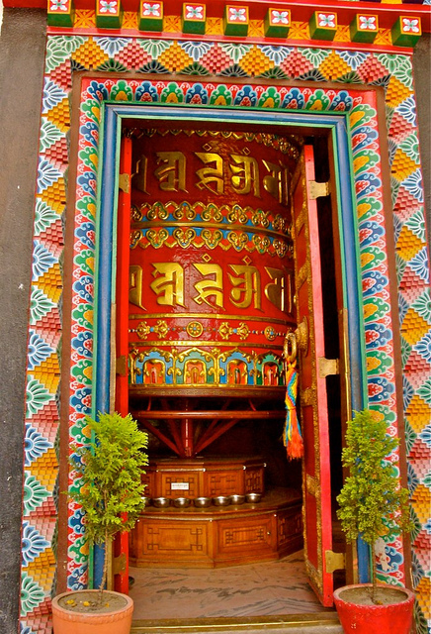
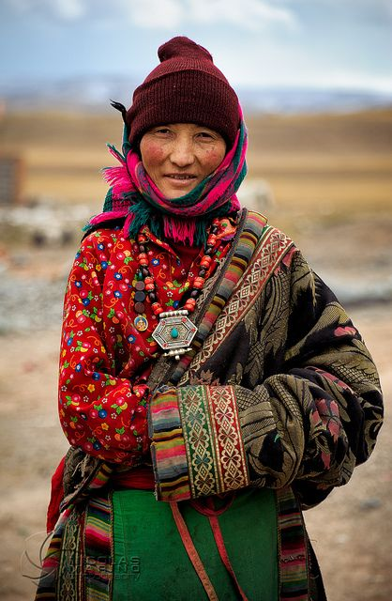
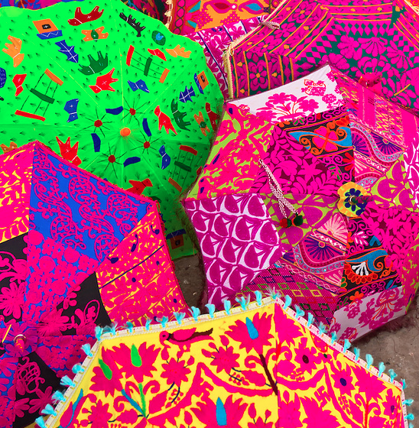
Studio Research: Inspiration
Peruvian Textile J. Mazzotti
Peruvian Textile Jairo Ossabai
Prayer Wheel Kathnmandu, Nepal neezieneezie
Umbrellas outside a shop, Jaipur, Rajasthan, India
Tibet Costume Flickr Images: Nicolas Marino
Notes:
-For studio, I researched further into cultures like Nepal because of my original inspiration of my bag made from Nepal.
-I looked at Peru, India, Nepal, and Tibet for textile inspiration and took away from it the bright colors and the floral embroidery
-Refined by my research from seminar, I decided to take these elements and utilize them in my garment

Slide 8
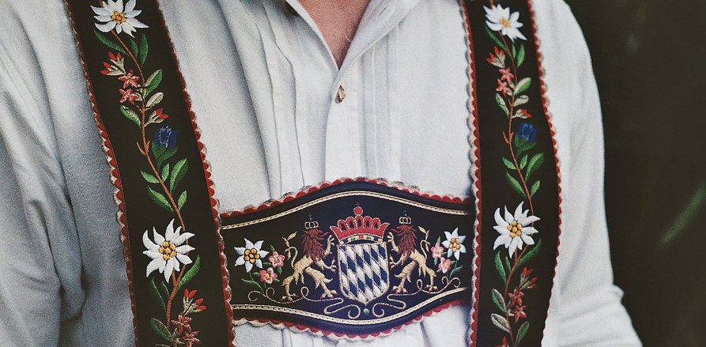
Studio Research: Inspiration
Flickr images: Chrrristine
Flickr images: Martin
Notes:
-As a result of my seminar research, I became aware that the designers with successful uses of cultural appropriation often took elements from the culture instead of mimicking ideas.
-Because of this, I took a similar approach and began to take certain aspects of the cultures I was appropriating for my garment.
-From the Bavarian culture, I took the criss-cross strap idea and the curved bib of the lederhosen.

Slide 9
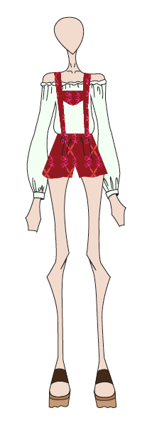
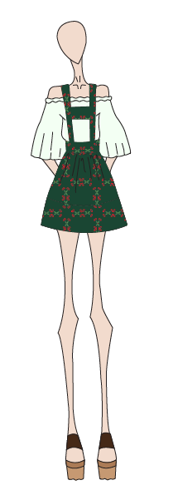
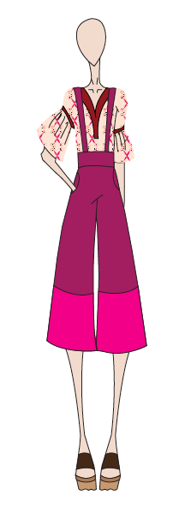
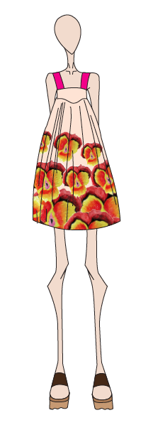
Inspiration into sketches
Notes:
-From my research, I decided that cultural appropriation that works in a positive way often takes subtle elements of the inspiration from outside sources and cultures and combines them in an effective manner.
-Through the swatch booklet project, we created four looks and I think my ideas transitioned from the sketches because they start out in a very obvious way that it is taking from another culture. Copying the lederhosen silhouette in an obvious way was not as effective to my research paper, so the final looks begin to take subtle elements from the silhouettes as my prints similarly took elements of embroidery instead of an all-over print that mimics those of a culture specifically.

Slide 10
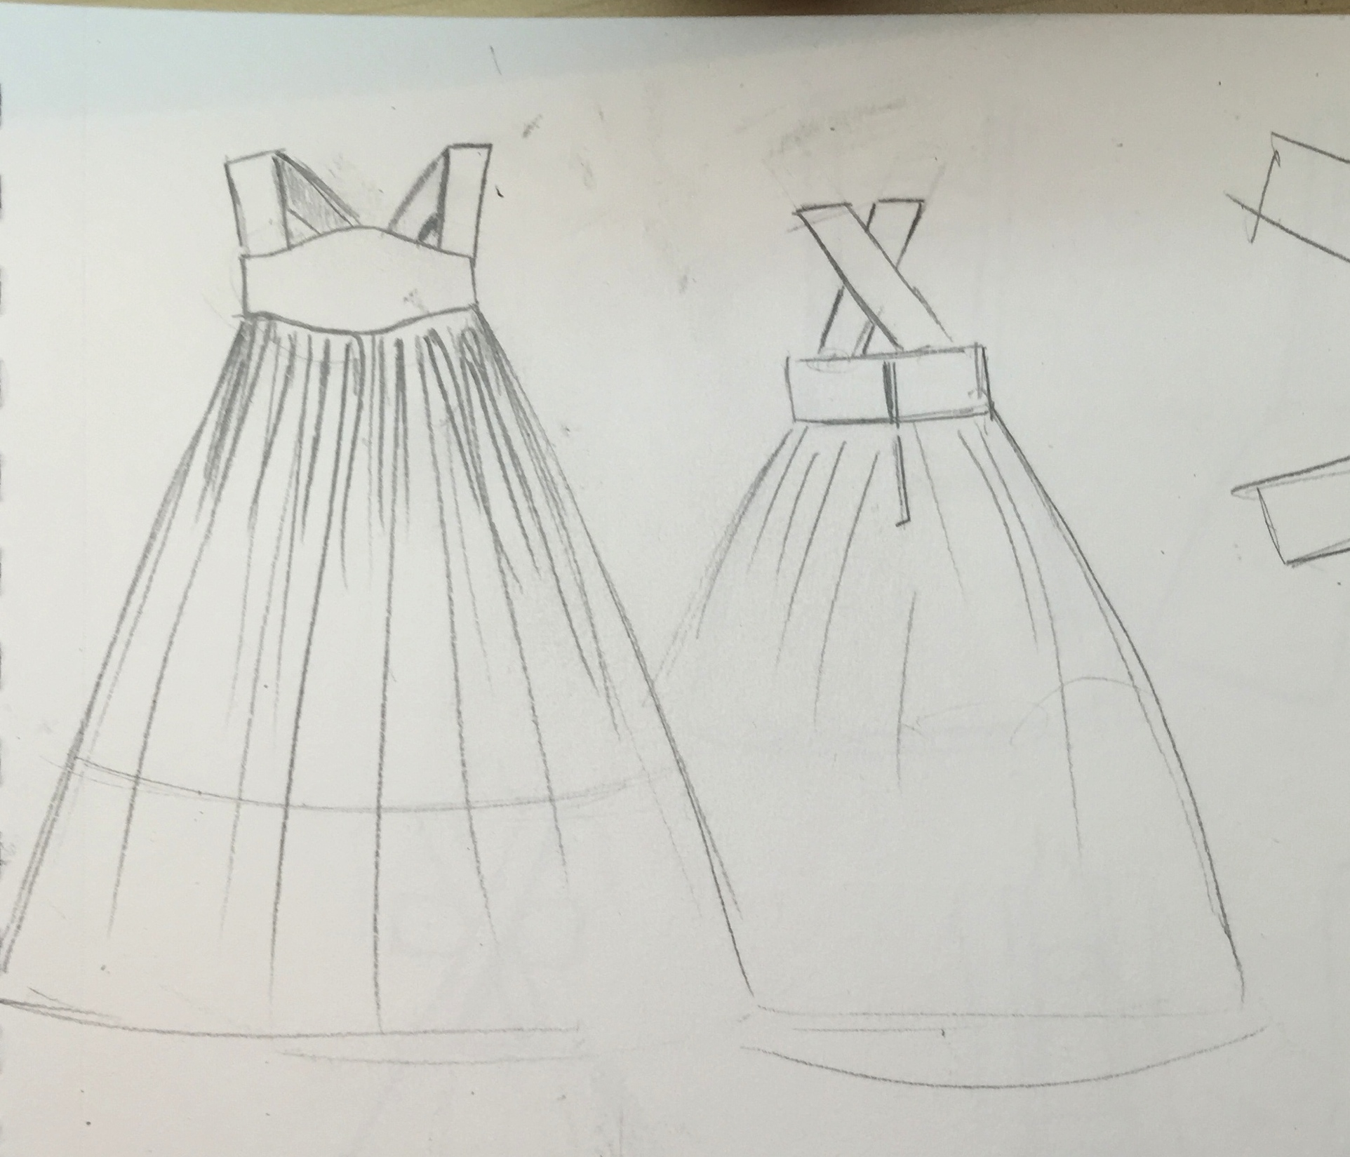
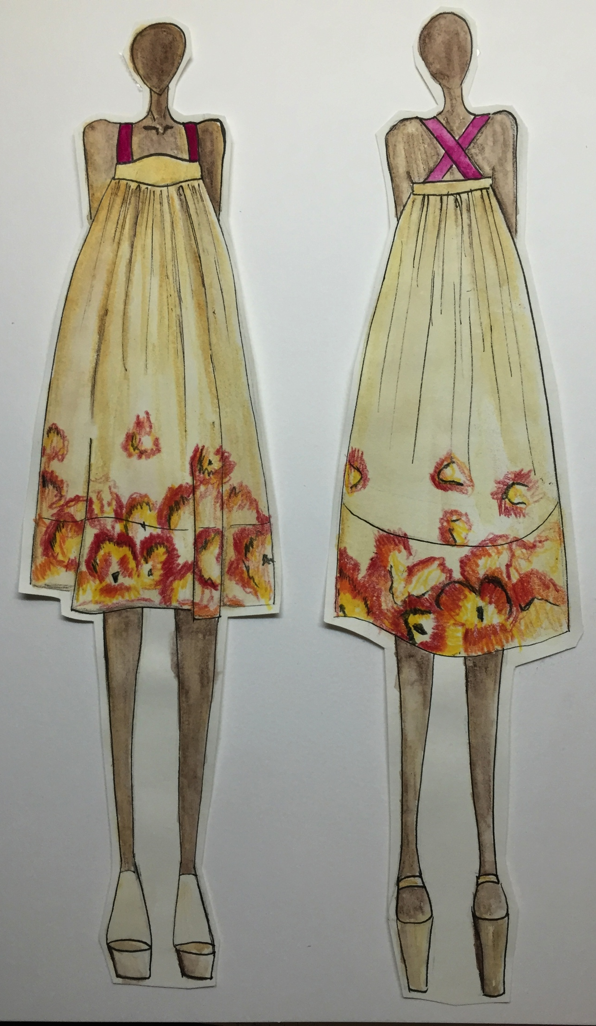
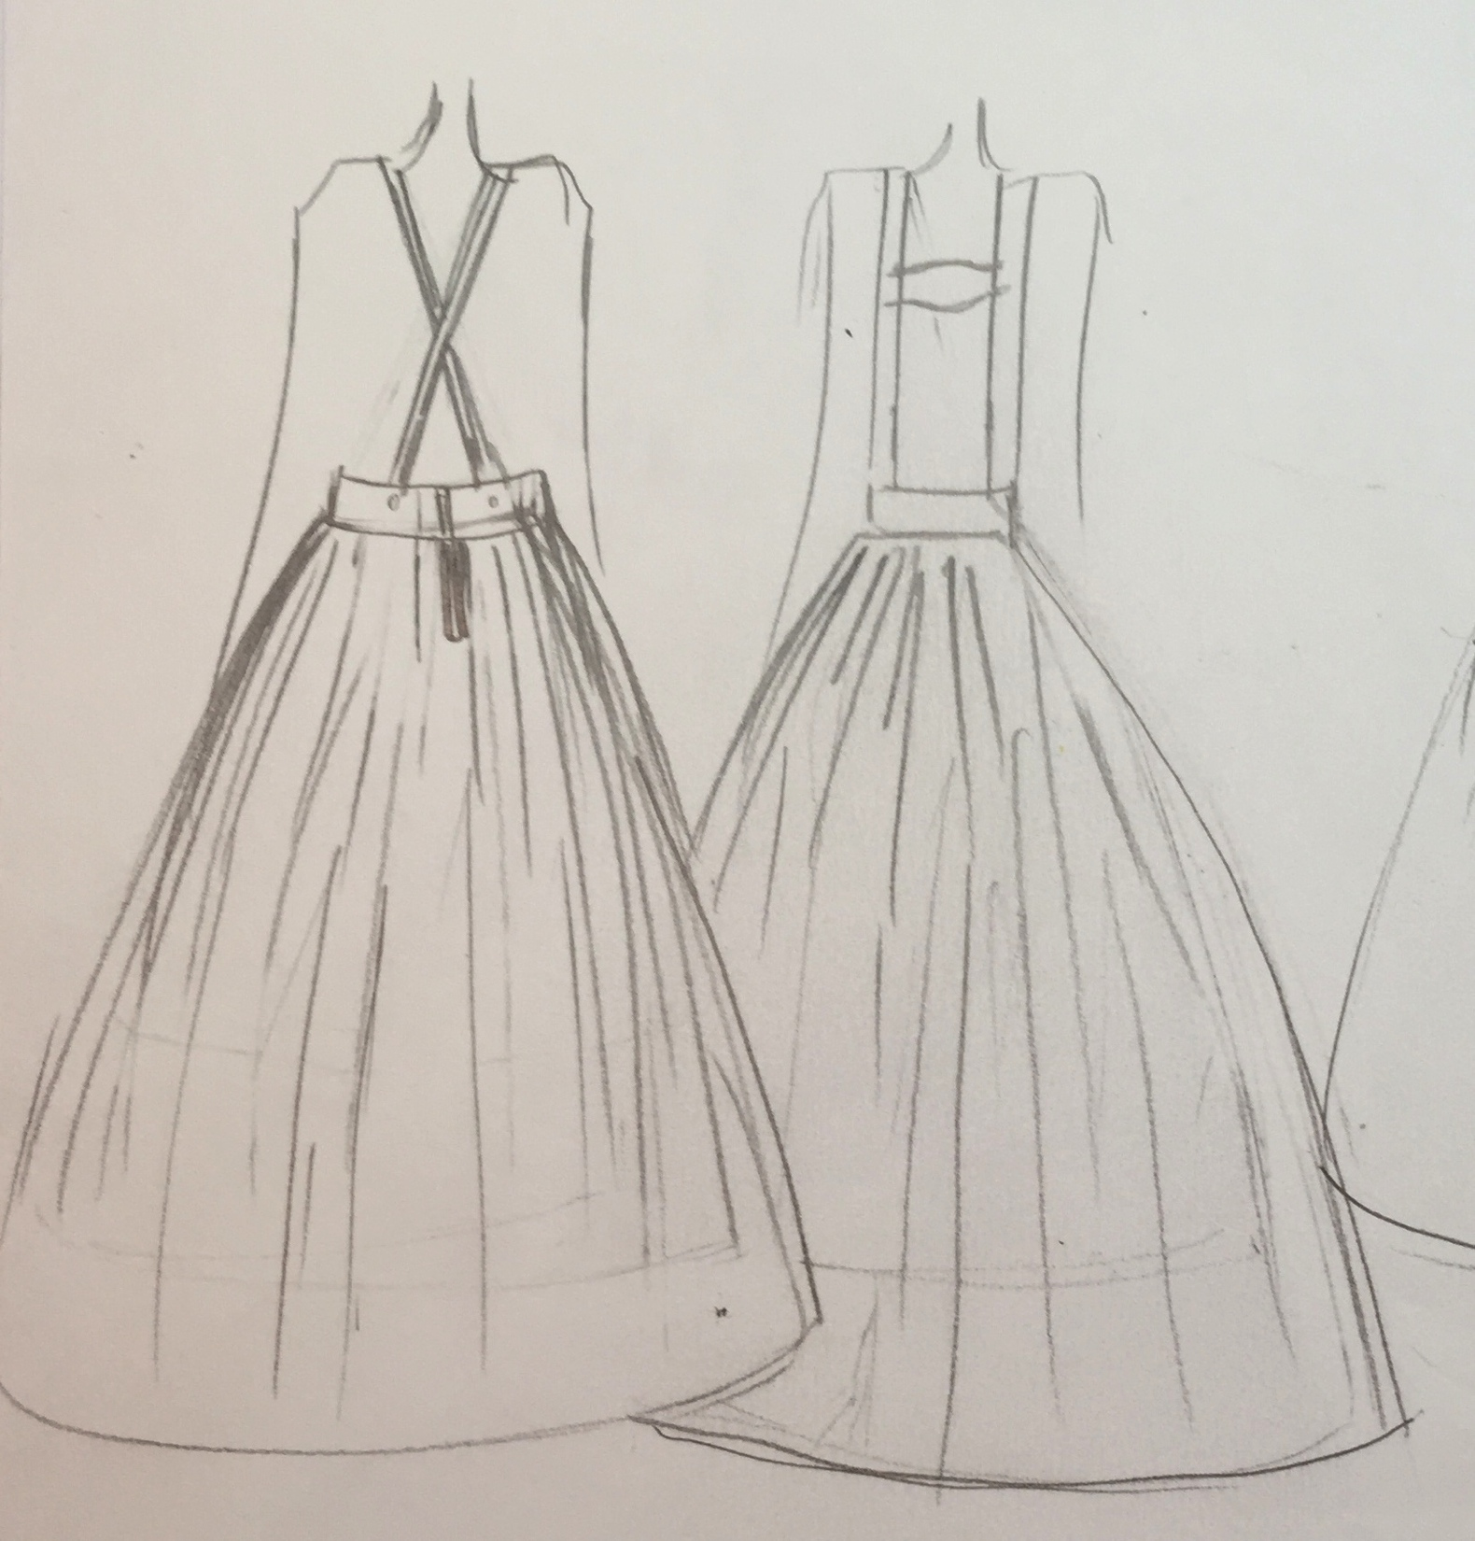
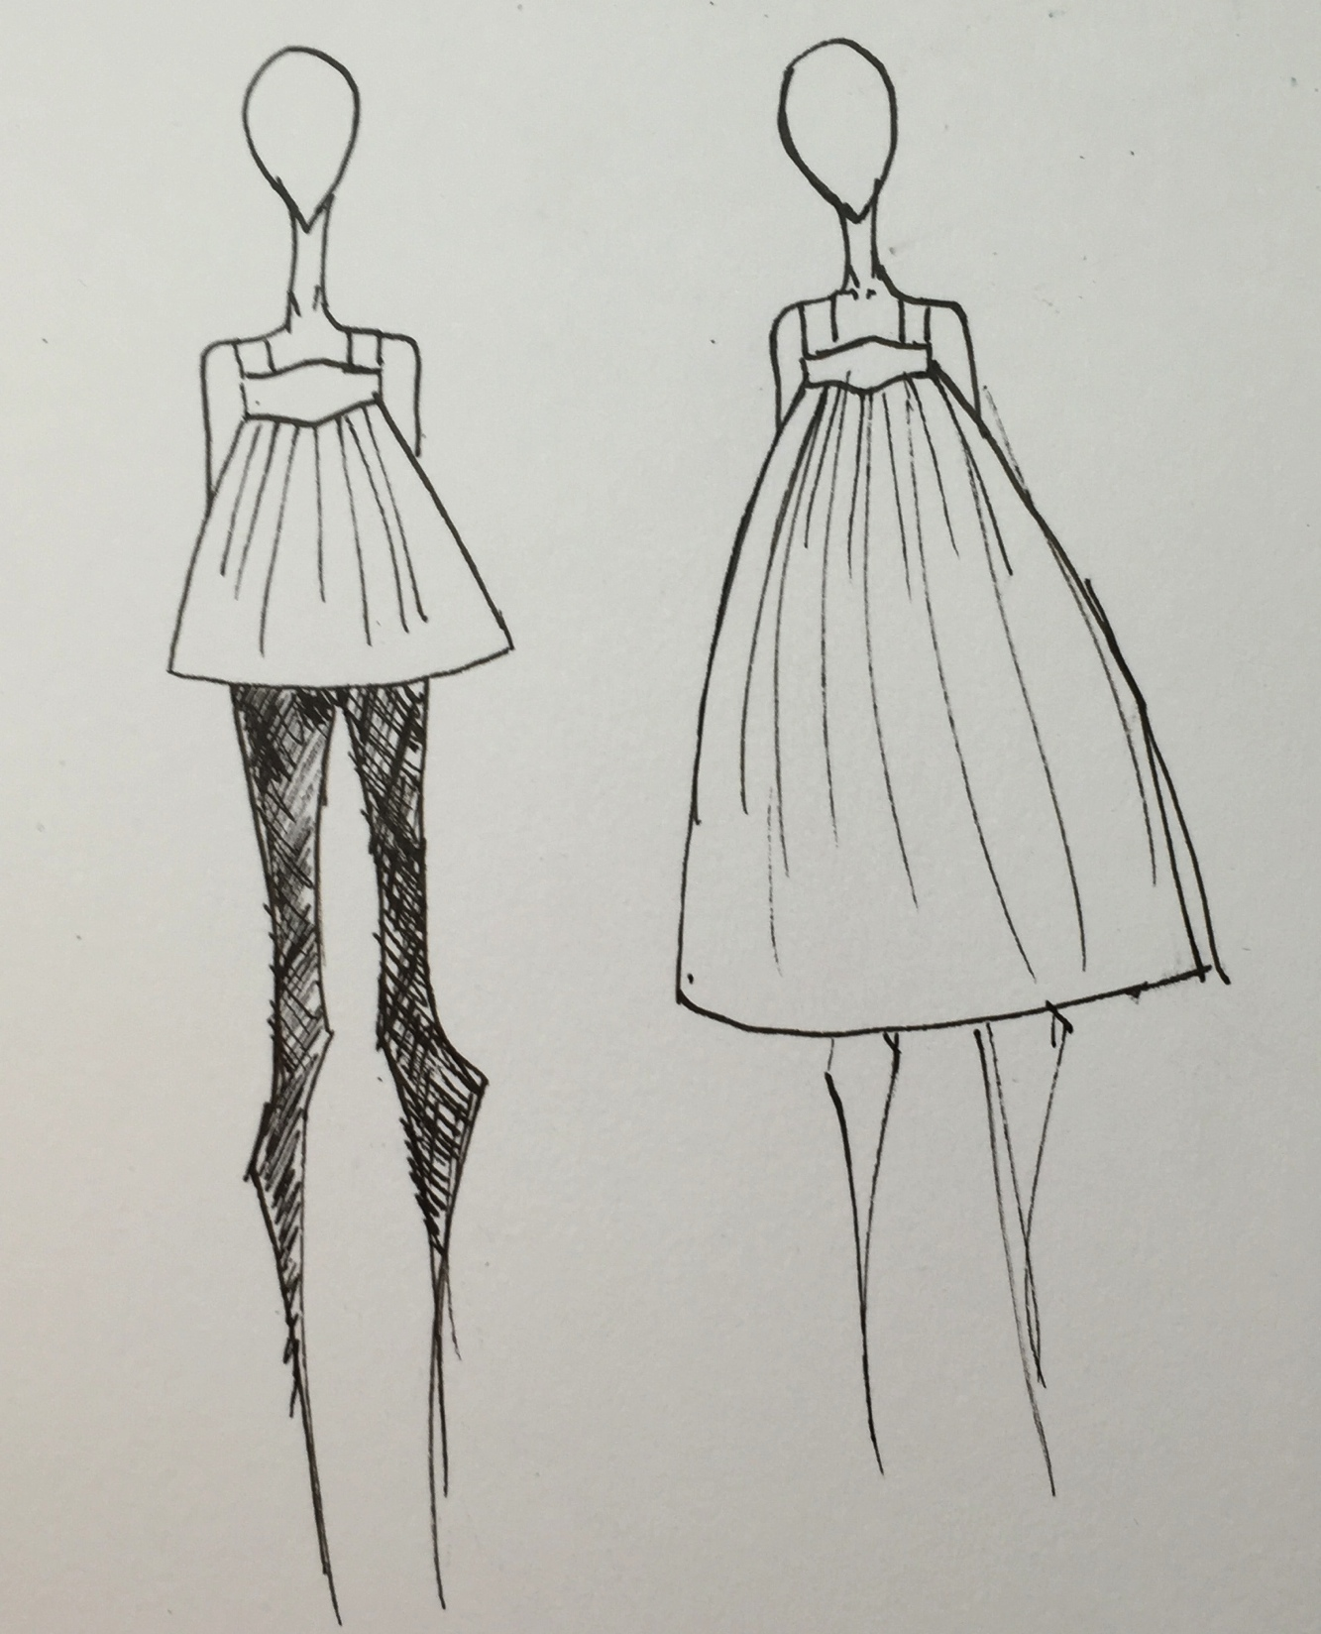
Transition
Notes:
-The final garment in my swatch booklet is the dress that uses inspiration from the Bavarian culture’s lederhosen in the curved bib-like yoke and the crisscross straps in the back.
-The print is subtle because it uses flowers that are very apparent in certain cultures’ embroideries including Peru, India, Tibet, and Nepal. Instead of using an all-over print like the one on my original inspiration of the bag, I took just the flower element and used paint to recreate the embroidered effect with the brushstrokes, and repeated it as a border print on the dress.
-This transition is a product of my research in both classes and allowed for me to create a garment that successfully appropriates without taking away a culture’s identity and claiming it as my own.

Slide 11
Outcome and Connections

Slide 12
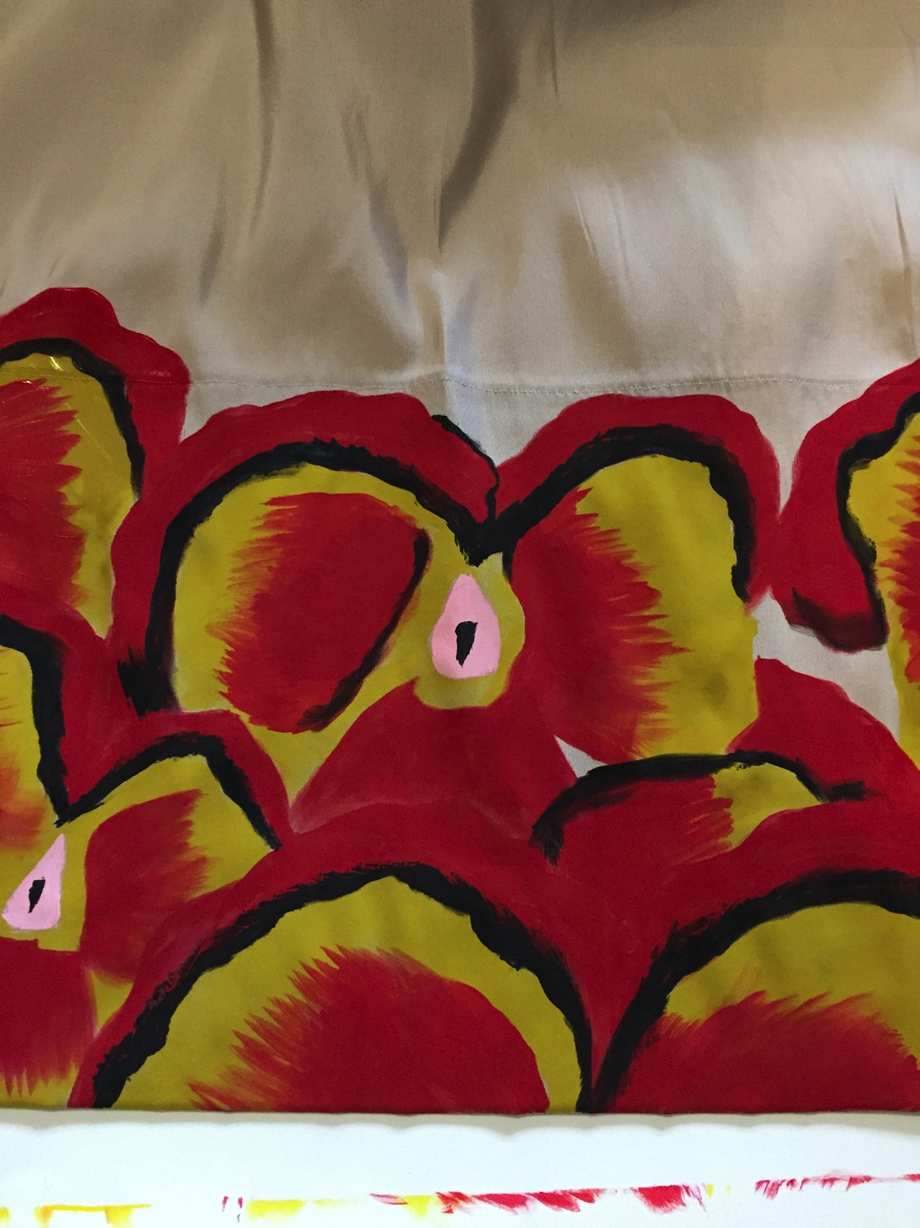
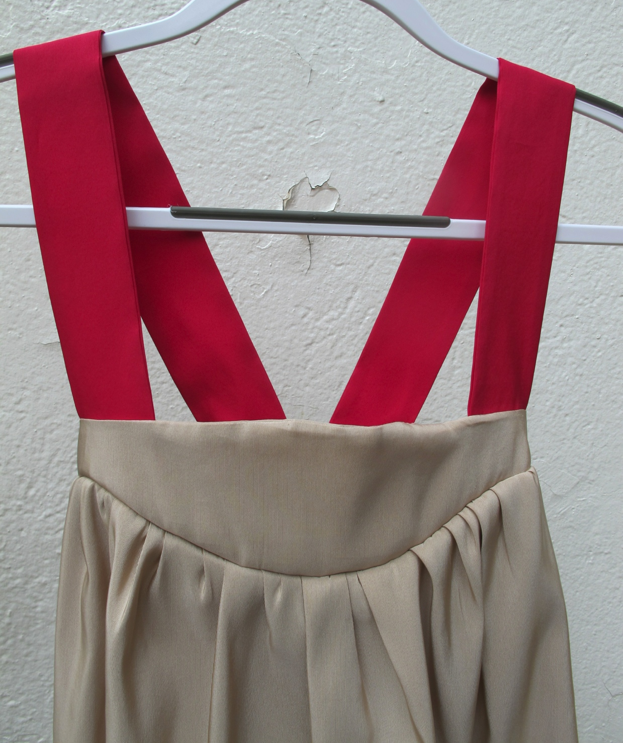
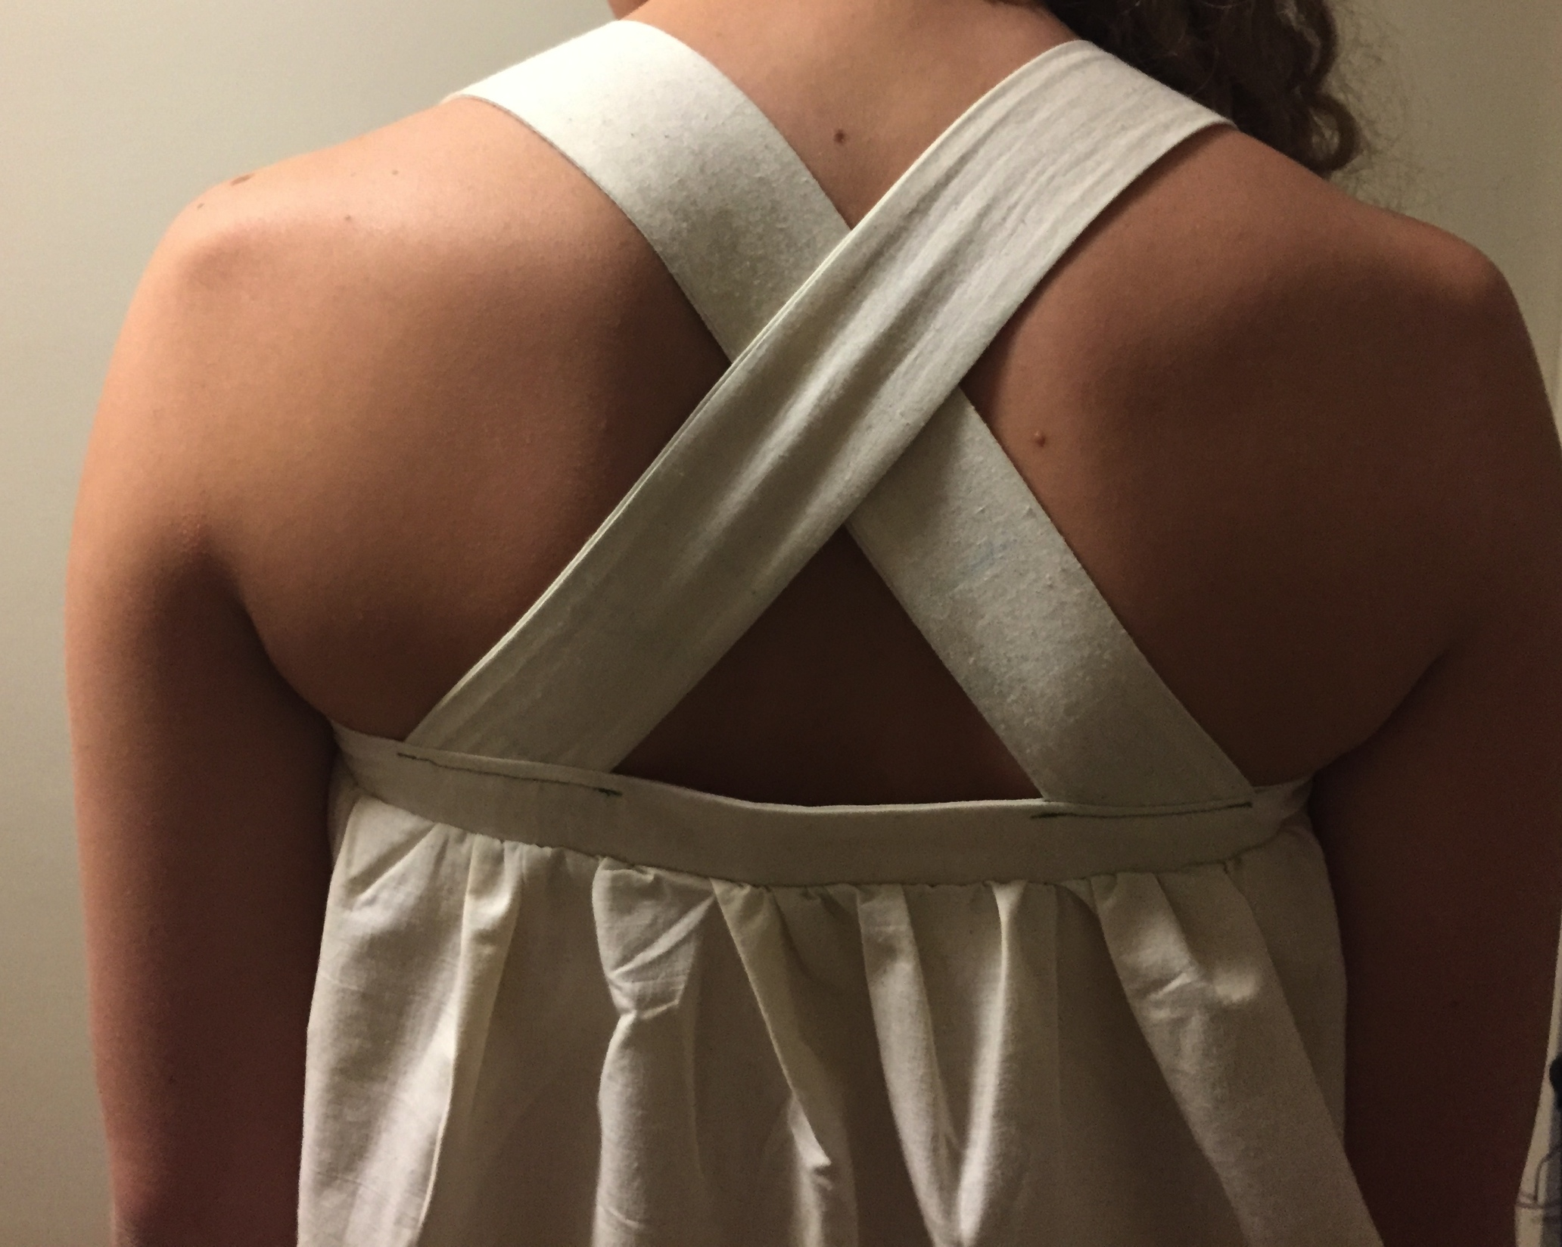
Resulting Connection
Crisscross straps
Painted “embroidery”
Curved yoke

Slide 13
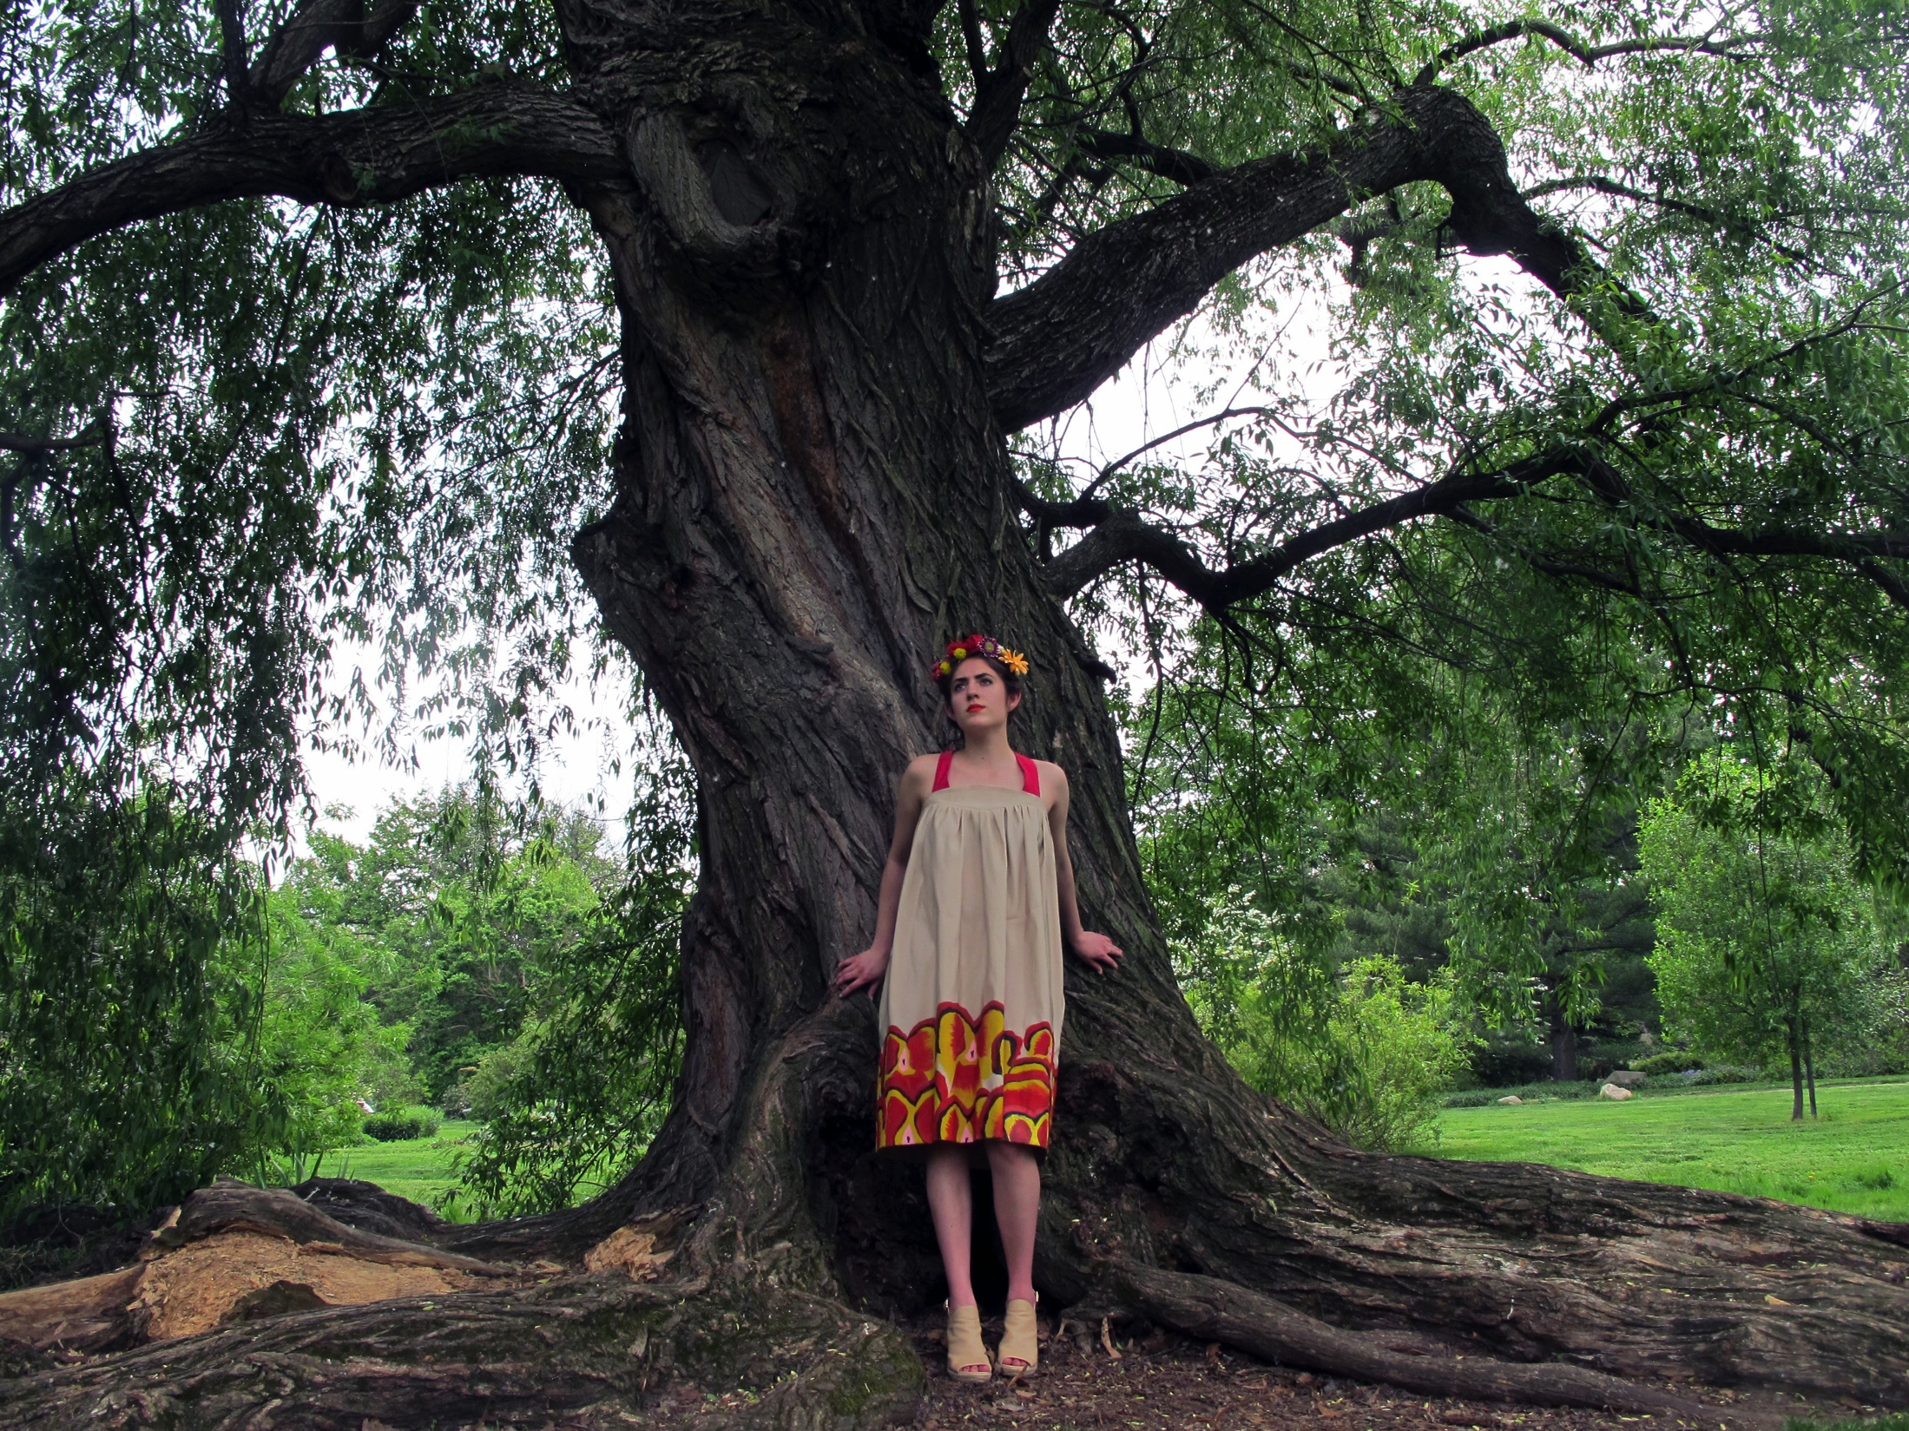
Resulting Connection
“To me it seems incredibly clear that all fashion is just a rebirth of older styles, patterns, and shapes. It is a revamping of other people’s ideas and indeed cultures. If we were all to stick only to our own cultures we would all just be dressed as cultural stereotypes.”
--Yost, Clementine. "Is Cultural Appropriation in Fashion Offensive? Part - II Kat Clinch Doesn't Think so." University Wire, Nov 02, 2013.
Notes:
Summary of both projects:
-By the end of the project, I think the connection between the studio garment and the seminar research paper topic are more in the process of understanding and using cultural appropriation.
-The use of the cultural appropriation itself is subtle, but the idea is present. I found through my research that it is beneficial to appropriate from outside cultures for a multitude of reasons.
-From my point of view, I like to take ideas from travel and I think many established designers in America do this. Diane Von Furstenberg or Mara Hoffman for example used travel whether physically or through the internet to gain inspiration.
-While some argue that this is negative because they do not have the rights to take motifs, inspirations, or ideas from cultures they are not a part of, I think it is an invalid argument.
-We are a melting pot that represents various cultures and we should have be using these cultures in fashion so garments can act as walking museum pieces that spike people’s interests in outside cultures and educate the viewers.
-I think that my garment is a proponent of this argument because it takes from various outside cultures that I researched and incorporates them into a piece that should subtly show references, but more importantly start conversation and education.
-Without this use of cultural appropriation, we would be stuck In a one-track form of fashion that would restrict our ability to come together and learn about the world that we are a part of.
---, “Cultural Appropriation is described as an assimilation of the cultural markers of one group by a more dominant one.” In an article for Refinery 29, Akbari describes cultural appropriation as “a way of using another culture in a way that delights our imagination, while making them the Other, and stripping them of their identity.” Akbari, Anna. " When Is Cultural Appropriation Just Cultural Creation?" Sociology of Style.
Duggan, Leeann. "Cultural Appropriation — Is It Ever Okay?" Refinery29

