Slide 1
Accessory Design Inspiration
Week 1
Sydney Loew

Slide 3
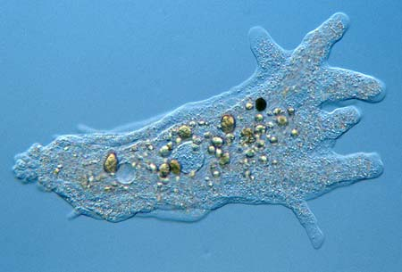

Slide 4
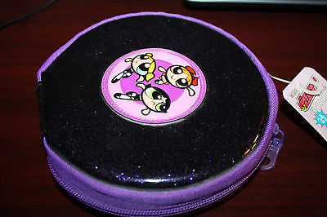

Slide 5
