Slide 1
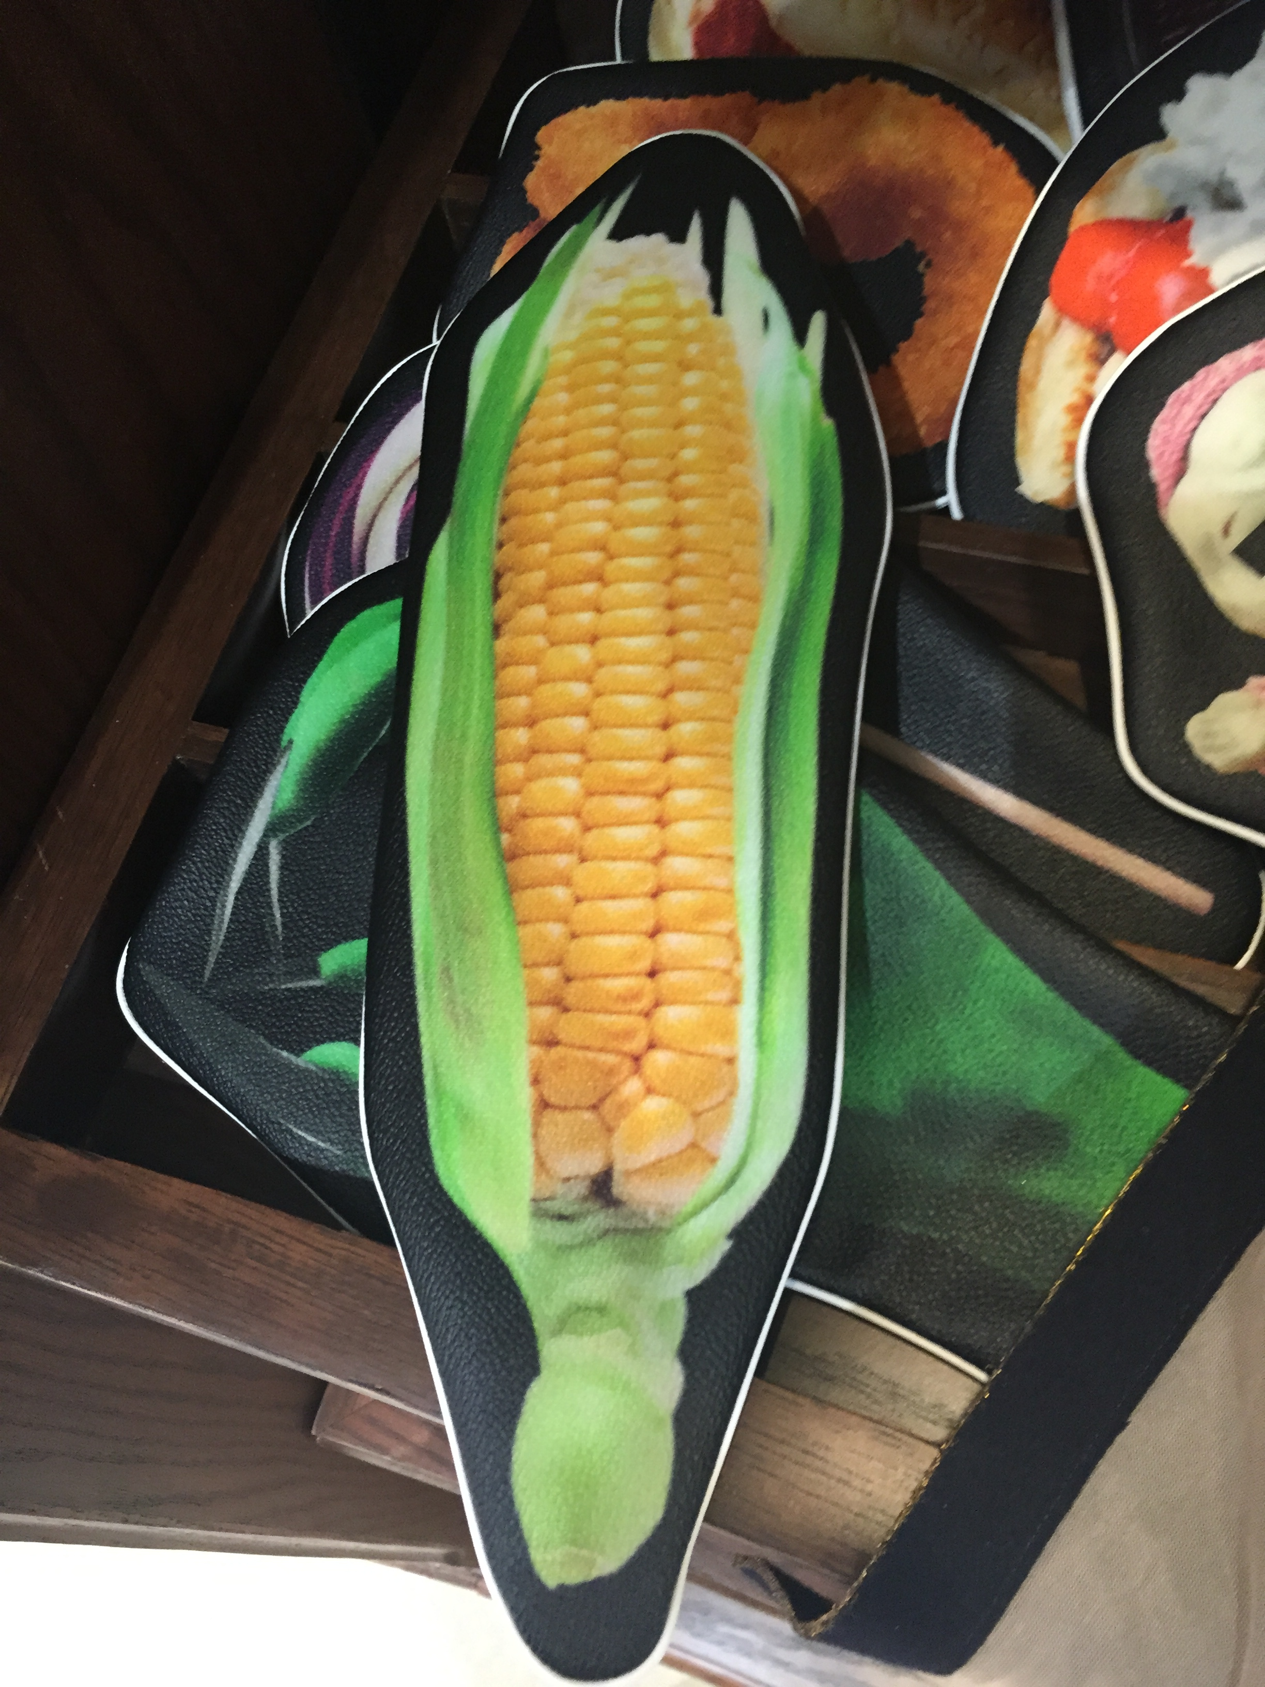
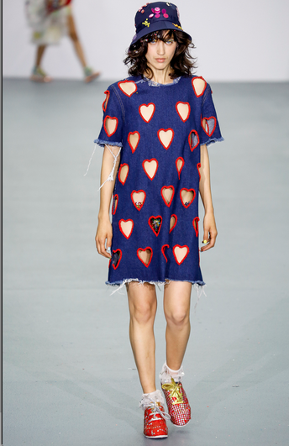
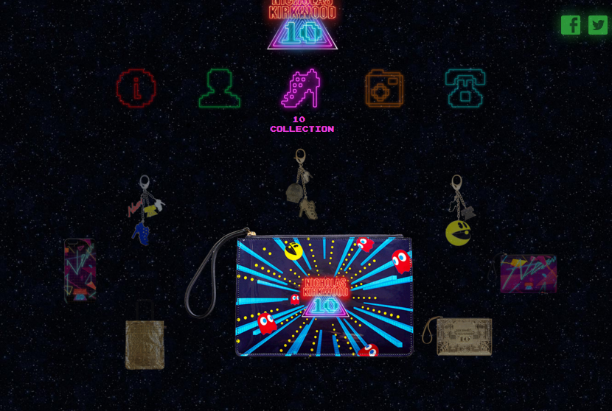
Trend Research Accessory Design Project 2
Sydney Loew

Slide 2
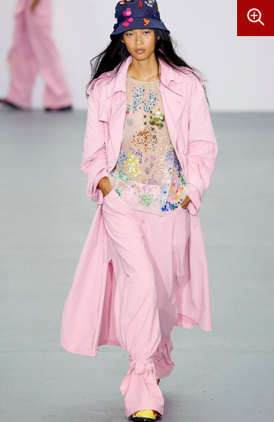
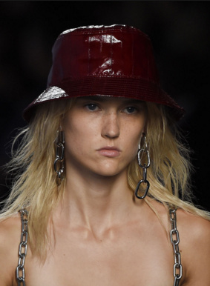
Bucket Hat
ALEXANDER WANG
SPRING/SUMMER 16
ASHISH SPRING/SUMMER 15

Slide 3
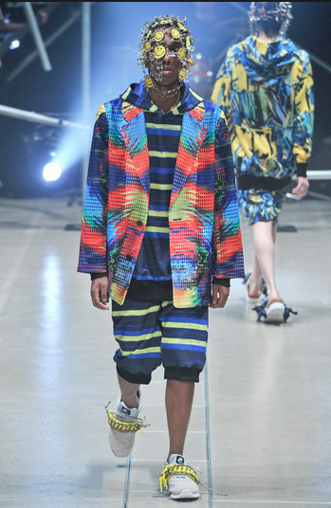
Facemask
YMC SPRING/SUMMER 15
PLASTIC TOKYO SPRING/SUMMER 16

Slide 4
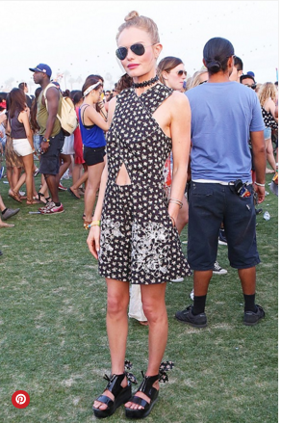
Kate Bosworth

Slide 5
Hair ornamentation

Slide 6
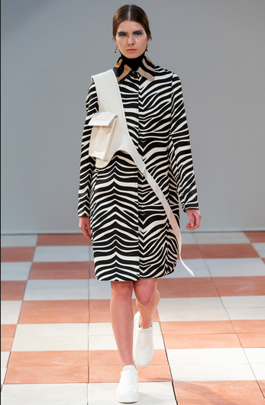
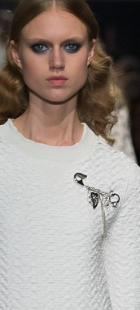
Sleek Utilitarian
CELINE SPRING/SUMMER 16
SONIA RYKIEL

Slide 7
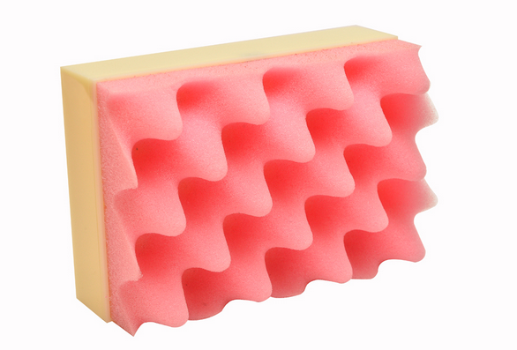
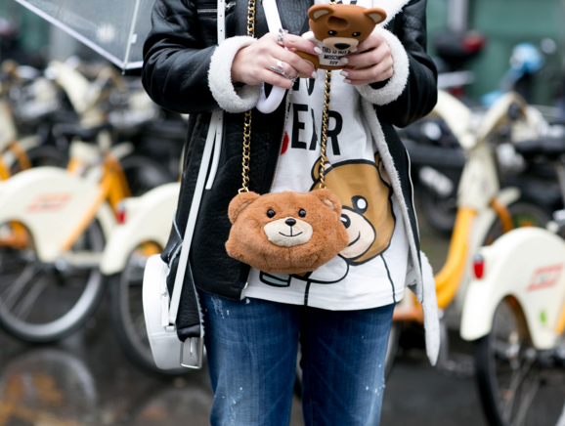
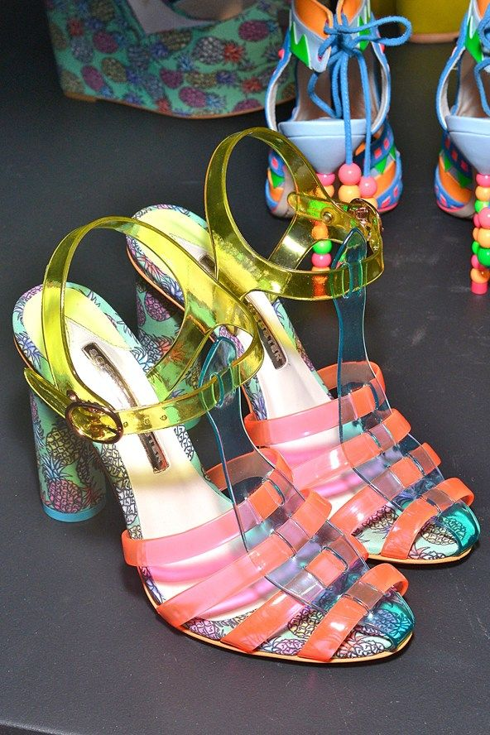
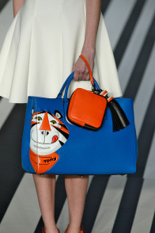
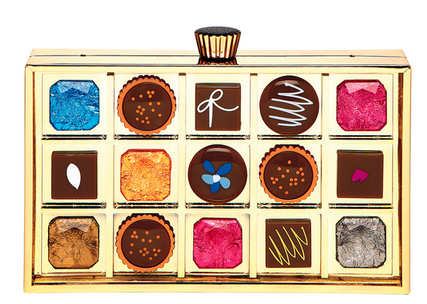
Kitsch Culture
Sophia Webster
Moschino
Anya Hindmarch
Mary Katrantzou
Kate Spade

Slide 8
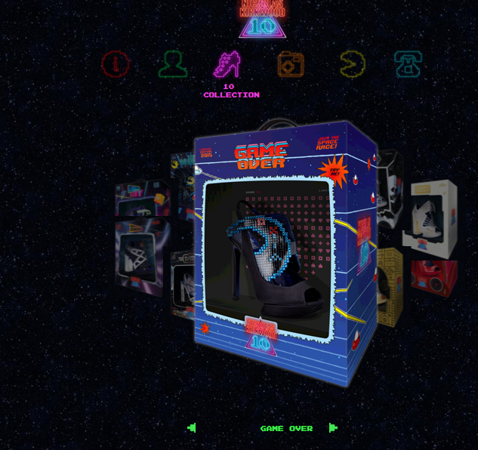
Kitsch Culture
Nicholas Kirkwood 10 Collection

Slide 9
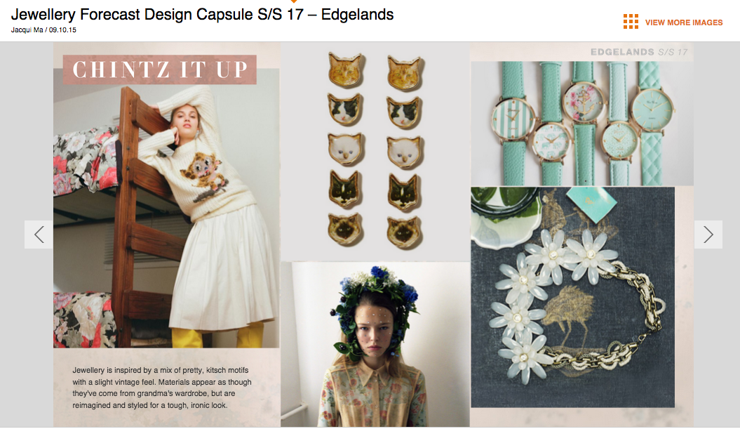

Slide 11
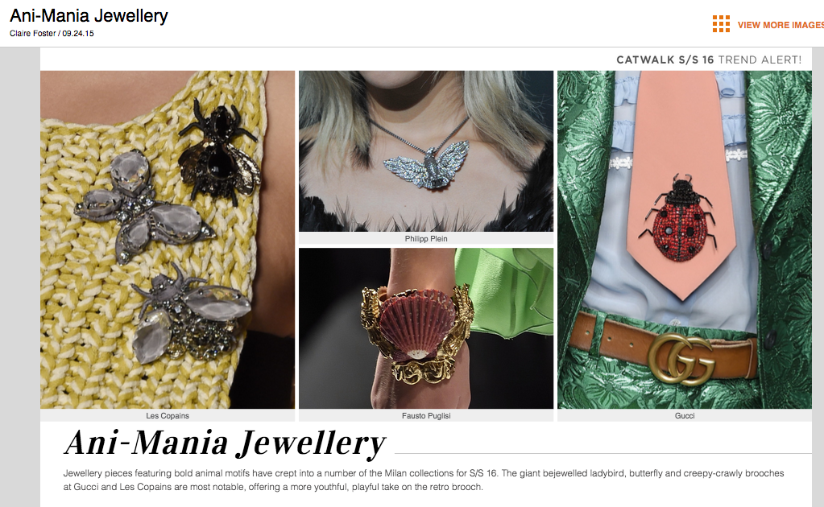

Slide 12
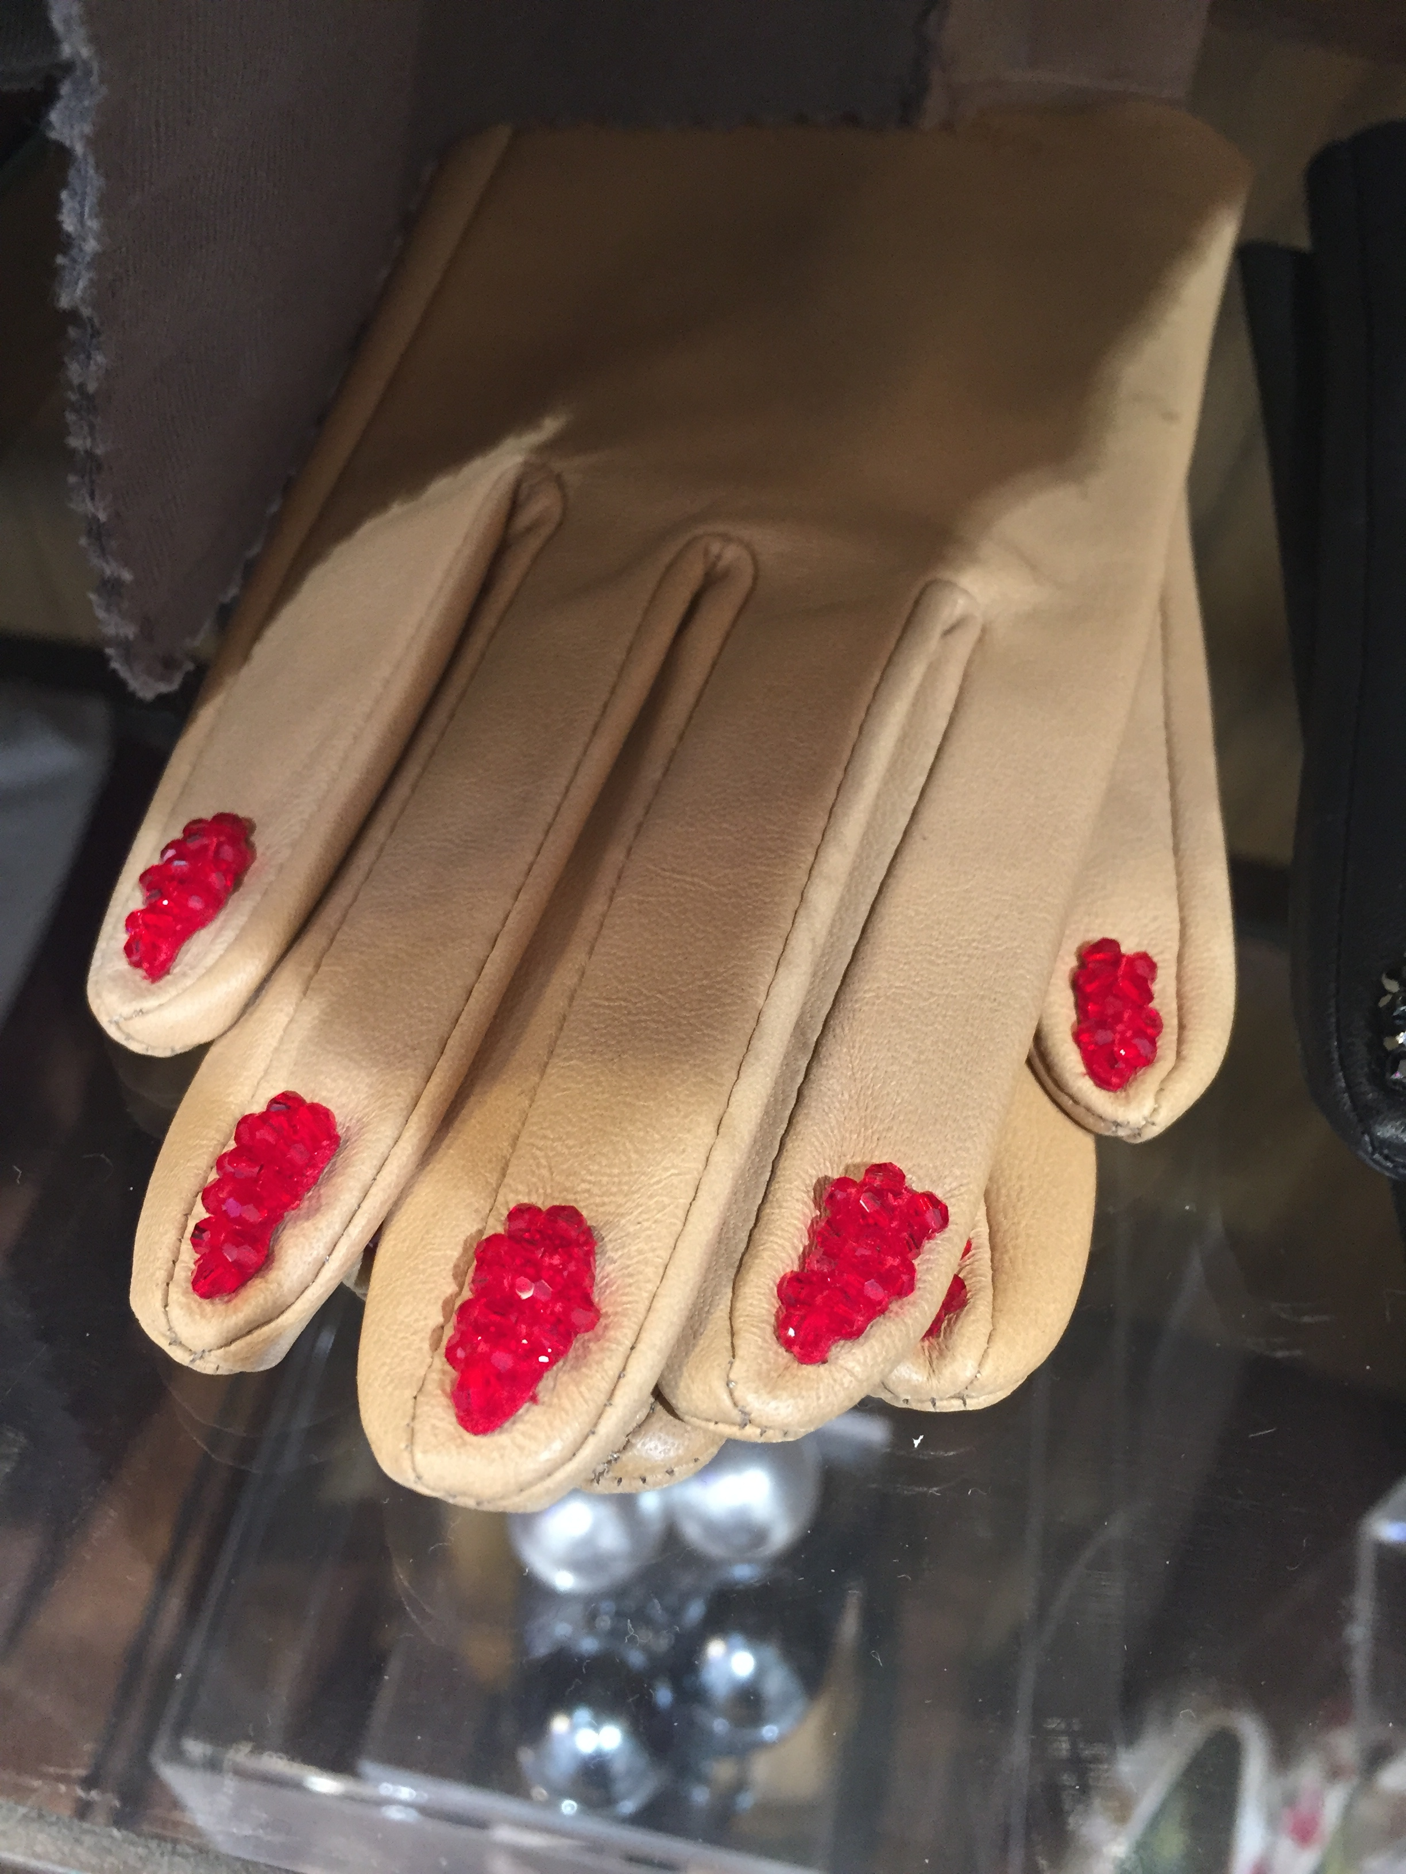
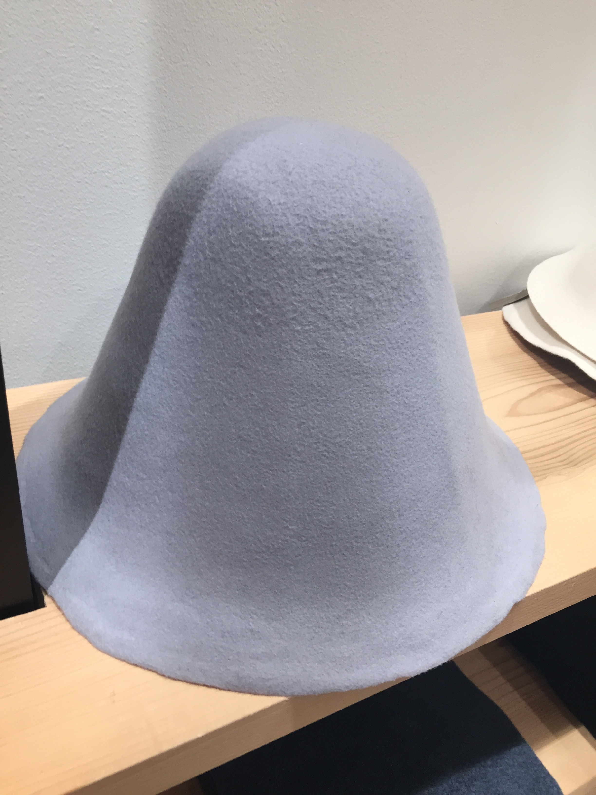
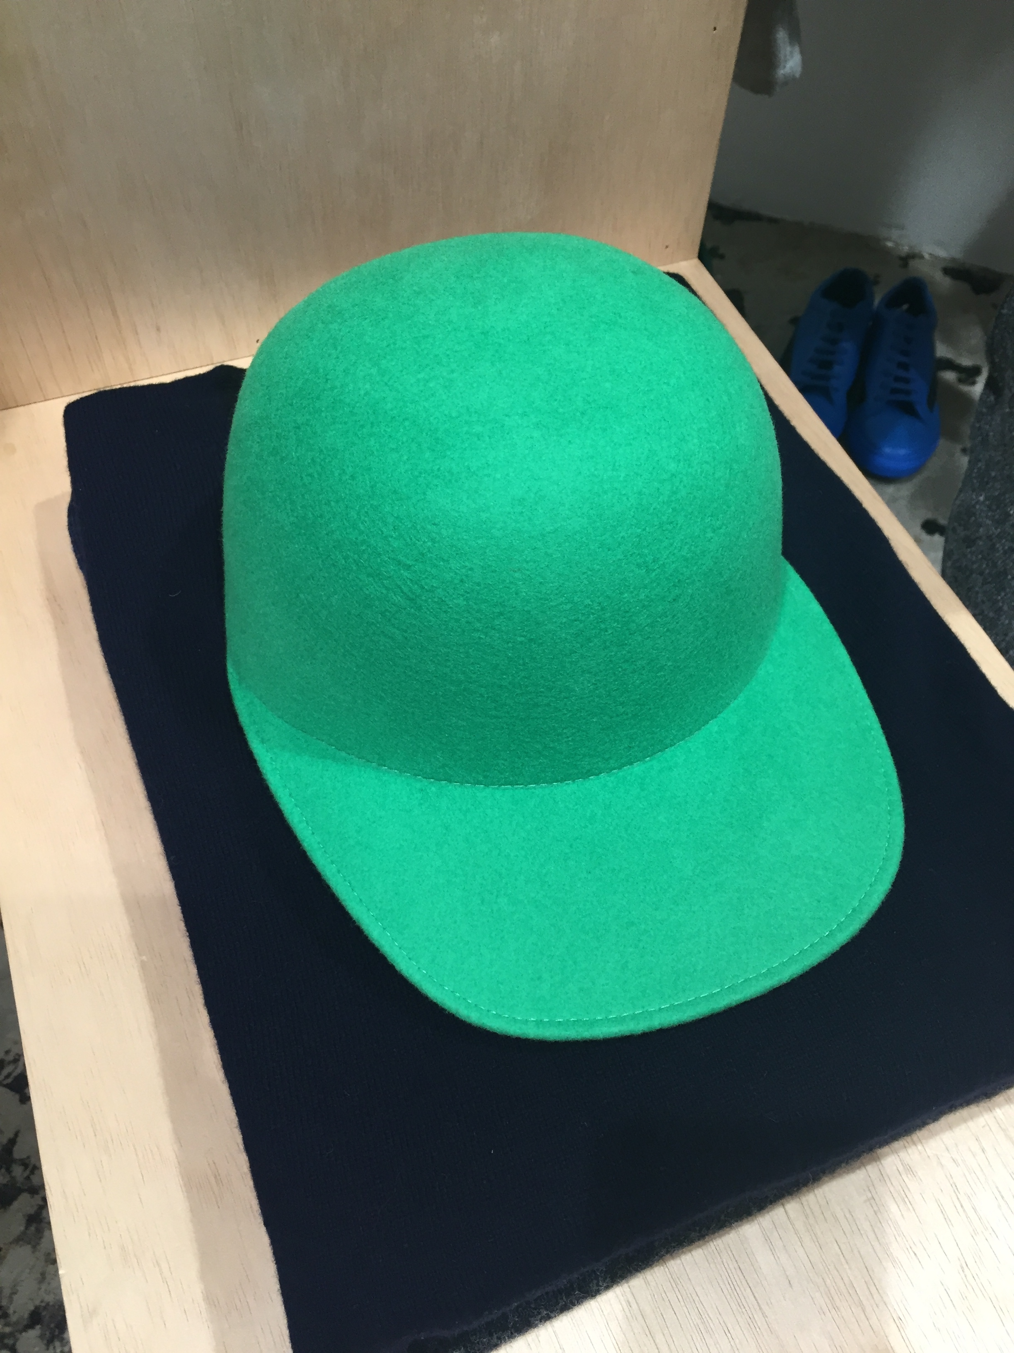
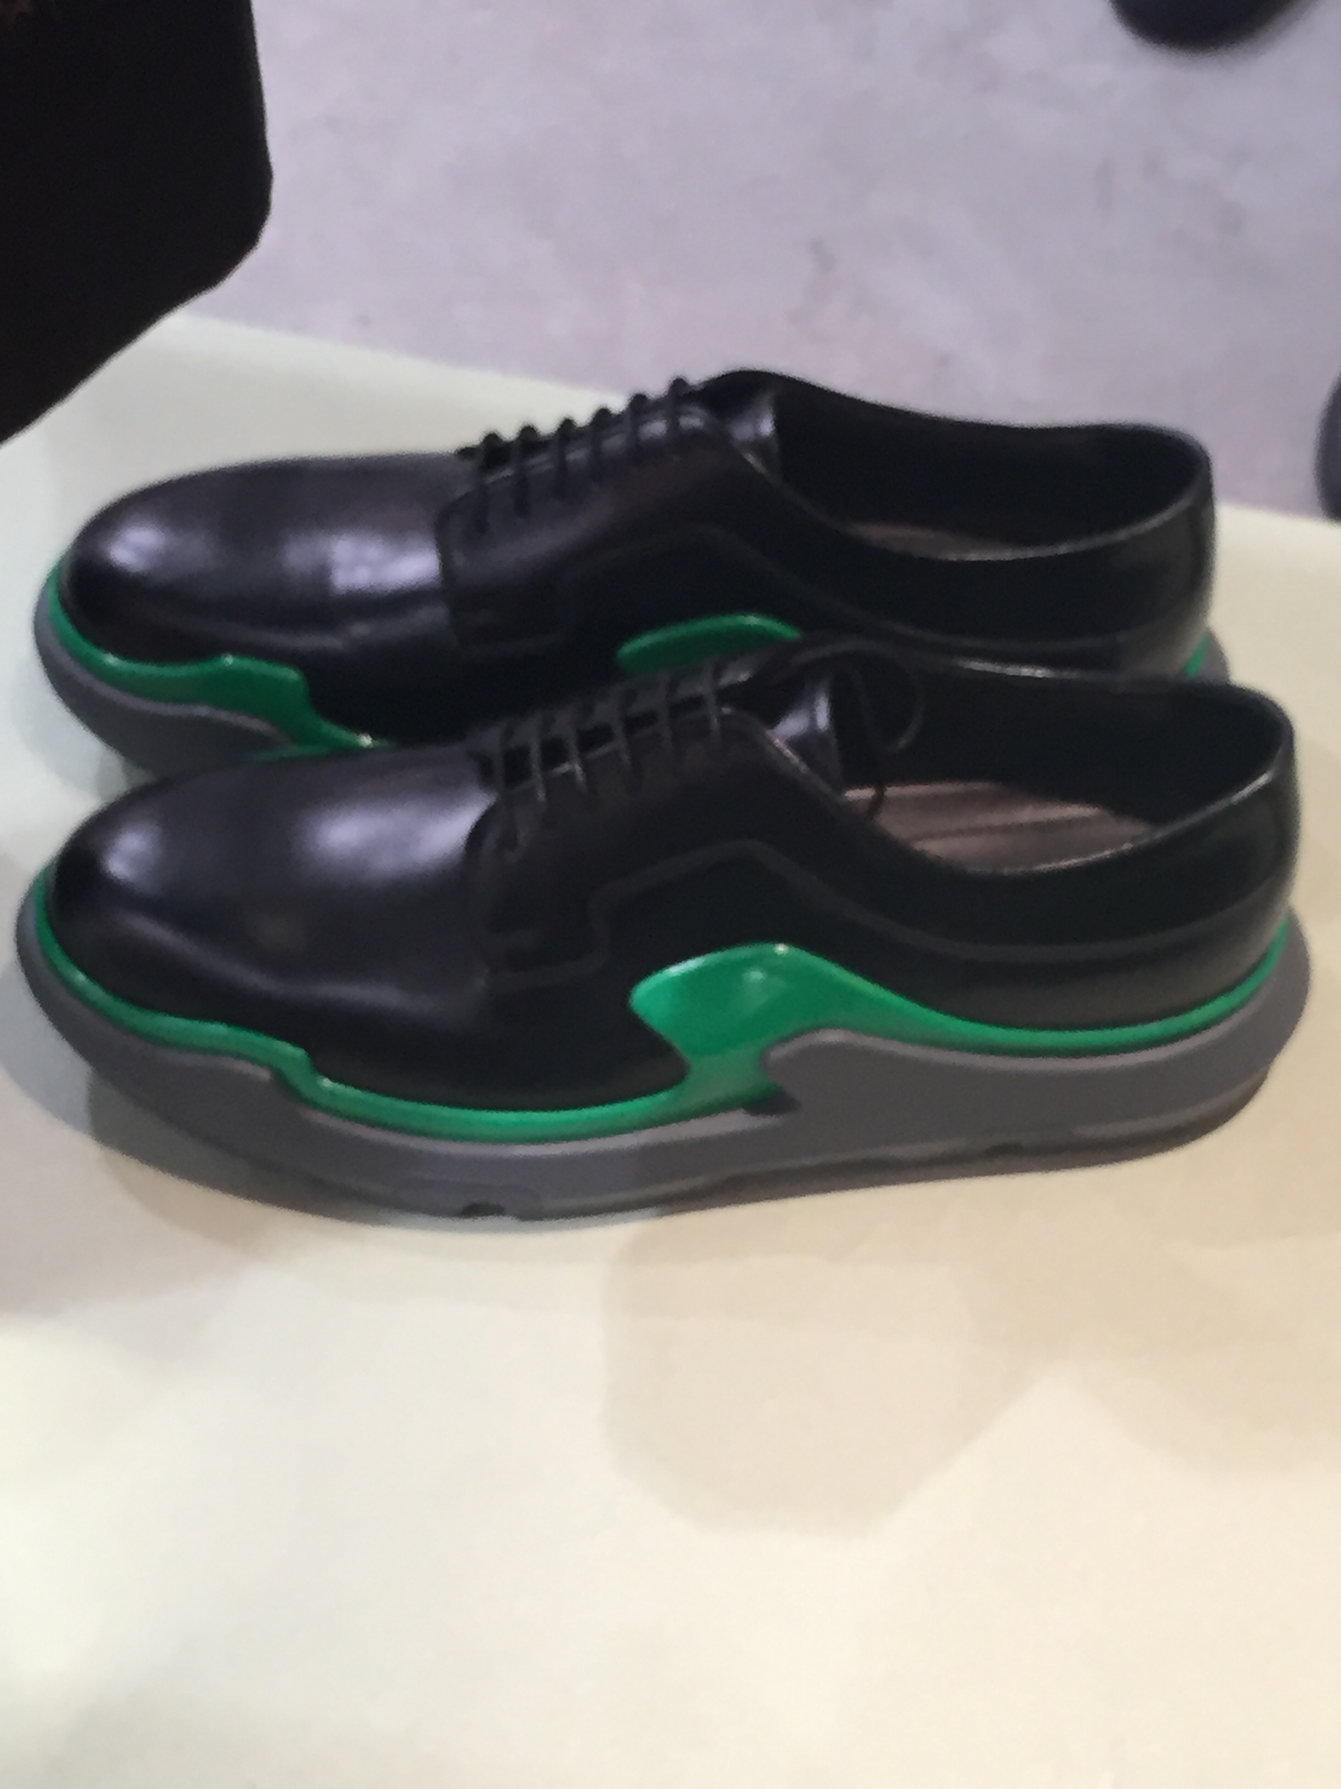
Dover Street Market
Child playfulness,
Mundane everyday
Food
Minimalist sleek hats

Slide 13
Some of the latest trends on the runways and streets include kitschy culture , food, everyday mundane, and play. Key silhouettes in trends include bucket hats, chokers, and pouch bags. While jewelry designs are delicate with humorous nods to animals and kitsch vintage motifs, shoes are bright and bold in fun materials exampled by Sophia Webster’s jelly sandals, which show a 90’s revival trend, and Nicholas Kirkwood’s latest 10 year anniversary collection, showing a nod to nostalgia, play, and kitsch.
Hair accessories are a trend themselves in many forms. From fun barrettes and delicate adorned elements with embellishments, people are focusing on hair as another medium to decorate.
As an added sense of playfulness in the market, designers like Jeremy Scott for Moschino and Anya Hindmarch are creating poppy purses with motifs from childhood including cereal brands and teddy bears. Along with cereal as a playful motif, Anya Hindmarch’s collection underscores the theme of the mundane everyday as a current and quirky trend. From bags in the shapes of telephones by Charlotte Olympia and construction foam inspired clutches by Mary Katrantzou, it is evident that designers are playing on the humor of the everyday life.
Bucket hats are an extreme silhouette, continuing form previous seasons. The new take on the bucket are new materials from embellishments, and synthetic materials like pvc and vinyl. The choker is extremely apparent on the runway as well. The trend roots from festival and 90’s revival, but comes in new forms with large adornments and a sleek update.
Celine’s show focuses on the utilitarian trend. The cross body sling with a utility pocket shows this trend in its current state, mixing the idea of the easy that comes with a fanny pack and a cross body purse into one. As the customer becomes even more on the go, this trend grows and shows that we value functionality
From Dover Street Market, I saw the trend on playfulness, food, and mundane everyday. I think the gloves with the embellished painted nails and the photographic food clutches show that childlike state of mind and quirkiness. New materials with shows are also important, showing chunky platforms in bright and plastic materials.
Analysis

