Slide 1
Dominican Slang (Endemic)
"I am studying Dominican slang, because I want to know what are the different meanings each word/ phrase carries in order to show the value of the dominican language and its colloquialisms"
coin·age: the invention of a new word or phrase.
col·lo·qui·al·ism: a word or phrase that is not formal or literary, typically one used in ordinary or familiar conversation.

Slide 2
Medium and Size
Bristol and Ink: 5x17 Inch filled with patterns that hide the word and other words that define it inside: 20 words

Slide 3
Audience
People that have an appreciation for slang and the meaning of words that are significant in a specific culture.

Slide 4
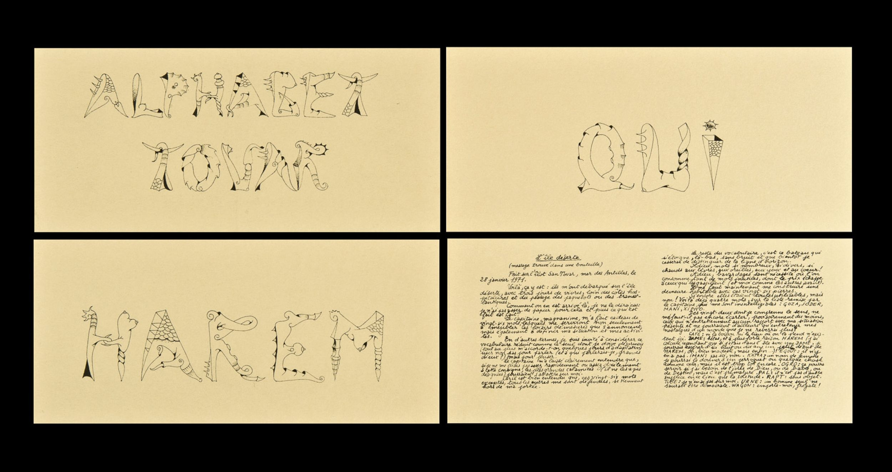
Inspiration
Alphabet By Ivan Tovar

Slide 5
What To do next..
I Have some ideas as for how to push this project further I thought that maybe I could laser cut the patterns and words into a Metal sheet.

Slide 6
Words
VERDUGO (Ver-Doo-Go): In the Dominican wrestling, Los Hermanos Bronco were called “Los Verdugos”, since they were considerably bigger muscle-wise than the average Dominican Wrestler, the term is also now used to describe someone who is muscular or strong 3. Someone who is heavy handed
AFICIAO (Ah-Fee-Ciao):From the word “asfixiado” meaning to asphyxiate.To Be enamoured with or in love.Used to describe someone whose life/thoughts is/are consumed with another person.
BABOSO (Bah-Bozzo): Meaning you talk alot.Literal meaning “drooler” as in you got verbal diarrhea. sh*t talker
BAINA / VAINA or Bainita (Bine-ah): Literal meaning a type of pea, or sheath to a sword. Womans private part.Dominican slang word to describe a “thing” – any “thing”
CACHE-CACHE (Catch-A):In French meaning “Hide and Seek”.Used as “cool”, “doing good”
CARAJITO (car-ah-heet-Oh): A diminutive way of saying kid – i.e. Little kid
CARAJO (car-ah-ho):Made up place where your Mom sends you to when she’s mad. Another way to say hell.
CHAN (chan): Dominican slang for Man, friend, person.Used instead of man, bro ect.
CHEVERE (Che-Ver-Eh): used as awesome, or cool.
CHIN (Chin):Meaning a little bit, a small bit of. A piece of, a part of. Origin from the Taino Language.
CHINCHILIN (chin-chee-lynn):a bad smell. From the Taino Language meaning a type of Black Bird.
COCOTASO (cock-oh-tass-oh): Dominican slang for A hit with a closed fist over the head.
CONCHO (Con-Cho): means Taxi, as in moto-concho.
CURA or Que Cura (coo-rah): Literal meaning to cure, a cure.Used to describe something funny.
DIACHE (Dee-Ah-Che): Comes from “DIATRE”, which means devilish. A PG-13 way to say “Damn”.Gosh is to God as Diablo is to Diache
DIQUE or Dike (Dee-Keh): Derrived from the actual word “dizque”.Used as “thats what I heard” or “supposedly”.. So I heard
FIEBRU or Fiebre (Fee-eh-broo): Literal meaning someone who has the flu.used to describe someone who is over-zealous about something
JABLADOR (ha-Blah-Door):From the word HABLADOR meaning a talker Someone who gossips a lot. Used to describe someone who lies, a liar
JEVI or Hevi or Jevi Duti (Heh-Bee): Derived From the English word Heavy, and the term “Heavy Duty” Meaning “all good, everything is cool”. Looks good, or OK
MANSO (Man-So):meaning Calm. Used to describe a domesticated pet, non agresive.Also used to describe your mood, “chilling”
MATATAN (Matt-ah-tan): Means the boss, the big boss, the man. a person that does boss-like things

Slide 7
Based on the definitions of :
coin·age: the invention of a new word or phrase.
col·lo·qui·al·ism: a word or phrase that is not formal or literary, typically one used in ordinary or familiar conversation.

