Slide 1
Camp: Second Childhood
Billstin Chen

Slide 2
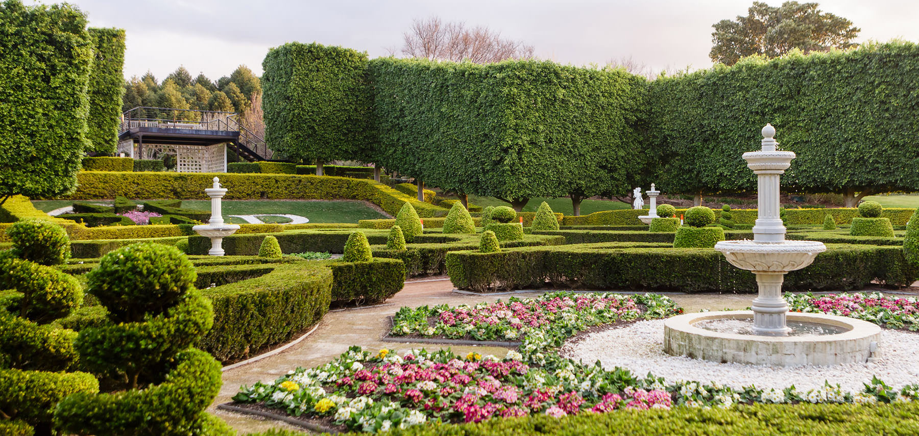
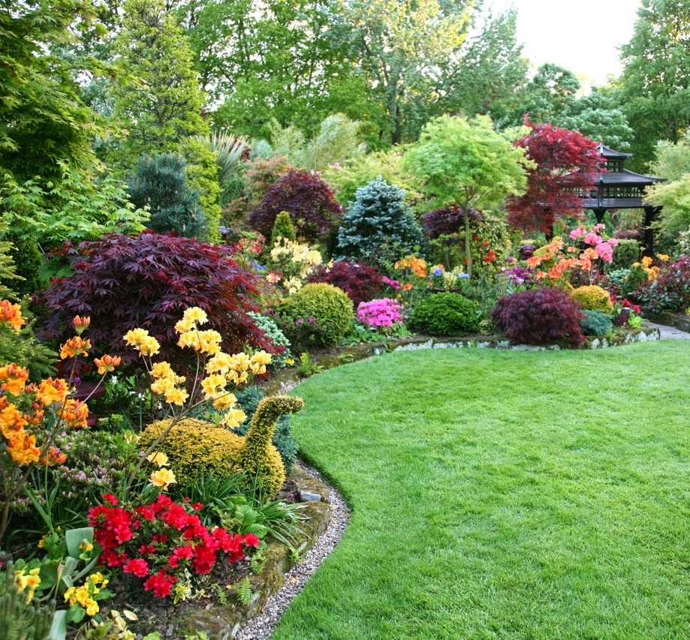
Background
When I was young, I lived in countryside, and my house was next to a huge garden.
This becomes my background of the design of Camp: second childhood. There are various kinds of flowers in the garden, many trees, as well as some natural animals—especially frog. Surroundings in my childhood does offer me wide range of imagination with amount of details. In short, all these have some to do on the outfit of the final look of my camp design.

Slide 3
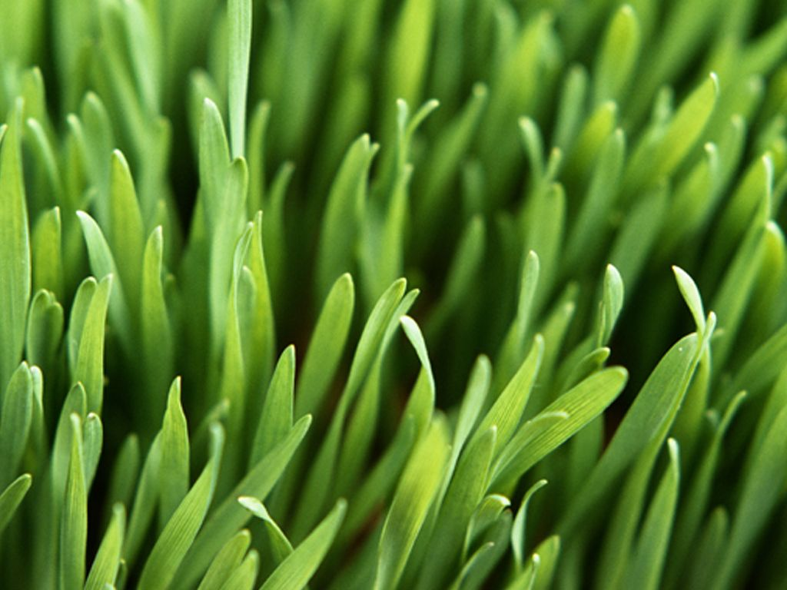
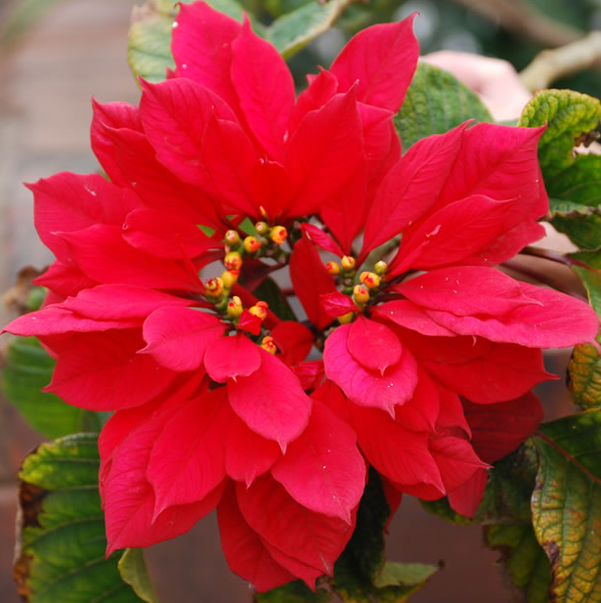
Inspiration one: Plants
In the garden, many kinds of flowers are planted with grass surrounded. The feeling of touching grass is one of my favorite textures, especially when you stand on them without wearing shoes, which I will never forget this kind of feeling. This inspires me about the texture of the costume I’m going to design. Also, flowers are good elements to be added on the costume.

Slide 4
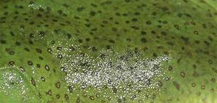
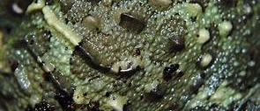
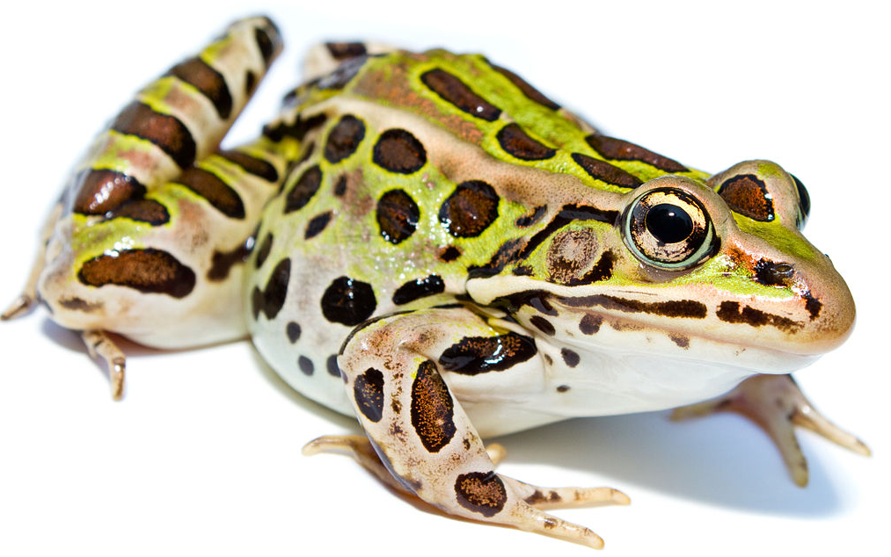
Inspiration two: Frog
Not only beauty exists in the garden, so does some scary “enemies”. I’m so afraid of frog, mainly because of its posture and skins. As the concept of Camp Style—exaggeration and humor, I plan to create a frog-shaped costume with flowers sprinkling on it. Frog is usually crawling on the ground, but if we make it standing, that’ll be pretty exaggerating and humor.

Slide 5
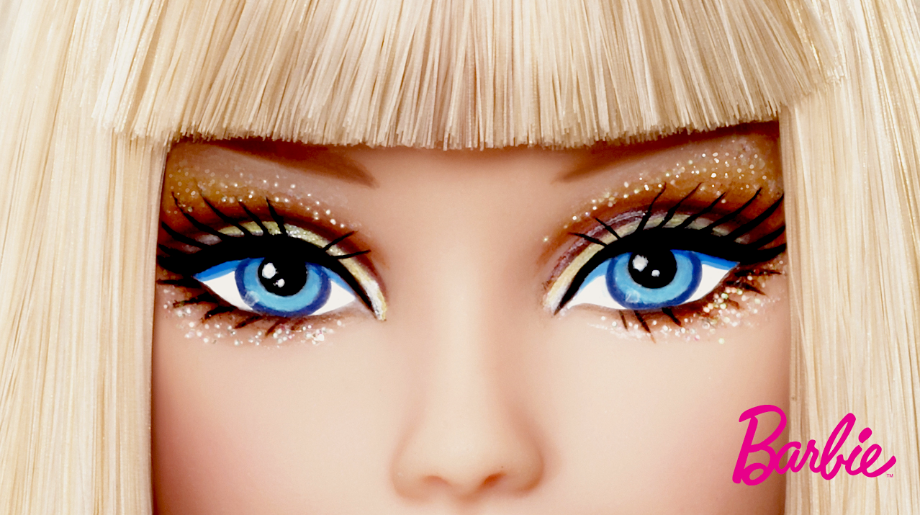
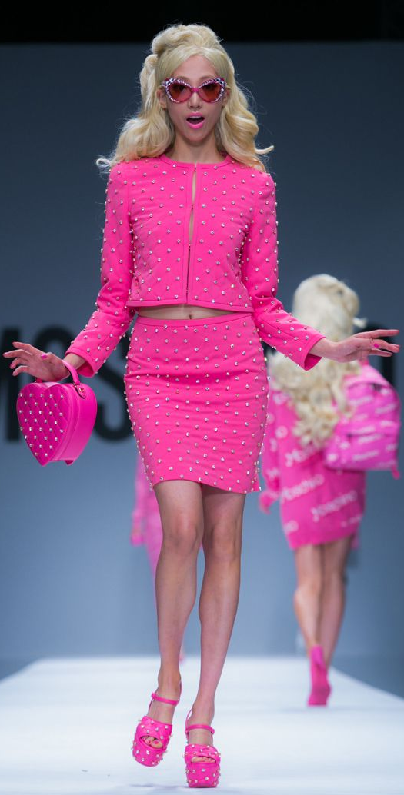
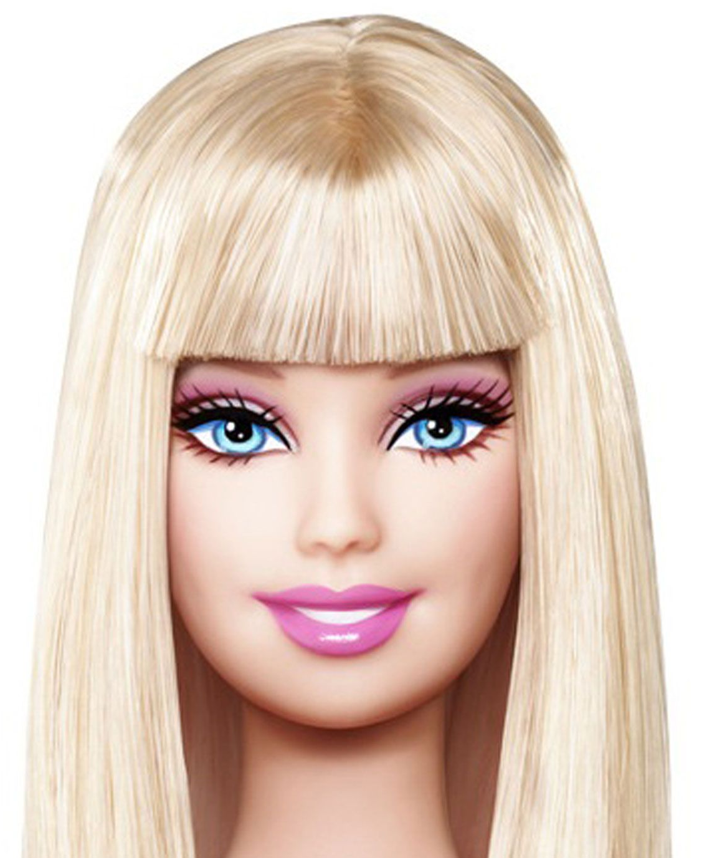
Inspiration Three: Barbie
Honestly, unlike other boys normally do, I used to like playing Barbie when I was young. I enjoy styling them, making them some simple dresses with my hands, or just playing their hair and try to make some styles. Barbie has a blonde hair, which also attracts most of us, I plan to mimic the Barbie hairstyle and makeup on the male model, and that’ll be Camp with Frog costume. The period of Barbie in my childhood was really significant, because it intrigues me to find out the difference between male and female, and teaches me how to be respectful to others, not only on the gender level, may be even respect an animal.

Slide 6
Ideas to outfit
I’m going to mix all these elements by Photoshop, and explain each part in the following.
Head: Mainly a Barbie style, as well as the Barbie make up.
Body: Most in the frog costume, flowers will be added on the outside of frog.
Feet: A pair of pink high heel shoes, Camp: homosexual.

Slide 7
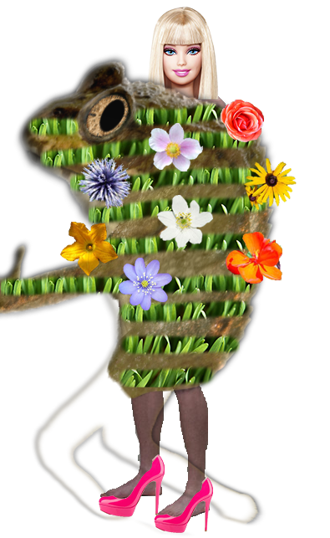
Final outlook
On the right is my final outfit of the Camp campaign: Second Childhood.
It’s mainly a frog costume covered by grass texture with couple individual flowers.
On the top, I just copy the Barbie head, including the hairstyle and makeup. I believe it’s also unique on a male model body.
On the bottom, I chose a pair of pink high heels. Pink is an important color in CAMP, and high heels represent femininity, which contributes to the definition of CAMP: homosexuality.
All in all, the whole look is exaggerating and stand out with humor, illustrating the essences of CAMP

Slide 8
THANK YOU

