Slide 1
Whitney Biennial 2017
Whitney Museum of American Art

Slide 2
Whitney Biennial 2017
March 17 until June 11, 2017
This is the 78th instalment
It includes 63 individuals and collectives

Slide 3
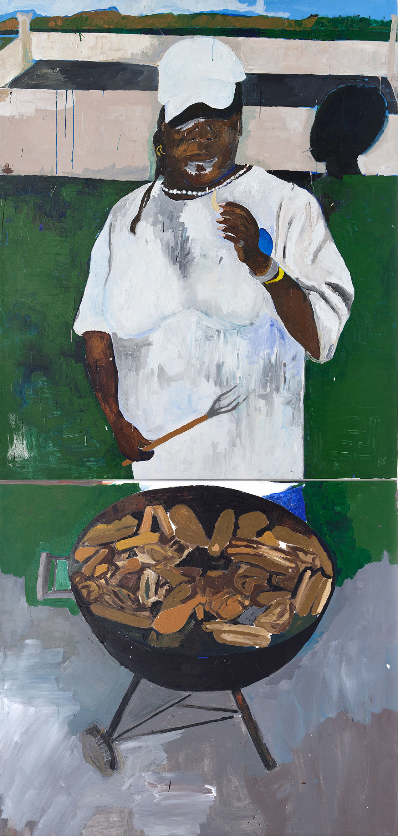
HENRY TAYLOR
Henry Taylor (b. 1958), The 4th, 2012-2017. Acrylic on canvas.

Slide 4
Henry Taylor, “THE TIMES THAY AINT A CHANGING, FAST ENOUGH! (2017), acrylic on canvas, 72 x 96 inches

Slide 5
DEANA LAWSON
Deana Lawson (b. 1979), Ring Bearer, 2016. Inkjet print, 43 x 54 in. (109.2 x 137.2 cm).

Slide 6
GCC (Gulf Cooperation Council)
GCC, Local Police find fruit with spells, 2017 (Installation view—6th floor terrace). Metal, styrofoam, fibreglass, wood, latex pain, concrete pavers, faux rocks and other materials.

