Slide 1
final project: a feral woman
eli palandri

Slide 2
basics
real name: sofia bianca salazar
nicknames: sofie, sof, soapie, sofa, bea, barbie
age: 18
birthday: july 5th, 2000
zodiac: cancer sun, scorpio moon, aries rising
gender: cis girl
sexuality: bisexual
nationality: american
ethnicity: sephardi jewish, spanish, british
religion: reform judaism
hometown: manhattan, new york
birthplace: eden, georgia
occupation: high school menace, low-grade model, cryptid
species: cursed human
parents: vicente salazar, serena keats
inspirations: private school girls, vriska serket [homestuck], the witch [into the woods], mileena [mortal kombat], jennifer check [jennifer’s body], fairy tales, the beast [beauty & the beast], glinda the good [wicked], lawrence kohlberg’s six stages of moral development, maleficent [sleeping beauty/maleficent], frankenstein, “beauty is terror”

Slide 3
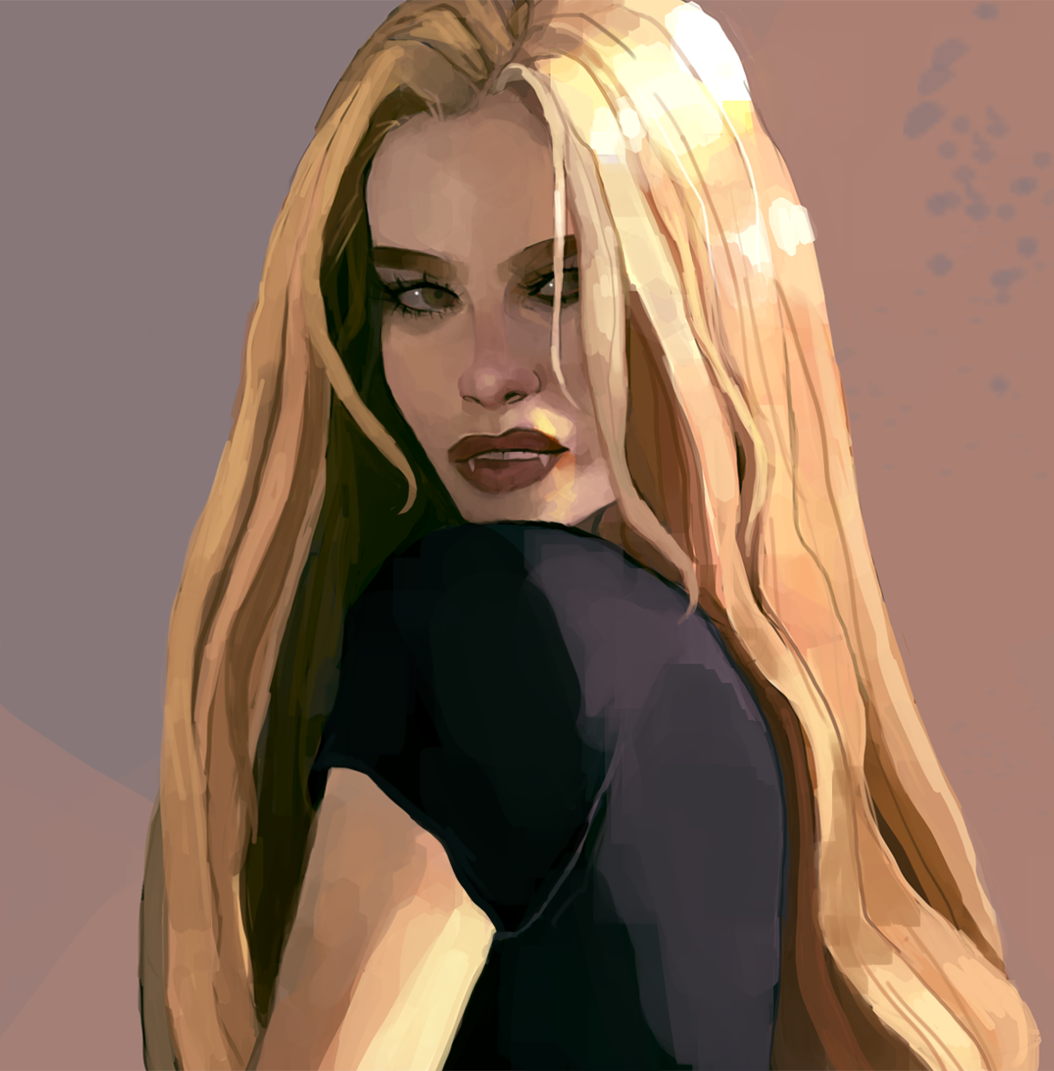
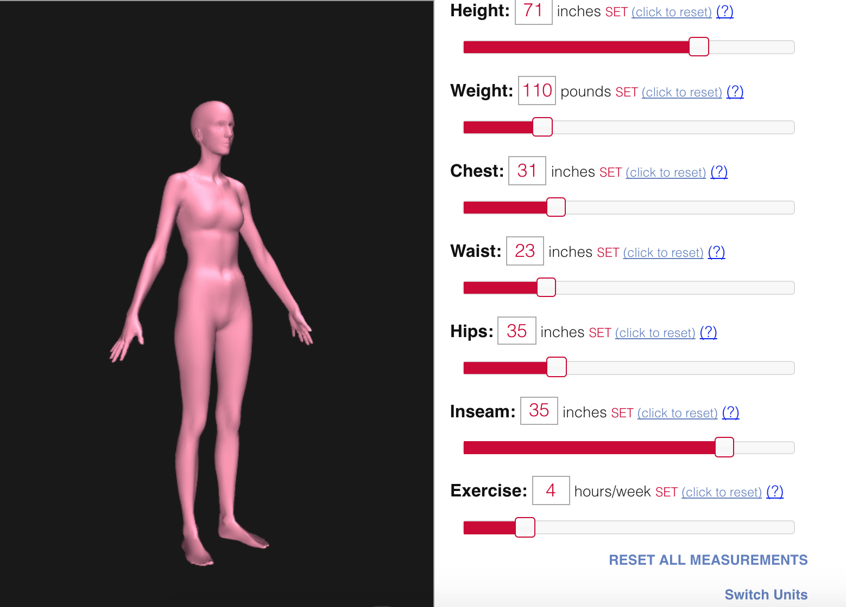
physical
height: 5’11”
weight: 100-120lbs, fluctuates
build: lean hourglass, bony, extremely underweight, loooong legs
complexion: olive, normally glowing and clear, dulls if she hasn’t eaten
in a while
eye color: hazel brown
hair color: golden blonde, later platinum
hair type: slightly wavy, thick, cared for religiously
hair style: ultra-long, no distinct style

Slide 4
personality
traits: vain, assertive, forgiving, self conscious, hypocritical, judgemental, bold, altruistic, charming, snotty, polarized, generous, wrathful, dramatic, insightful, empathetic, ditzy, volatile, direct, oblivious, opinionated, talkative, tenacious, impulsive, competitive, violent, brutally honest, cruel, extroverted, envious, outspoken, credulous, jaded
philosophy: optimistic idealist
alignment: true neutral
mbti: esfj
enneagram: 2w3 sx
temperament: choleric
deadly sin: wrath
heavenly virtue: charity
major arcana: death
fears: herself (her monster/powers, more specifically), butterflies, rejection, the future, the unknown, being ugly, old age, fire, her past coming back, severe injury
talents: mathematics, chemistry, beauty (haircare, fashion, makeup, etc), photography, counseling, making connections, formulas/recipes
likes: fashion, makeup, kids, hair styling, photography, bunnies, baking, horror movies, gossip girl, being with people, parties (formerly), pink, bath bombs, fur coats, numbers, thinking about love, poison, netflix, old rage faces, decorative pillows, disney, being the center of attention, singing, massage chairs, bad poetry
dislikes: overly nice people, purple, thunderstorms, humanities subjects, people having assumptions about her, hospitals, doctors, people she thinks are too much like a “clone” of her, schnapps, hot weather
mental health: c-ptsd, anxiety, anorexia (treated)

Slide 5
curse
puppetry: a form of mind control that’s essentially a reverse ella enchanted; any verbal command she gives must be followed. specifics are essential, as anything unclear will be taken literally. this is a power she never truly mastered and always did more harm than good– she can only control it through modifying her language, it does not shut off. when it is used victims are still in possession of their mental faculties but may or may not be aware of what’s happening and have no power to stop their own action, hence its shorthand name
immortality: due to the nature of her curse, she can not die until it is passed on to another, and as a result can survive grievous bodily harm, and will not age past her prime. she is able to restore her health by consuming the flesh of another– when feeding, her curse manifests physically and her form becomes monstrous until she consumes enough flesh to recover what she has lost
monstrous form: she transforms into this when severely injured to hunt and restore her flesh. some horror movie shit; horned and emaciated. about 10 ft tall with elongated limbs, hands, and talons. legs end in taloned, tactile feet. white-gray skin, hair, and eyes with black innards. blood, tears, and digestive fluid are a roiling tar-like acid that dissolves any natural substances, including flesh. gnarly teeth with a jaw that completely unhinges. it is completely wild and will kill indiscriminately until sated. it sees by temperature and movement, not light
while in this form, she has a strong aversion to light and can be driven off and killed with fire, heat, explosion, or intense sunlight
while not in this form, she retains its digestive fluid and blood, and its vision to some extent (her eyes are drawn to warmth and motion more easily, and she can see a bit better than most in the dark). she also has sharper teeth, clawlike nails, longer canines, and can stretch her jaw wider than normal
eternal hunger: because as a human she is technically constantly dying, she has a 24/7 stabbing hunger to consume (ideally human) flesh. her body does not accept sustenance other than flesh, blood, or bone in some form, and though only human can repair her, she manages it as best she can by near-constantly consuming animals

Slide 6
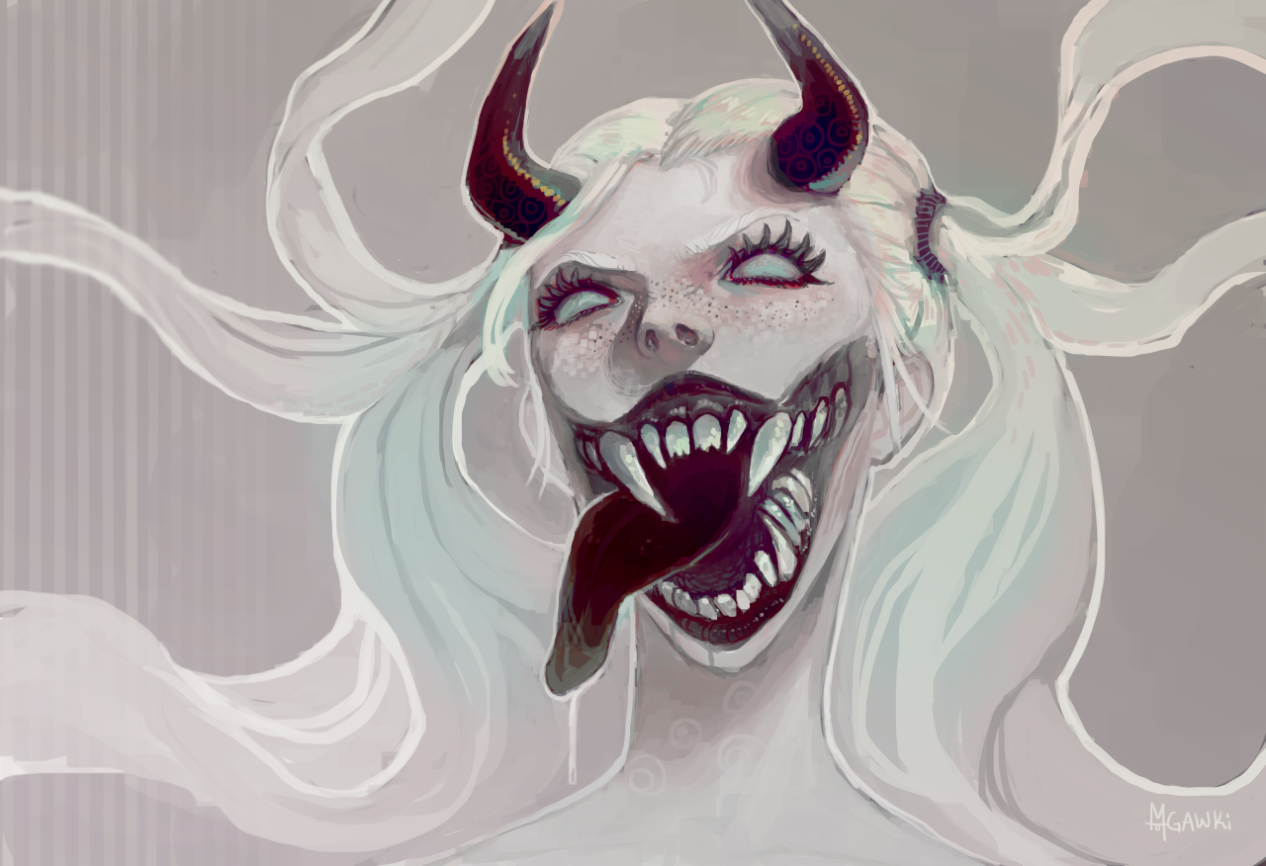

Slide 7
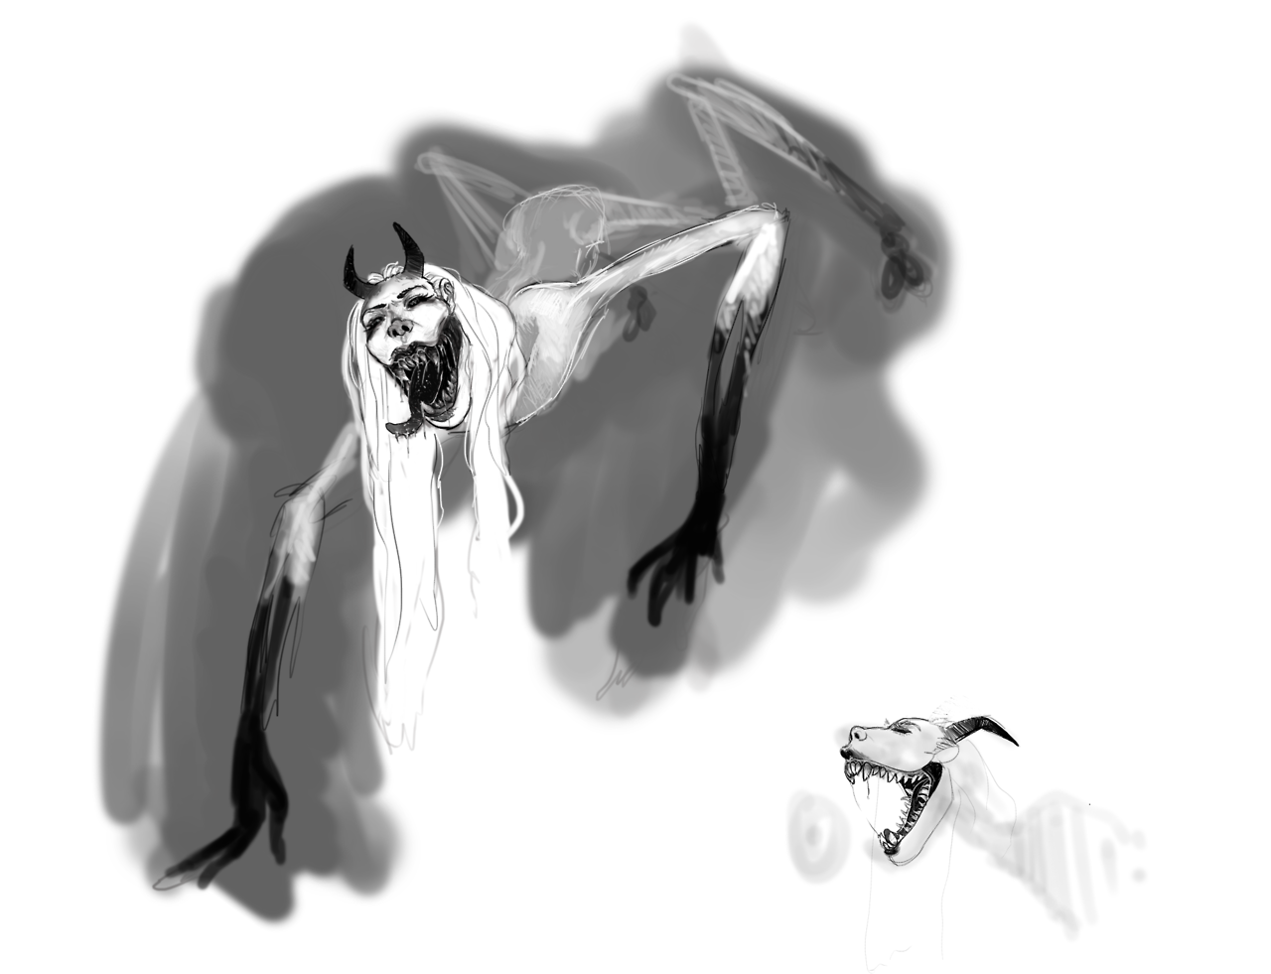
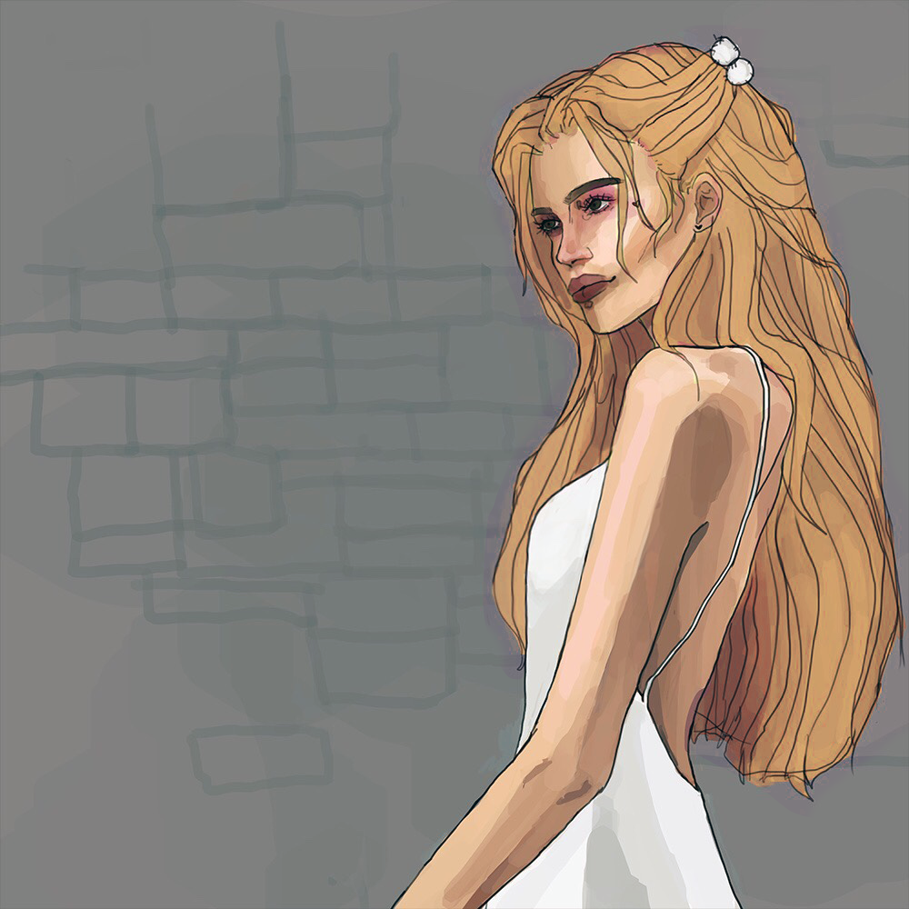
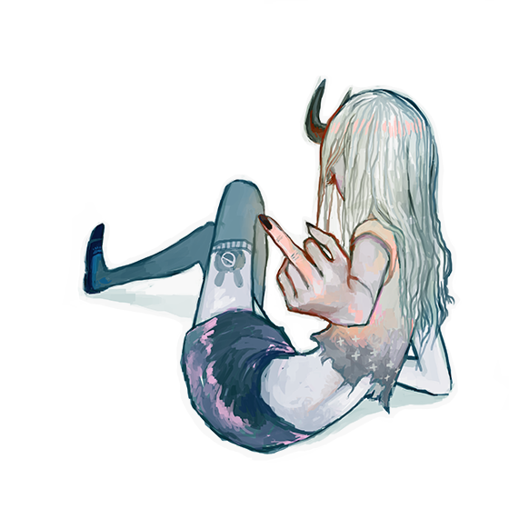

Slide 8
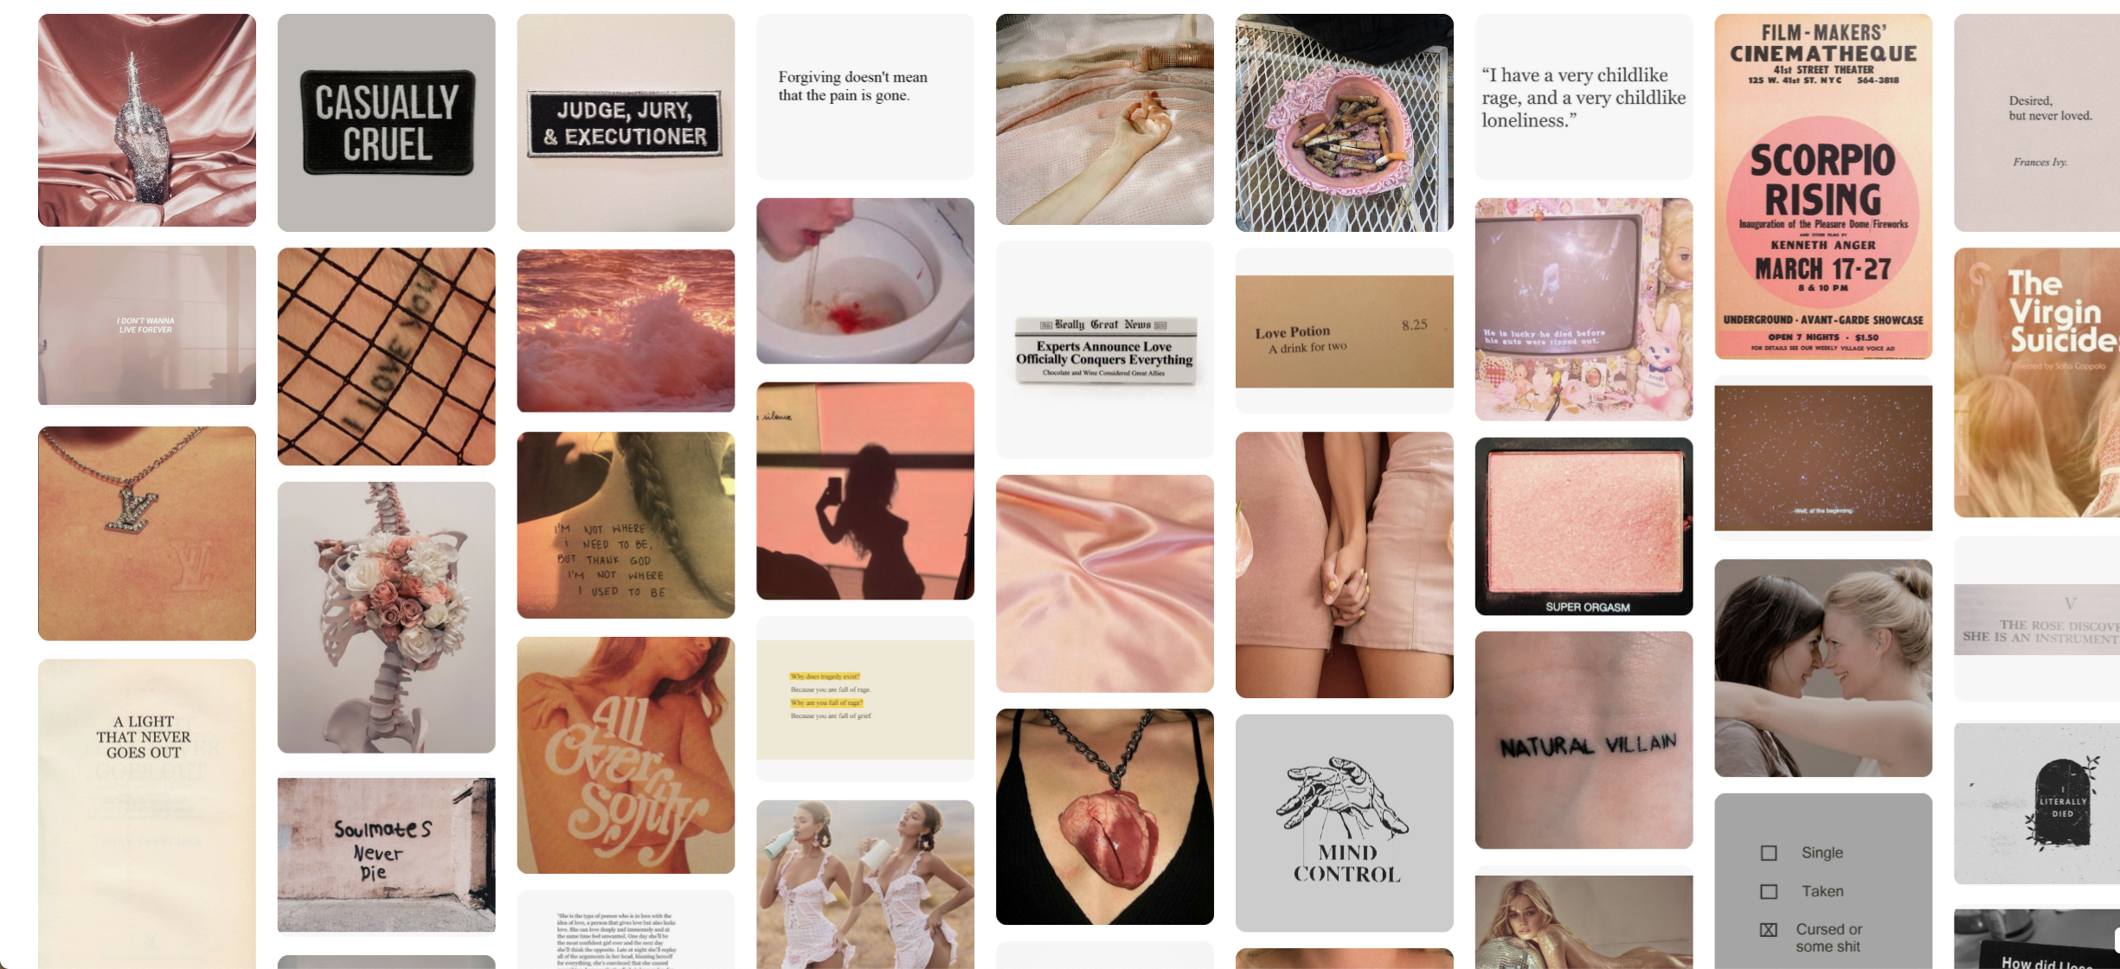
inspo: general

Slide 9
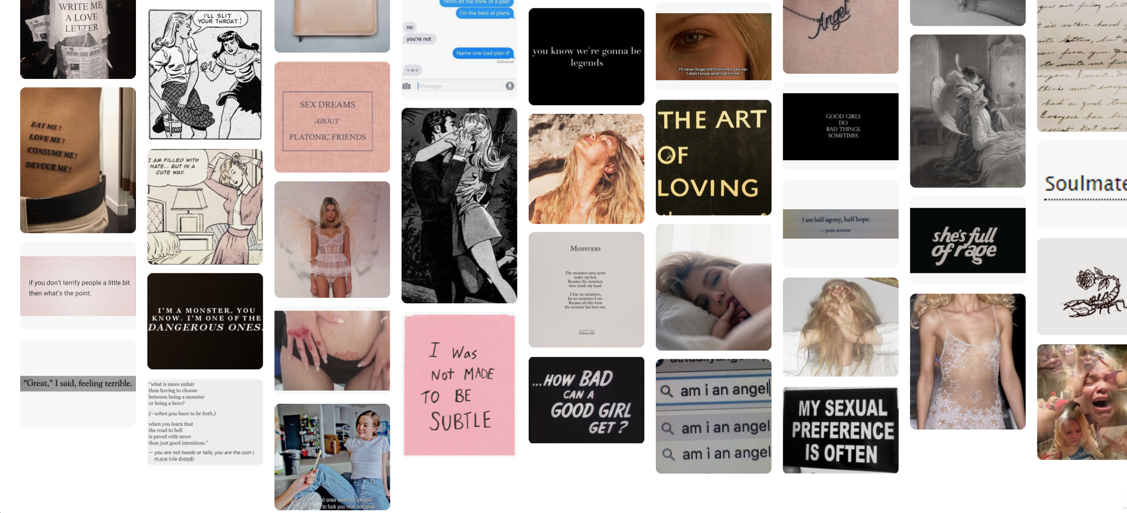
inspo: general

Slide 10
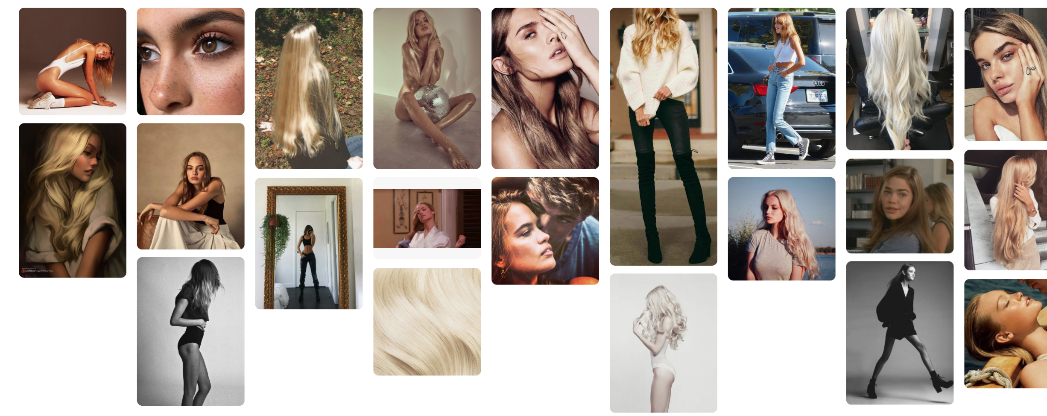
inspo: appearance

Slide 11
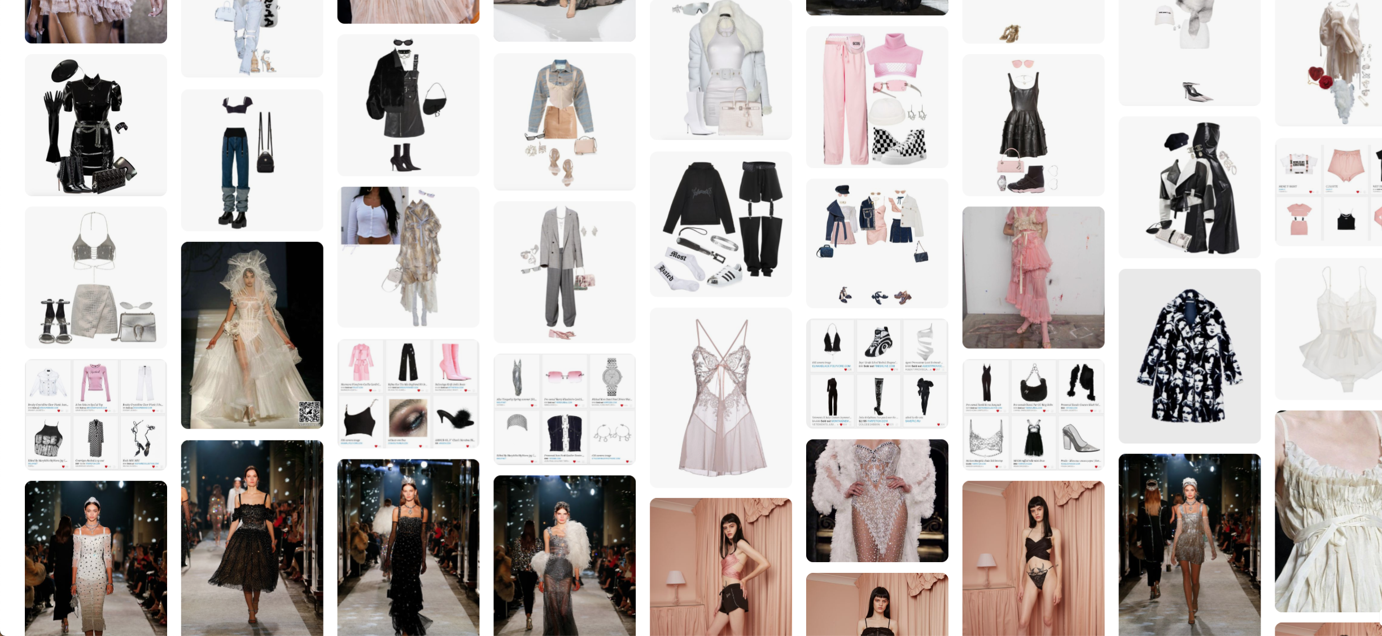
inspo: wardrobe

