Slide 1
Feminism /Fashion

Slide 3
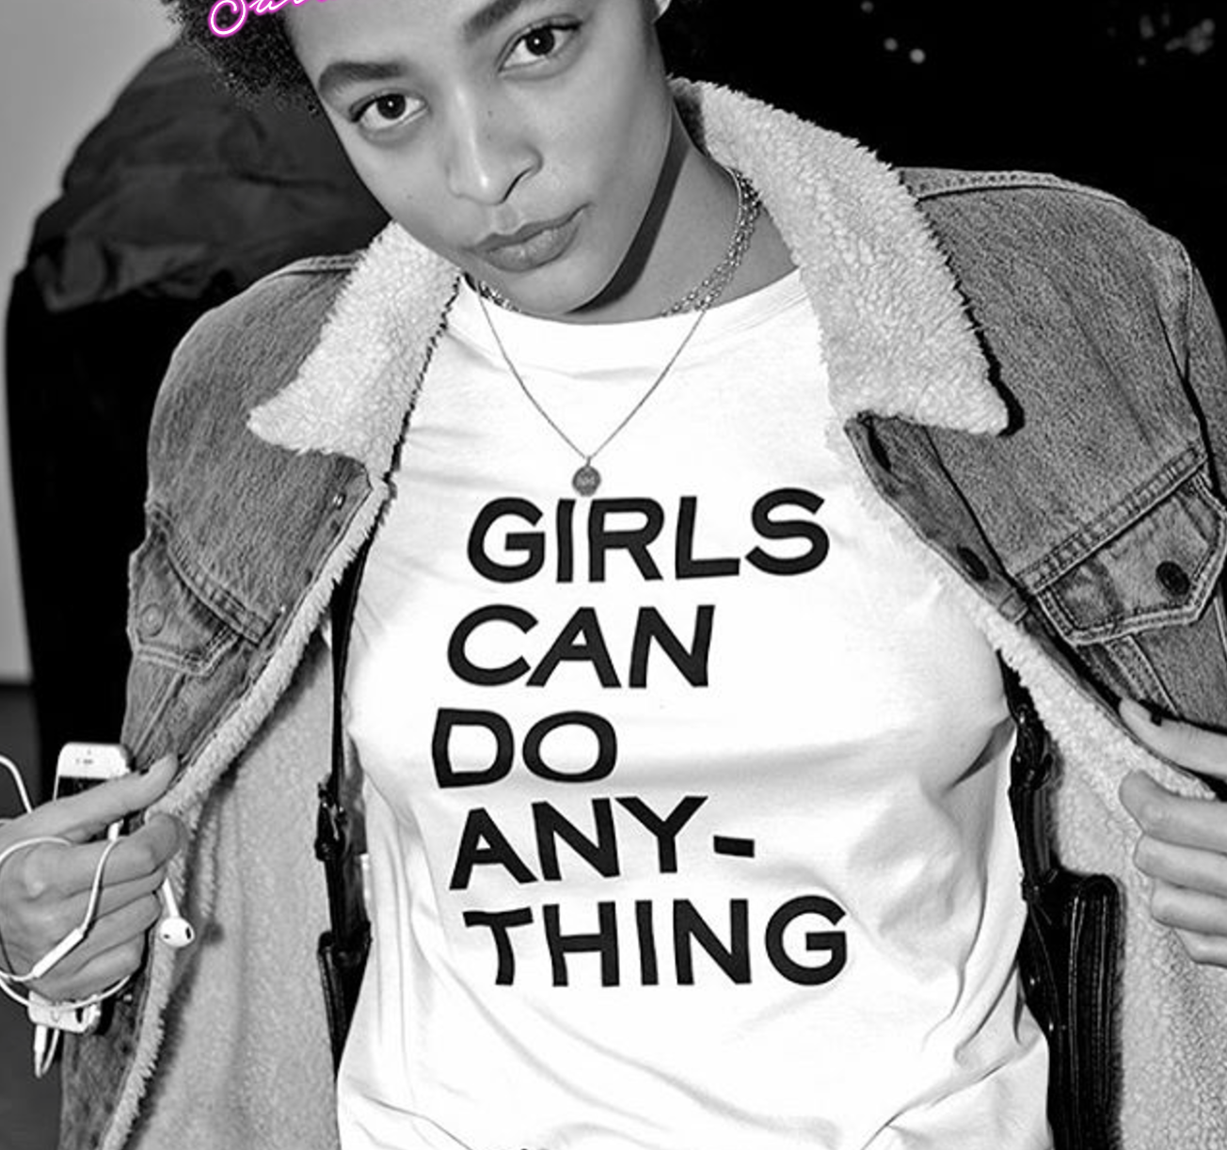
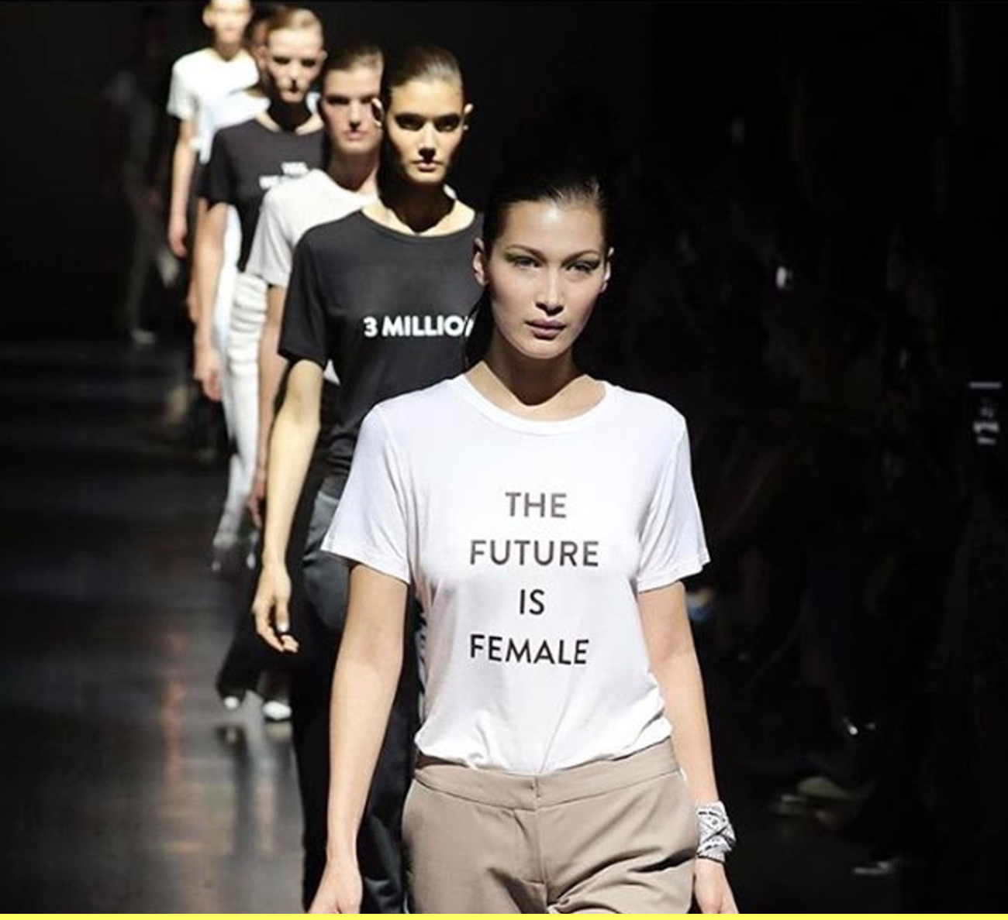

Slide 4
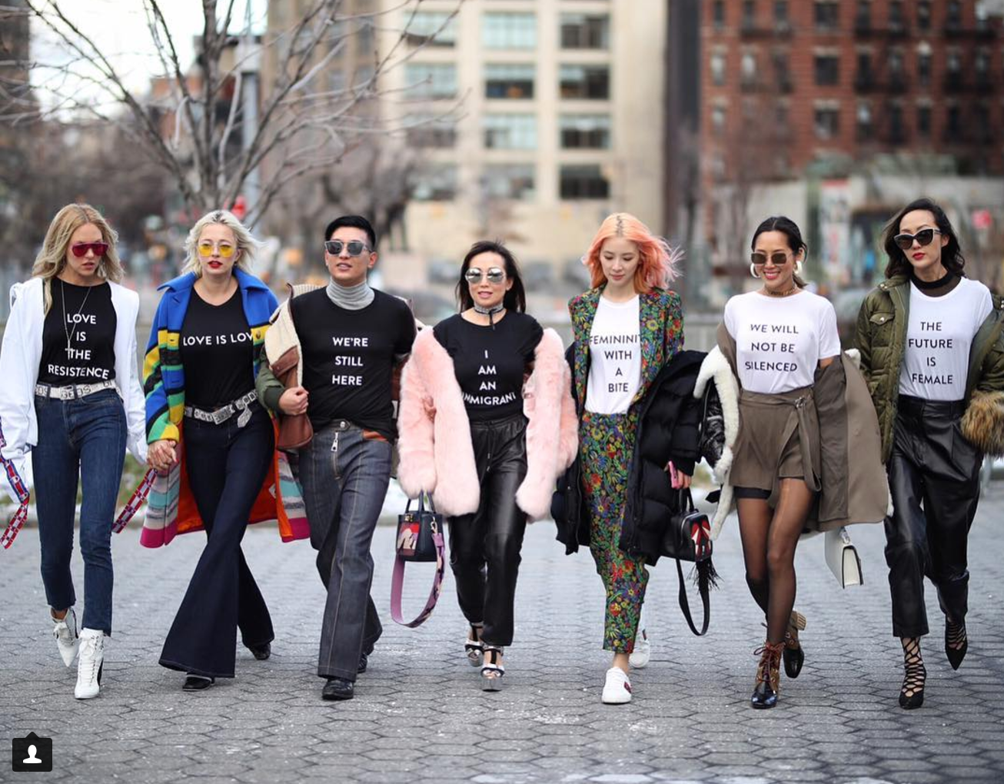

Slide 5
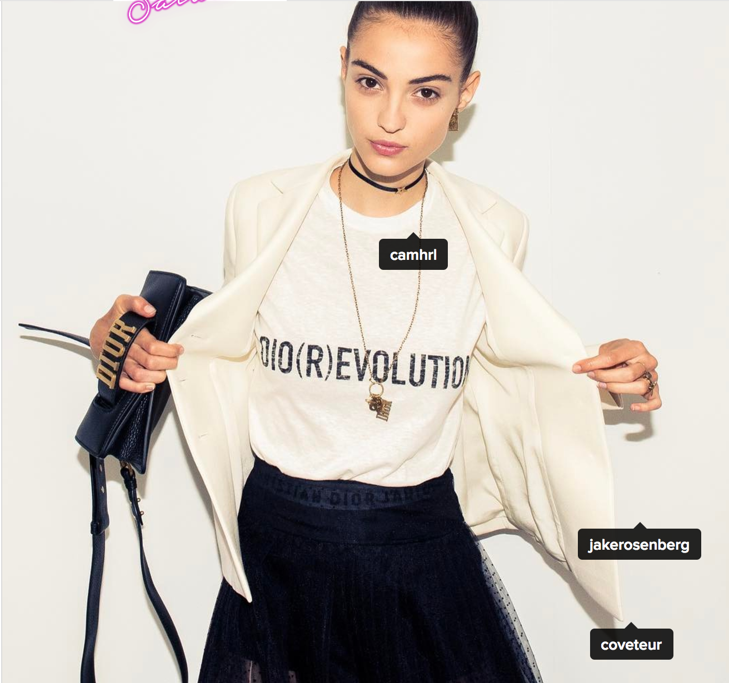
THE INSTAGRAMERS

Slide 6
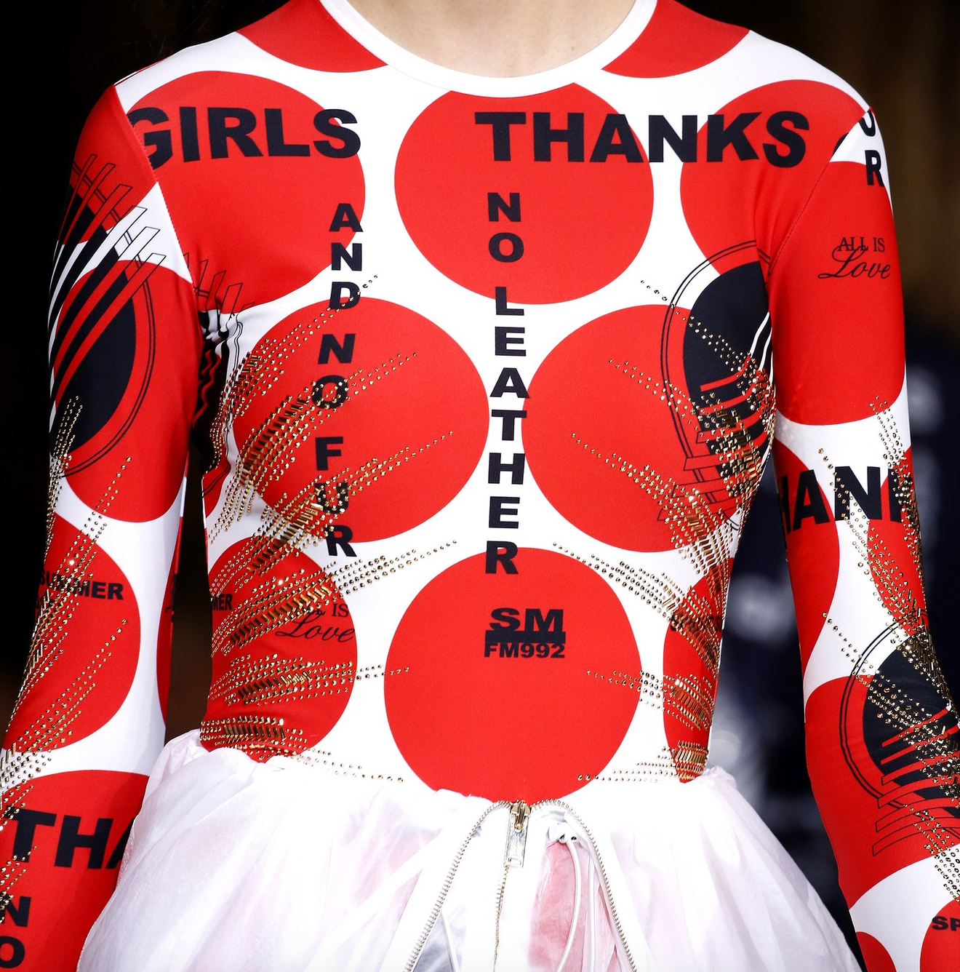
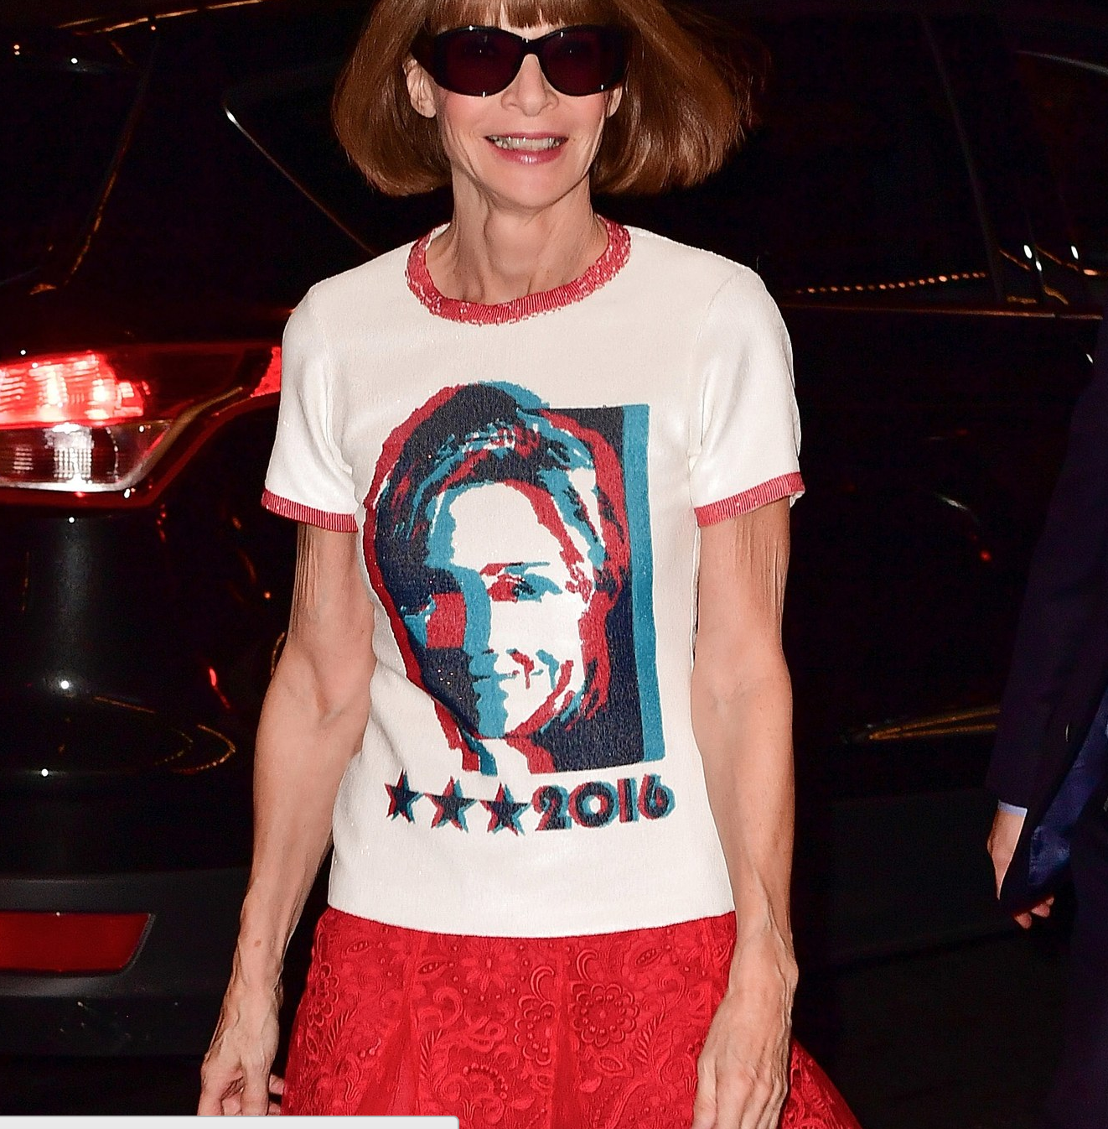

Slide 7
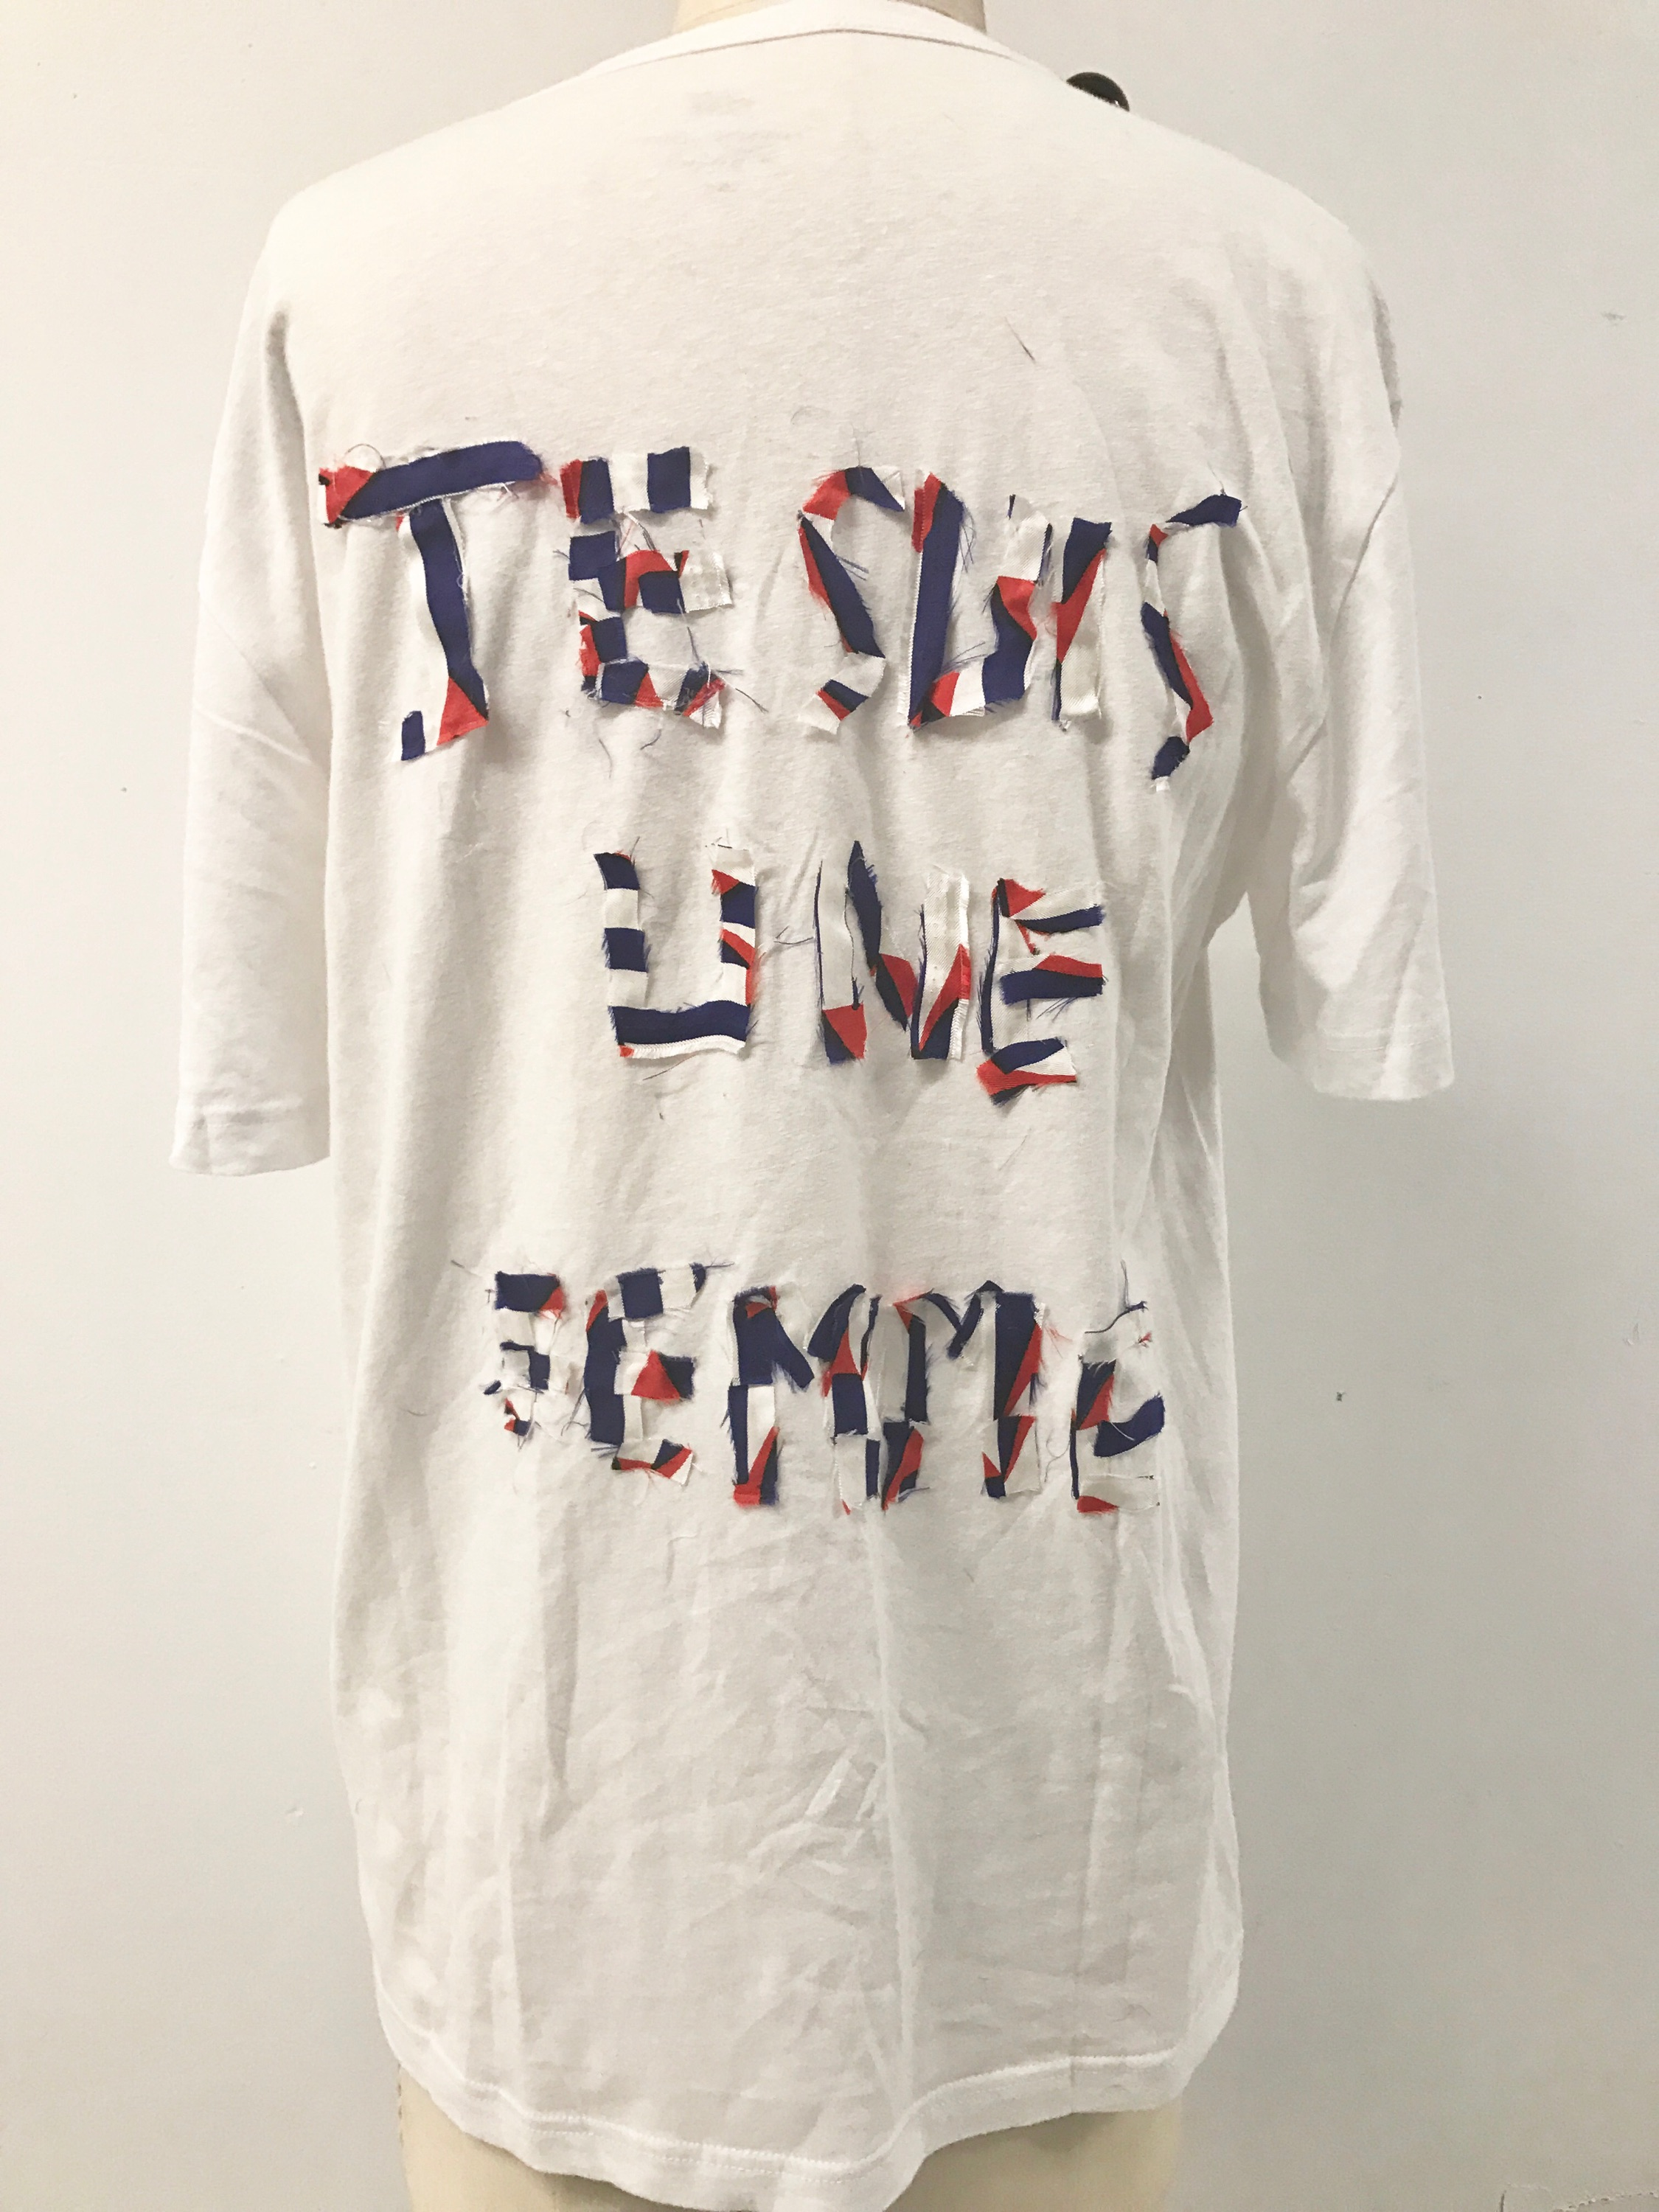
Why this Design ? pt1
Colors of France, decided to chose the country I’m from because the movement is not developed enough there in my eyes.
“Je suis une Femme” ---> I am a women
It is a very strong sentence in French, but after translating it in English, the context is way less interesting

Slide 8
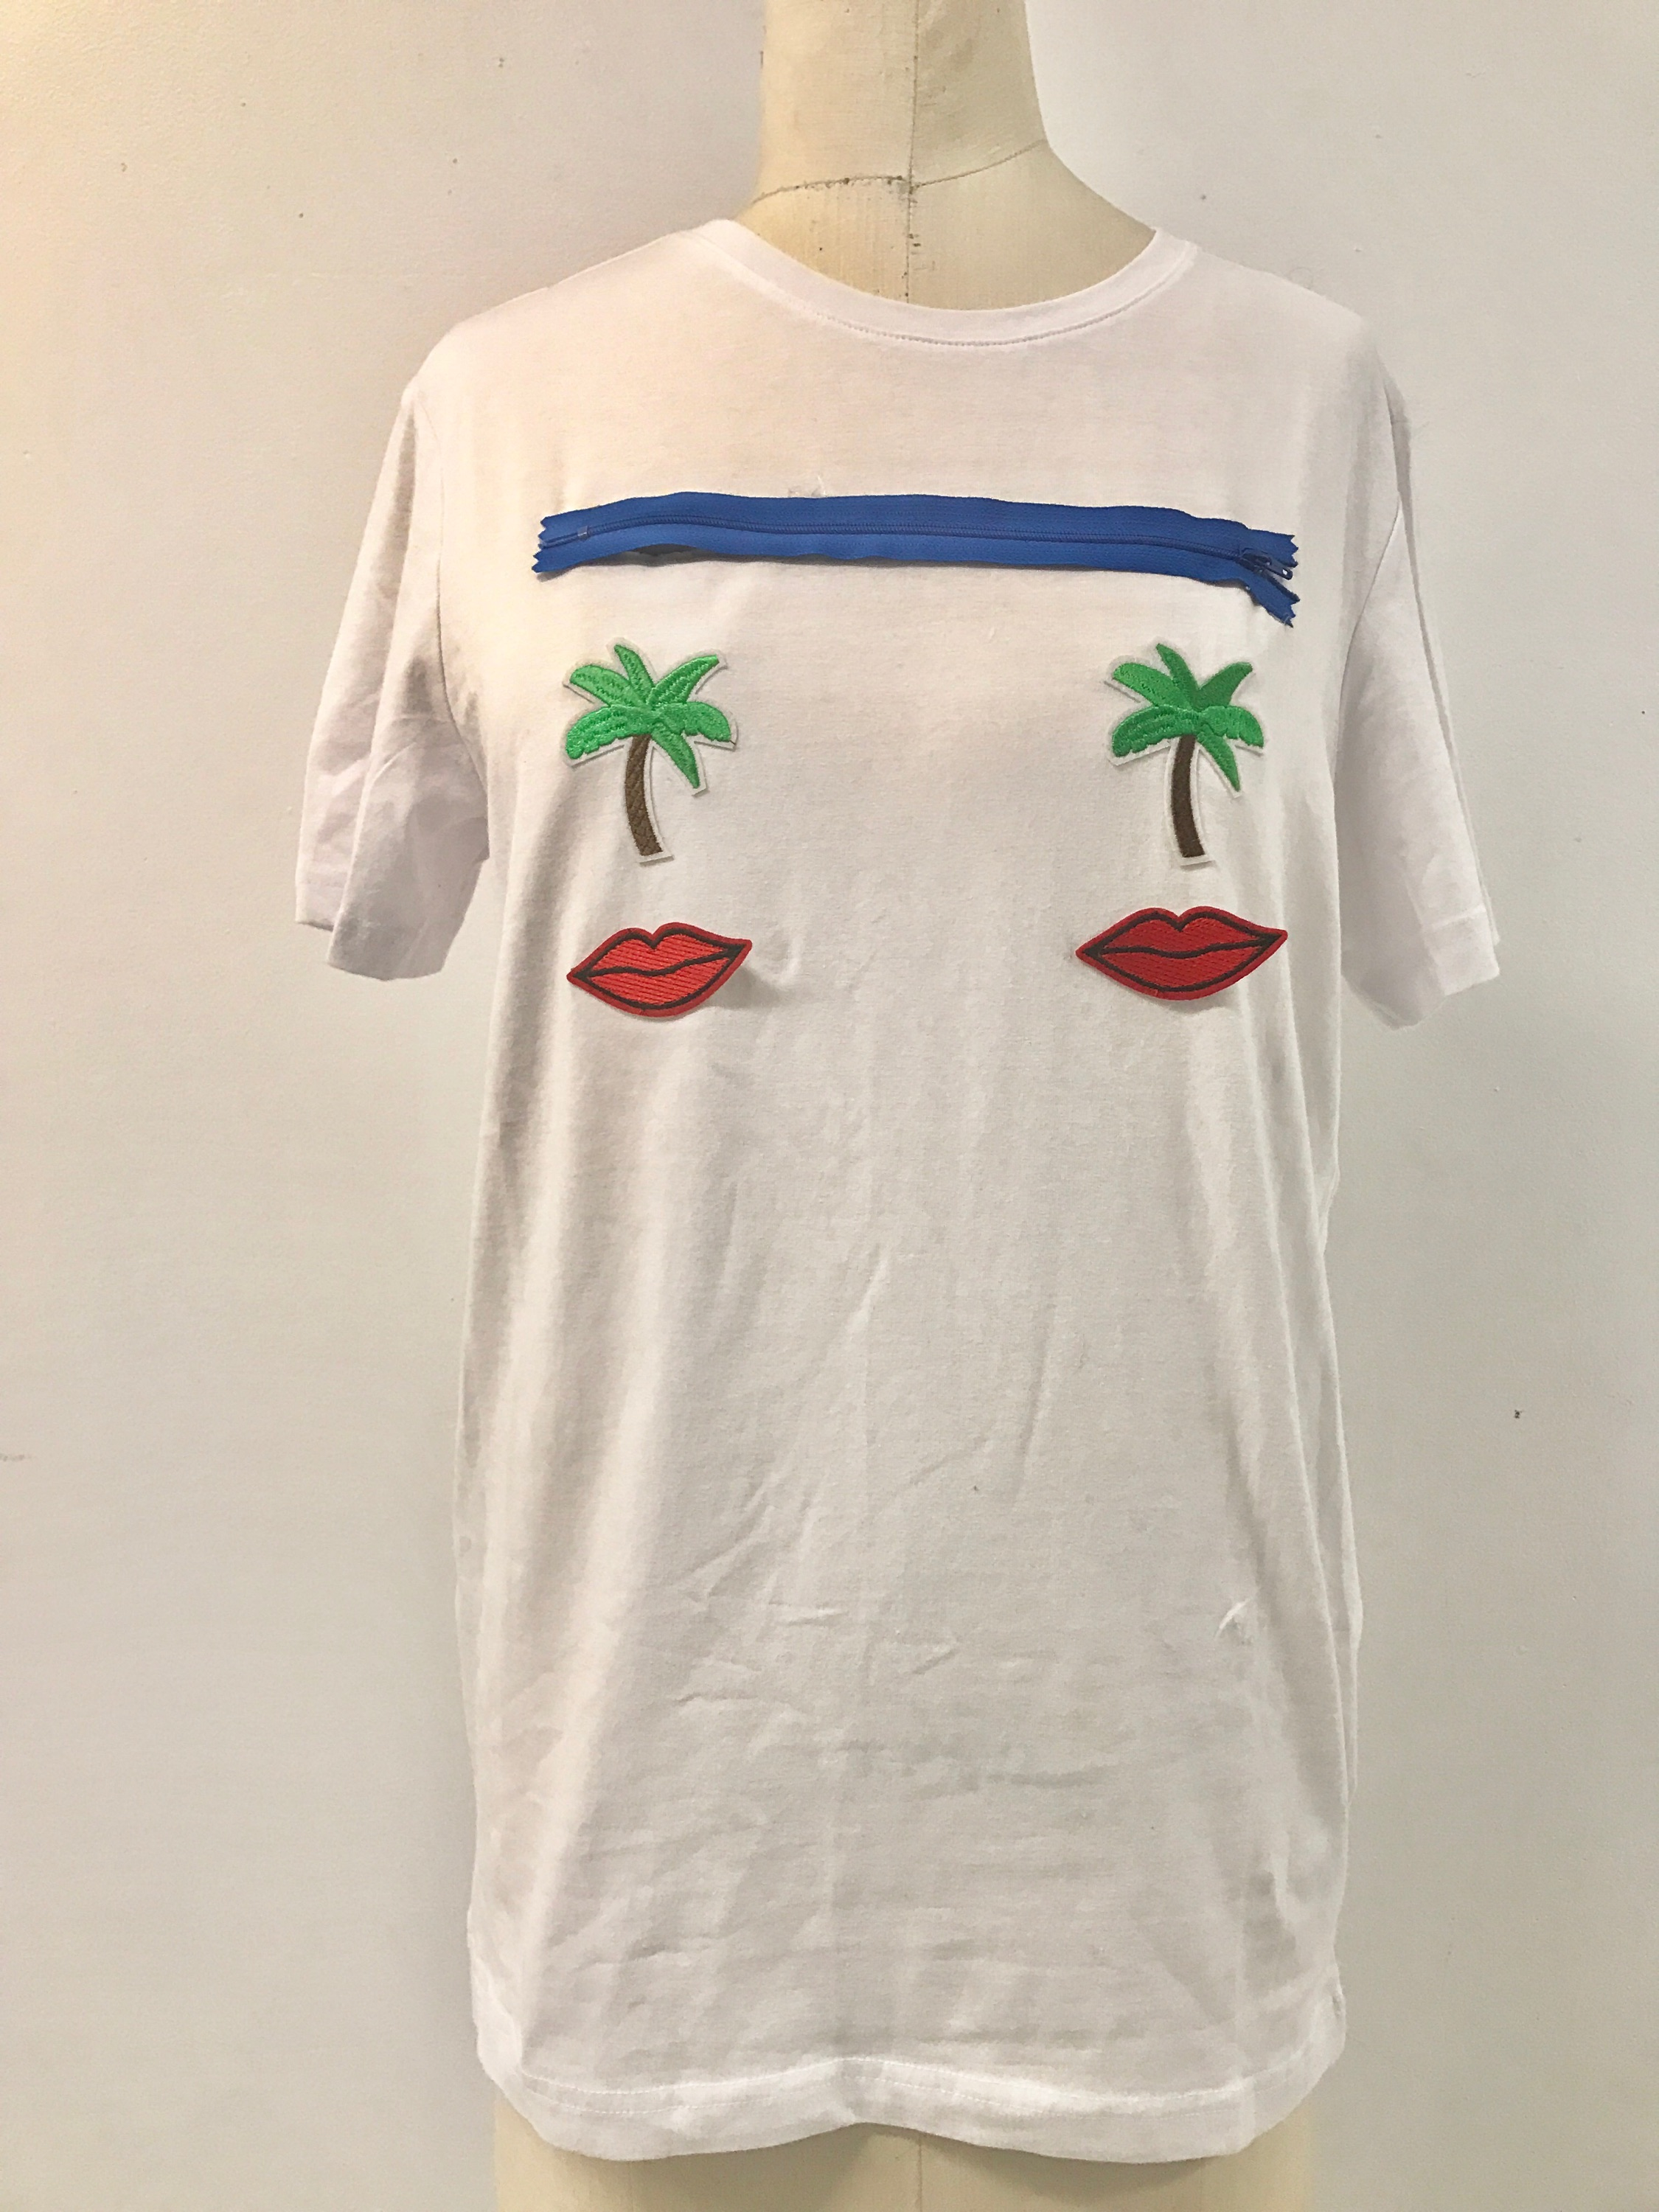
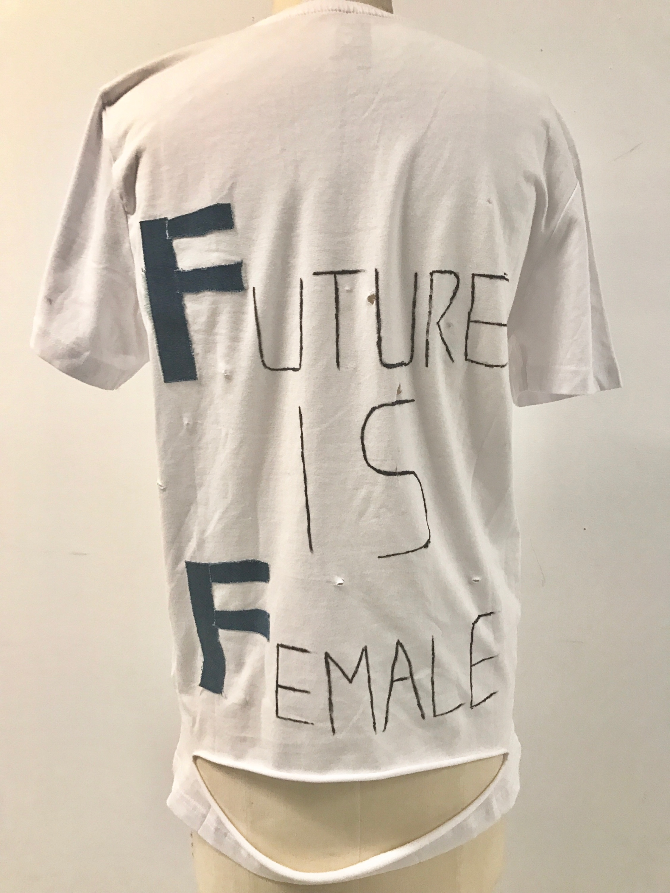
Why this Design ? pt2
I wanted this shirt to be a little more fantasy, and used patches that could be worn everyday but still has a feminist side.
I chose this saying because it is first of all what I think and a sentence that puts the Female in position of superiority for me.

Slide 9
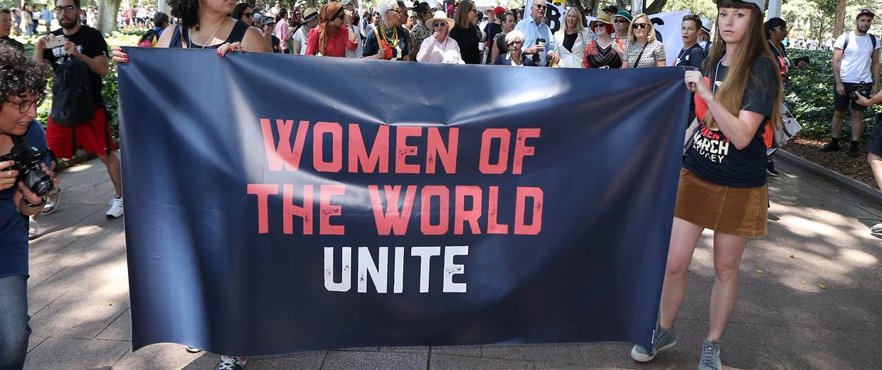
Women Strike in march

Slide 10
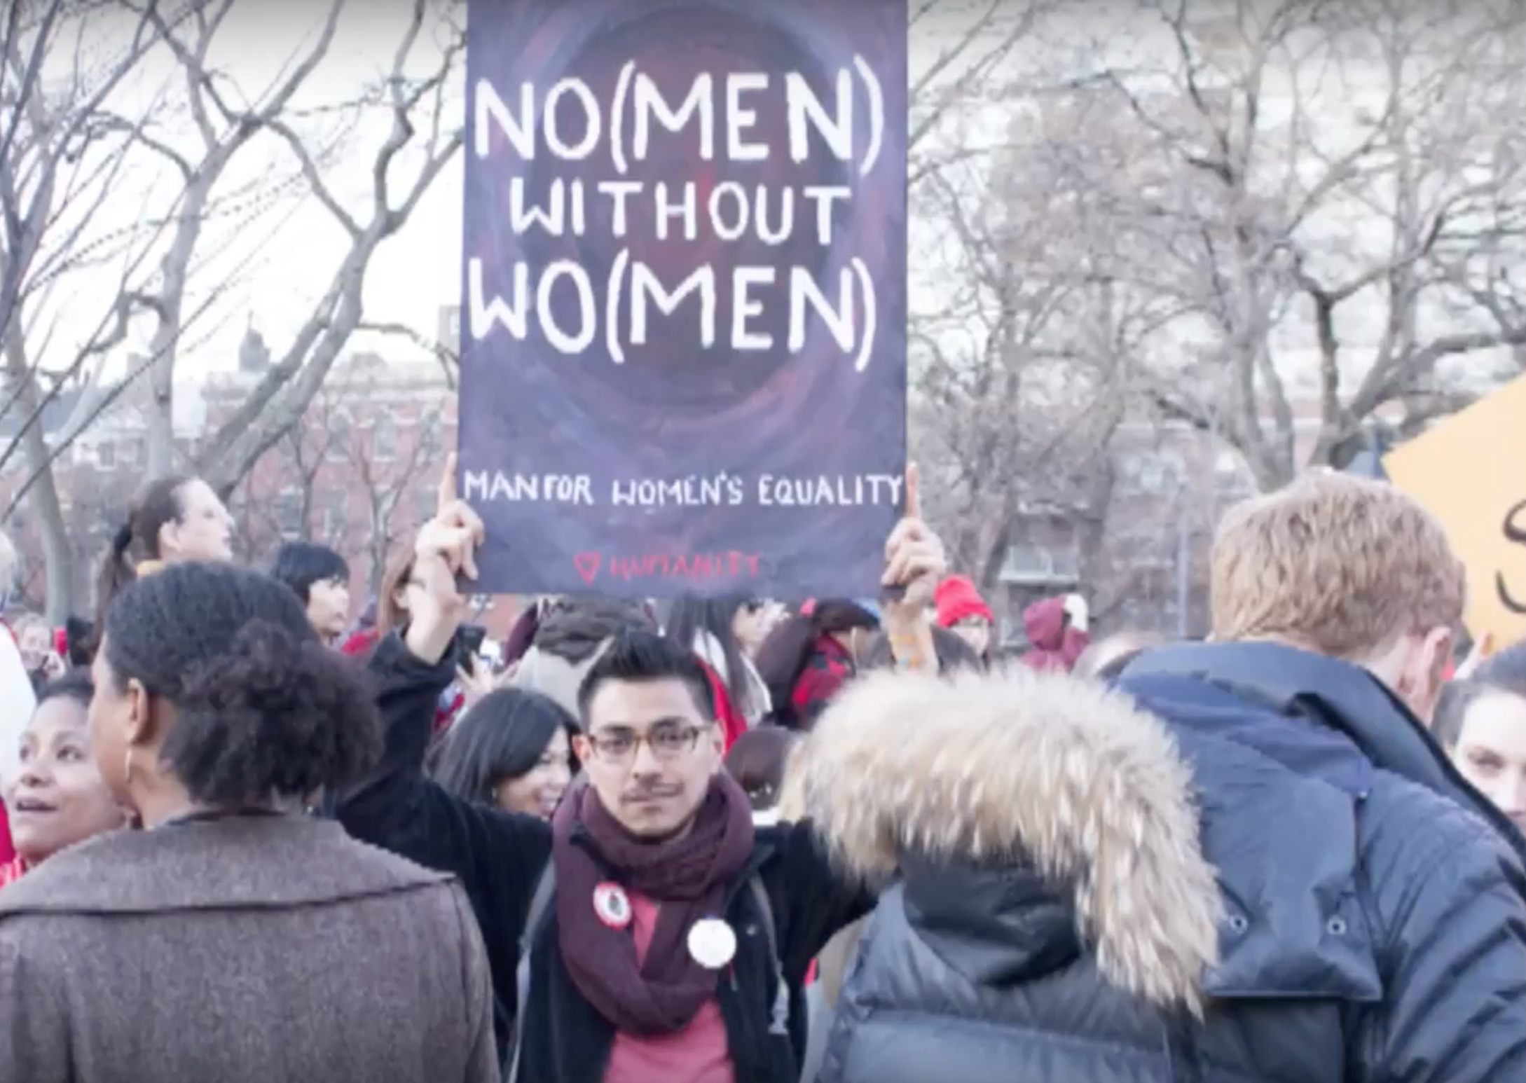
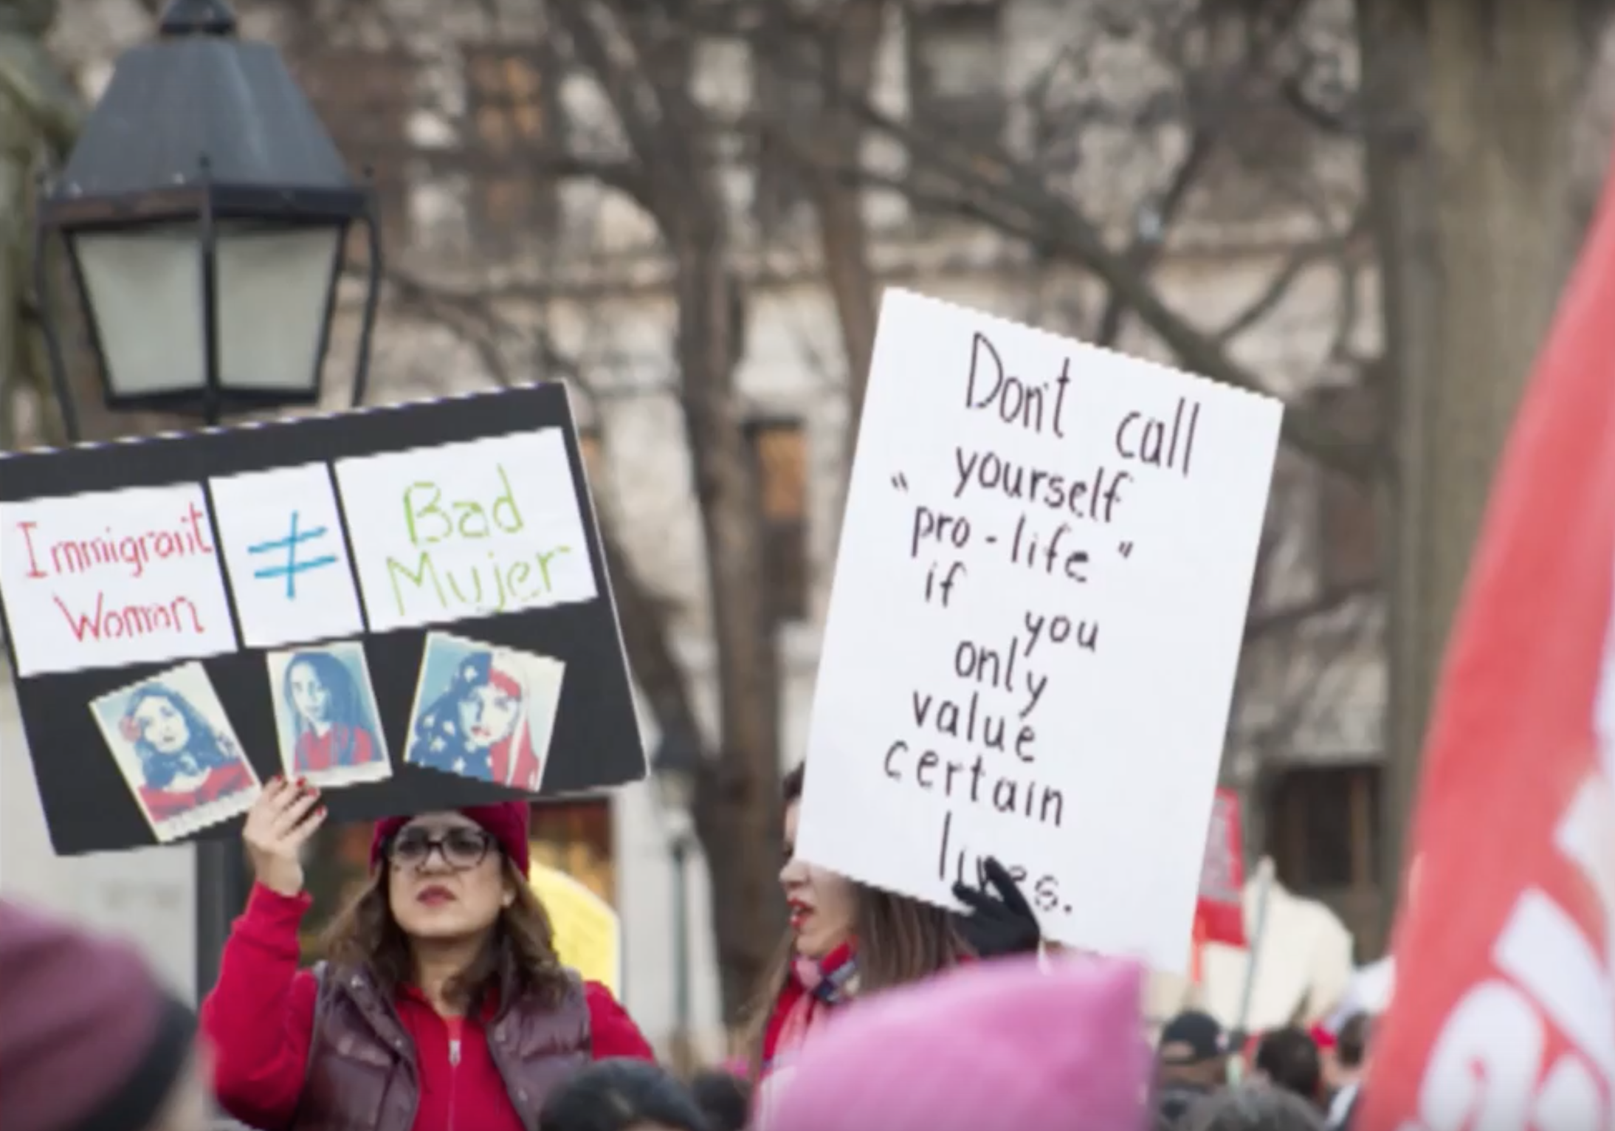

Slide 11
