Slide 1
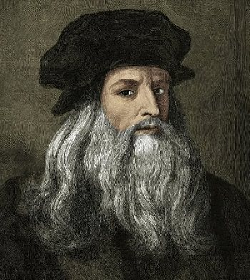
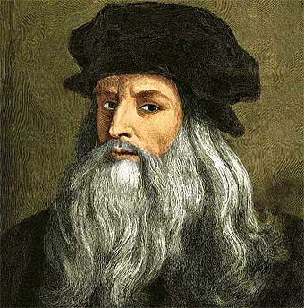
Leonardo da Vinci
Kristina V. Kalabacas

Slide 2
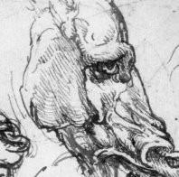
Background
Full name: Leonardo di ser Piero da Vinci
Born: 15 April 1452 in Vinci, Republic of Florence (present-day Italy)
Died: 2 May 1519 (67 years old) in Amboise, Kingdom of France
Was an Italian polymath (aka a “Renaissance man”); focused on invention, painting, sculpting, science, architecture, music, literature, engineering, mathematics, geology, anatomy, writing, botany, astrology, cartography, and history

Slide 3
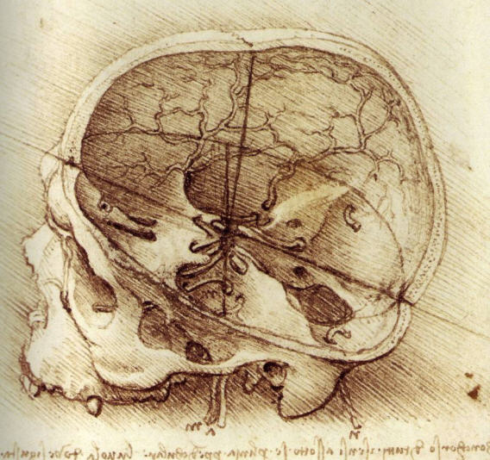
Quick Facts
Considered one of the greatest painters of all time
Notable work: The Last Supper, Mona Lisa, The Vitruvian Man, & Lady with an Empire
Style: High Renaissance (“High Style”)
Regarded as a “Universal Genius”, an individual of “feverishly inventive imagination” & “unquenchable curiosity”
Today, Leonardo is widely recognized as one of the most diversely talented individuals ever to have lived
He was left-handed, writing famously in mirror writing

Slide 4
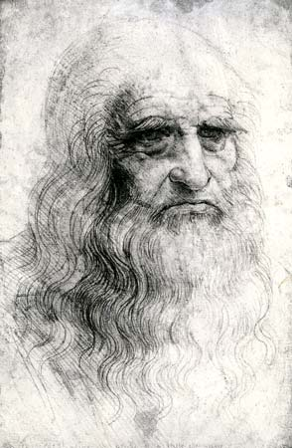
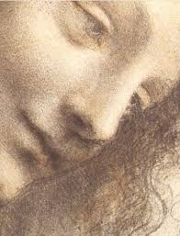
Theories/Fun Facts
Da Vinci was a cross-dresser, hence the theory that the Mona Lisa was a portrait of himself & that’s why the Mona Lisa is ‘smirking’
He was ambidextrous & paranoid dyslexic, he could draw forward with one hand while writing backward with the other, creating a mirror-image script (reverse) that others found difficult to read
da Vinci dug into graveyards at night to steal corpses and study human anatomy (and to also find out where the soul was)

Slide 5
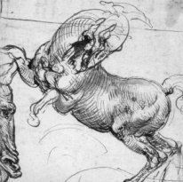
Materials used (media)
When da Vinci was younger he mostly sketched with metal (silver) pencils on tinted paper
As he matured he preferred colored chalk, although he used a brush and ink, or a pen and ink for life studies
Throughout his long life he also developed a number of his own personal drawing tricks, including inventing curved hatching, to give an especially three-dimensional look

Slide 6
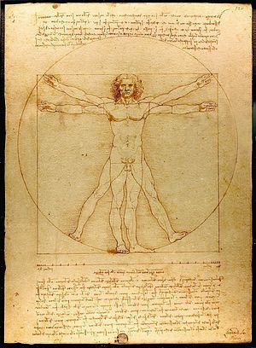
Vitruvian Man, ca. 1490
Pen & ink w/ wash over metalpoint on paper

Slide 7
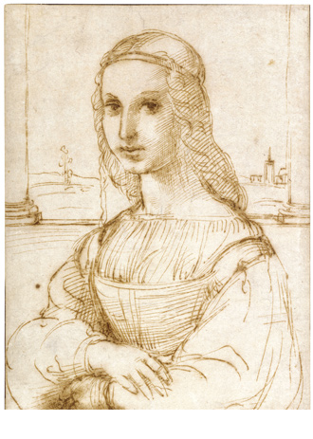
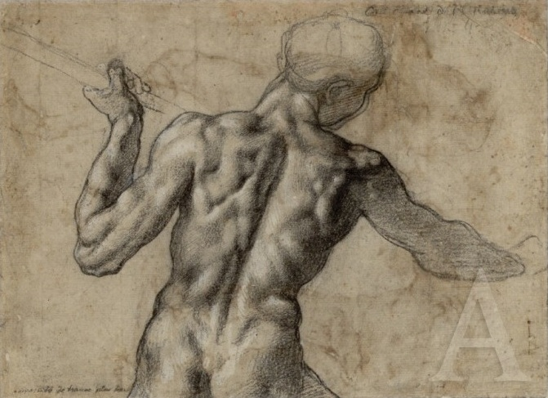
Influences
Raphael’s ‘Young Woman on a Balcony’, pen and ink sketch, c. 1504.
Michelangelo’s anatomical drawing

Slide 8
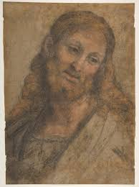
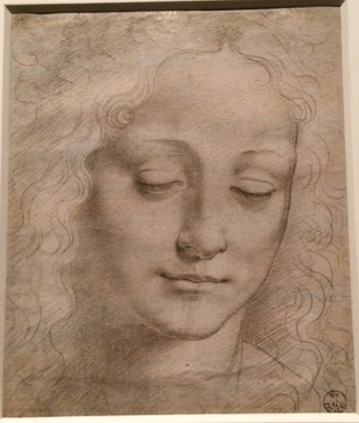
Andrea Solario’s Bust of a Bearded Figure
Giovanni Antonio Boltraffio
Both were students of da Vinci

Slide 9
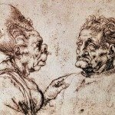
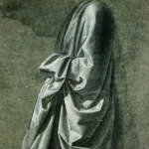
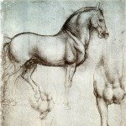
Caricature c. 1490 depicting people in a grotesque manner (intrigued by deformity)
Study of a horse c. 1490 (silverpoint study)
Drapery c. 1470

Slide 10
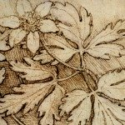
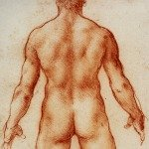
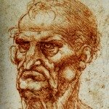
Nude Male Back c. 1490 (nudes were depicted rarely, especially female, males served as models for females
Portrait c. 1490 da Vinci didn’t precisely produce the model before him, kind of a caricature
Flowers c. 1490 using pen & ink

Slide 11
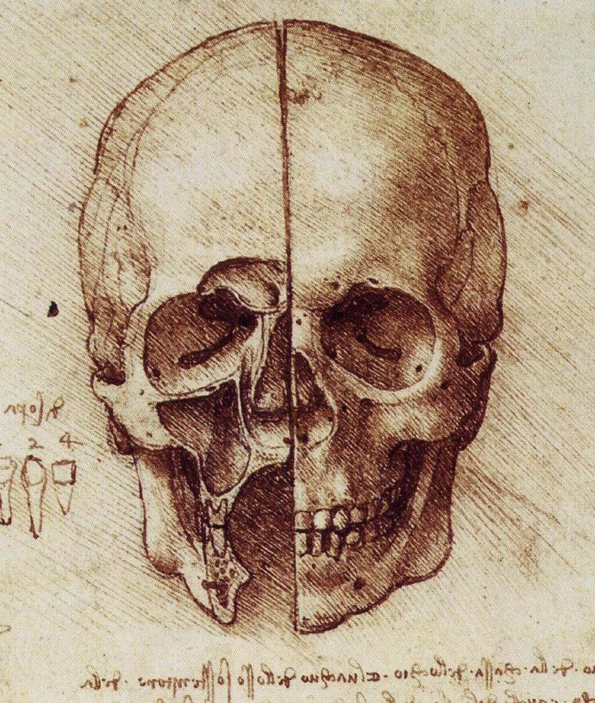
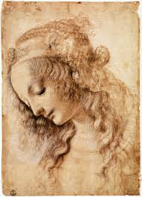
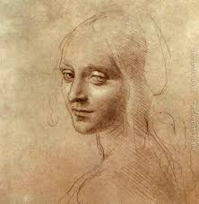
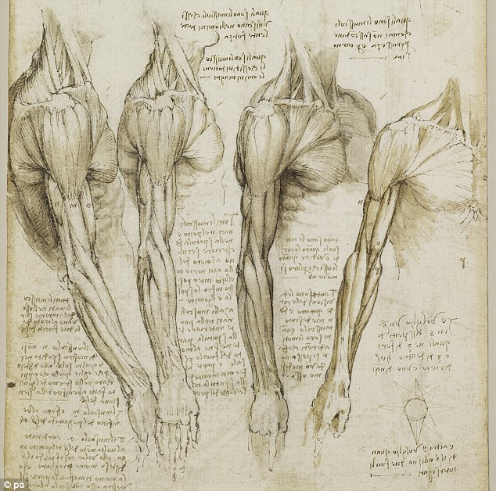
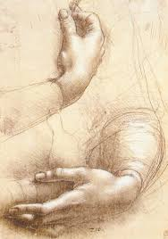
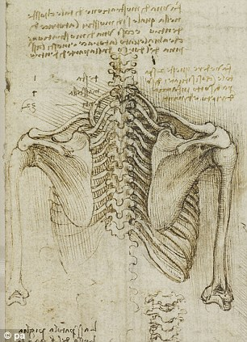
More work

