Slide 1
Andersen’s The Little Mermaid
Kristina V. Kalabacas

Slide 2
Thesis (W.I.P.)
There is strong importance/significance with the body in The Little Mermaid, there are alterations and mutilations. This is done for many reasons: to fit in, out of curiosity, to feel beautiful, to be accepted, etc

Slide 3
Questions
How did religion play a role in The Little Mermaid?
How is sin represented in The Little Mermaid?
What is the moral of the fairy tale?
What is/are the theme(s) of the tale?
What did Andersen want readers to fear in this tale?
How are punishment/consequences depicted?
What is the importance of the ‘soul’ in The Little Mermaid?
How is society & class represented in the tale?
How is love portrayed in this tale?
Why do happy endings involve death & having faith in the Christian God?

Slide 5
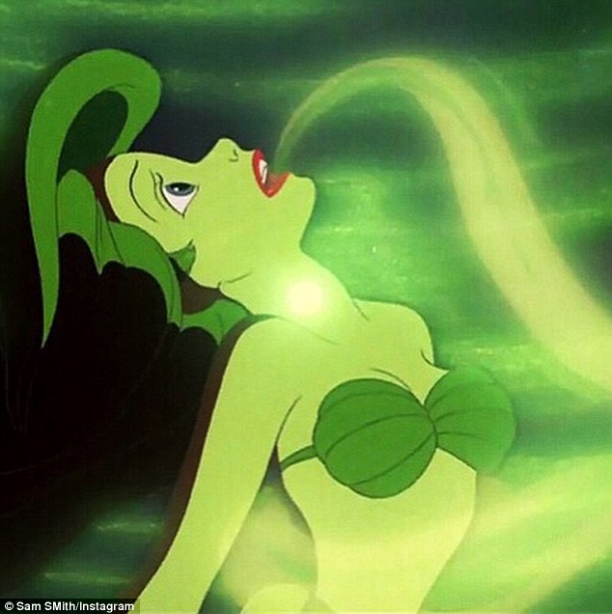

Slide 6
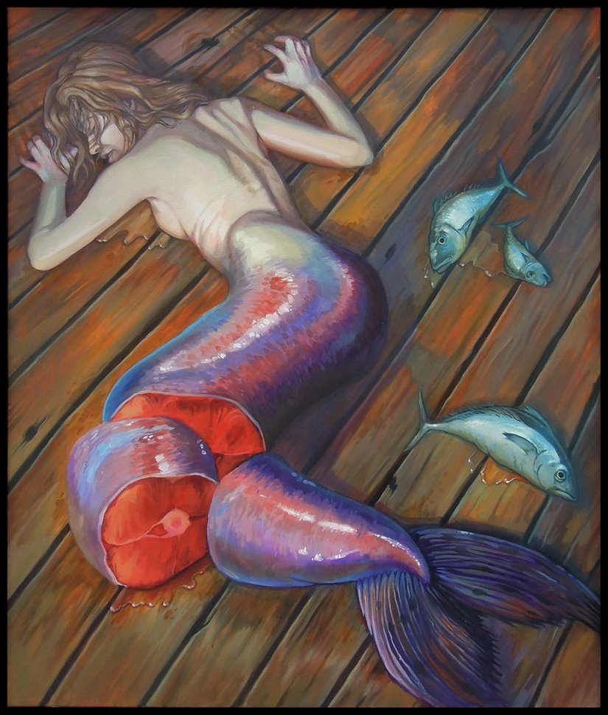

Slide 7
