Slide 1
Int. Studio 2 Final proj. progress
Kristina

Slide 2
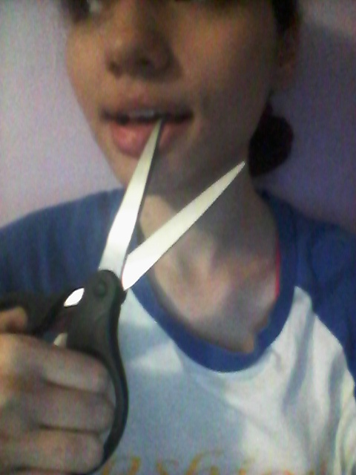
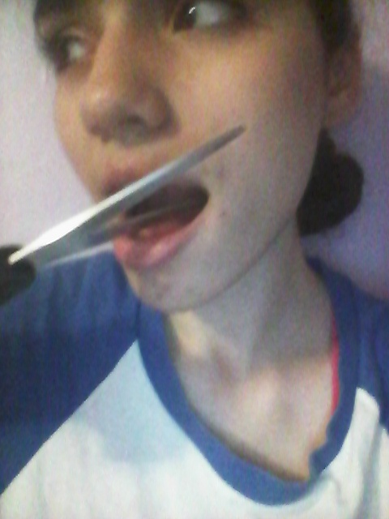
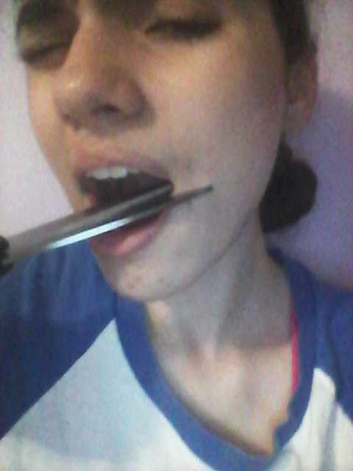
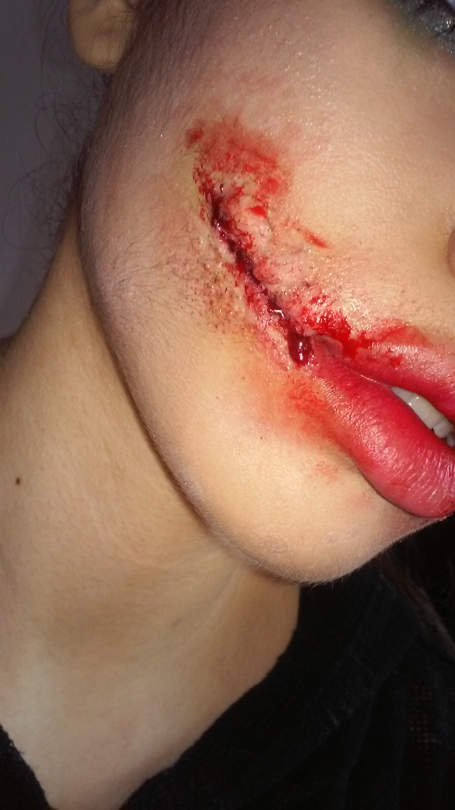
Example

Slide 3
Questions to consider
What comes to mind when you think of punishment?
Do consequences only occur when bad things happen?

Slide 4
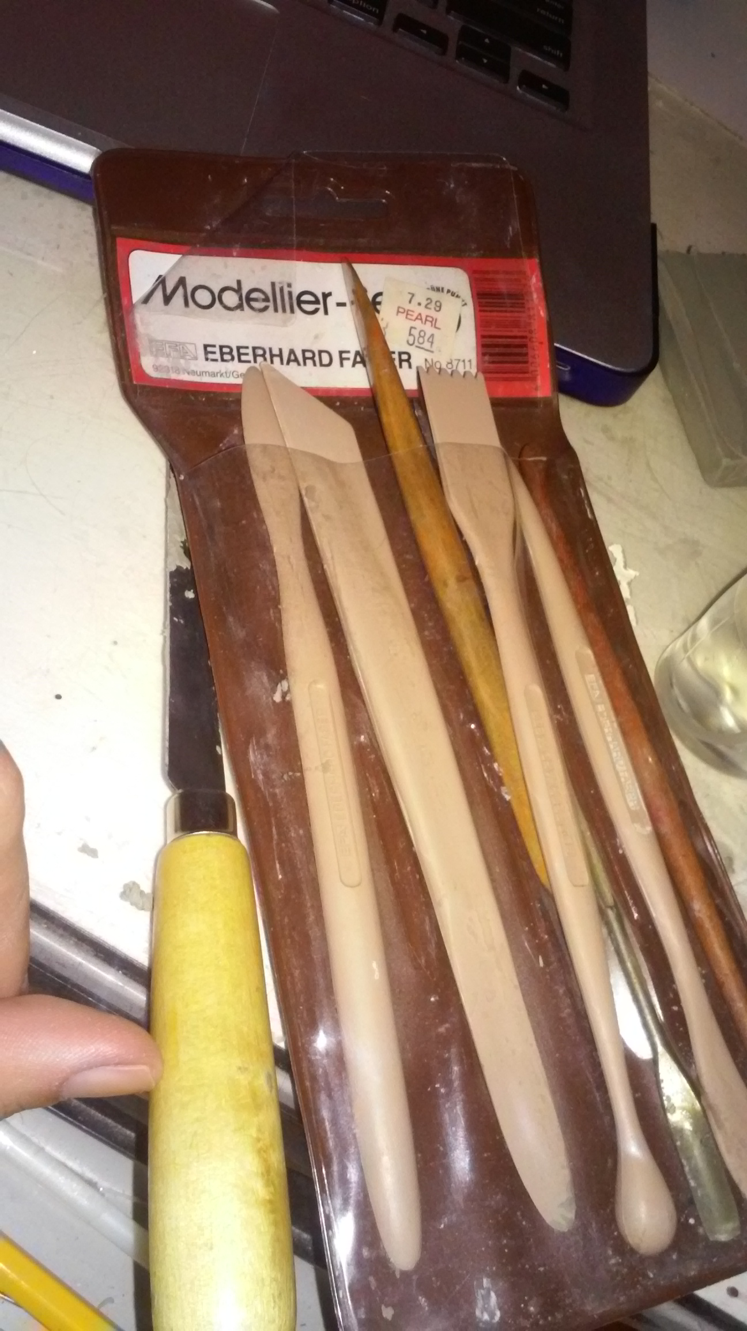
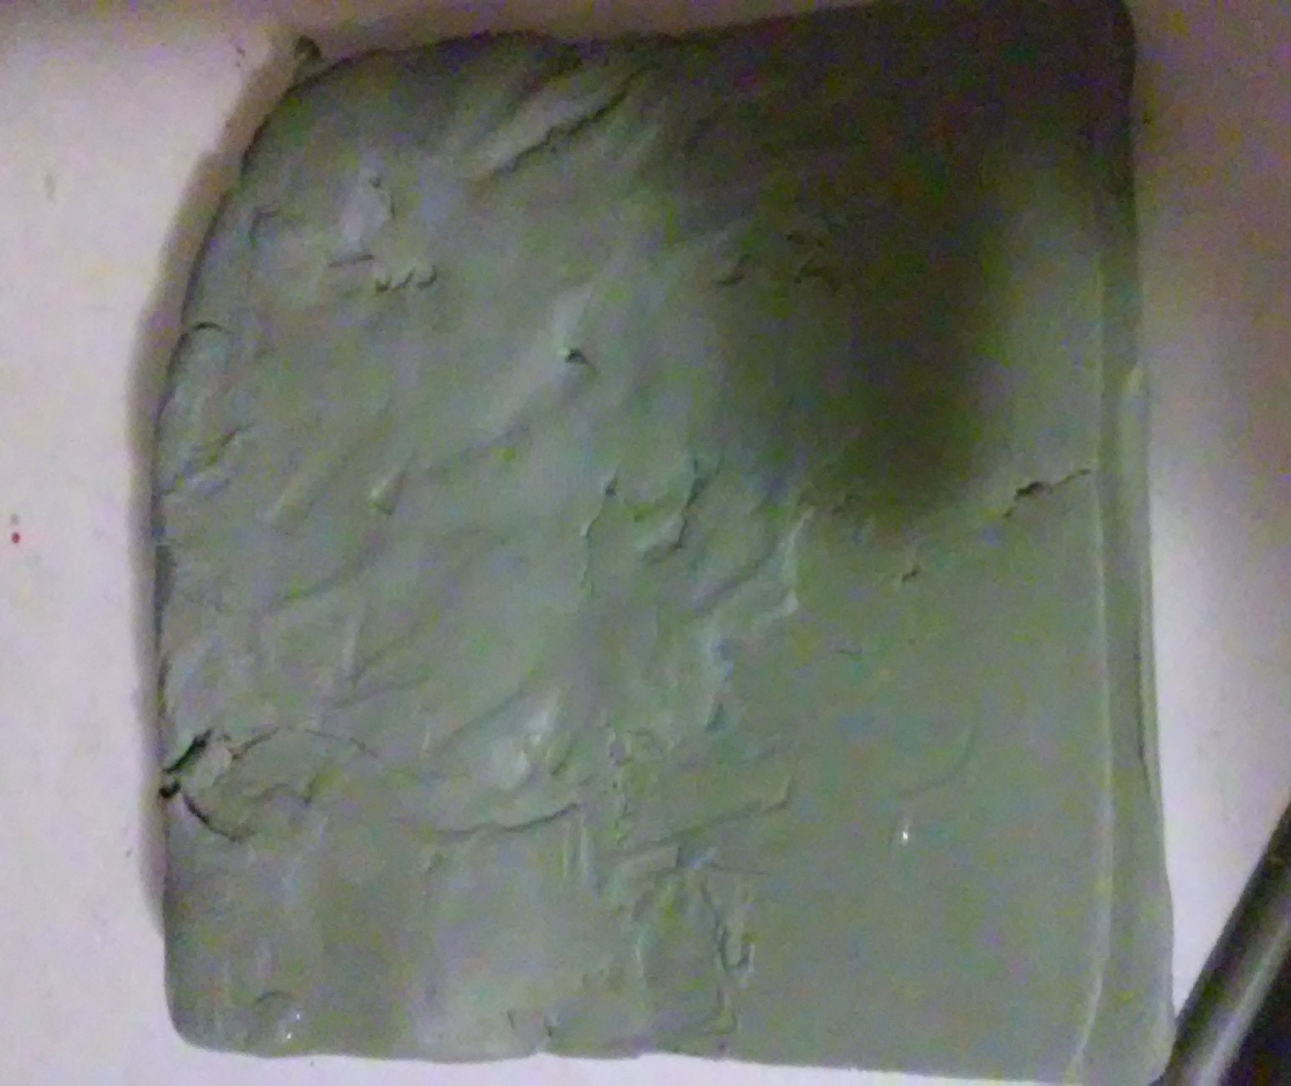
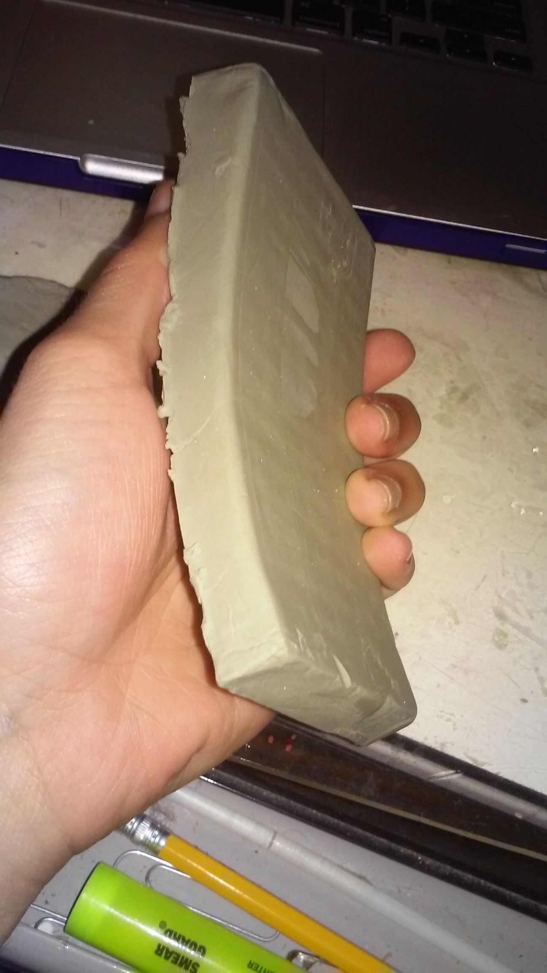
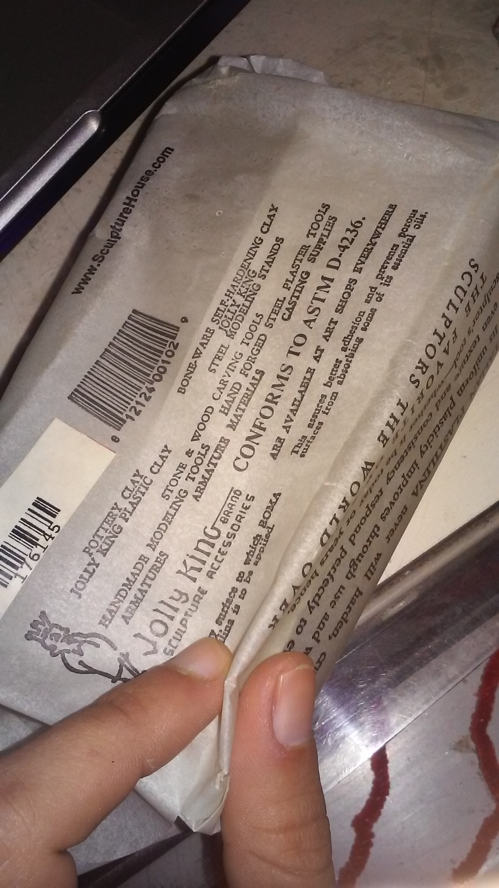
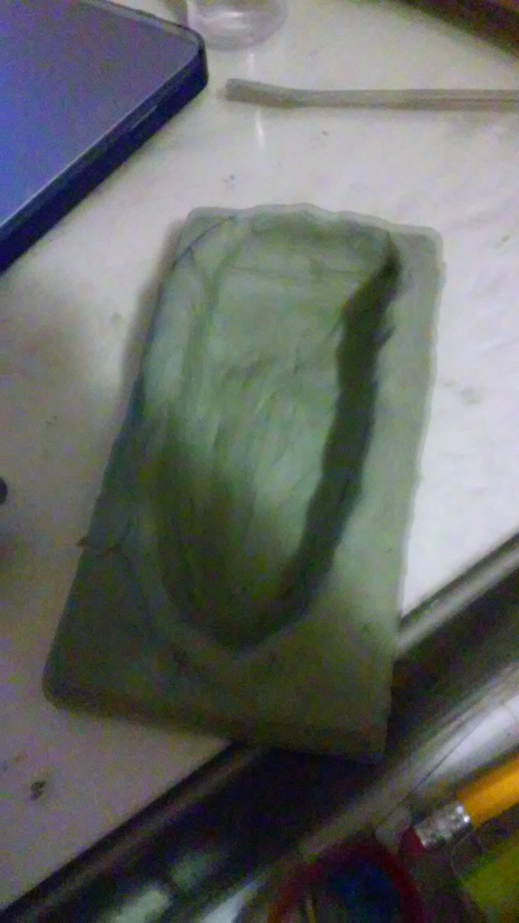
Materials

Slide 5
Process
Prosthetic makeup:
the process of using prosthetic sculpting, molding and casting techniques to create cosmetic effects.

Slide 6
In the end…
I want evoke consequence through visual representation (photo series). This ties in with my paper because in the Christian religion (especially back then) if you sinned you were to be punished, there are consequences for sin.
Also, I would like to throw in a Little Mermaid aspect as well.

