Slide 1
Bridge #2: Walk
Komal Vij and Tamara Rasamny
East 92nd St. and 5th Avenue → Union Square
West 92nd St. and Broadway → Union Square

Slide 2
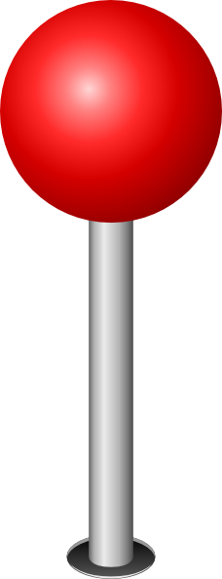
Cooper Hewitt Museum

Slide 3
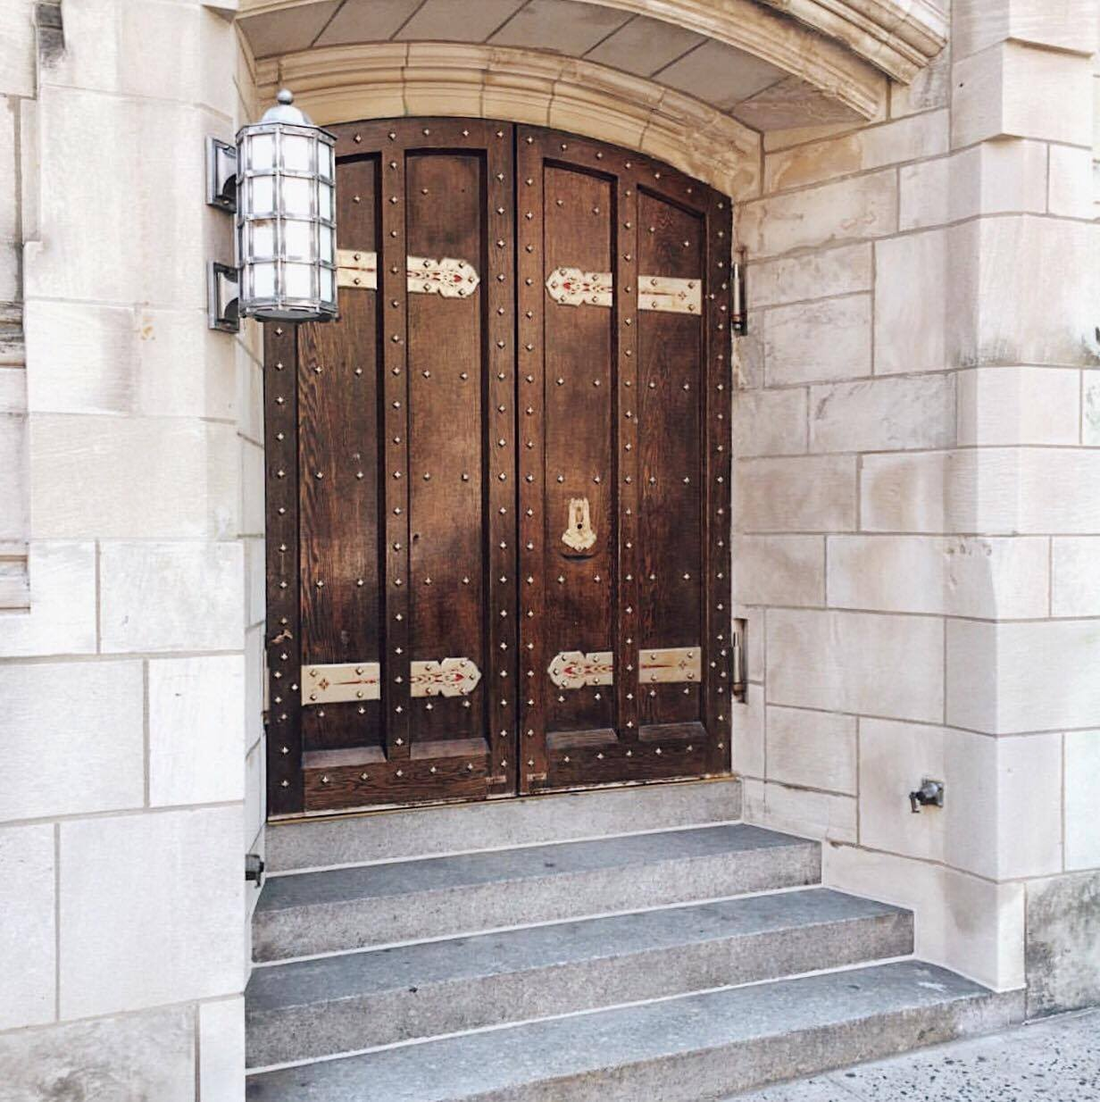
Church of the Heavenly Rest

Slide 4
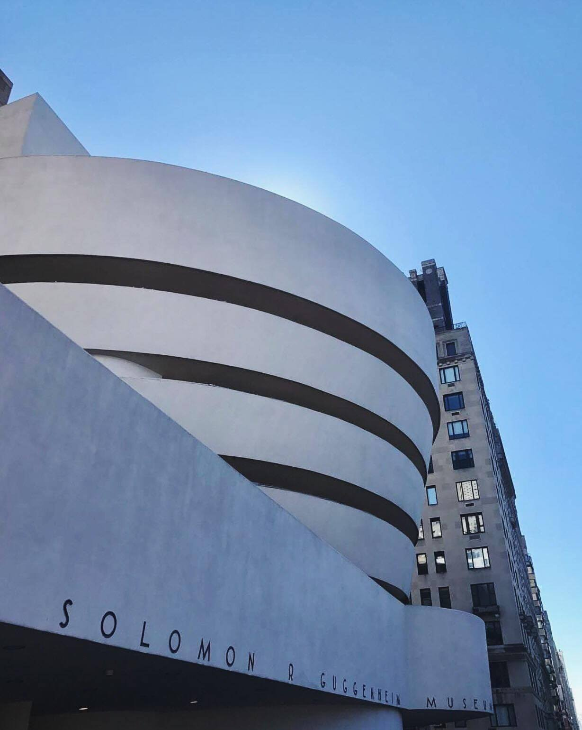
Guggenheim Museum

Slide 5
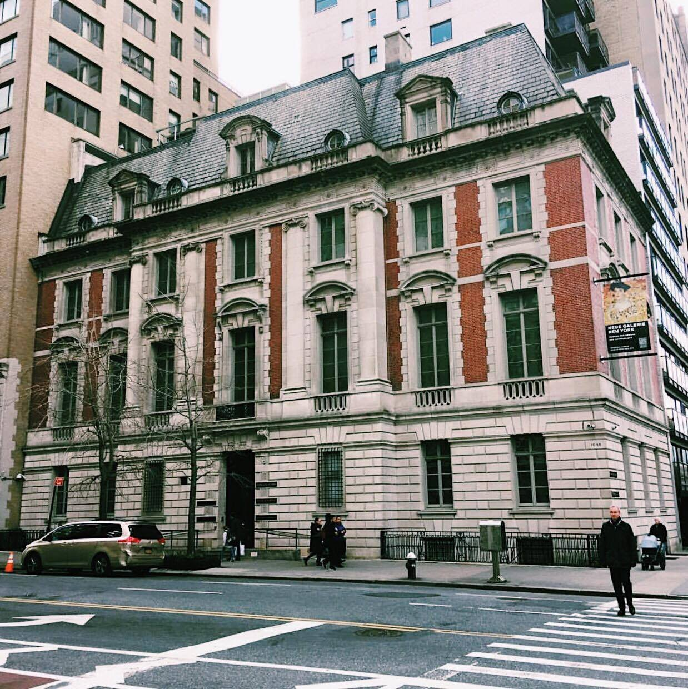
Neue Gallery

Slide 6
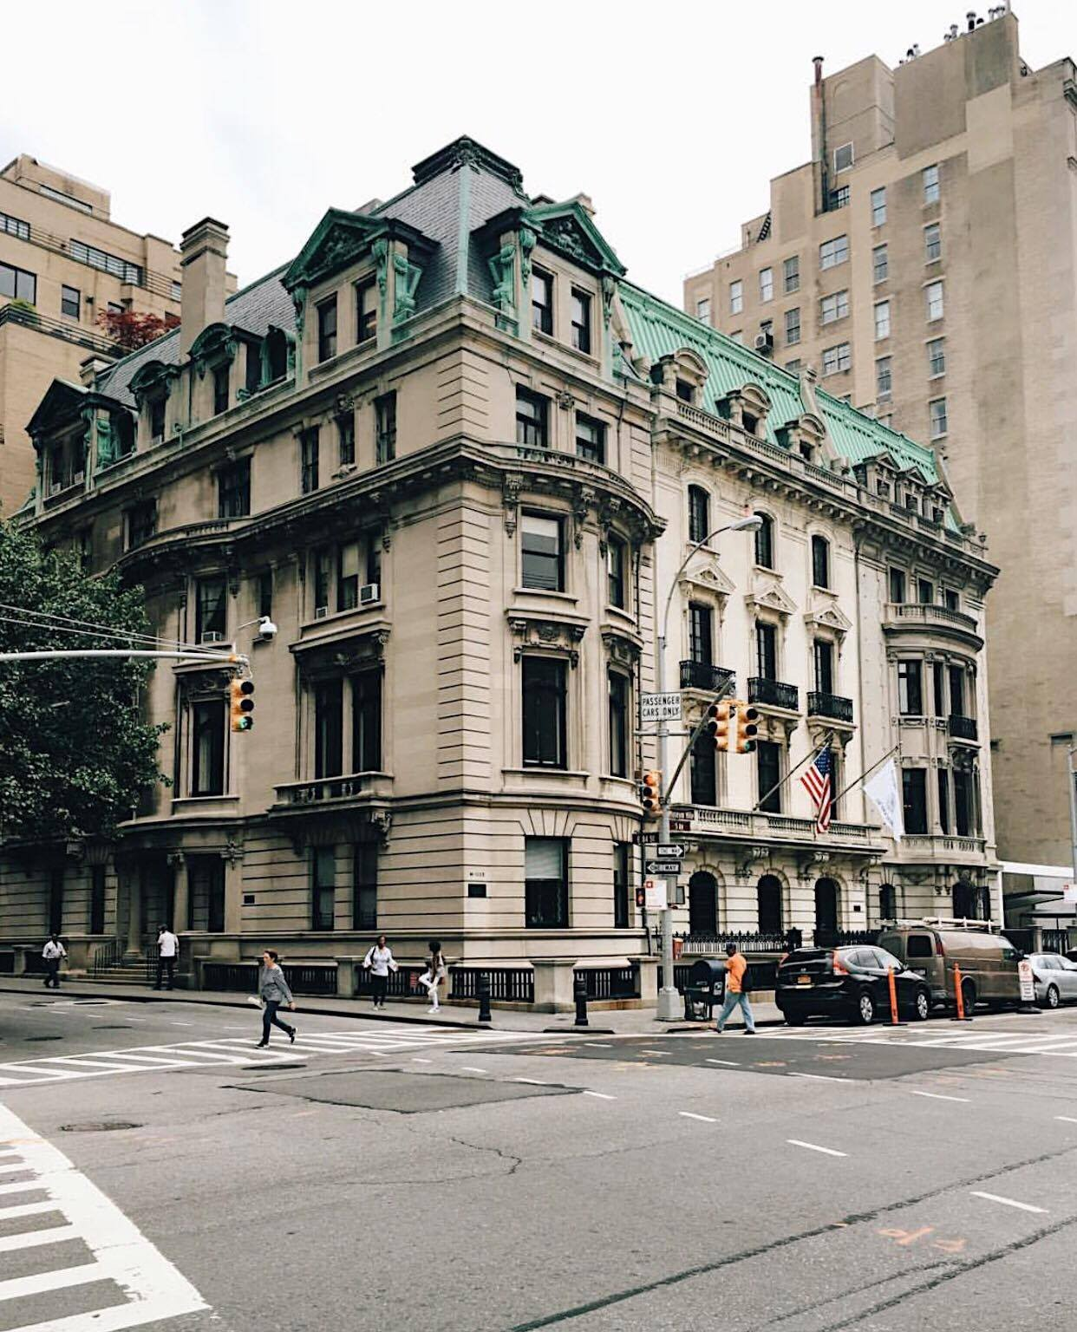
Marymount School of New York

Slide 7
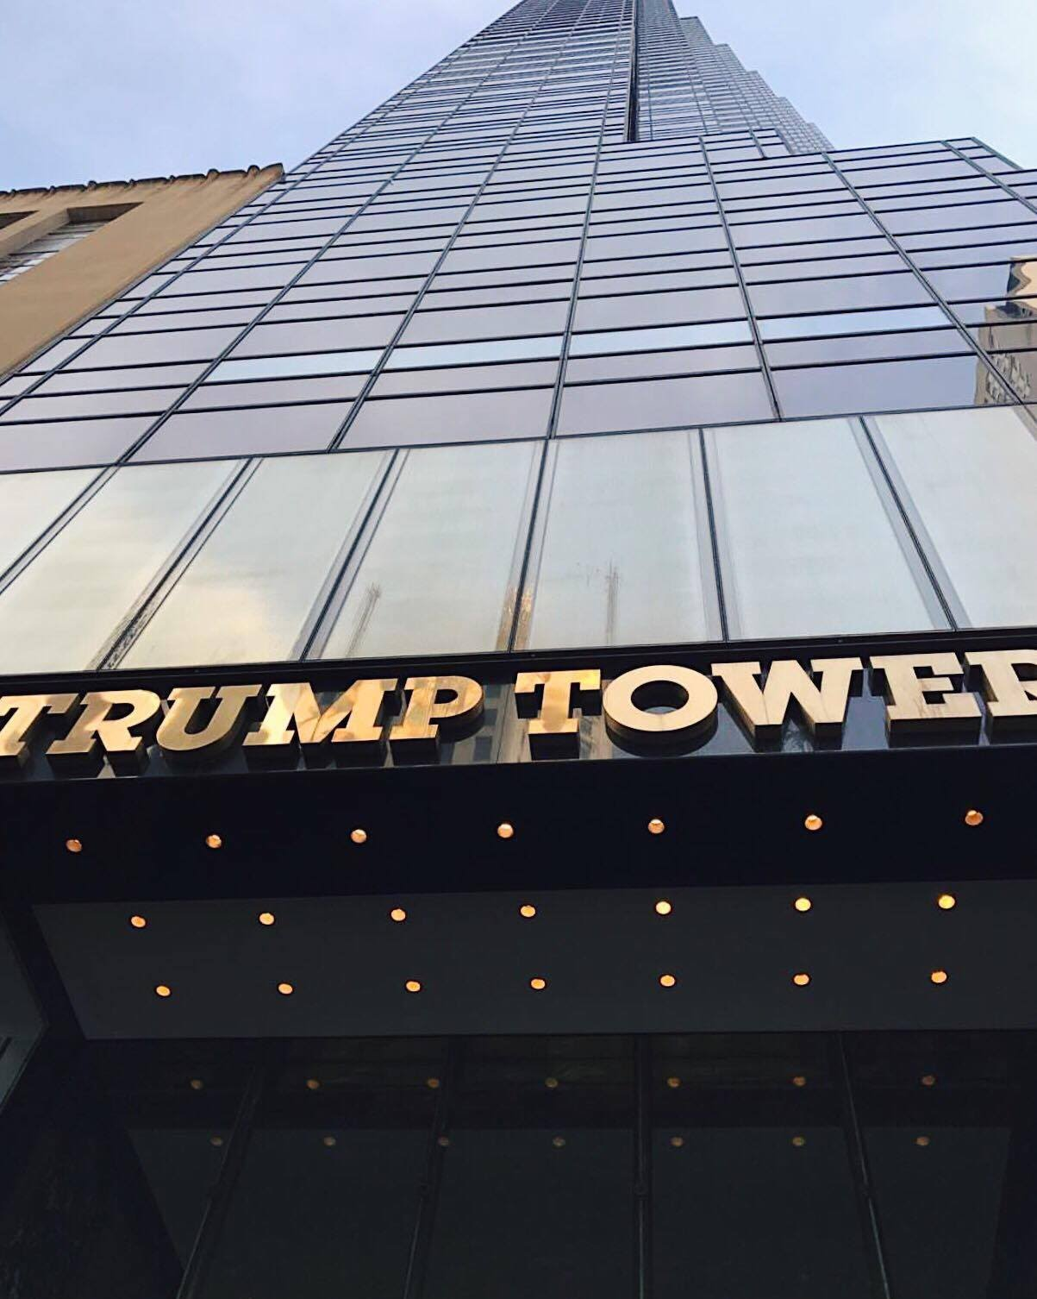
Trump Tower

Slide 8
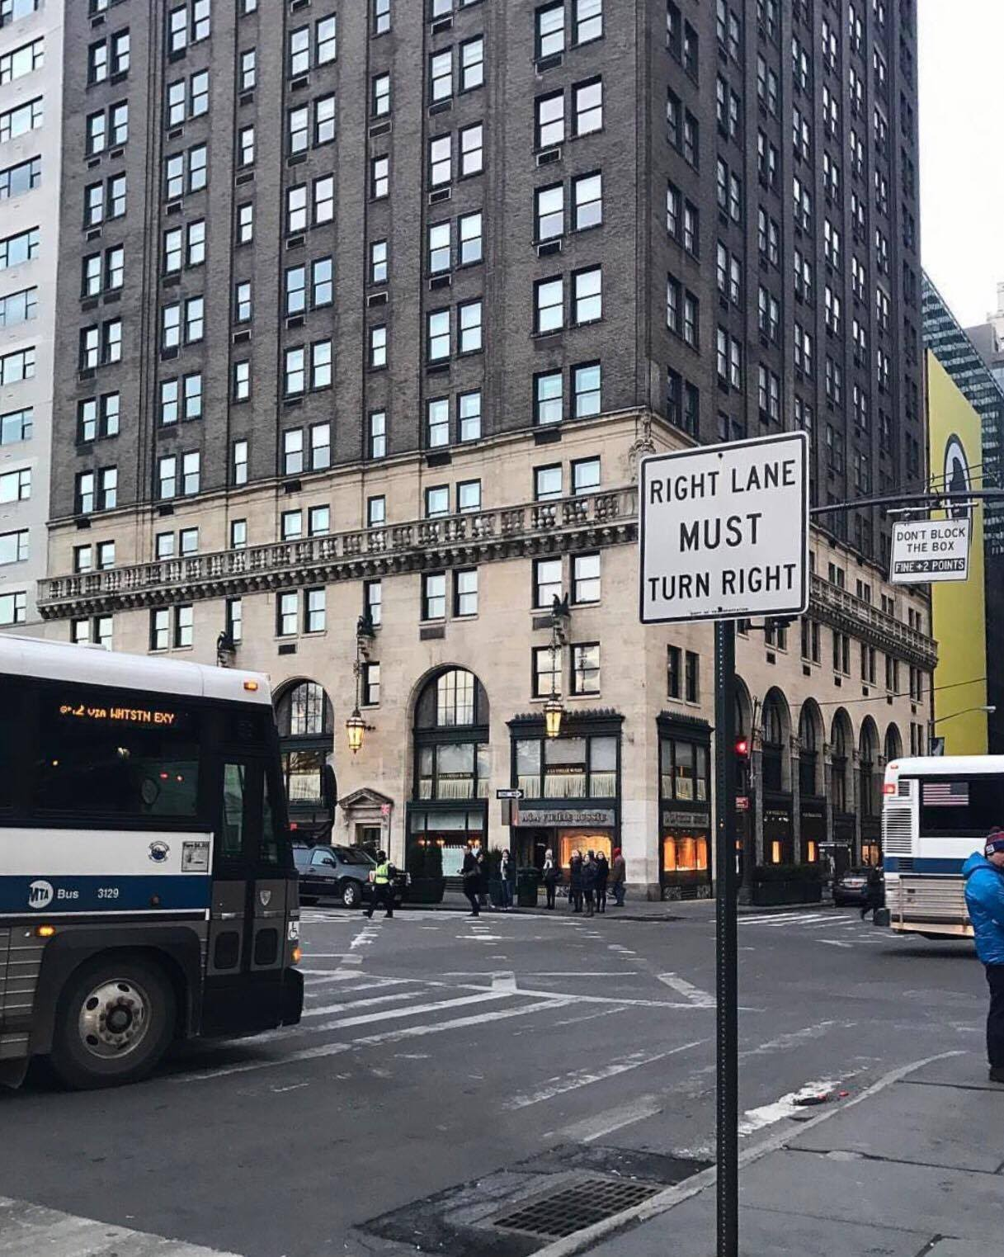
Bergdorf Goodman

Slide 9
Flatiron Building

Slide 10
Dante Park

Slide 11
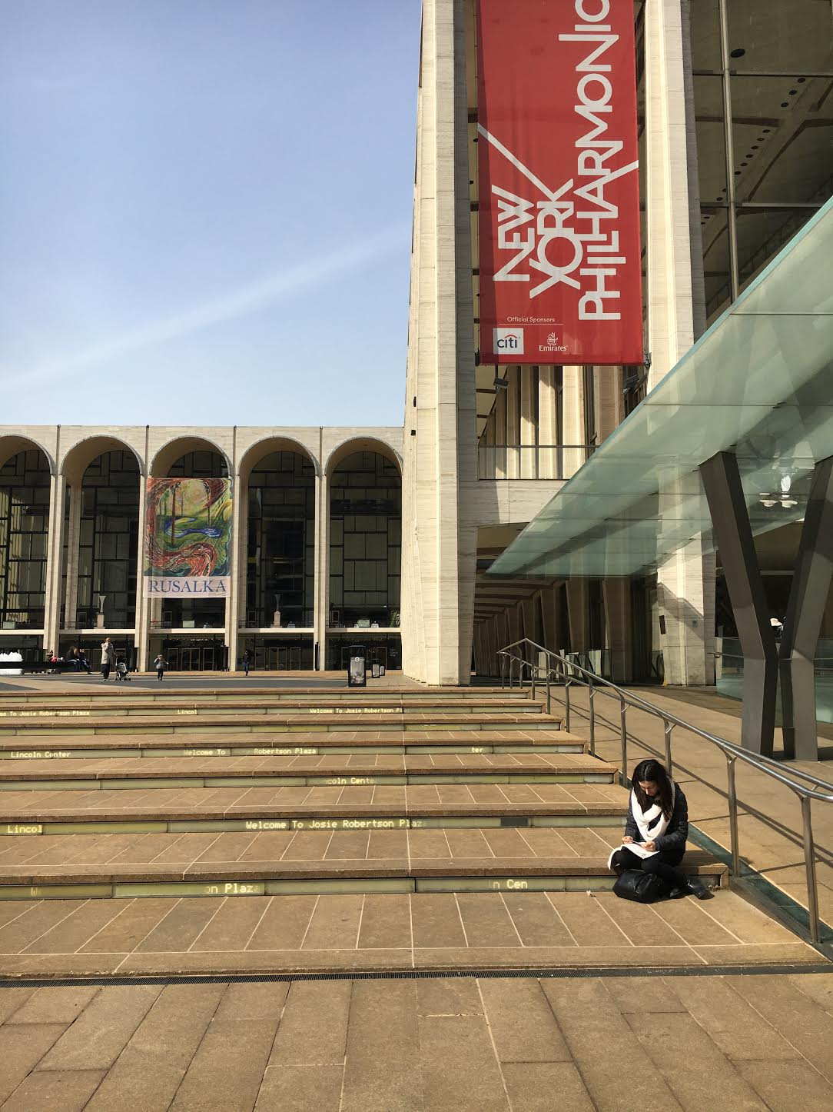
Lincoln Center

Slide 12
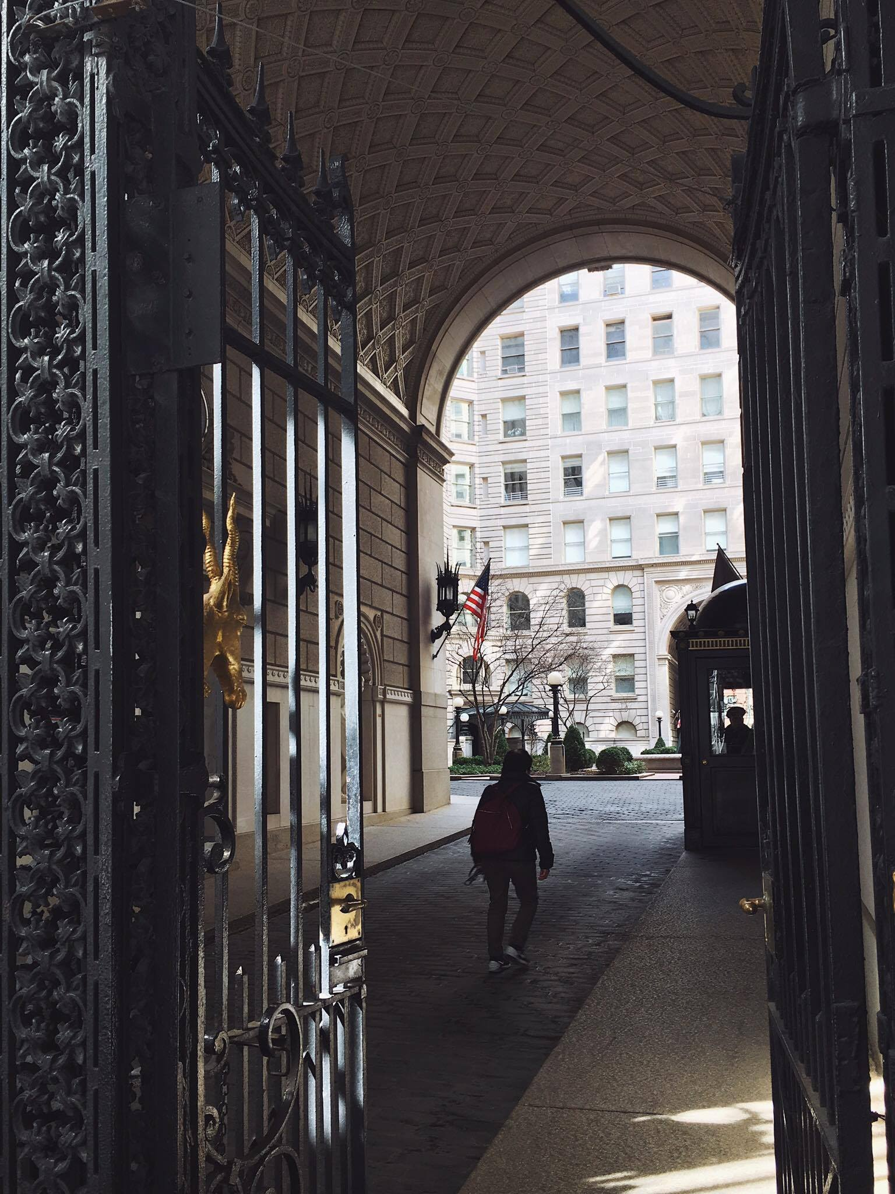
The Apthorp

Slide 13
Times Square

Slide 14
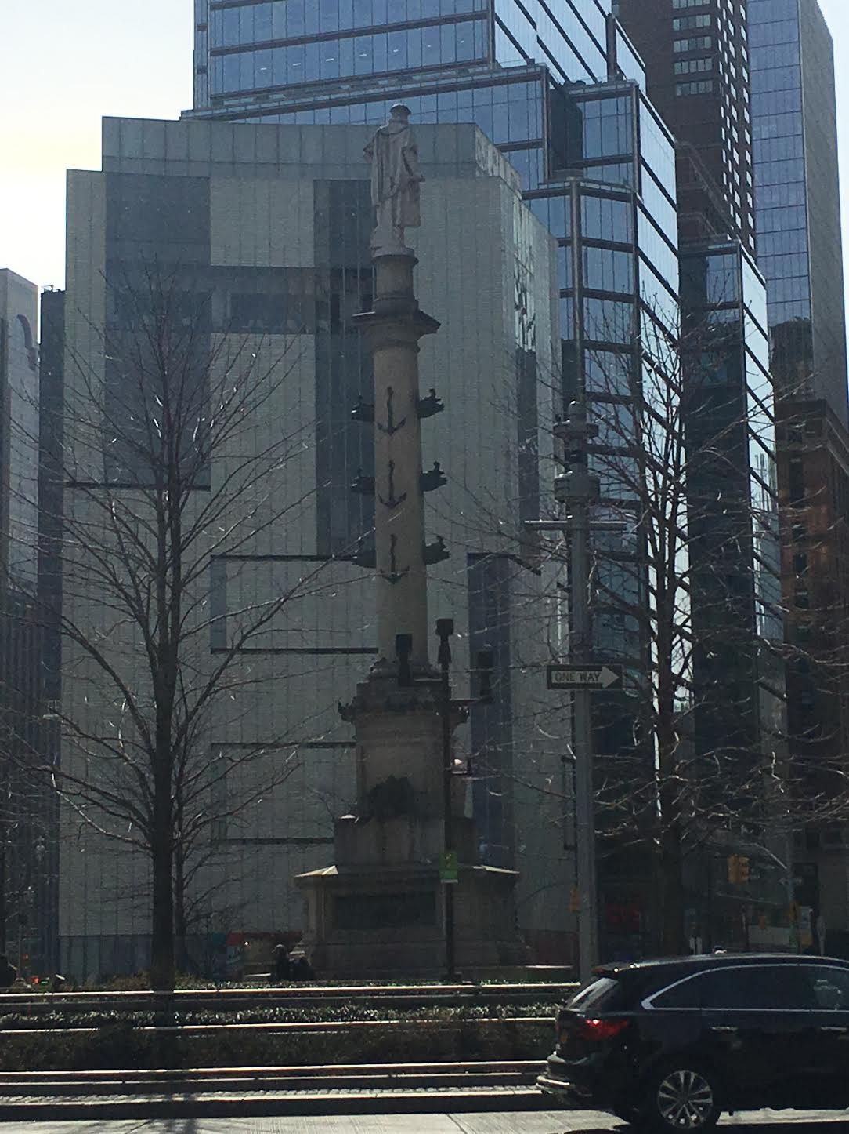
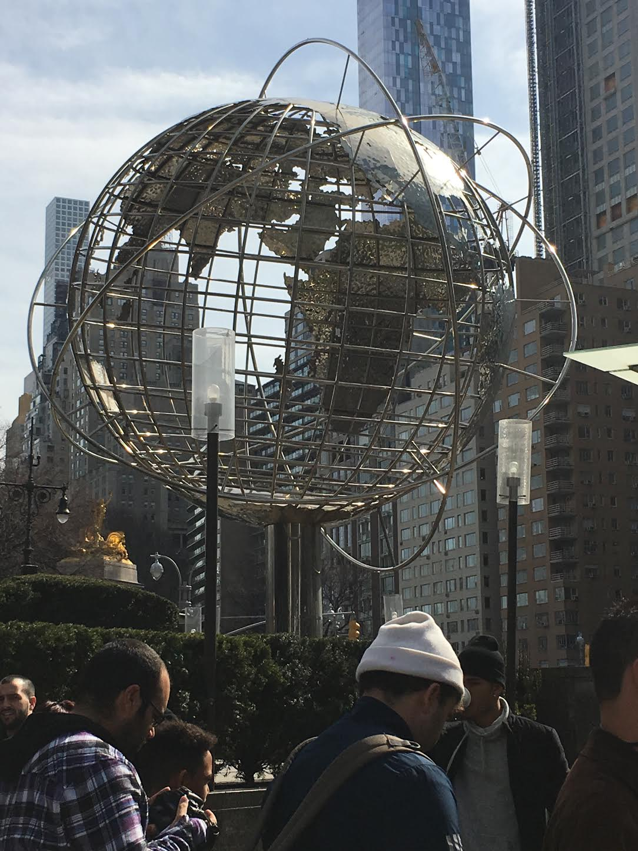
Columbus Circle

Slide 15
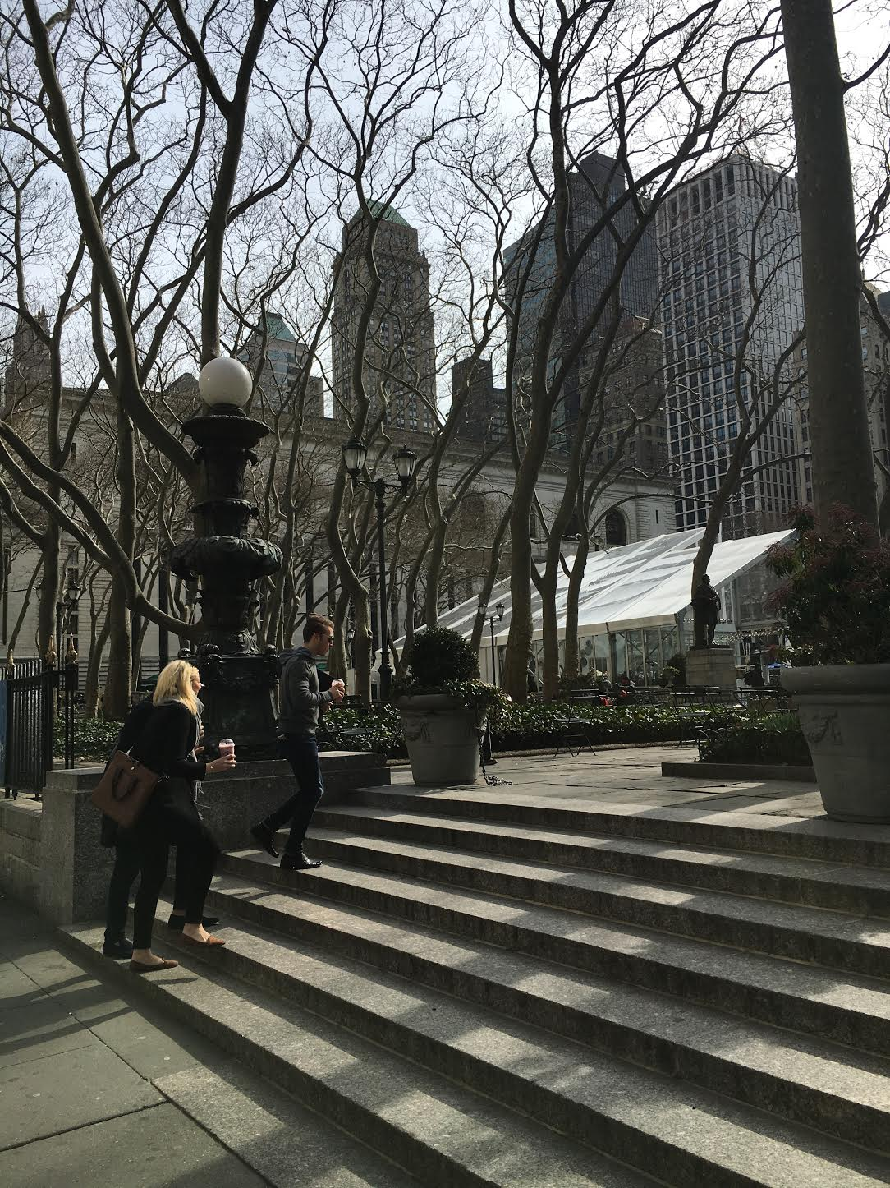
Bryant Park

Slide 16
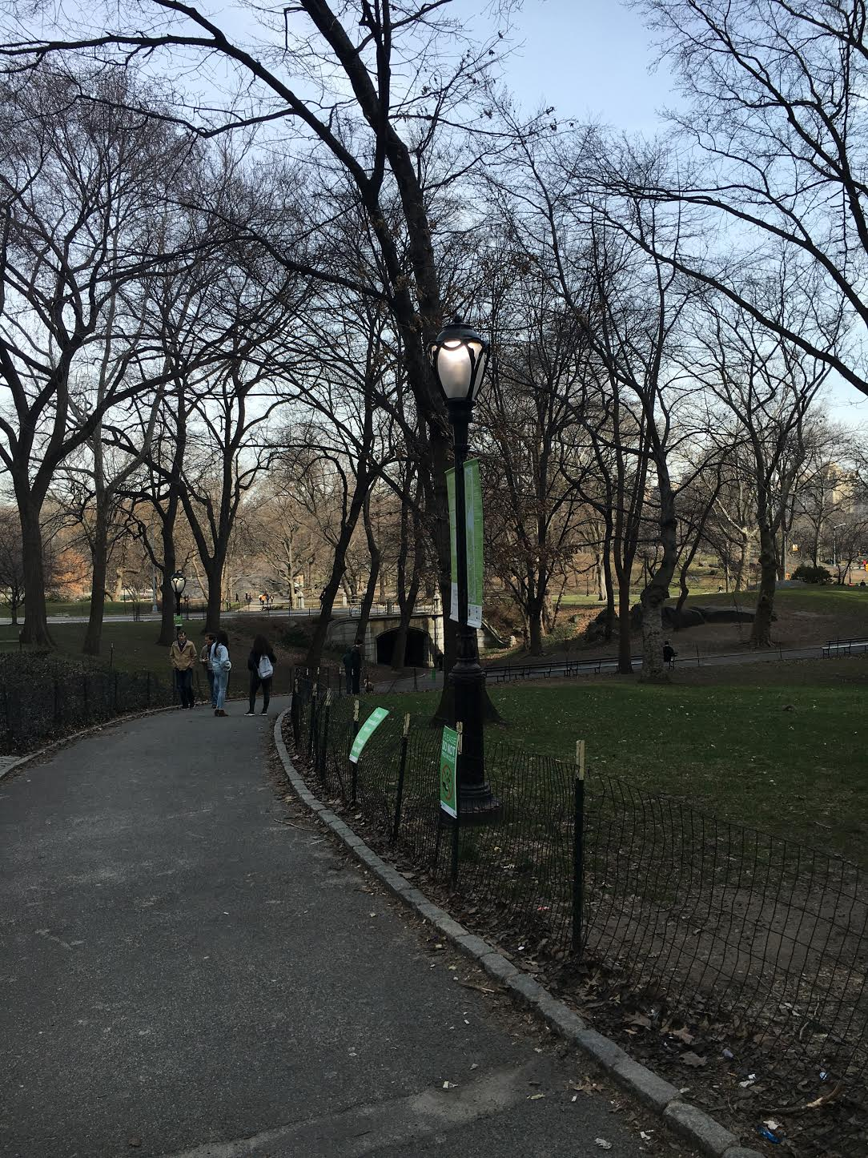
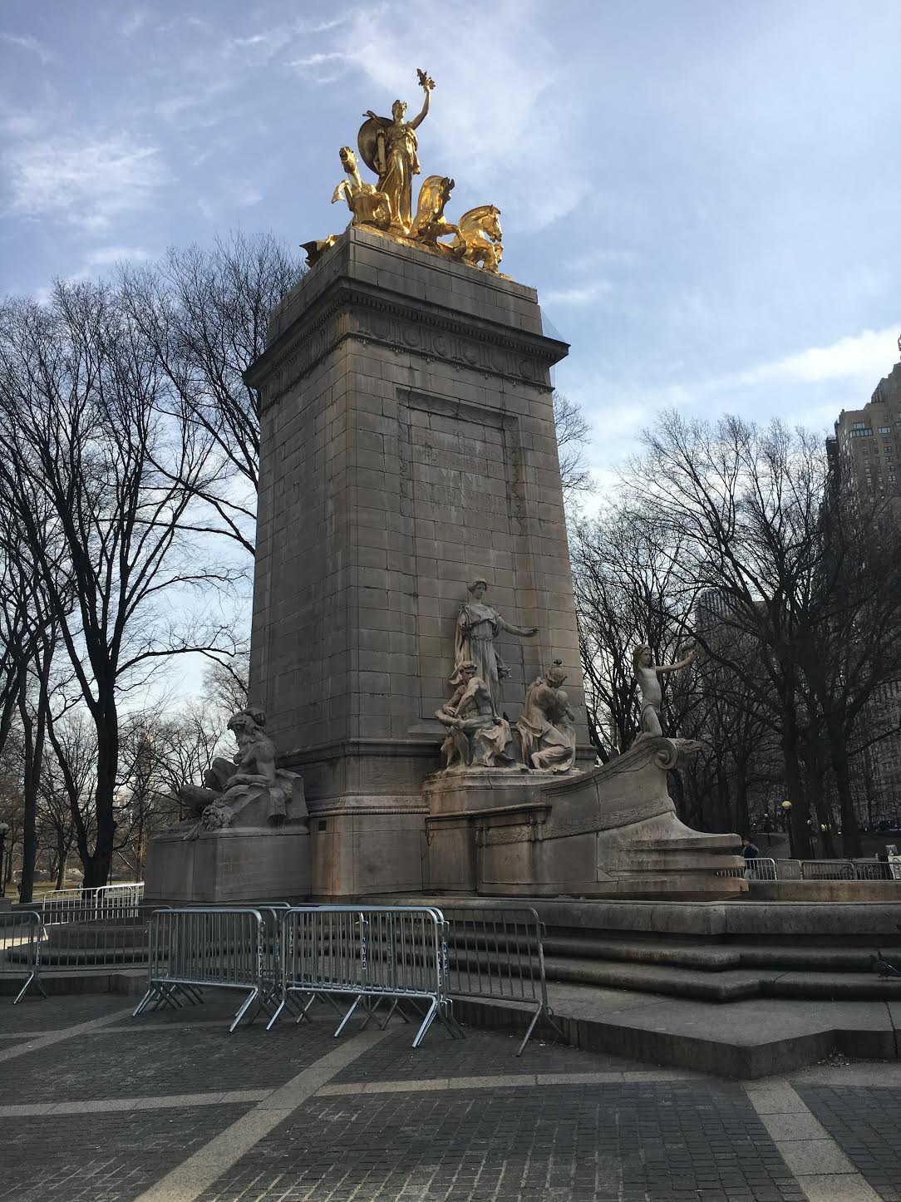
Central Park

Slide 17
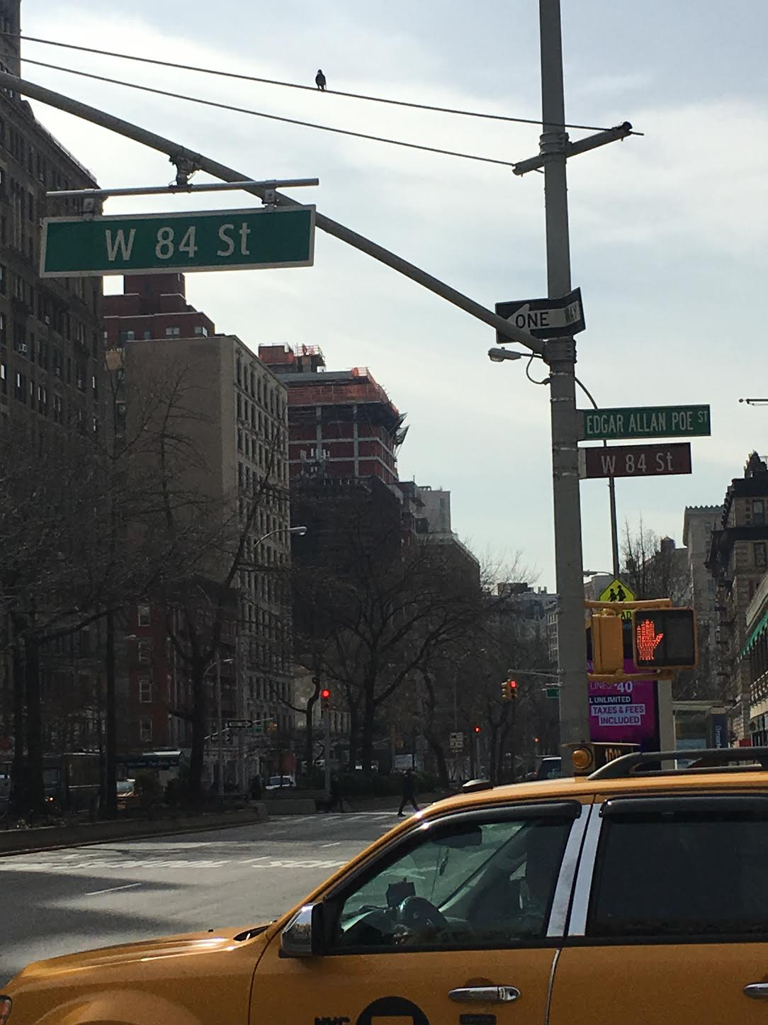
Edgar Allan Poe St.

Slide 18
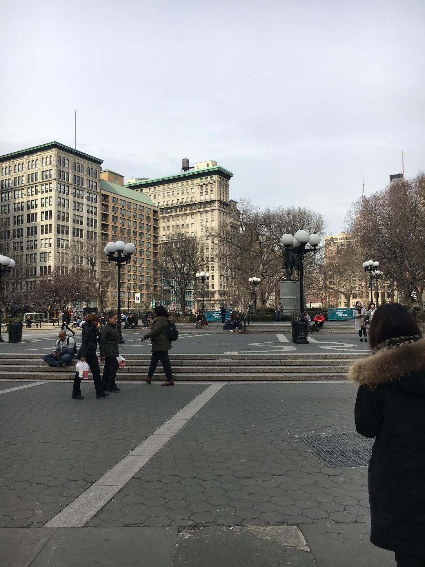
Union Square

