Slide 1
Bridge 4 New Monuments
Vinay Solipuram and Hana Lanzkowsky

Slide 2
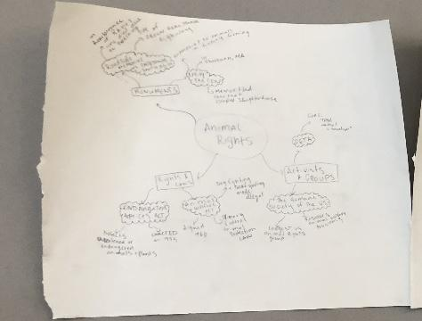
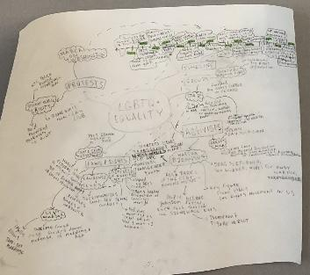
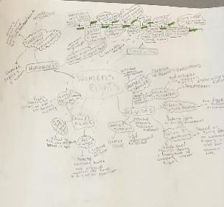
Mind Maps
Notes:
Hana
Mind Maps:
For our mind maps we had 3 ideas
LGBT rights
Women's rights
And animal rights
Each of these meant something to us and through our mind maps we researched:
Activists
Protests
History
And groups
We felt that these things were most important to any topic and would lead to a monument
Although we felt strongly about each topics we felt that for
Animal rights we felt less strong about and had the least amount of research so that's why we didn't end up with that one
With women’s rights we found it was a very researchable topic and didn’t have many monuments but we didn’t have as many ideas about that topic and we didn’t know where to place it
But the one we had the most info on was…

Slide 3
LGBT RIGHTS
Notes:
Hana
We both felt very passionately about this topic and had many ideas so this was the perfect idea

Slide 4
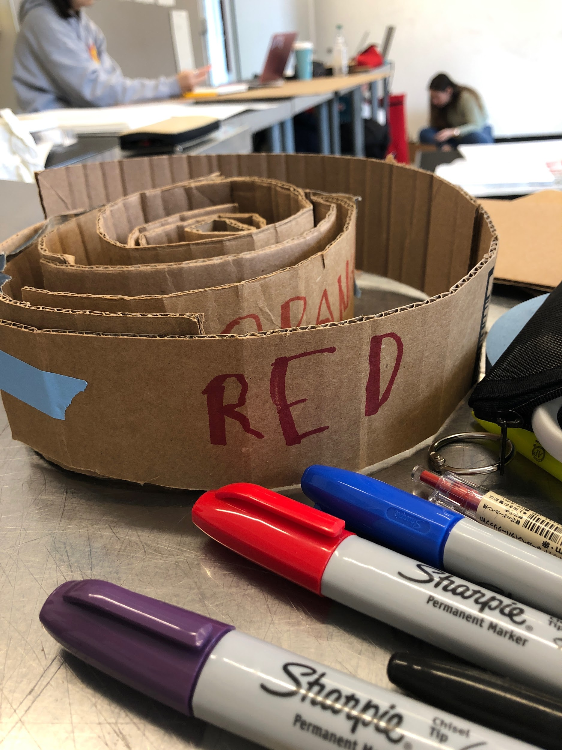
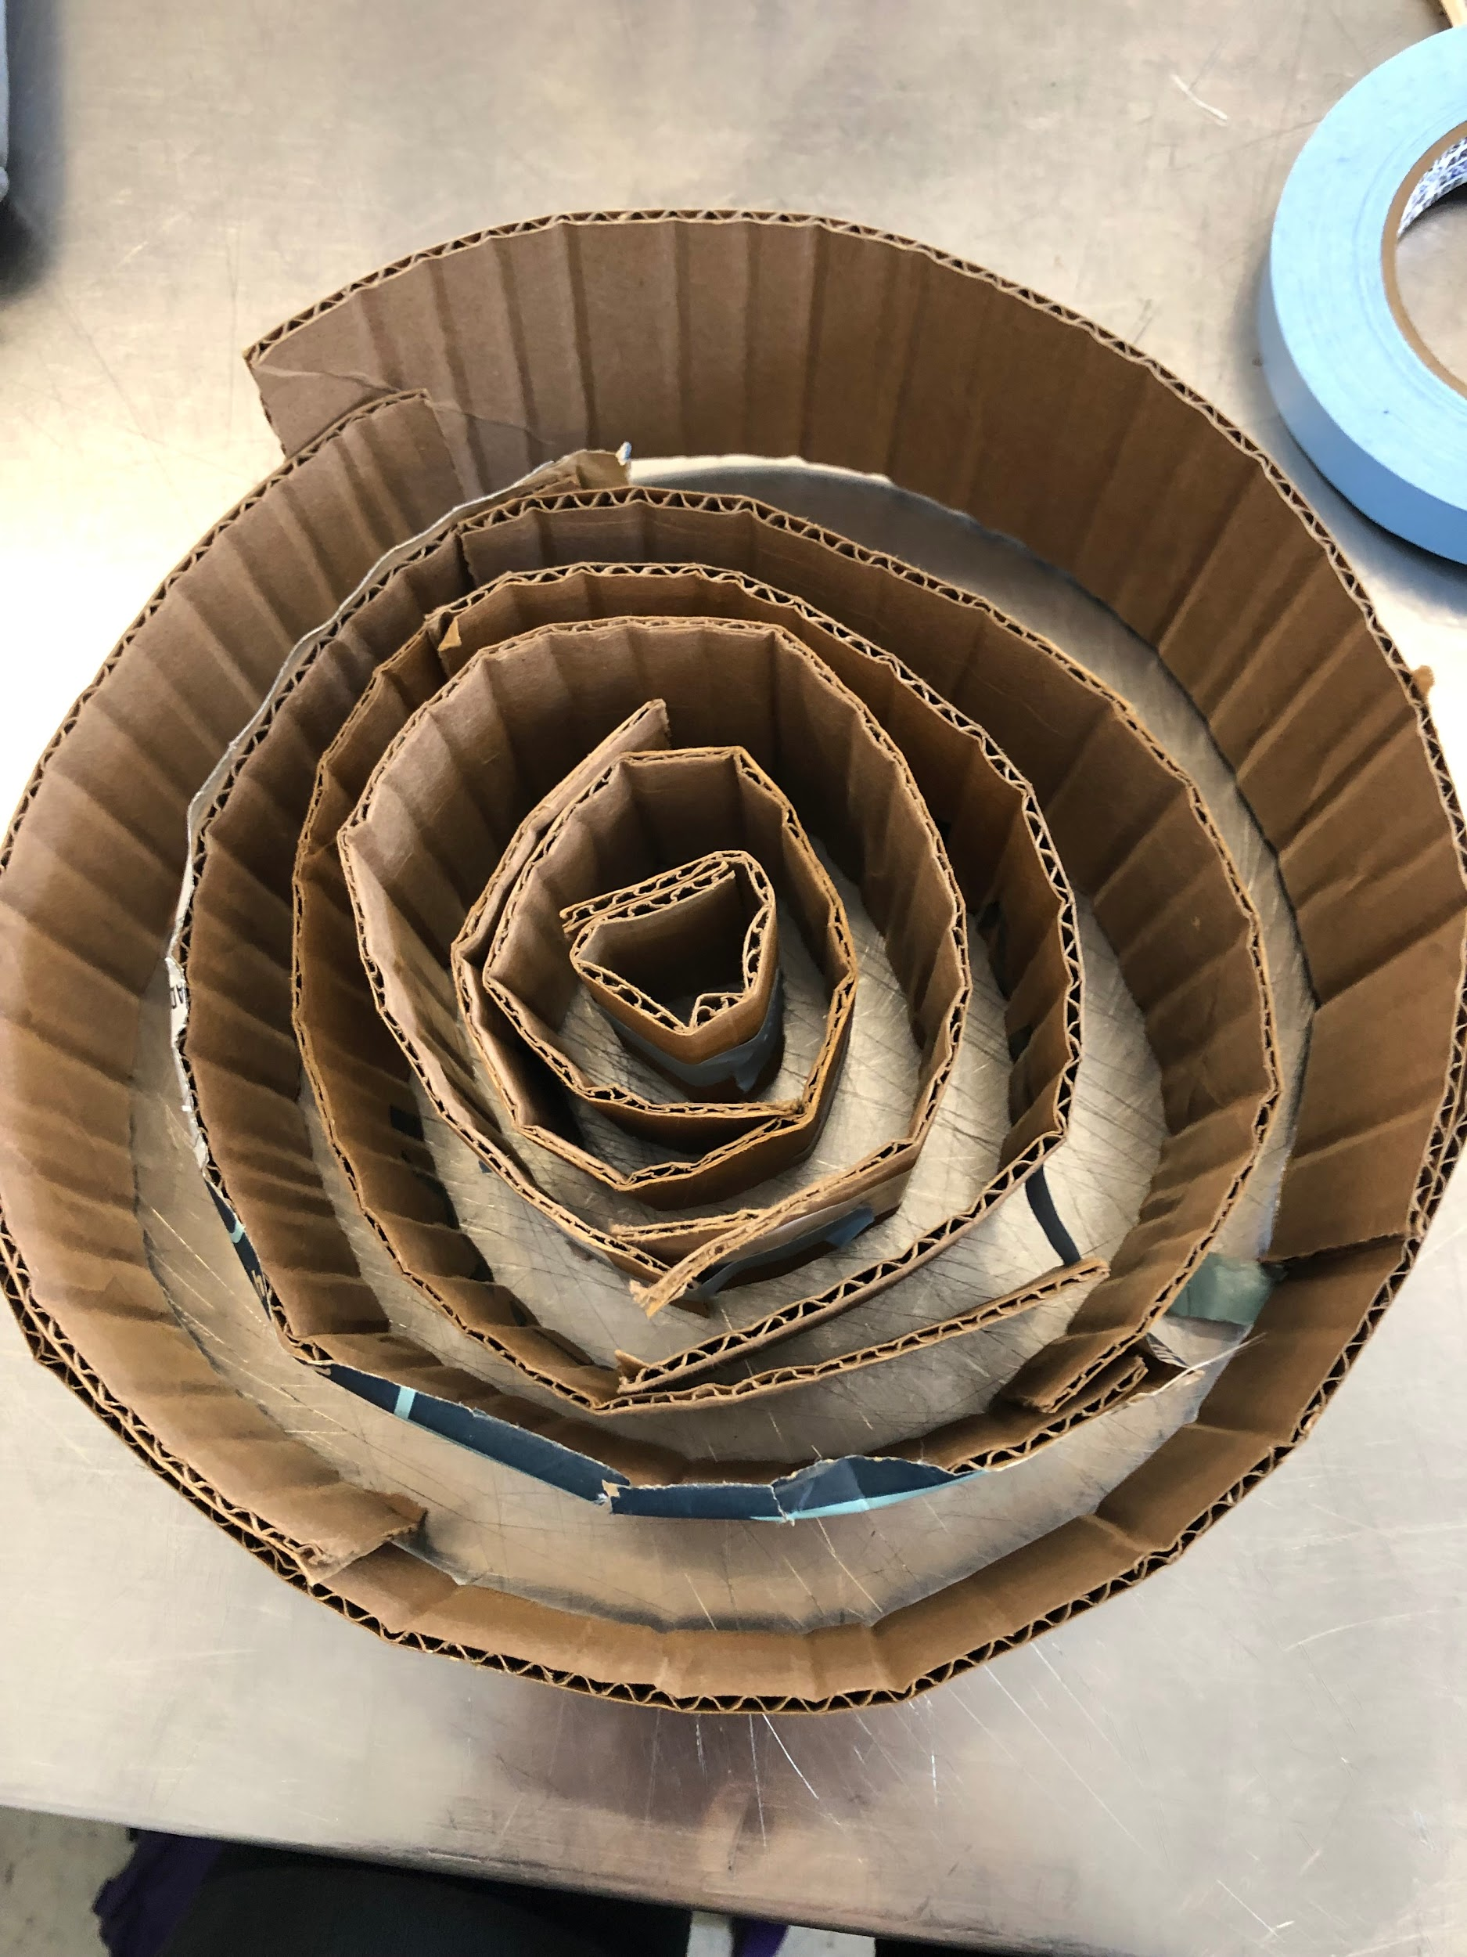
Idea
#1
Notes:
Vinay

Slide 5
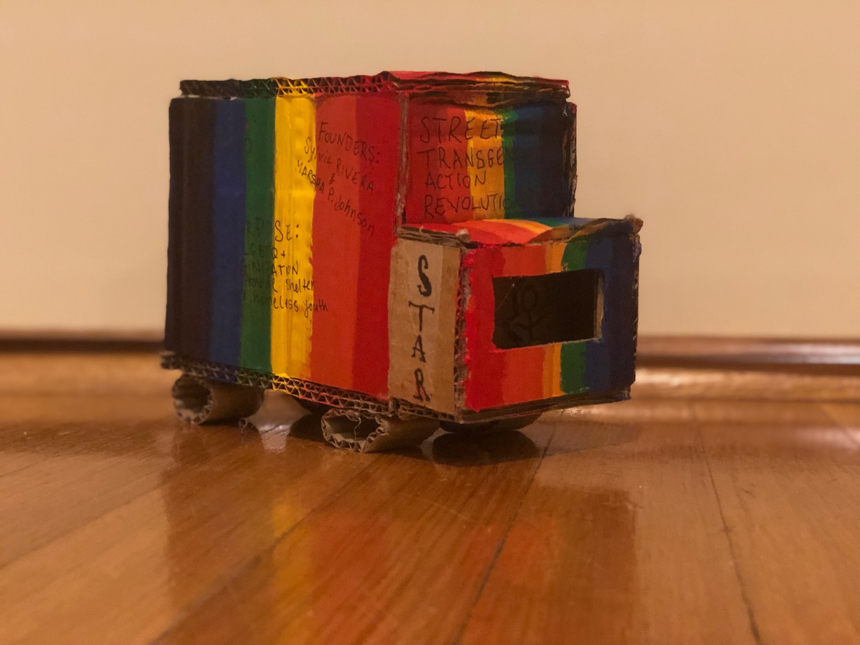
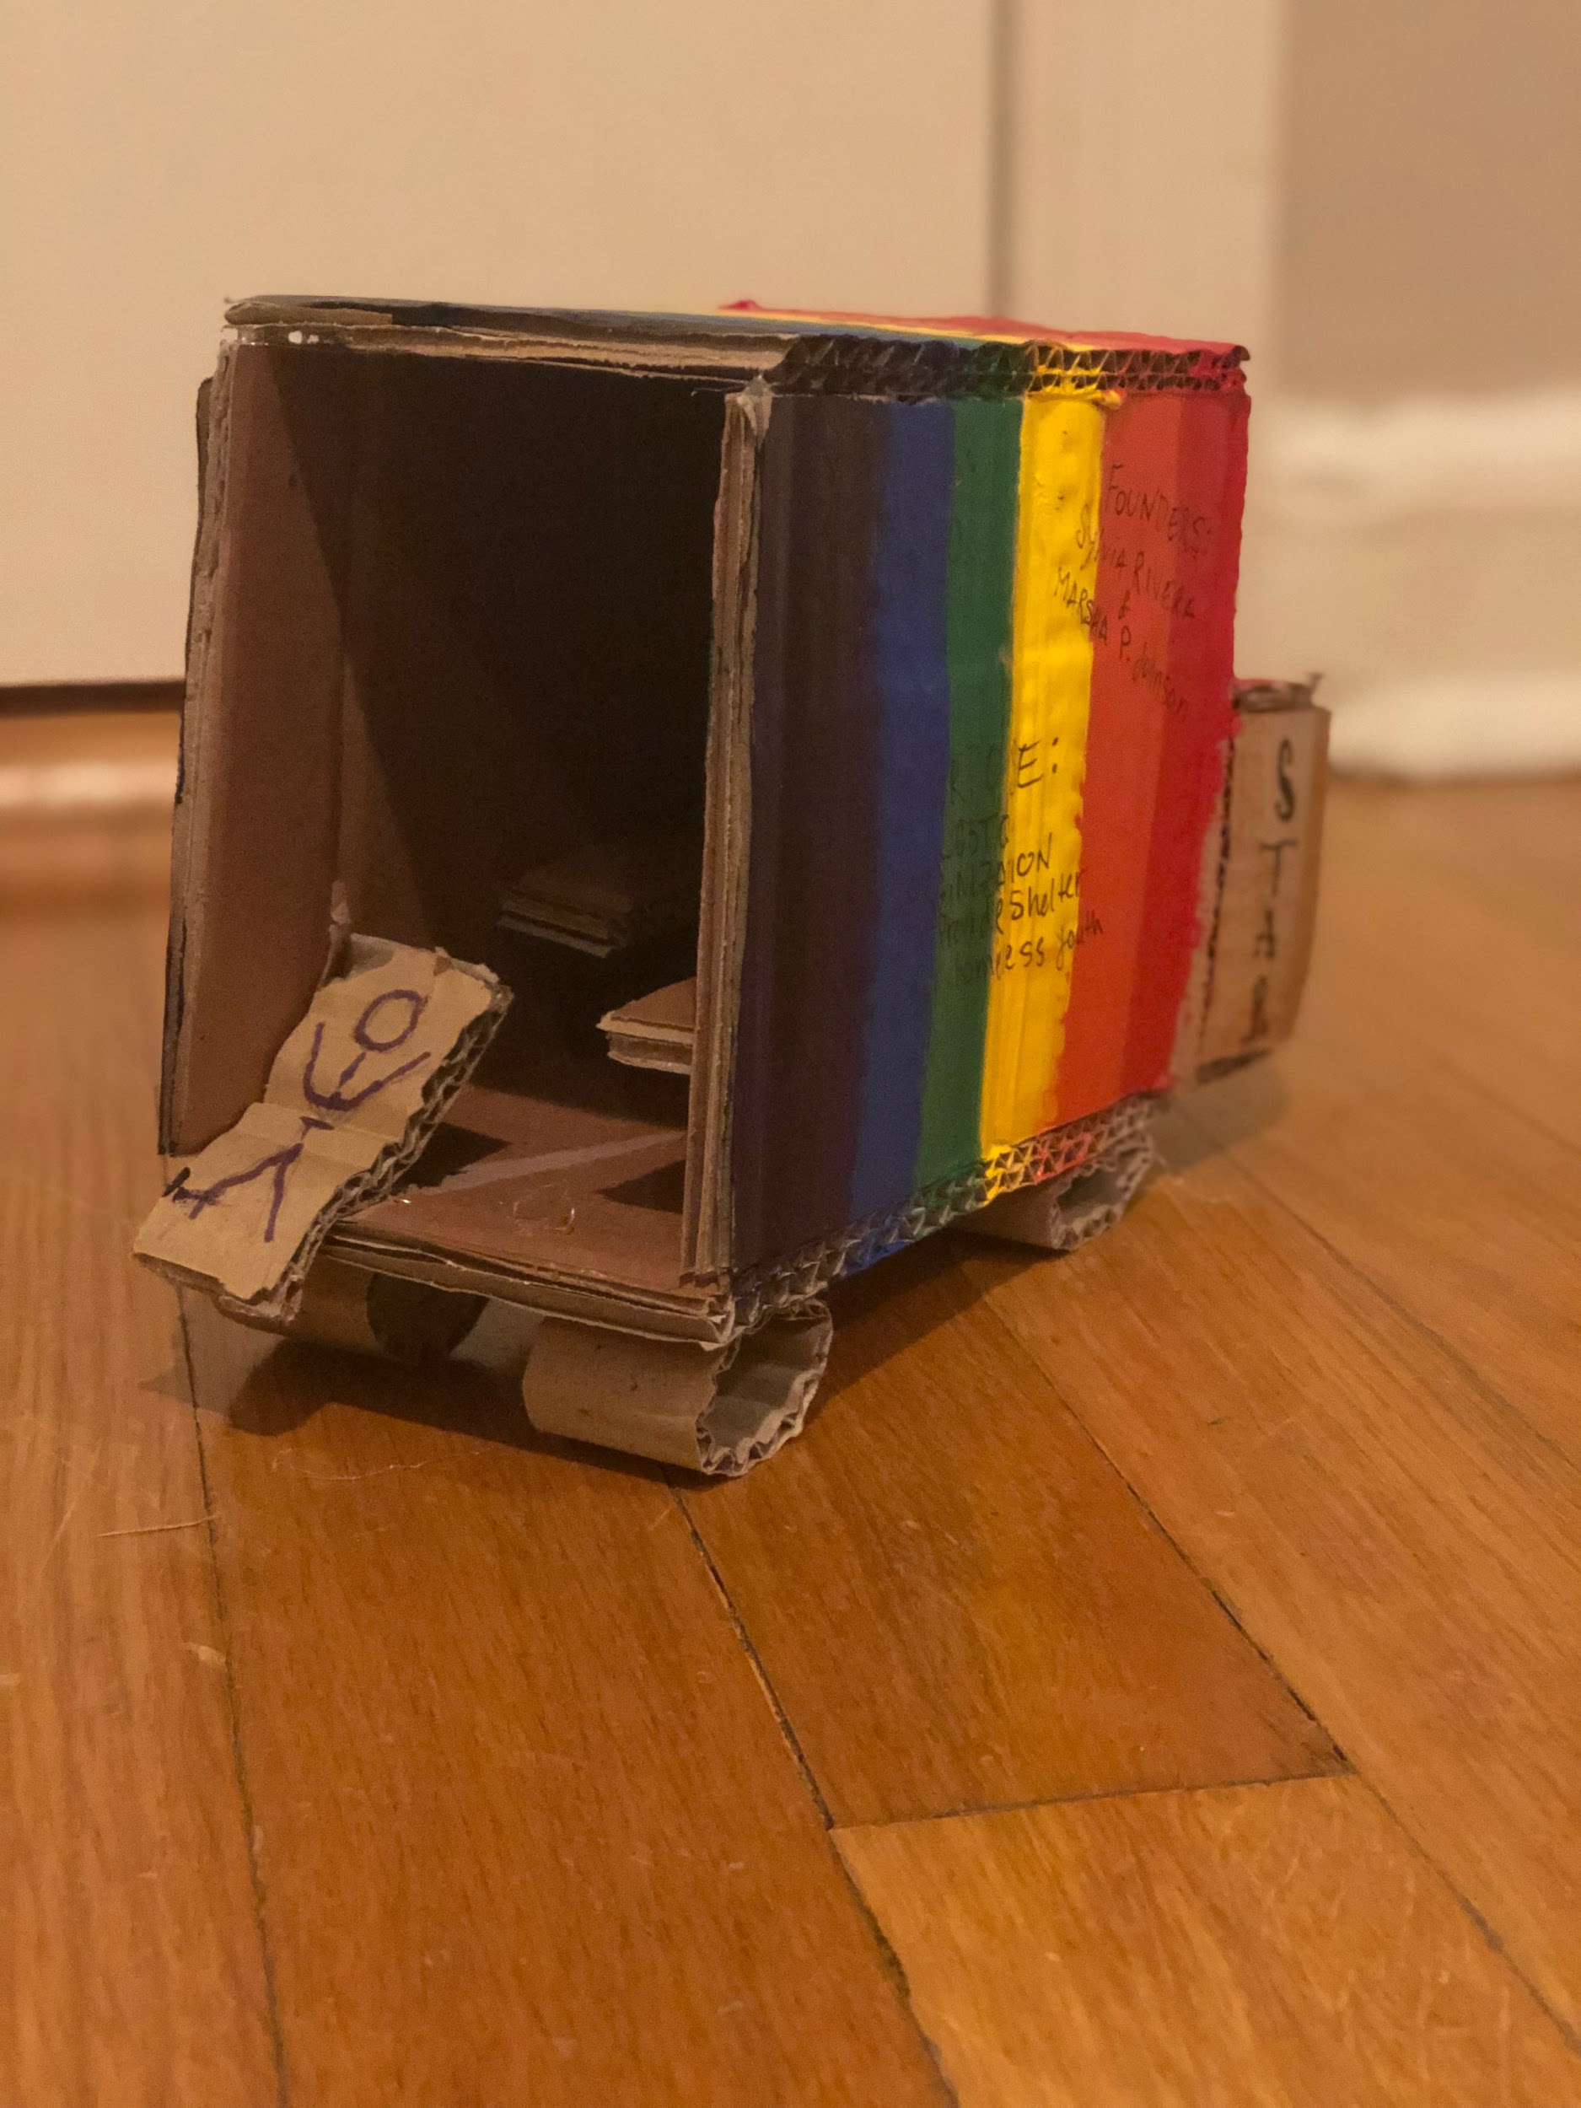
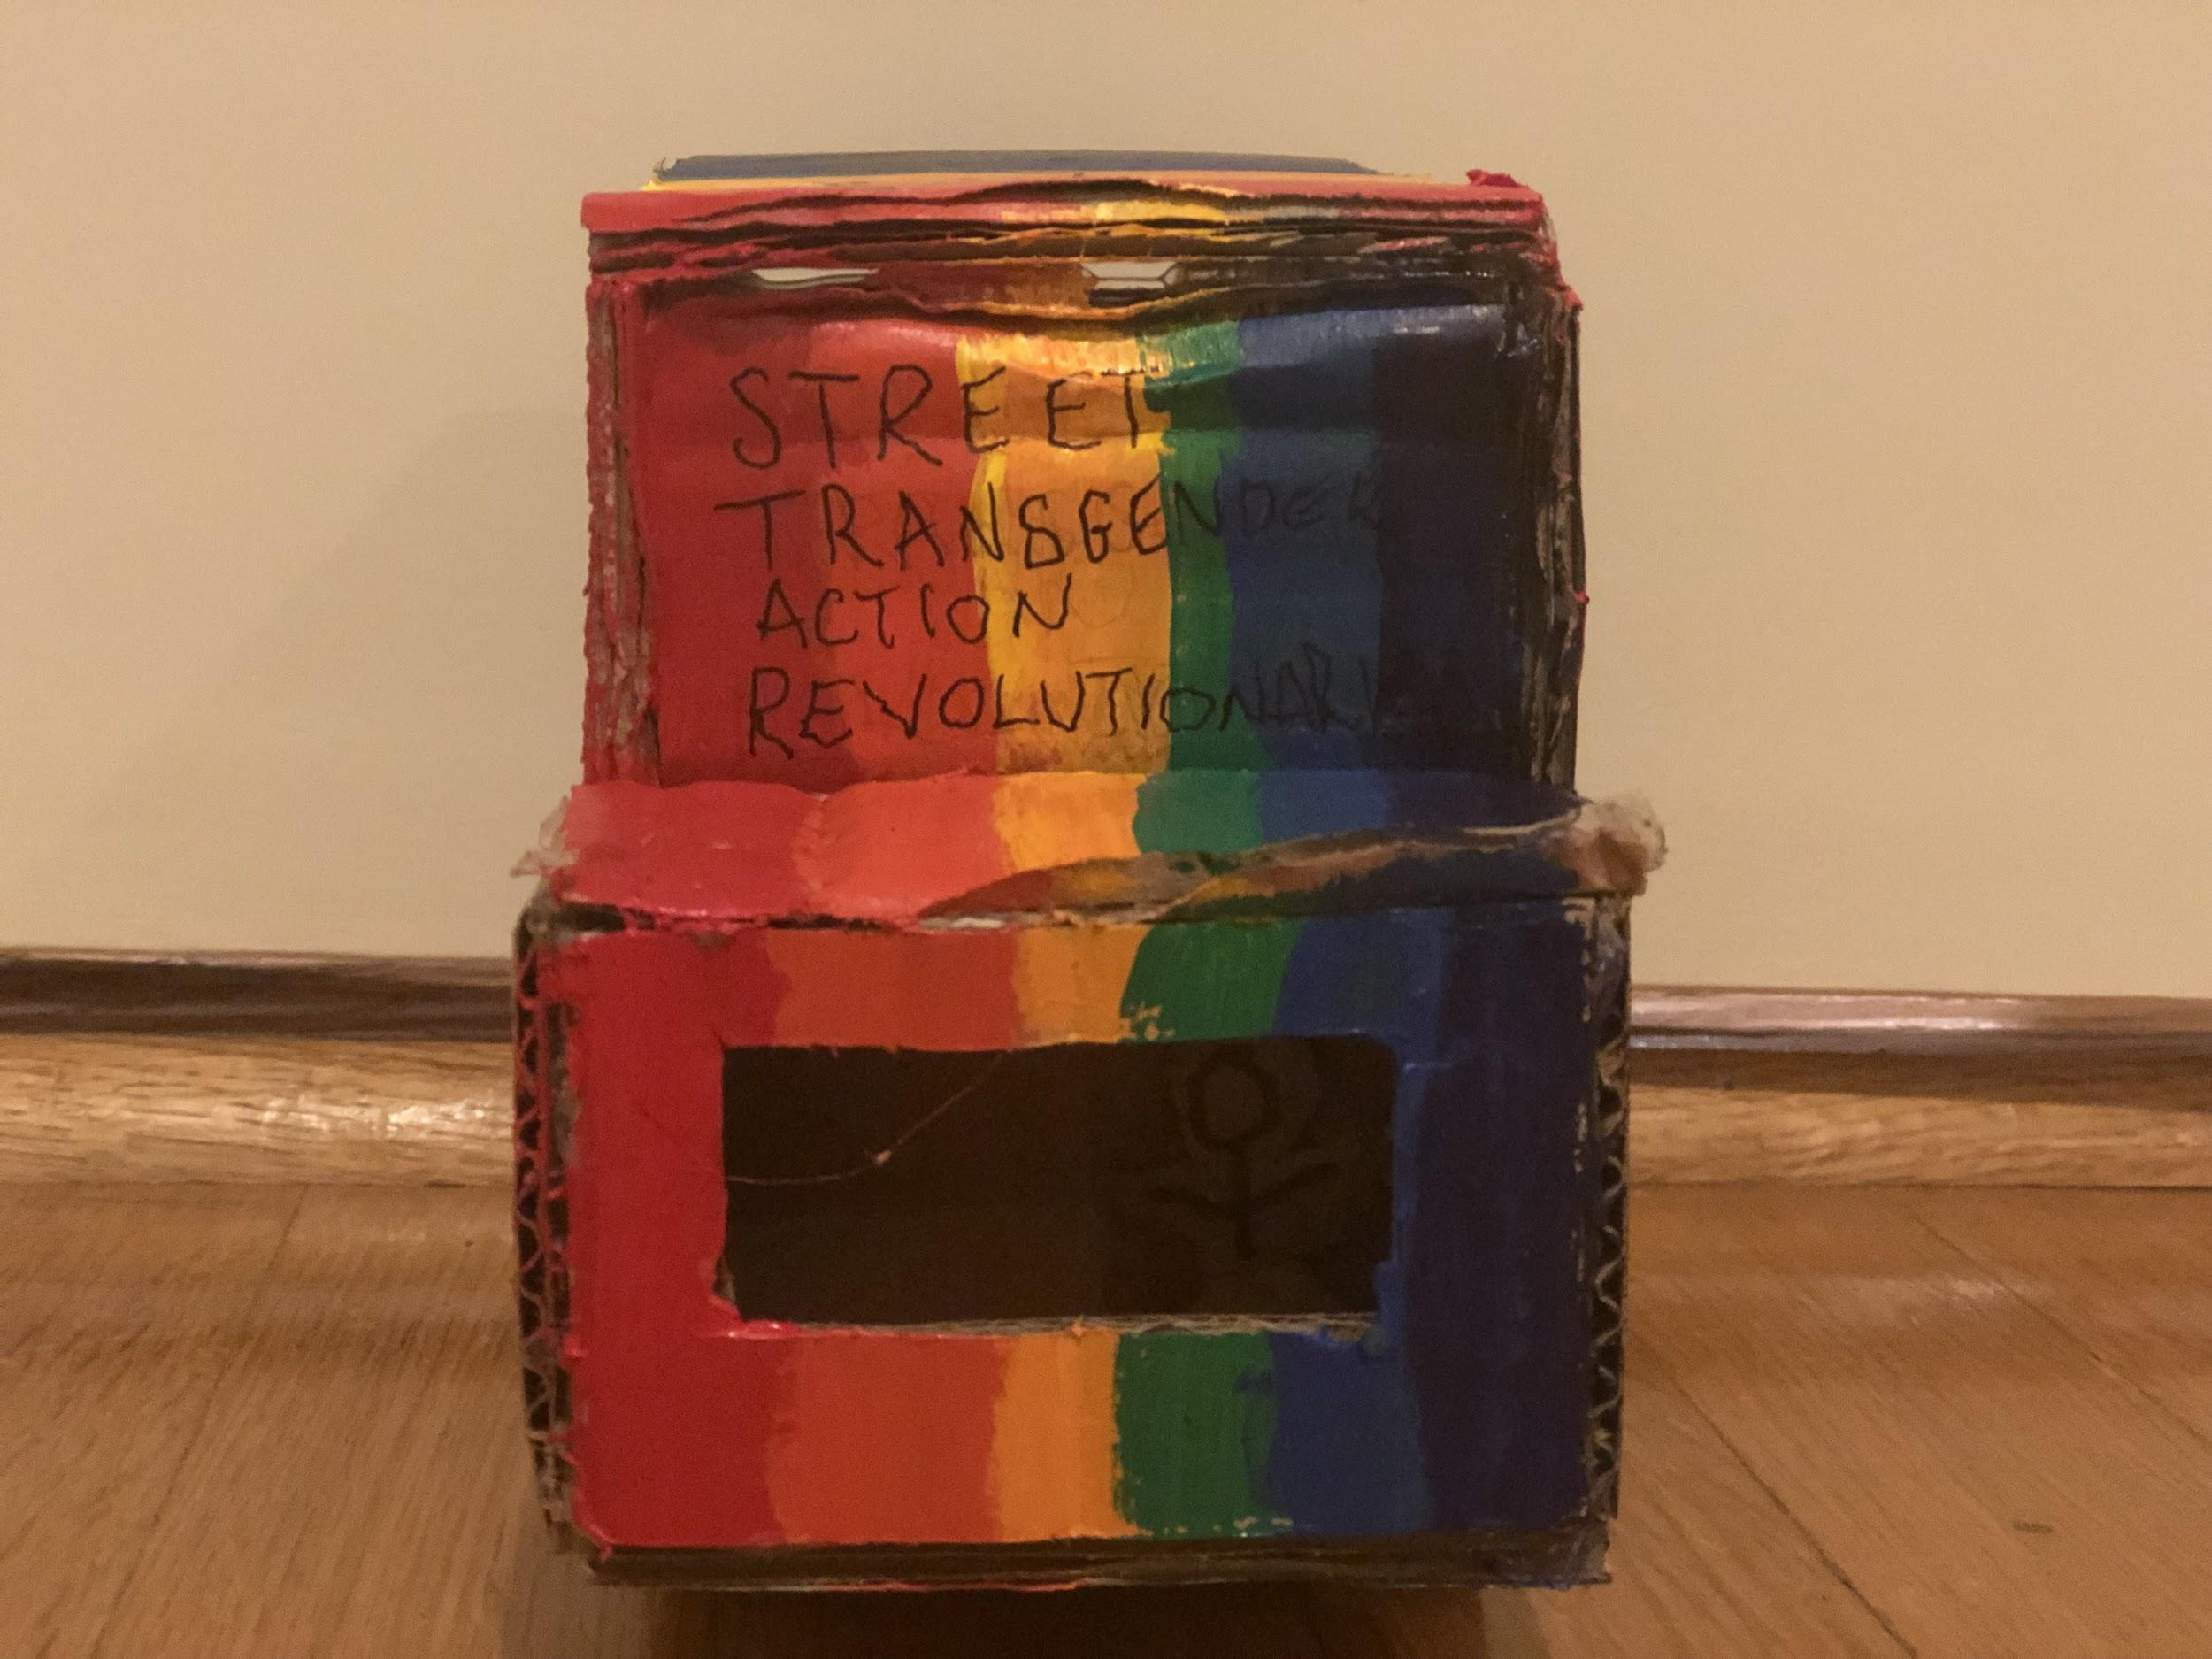
Idea #2
Notes:
Vinay

Slide 6
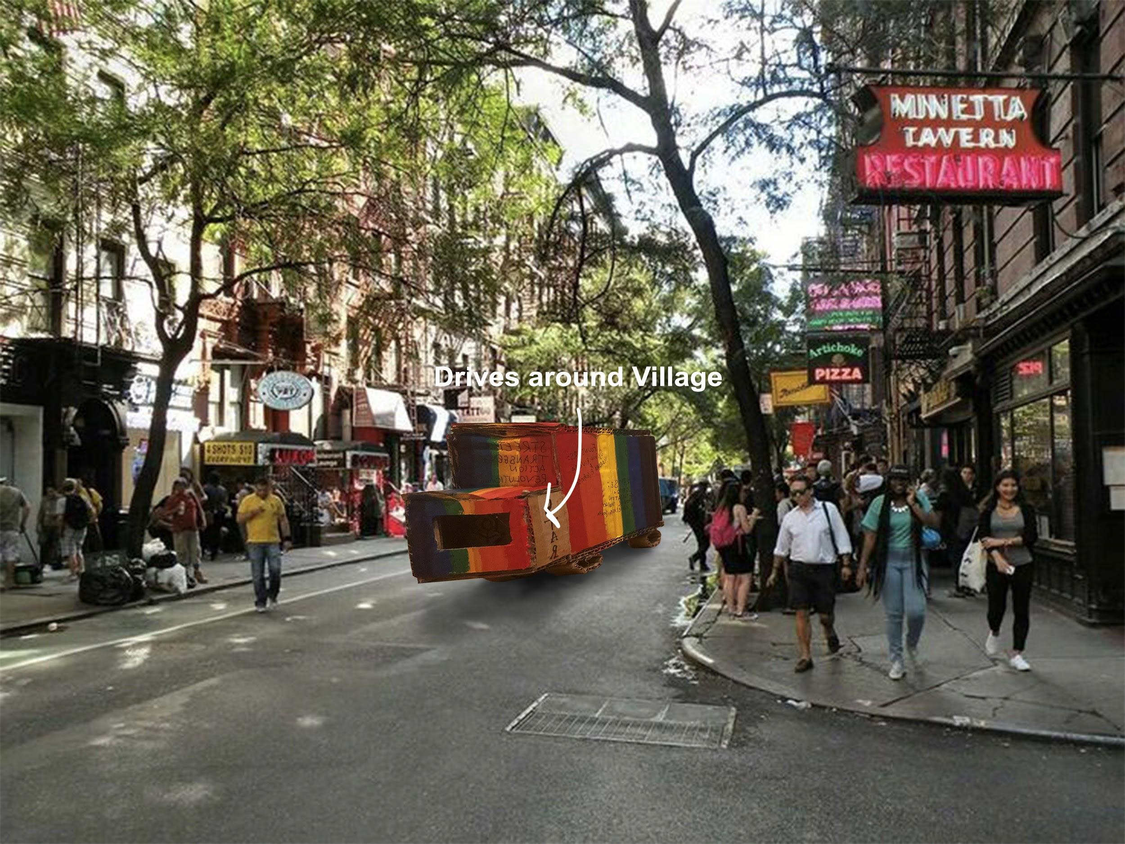
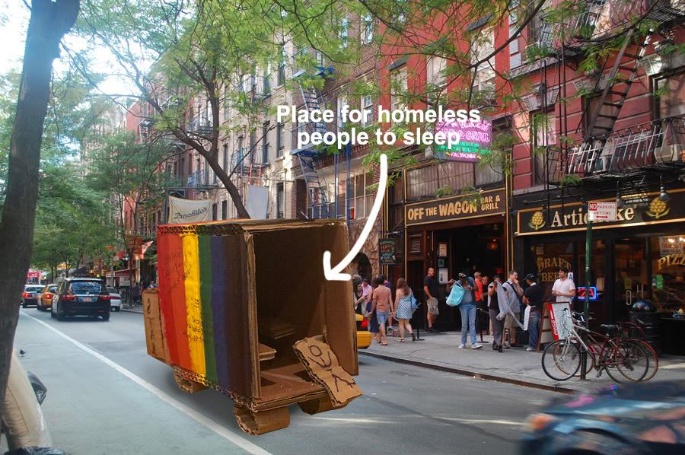
Notes:
Hana
This idea of driving around the village and having a place for the homeless never strayed this was a very important aspect to us that we knew had to make it into our final peice.

Slide 7
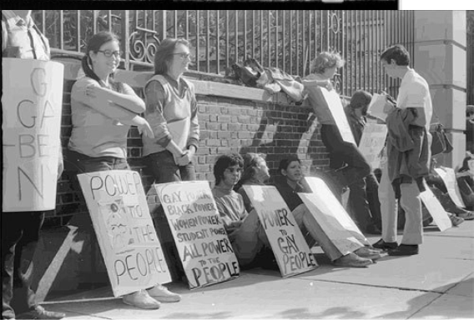
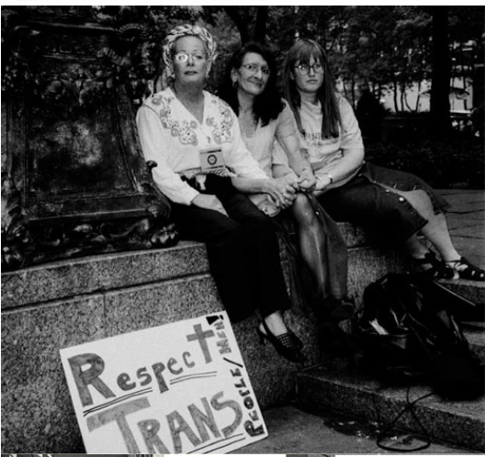
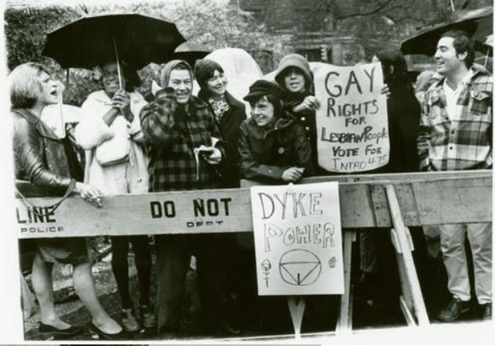
The route
NYU Weinstein Hall
Washington Square Park
St. Marks Place
Old STAR house (640 E 12th St.)
The Stonewall Inn
Notes:
Vinay -
First 3
Hana -
Last 2
Old Star House: The star house was where it the organization ended up when they got enough funding and were able to properly support the LGBT community here and give them a life and resources they deserve.
Stonewall: This is the most crucial place to the LGBT rights movement and a place that started the revolution. Here is where the Stonewall riots occured where the police raided this gay bar and the patron fought back for the first time leading the movement we know today

Slide 8
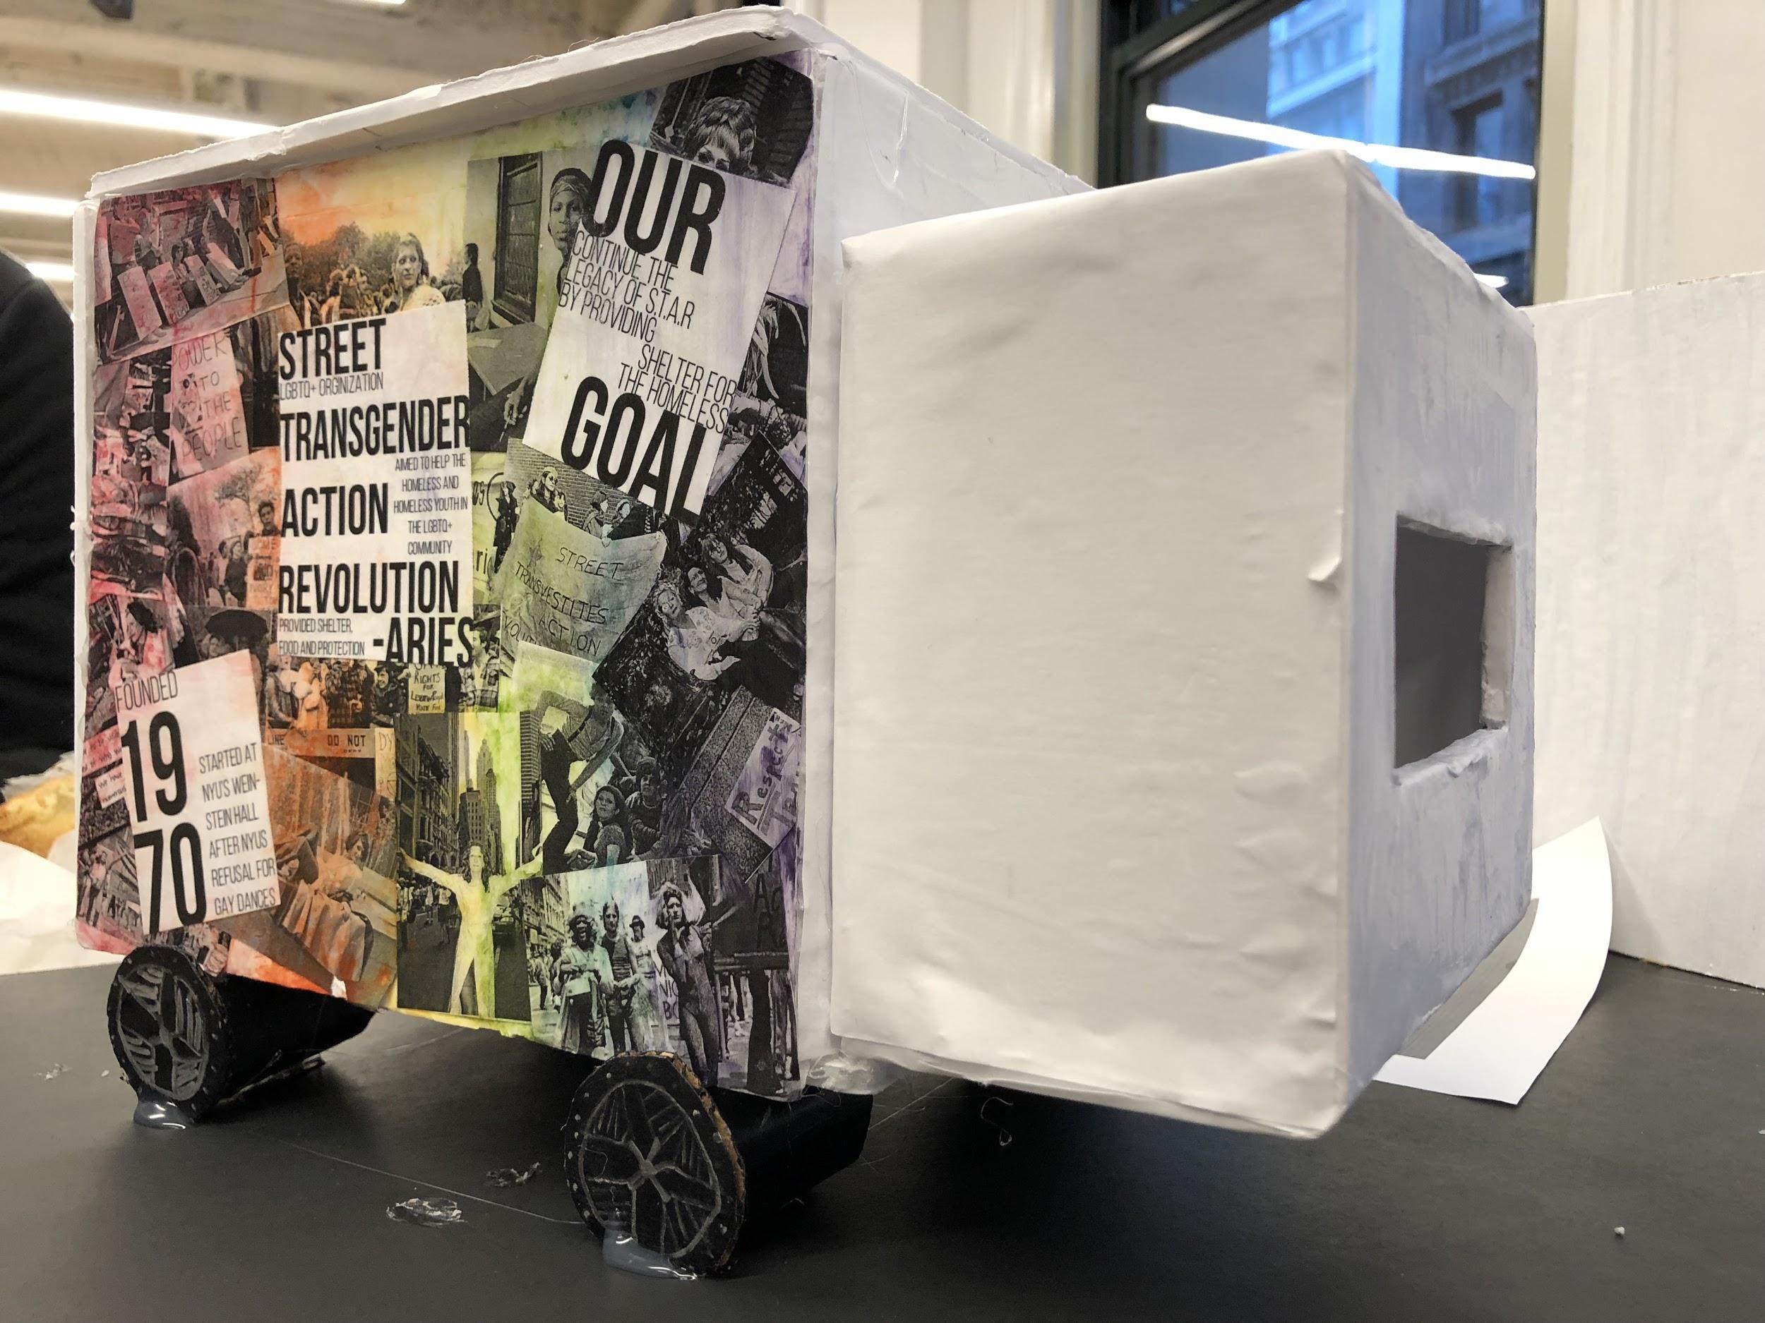
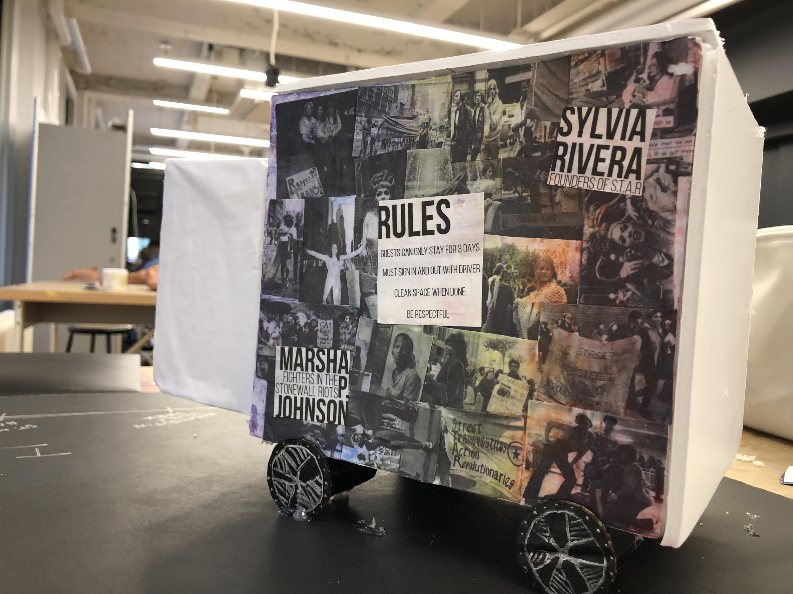
The Final Outcome
Exterior
Notes:
Vinay

Slide 9
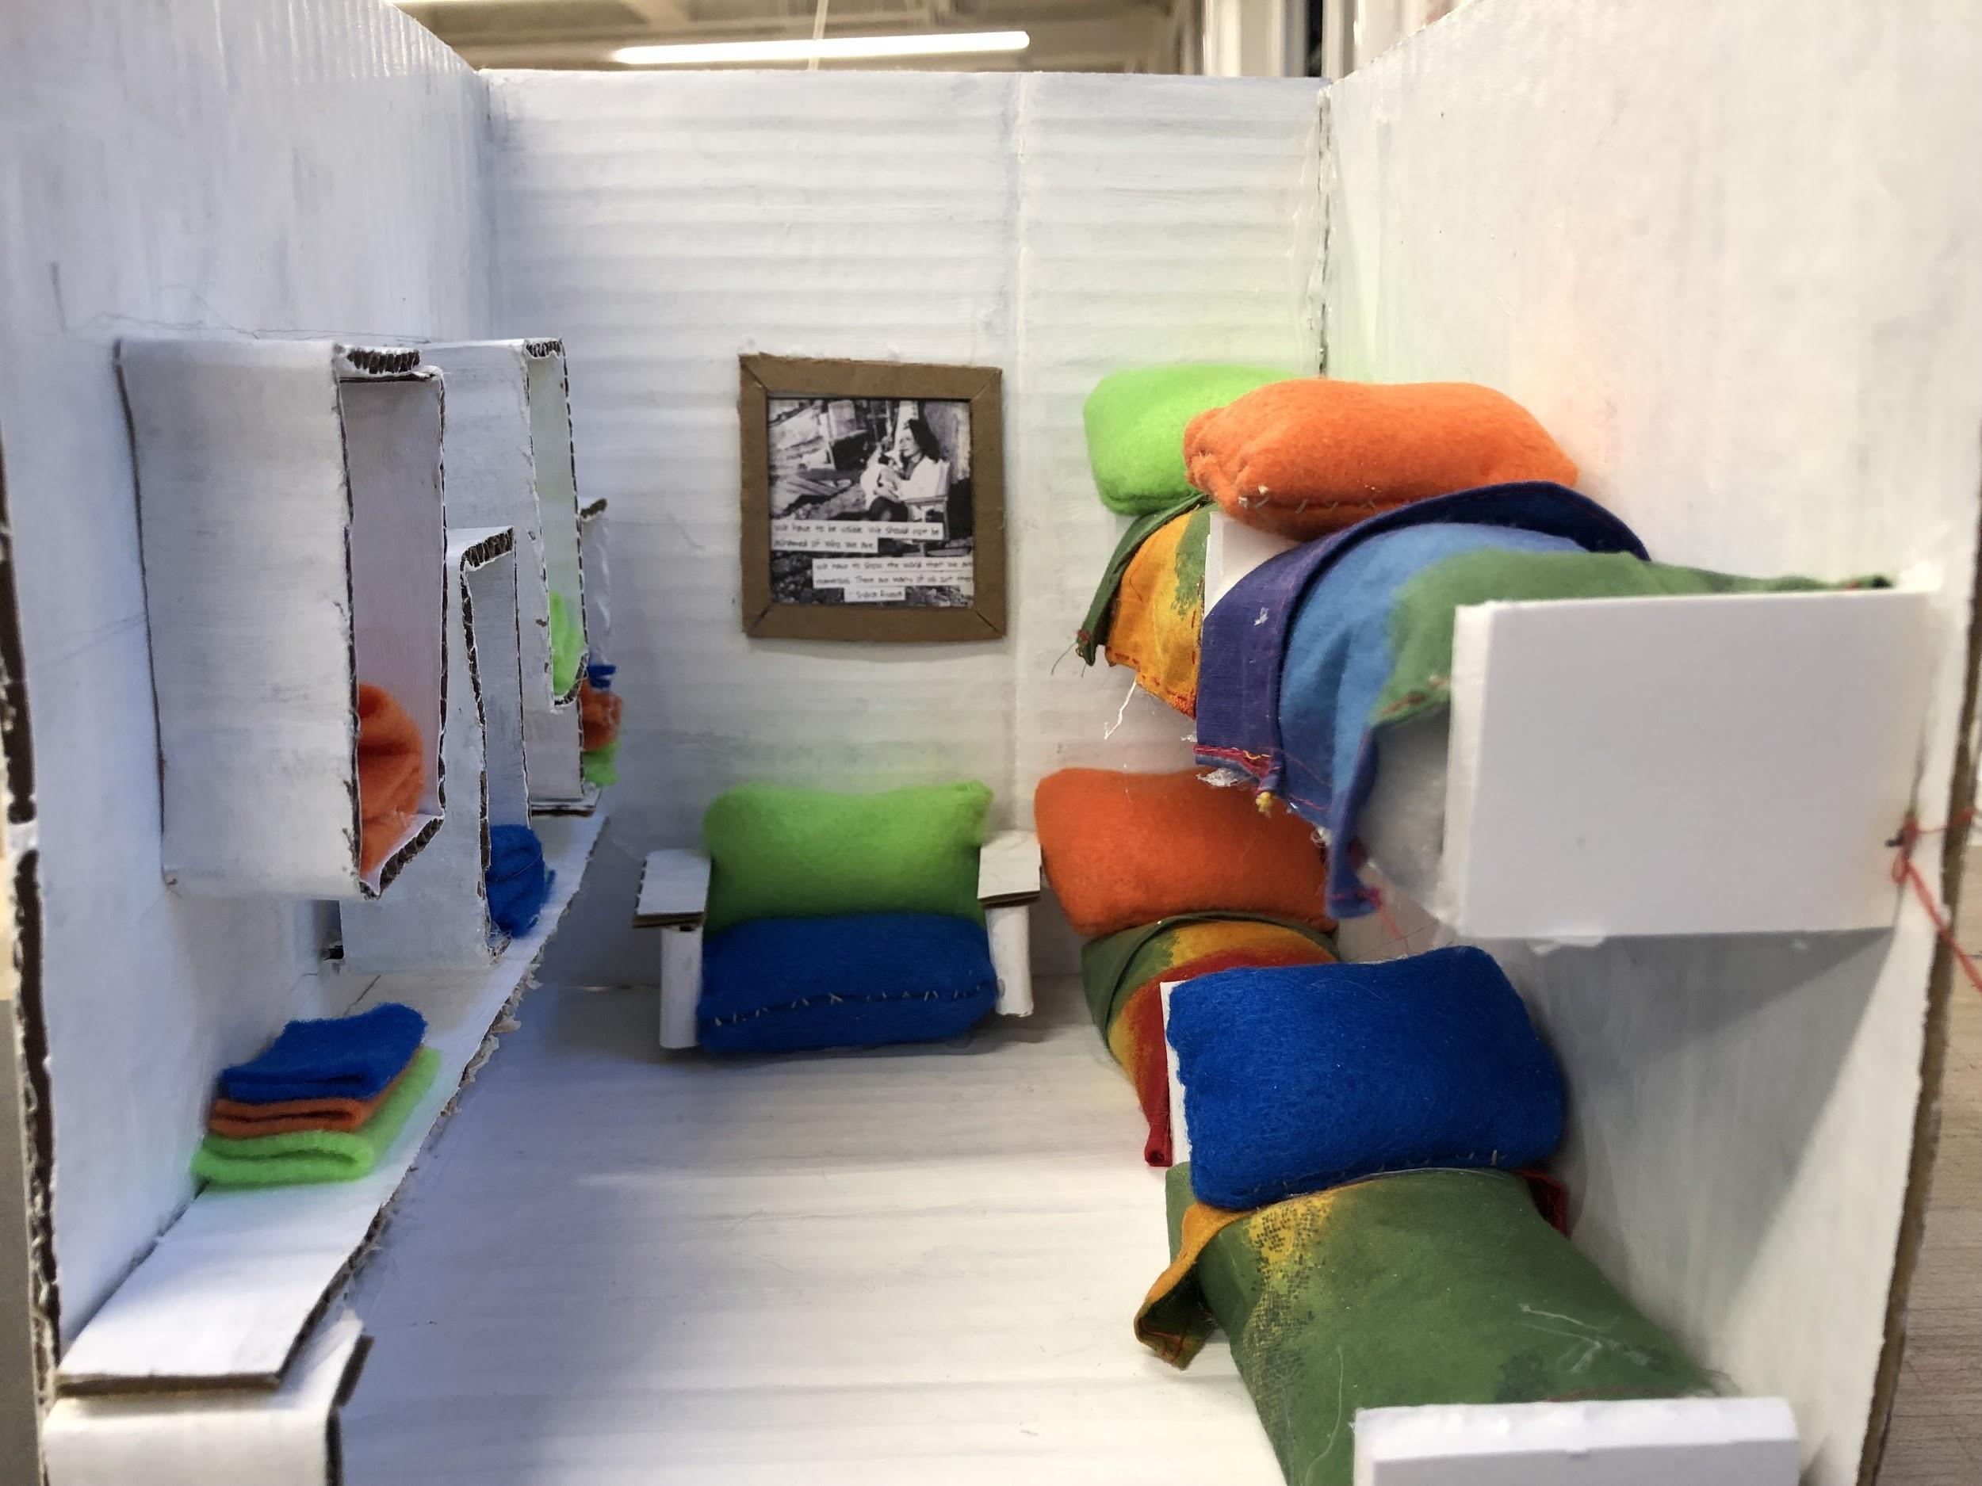
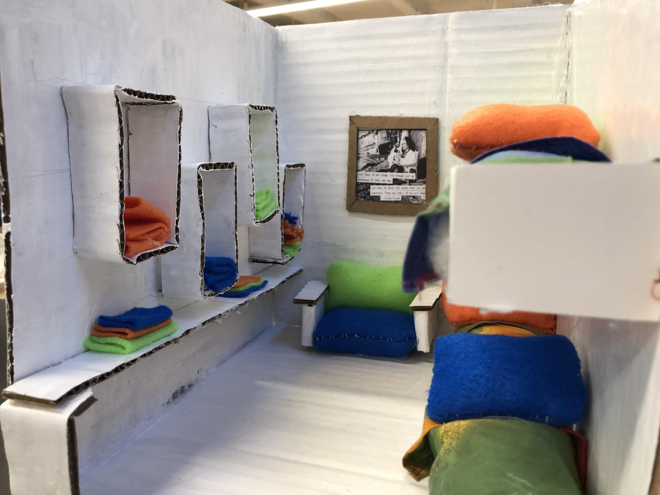
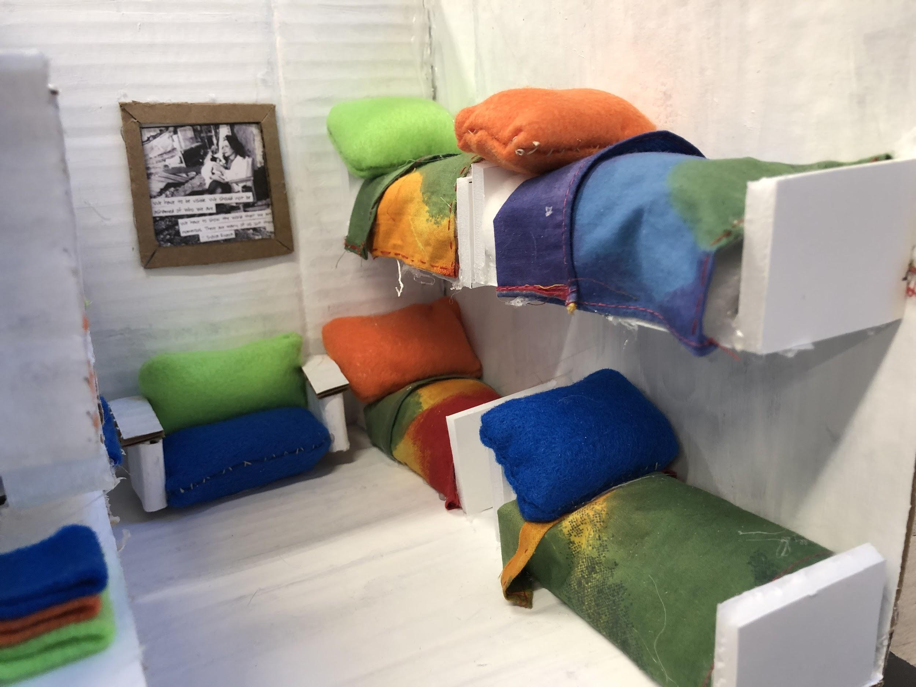
The Final Outcome
Interior
Notes:
Hana
For the interior we wanted to create a homey feel. We use cardboard for the walls and bookcases and foam core for the beds and painted it white to match the van. We used fabric to go along with the homey feel because soft fabric is often associated with warmth and comfort and this is what we wanted to provide to the people who stay here

Slide 10
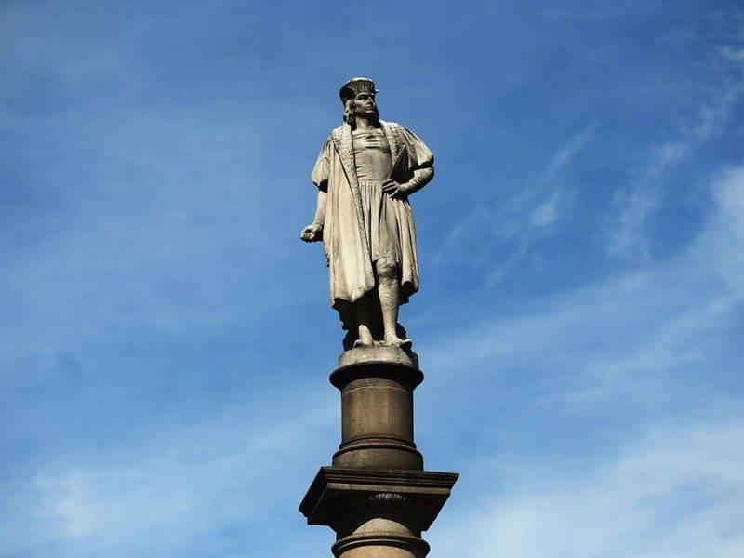
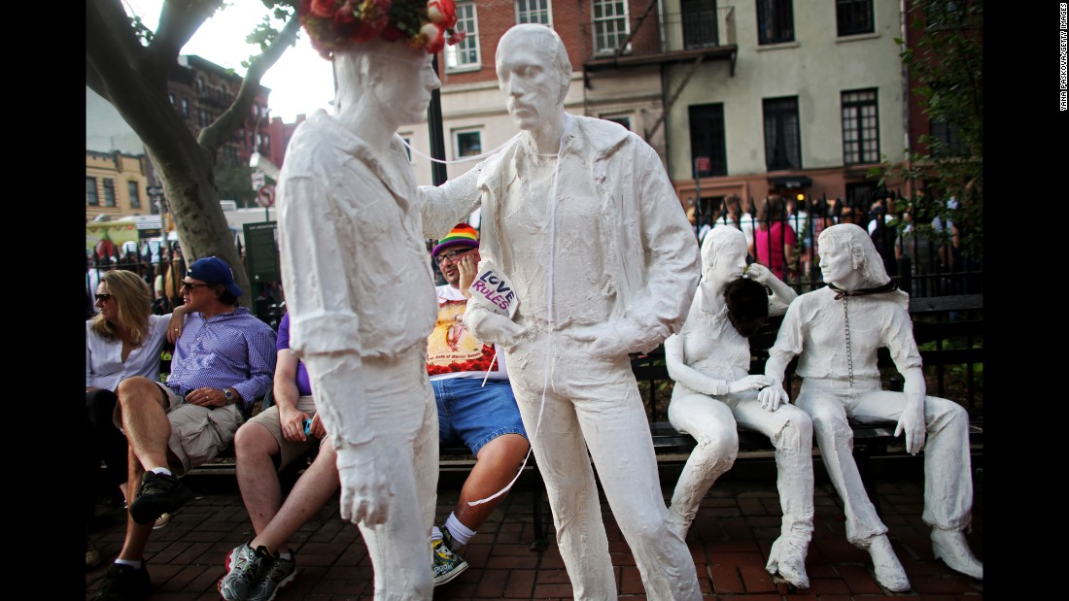
Monuments
Notes:
Many Monument are statues or busts and through this project i realized that this isnt the case. Monuments can be abstract interactive and in our case even movable. The was people use our monument is vital to continuing the legacy of STAR. If no peole come and stay when they need to our purpose would not be fufilled. It is a place to convene not only for the homeless but for everyday people to learn about starr and educate themselves in LGBT rights and even go home and research the topic furrther. Without reading about how public art and monuments can be something more then we thought we couldnt have thought of this idea and we hope that this can be soemthting that can happen in the future.

