Slide 1
By: Hannah, Esther, Kristi & Alyssa
Strategic Management
Spring 2021

Slide 2
GOAL:
Exploring opportunities outside of the industry
Expansion of business model
Creating new growth
Create an Explore Portfolio

Slide 3
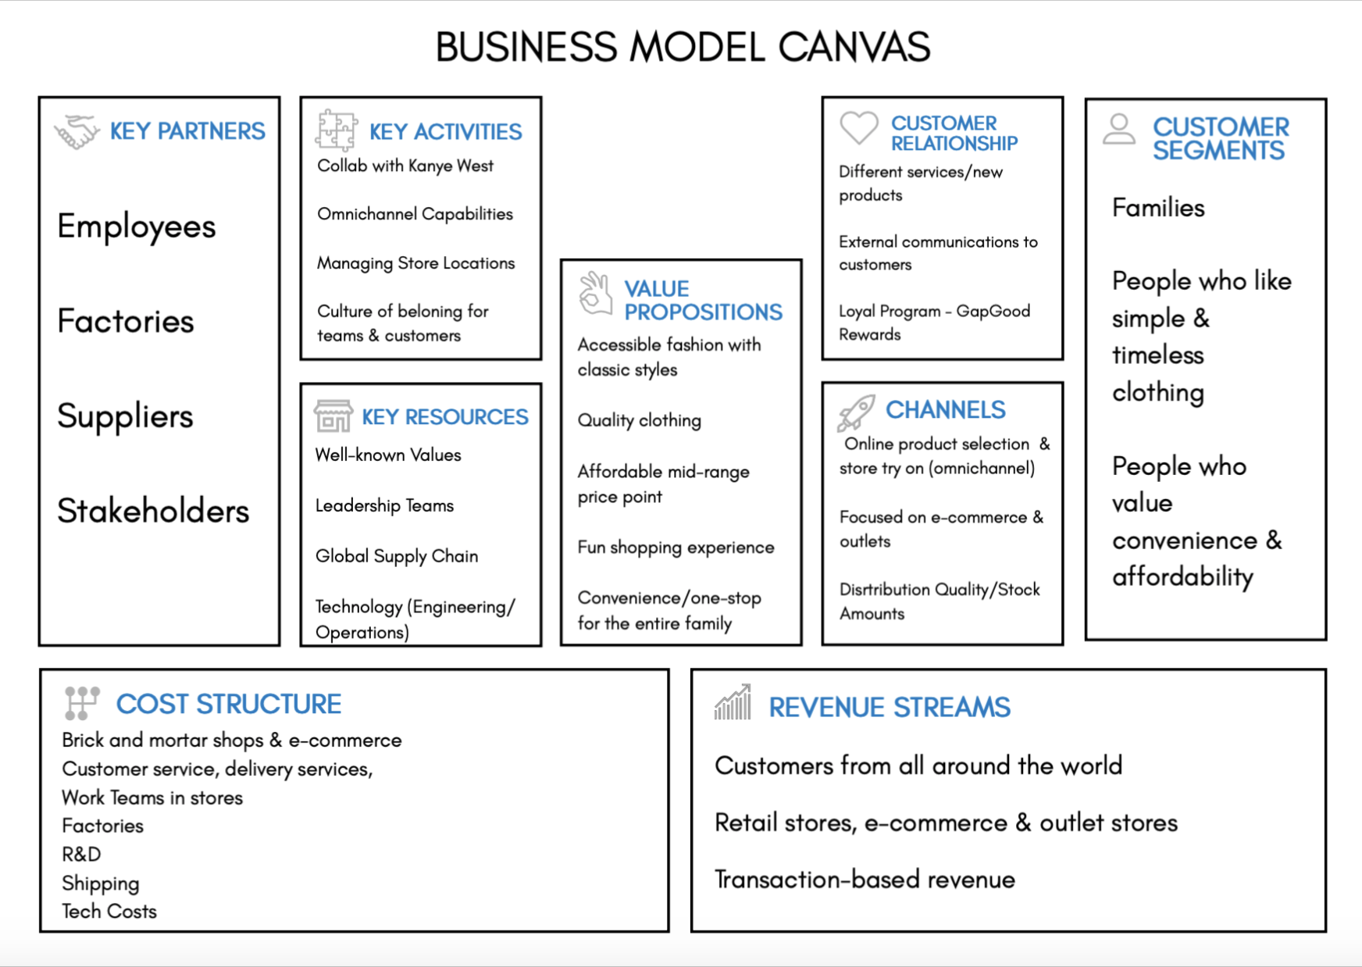
Omni channel capabilities
Managing store locations & distribution
Frequent new products
Loyalty programs - Gap good rewards
Families
People who value convenience, accessibility, and affordability
Factories
Stakeholders
Well-known values
Accessible fashion
With classic styles
Convenience/one stop shop
Team of trained employees
Global supply chain
Omni-channel
E-commerce
Outlets
Customer service
Shipping
R&D & Technology
Retail stores, e-commerce, outlet stores
Transaction based revenue
Notes:
Hannah

Slide 4
SWOT ANALYSIS
Notes:
Hannah

Slide 5
STRENGTHS
WEAKNESSES
-Adaptable to change
-Well-established household name
-Social justice initiatives
-Media attention
-Investors
-Affordability & convenience
-Outlet stores
-Production advancements
-Omni-channel capabilities
-Lack of transparency for sustainability factors
-Physical stores & excess product
-Taking their stores out of malls can lose key customers
-Large amount of debt
S
W
OPPORTUNITIES
THREATS
O
T
-Reach a wider audience -
Millennials & Gen Z
-Adapting to new technology
-Increase activewear/ athleisure
-Increase partnerships & collaborations
-Focusing on sustainability
-International market expansion
-Rising production costs
-Shift to smaller businesses
-Cancel culture (demonizing large corporations)
-Pandemic
Notes:
Hannah

Slide 6
COMPETITIVE BENCHMARKING

Slide 7
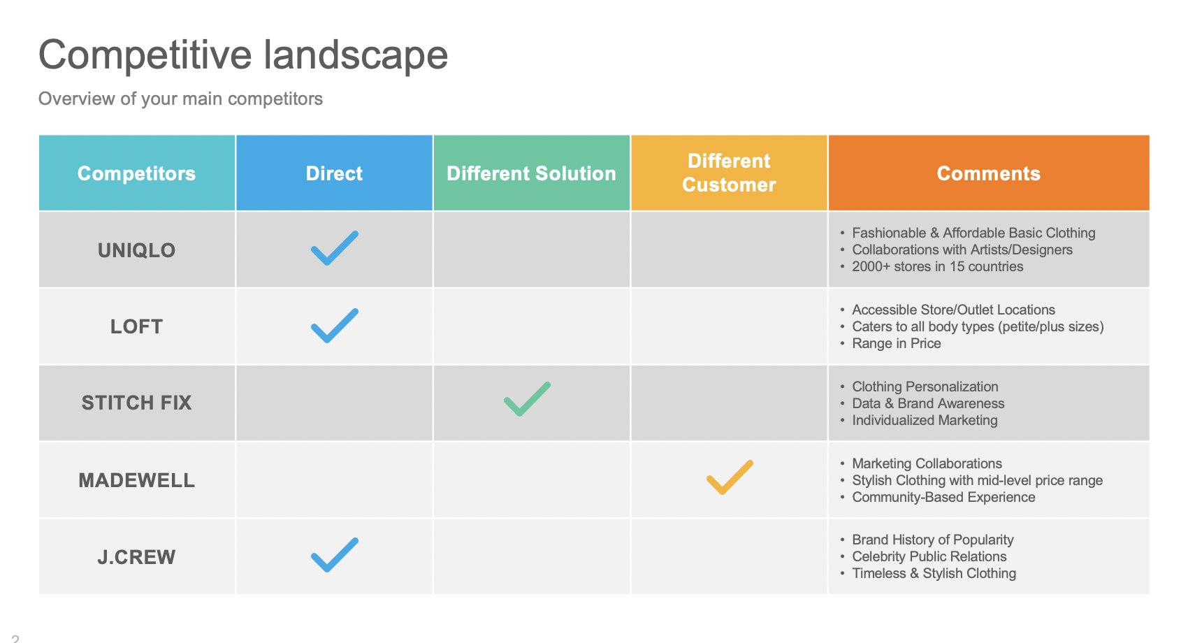

Slide 8
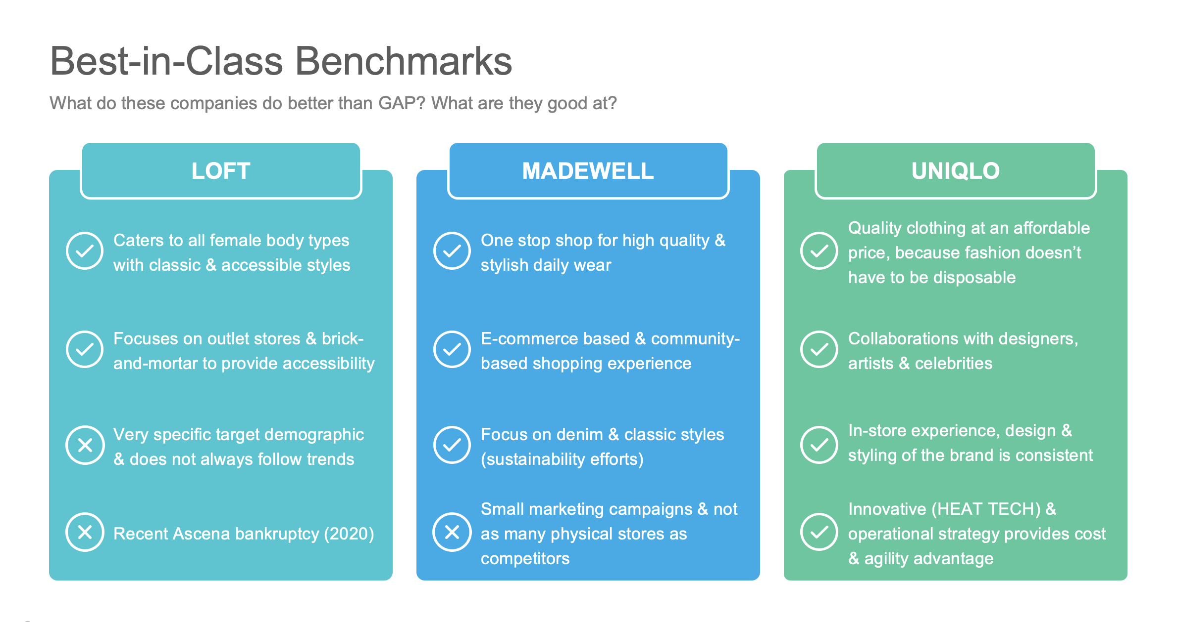

Slide 9
STRATEGIC BENCHMARKING

Slide 10
GAP’S PROBLEMS
PROBLEM 1: Slow to Leverage Digital
PROBLEM 2 Reaching New Customers, and Gaining Back Those Lost
→ Outdated Inventory & Marketing
PROBLEM 3 Being More Sustainable as a Large Fashion Corporation

Slide 11
OUT-OF-INDUSTRY SOLUTIONS
Starbucks:
One Medical:
Airbnb:
Mobile app
Pay ahead
Rewards
Still have their key retail stores
Sell through other retailers
Great omni-channel platform
Customer centered
Convenience
Semi-affordable
No physical stores
Focus on online platform
Human resources
Slow to Leverage Digital Companies leading the way in digital and omni-channel
Notes:
Summary: Establishing an online platform that offers convenience and attractiveness, whether it be through personalization or rewards systems, and bridging the gap between stores and online for those that want to use both.

Slide 12
OUT-OF-INDUSTRY SOLUTIONS
Tik Tok:
Glossier:
Robinhood:
Gen Z platform
Content for everyone
Easy to grow on the platform
Engagement
Celebrities
Marketing
Really good omni-channel (cool flagship)
Consistent customer support/
service
Making investing fun and accessible
Appealing to Gen Z as an easy way to make money
Shared by popular YouTubers
Reaching New Customers, and Gaining Back Those Lost
Companies leading in reaching younger/all audiences
Notes:
Summary: All of these companies have great marketing campaigns and reach, and they offer really cool and interactive in store experiences; as well as human-centered online platforms.

Slide 13
OUT-OF-INDUSTRY SOLUTIONS
Imperfect Foods:
Barco Uniforms:
A Good Company:
Affordable price point
Reducing food waste
Changing viewpoint on imperfect foods
Applying tech R&D used to design sportswear for medical wear
Sustainable, eco-friendly uniforms (each scrub set is made of 10 recycled bottles)
Material
Transparency
Encourages mindful consumption
Making everyday products sustainable
Being More Sustainable as a Large Fashion Corporation
Companies leading in sustainability
Notes:
Summary: These companies are innovative in their technology, while offering transparency regarding their practices; therefore encouraging their customers to participate in the mission.

Slide 14
STRATEGIC PRINCIPLES
Innovative E-commerce
Using algorithm based technology across all brands under the Gap umbrella to better understand customers’ habits and style preferences, providing a custom shopping experience via a sophisticated platform.
Bringing GAP Back
Generating excitement within younger audiences, through interactive and memorable in person shopping experiences and an active social media presence.
Promise to Ethical Practices
Having a concrete plan of action to become fully sustainable by the year 2050, and encouraging our customers to become involved in our process by promoting mindful consumption habits.
Notes:
Alyssa 3-4 innovations the business should adopt to differentiate themselves).

Slide 15
VISION STATEMENT
Material
Transparency
Encourages mindful consumption
Making everyday products sustainable
We are working towards bridging the gap between our physical stores and online platform, and leveraging the knowledge of our network under the GAP umbrella. Ultimately, this will generate excitement amongst our customers to take part in a catered shopping experience and join us in our commitment to sustainability.
Notes:
Alyssa

Slide 16
CONCLUSION
As a group, we were able to actively communicate throughout the collaborative process to utilize class time in an efficient manner.
Starting out, we wanted to create an explore portfolio for Gap. We learned about Gap’s journey, in terms of their strengths and weaknesses in remaining relevant as a clothing company. By assessing Gap’s competitors, we gained insight on what works well for consumer engagement. We were then able to devise a series of strategic principles to guide Gap in a direction we believe will be favorable to them.
We expect that Gap will revive their company if they appeal to the likings of the modern consumer, beginning with their highly anticipated collaboration with Kanye West.

Slide 17
APPENDIX
https://docs.google.com/document/d/1AP8sG2stVYiznhkqeWPqAQzTpqPq5k8U09thkMvdmp8/edit?usp=sharing

