Slide 1
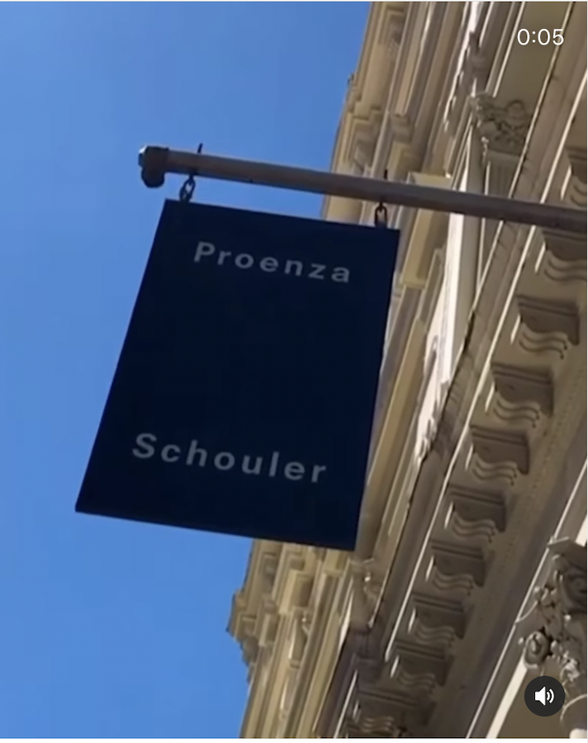
Proenza Schouler
Financial resolutions involved in putting on their unique Spring 21 show
By: Hannah Swart
Notes:
Taking into account their use of sustainable materials, the custom venue, aspects of production, people involved, marketing and PR

Slide 2
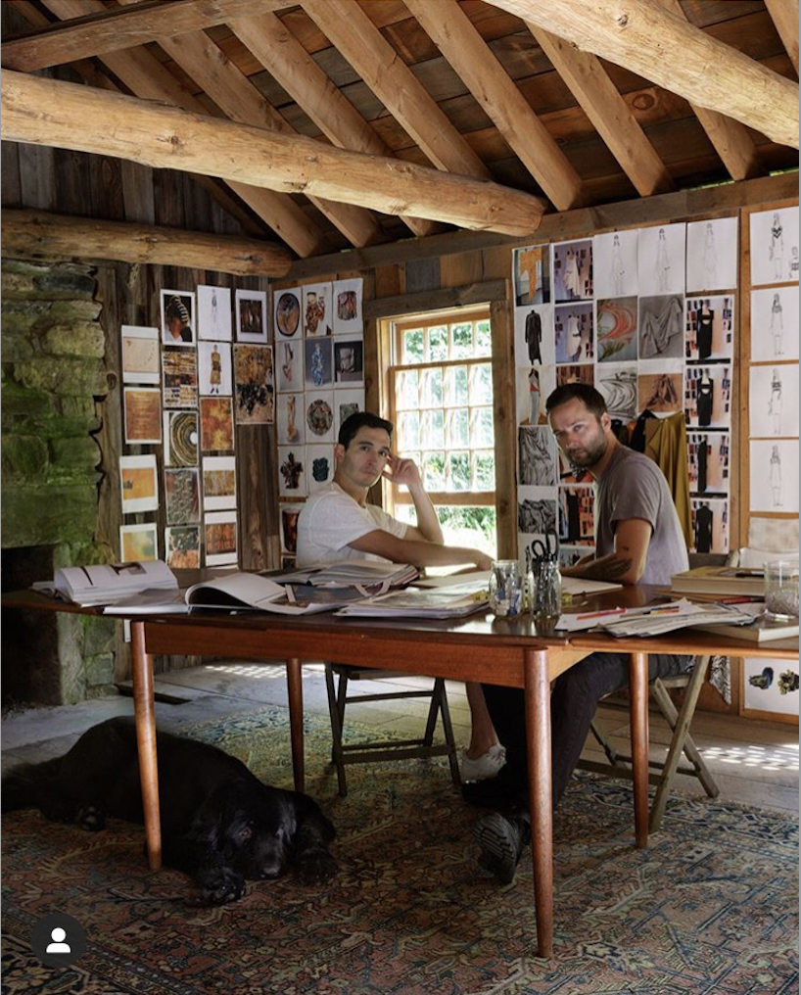
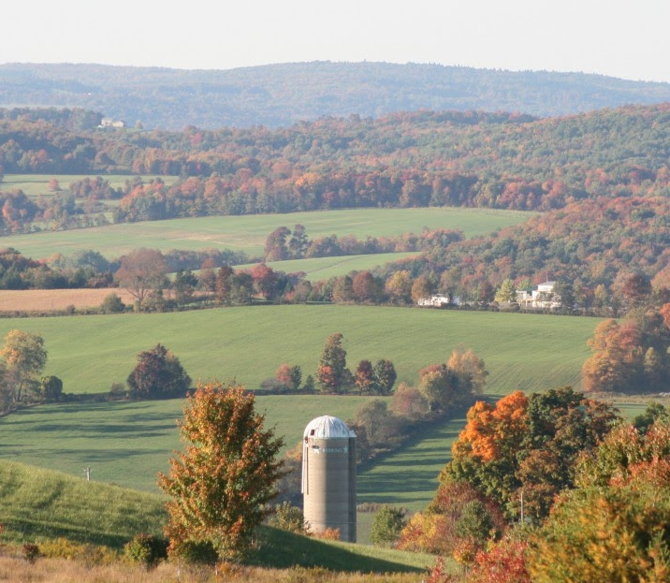
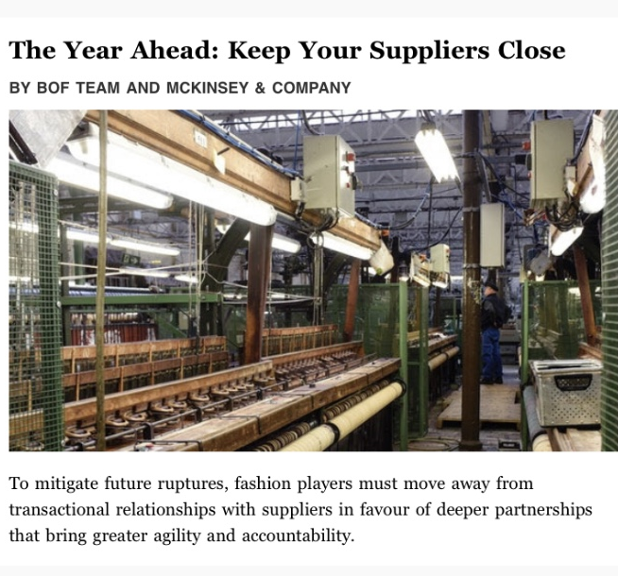
Producing the Collection
Partnerships with the local farms and farmers and moving the production closer to home → minimizing the cost of transportation.
While the clothes are made from these pricey materials, they are also very simple, comfortable, and utilitarian (the cost of expensive detailing is not a factor)
Notes:
It’s more costly to use sustainable materials and produce closer to home, but they know their customer well, and have hope that they too will see that this is the only option moving forward towards a more sustainable future.
Seen in BOF on 12/16/2020 (Wed) an article about keeping suppliers close in the future – more predictable

Slide 3
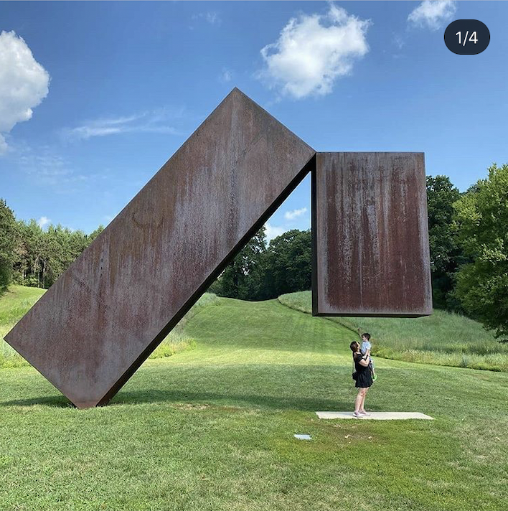
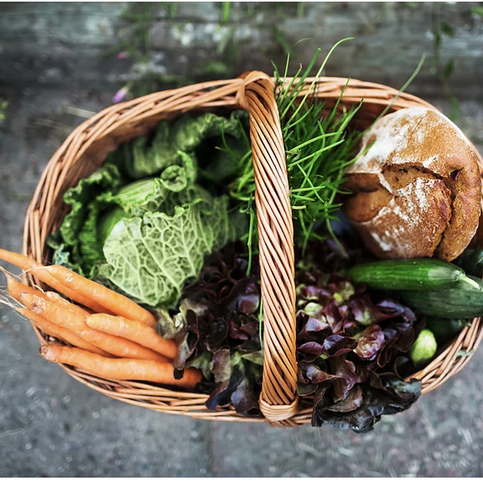
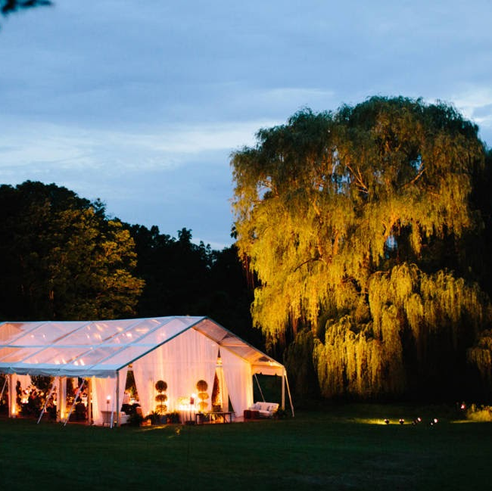
Production: venue rental, props, sound, lighting and food
Corporate membership to storm king
Cutting back on lighting and seating
Hiring a local film crew
Harvest farm to table catering co.
Notes:
Storm King offers Corporate Membership that comes with “invitations to online talks...including exclusive exhibition previews, company name recognition, logo, and link on the Storm King website, [and] the opportunity to host a private socially-distanced event.
Most of the event will take place during the day, which will save them on lighting
The use of benches – with socially distanced seat markers
Little to no props involved in the show, since this would not fit with the brands minimalist image.
They’ve hired a film crew and catering co. from the area, which is less costly than hiring one from the city because transportation
Also keeping in line with their mission to support local talent.

Slide 4
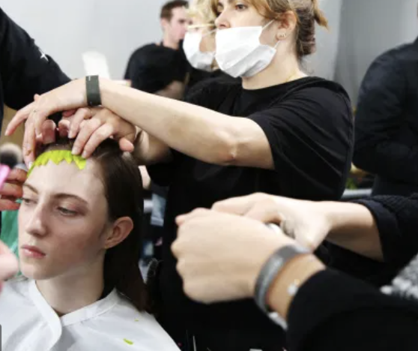
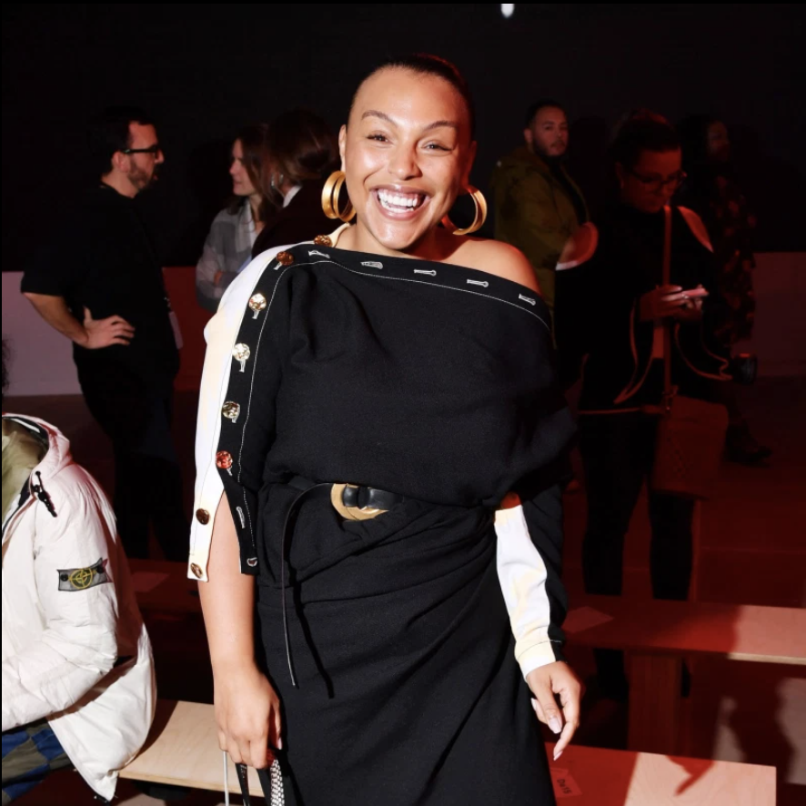
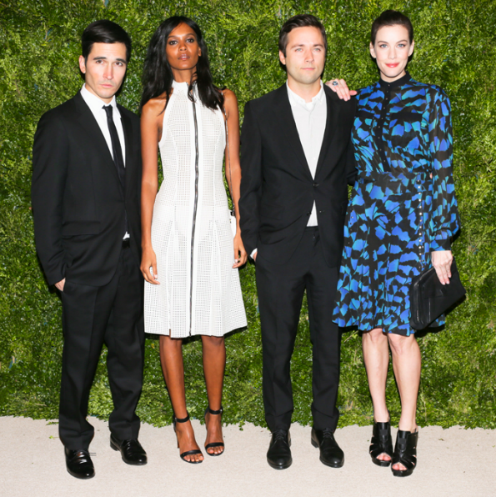
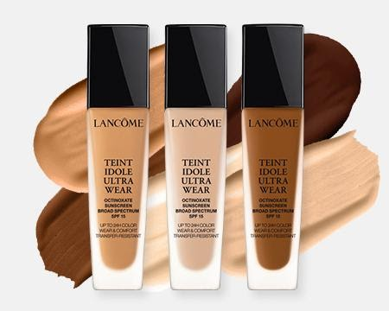
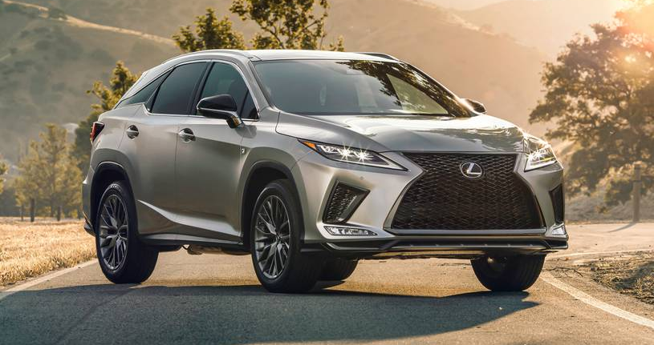
Human centered: staff, models, invitees
Models and staff paid in full (20 models, 6 of them high profile)
Instead of being paid directly, influencers will be gifted clothing and makeup items, which will also serve its marketing purposes
Lancome partnership and sponsorship by Tresemme negate the costs of makeup and hair.
Other sponsorships include Lexus and Visa
Notes:
McCollough and Hernandez still maintain that their main priority is taking care of those who are helping behind the scenes; as well as those featured in the show, so costs have not been cut on their account.
They will be given the same food as guests
Partnerships with sustainable organizations – they offered to come for free in exchange for getting their name out there and making their own connections with our industry

Slide 5
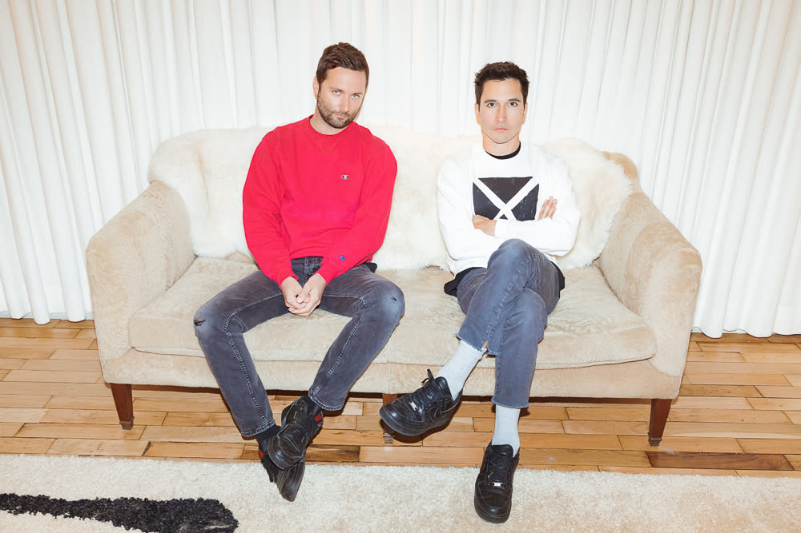
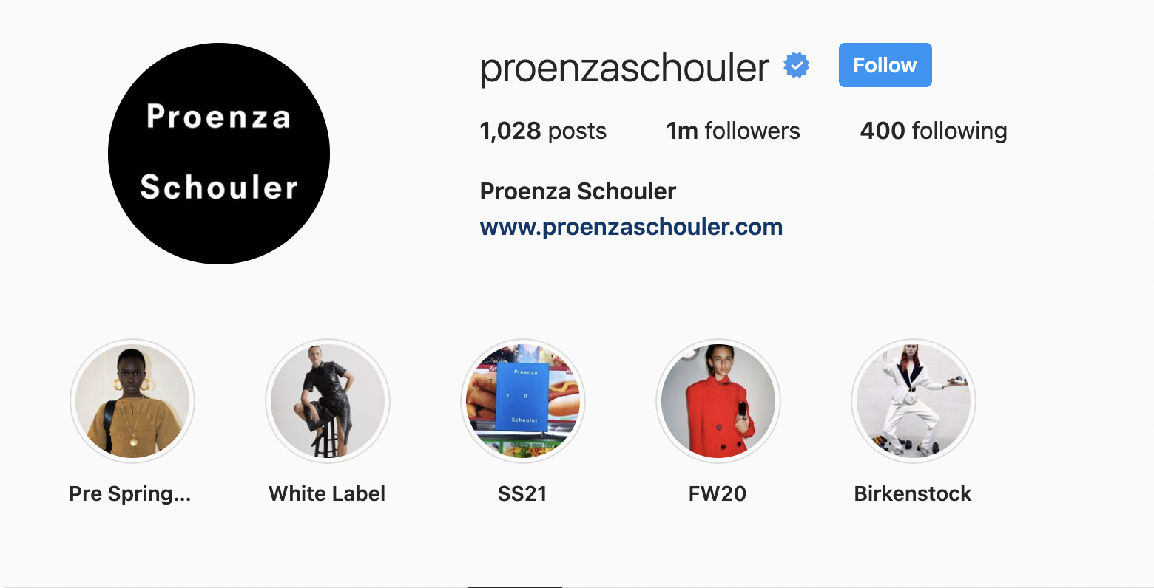
PR and marketing
PR is in house
No posters or programs, as they are trying to cut back on their use of paper. These can be found on their website or socials.
As their main marketing strategy, Proenza Schouler plans on filming the show for their social accounts and for Vogue’s Youtube channel.
Featured on BOF podcasts will be an interview with the creative directors talking about their reasons for the show + highlights.

Slide 6
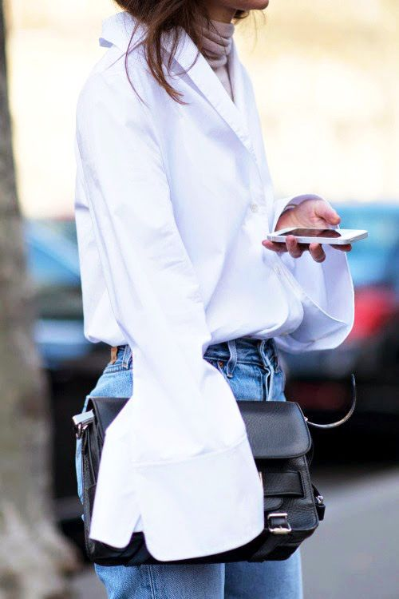
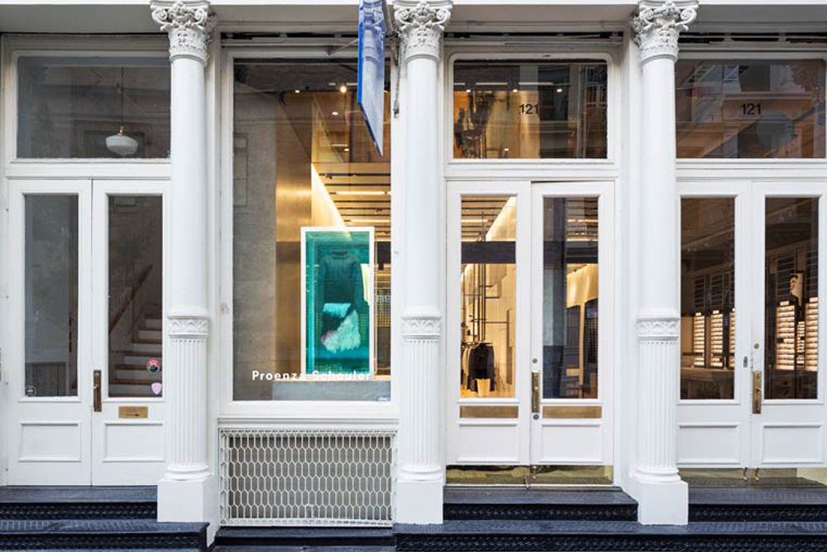
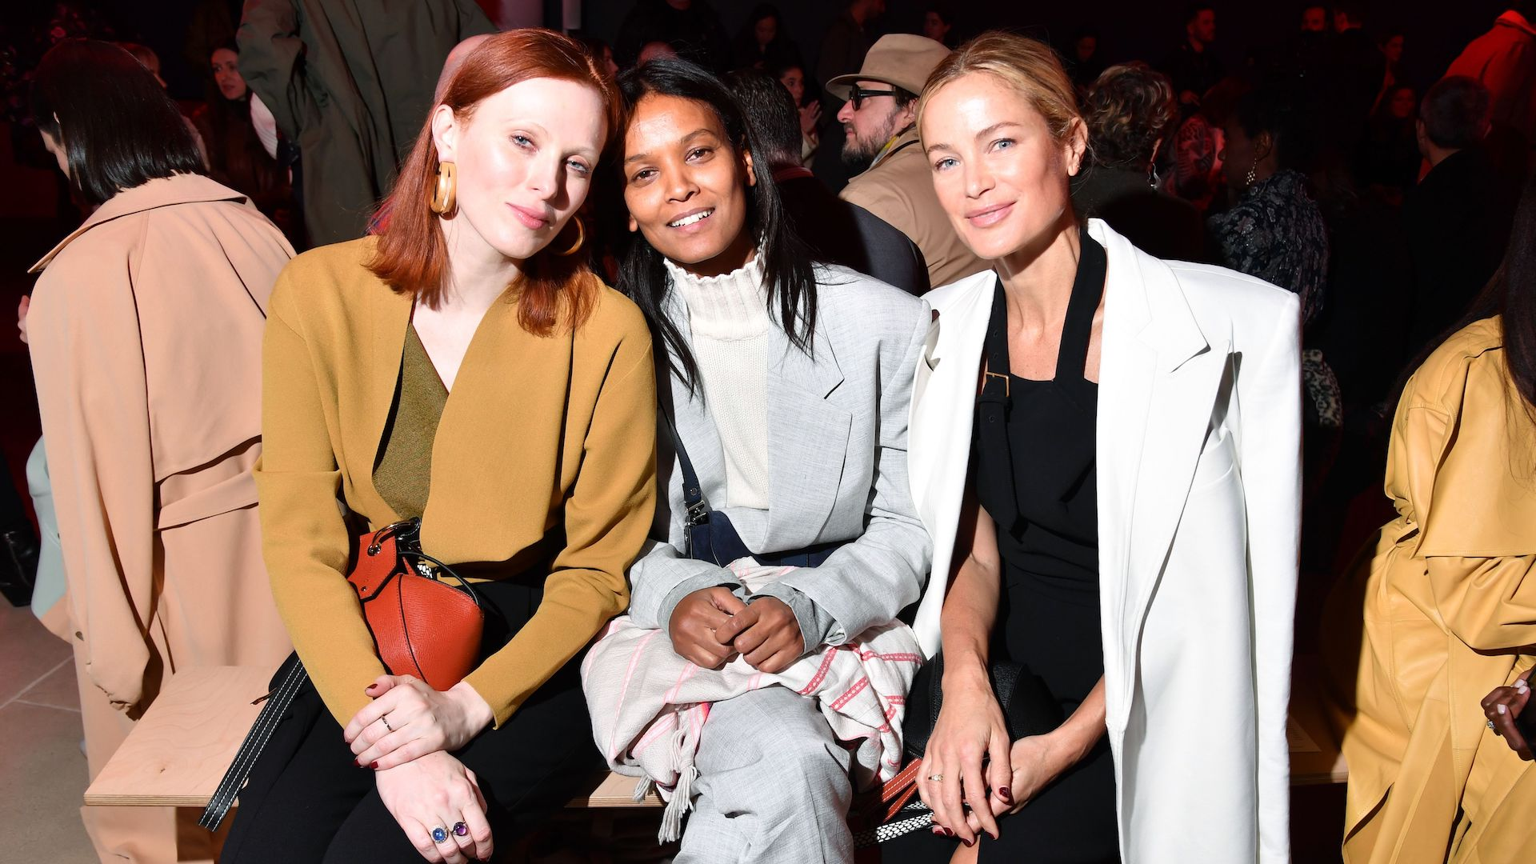
Challenges & Next Steps
Moving the show to mid-day instead of evening to cut back on lighting costs
Decision to keep with in house PR and implications
Decision to ask their guests to get themselves out to Storm King, since they will not be paying for transportation.
In using sustainable materials and producing many of the clothes locally, the costs of certain items will have to be adjusted.
Notes:
They ended up sticking with their in house PR team, but since the show is so localized and intimate, they had to put more thought into their marketing strategy in order to show the collection to a more global audience.
However, after talking with friends of the brand and a few invitees, almost everyone said they had been meaning to get out to Storm King, and now they have the perfect reason to.
With that being said, they know their customer well, and have hope that they too will see that this is the only option moving forward towards a more sustainable future.

Slide 7
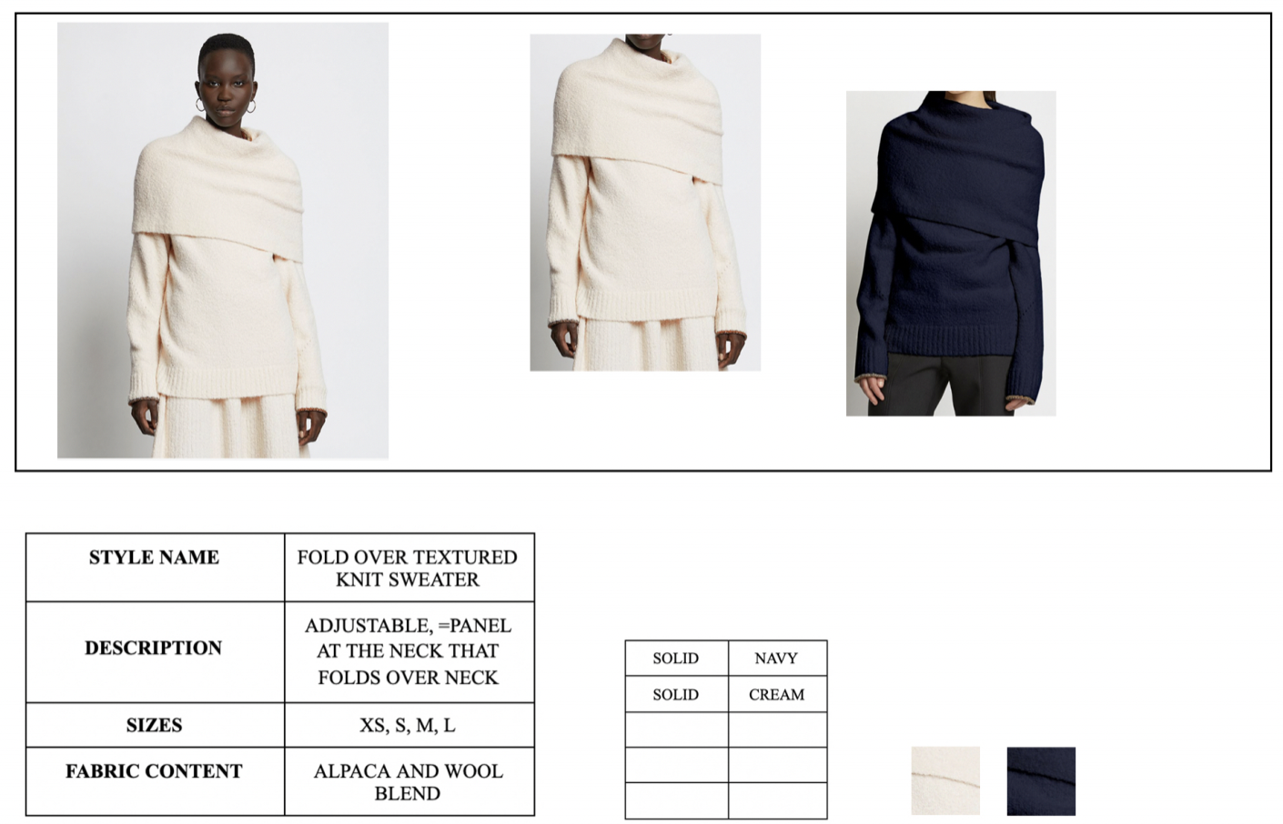

Slide 9
Thank You

