Slide 1
Bridge 5: final studio project
Union Square East 17th Street
AJ Durotoye

Slide 2
Purpose
To intervene within the system of violence at Union Square, reducing the rate of physical assault and making union safer for locals, commuters, tourists, etc.
The intervention should affect foot traffic around Union Square, ideally it should re-route people away from where assault has occurred.
Poverty
Street crime
+
-
Petty crime
Commuters/Tourists/etc
NYPD
+
Homelessness
Subway crime
-

Slide 3
Experimentation
Social Context
In an area with a high average foot traffic, the issue of crime within crowds presents many social issues. It discourages tourists from visiting the site, it dangers the local who must commute here everyday, and the history of the site can never be properly understood.
Experiment
Study the foot traffic by the subway entrances and the paths underground. Take note of who ”appears” to be a tourist. Find an average for 3 days
Spatial Context
During peak times the train station becomes highly congested, it is in the congestion where activity such as assault or pick-pocketing take place.
Determine where subway crime is most likely to take place in Union Square and decide size parameters for my intervention

Slide 4
Site Map

Slide 5
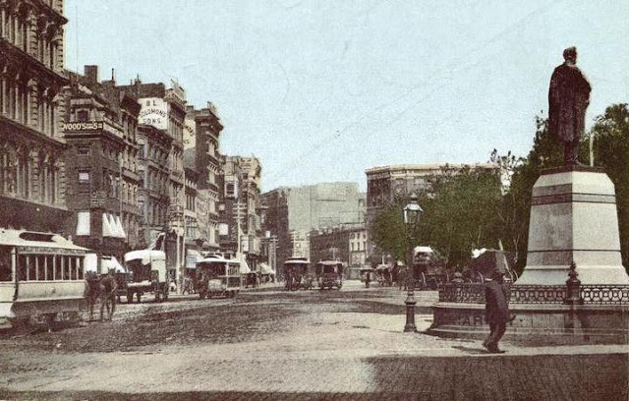
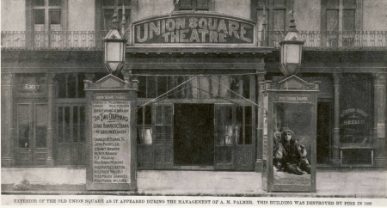
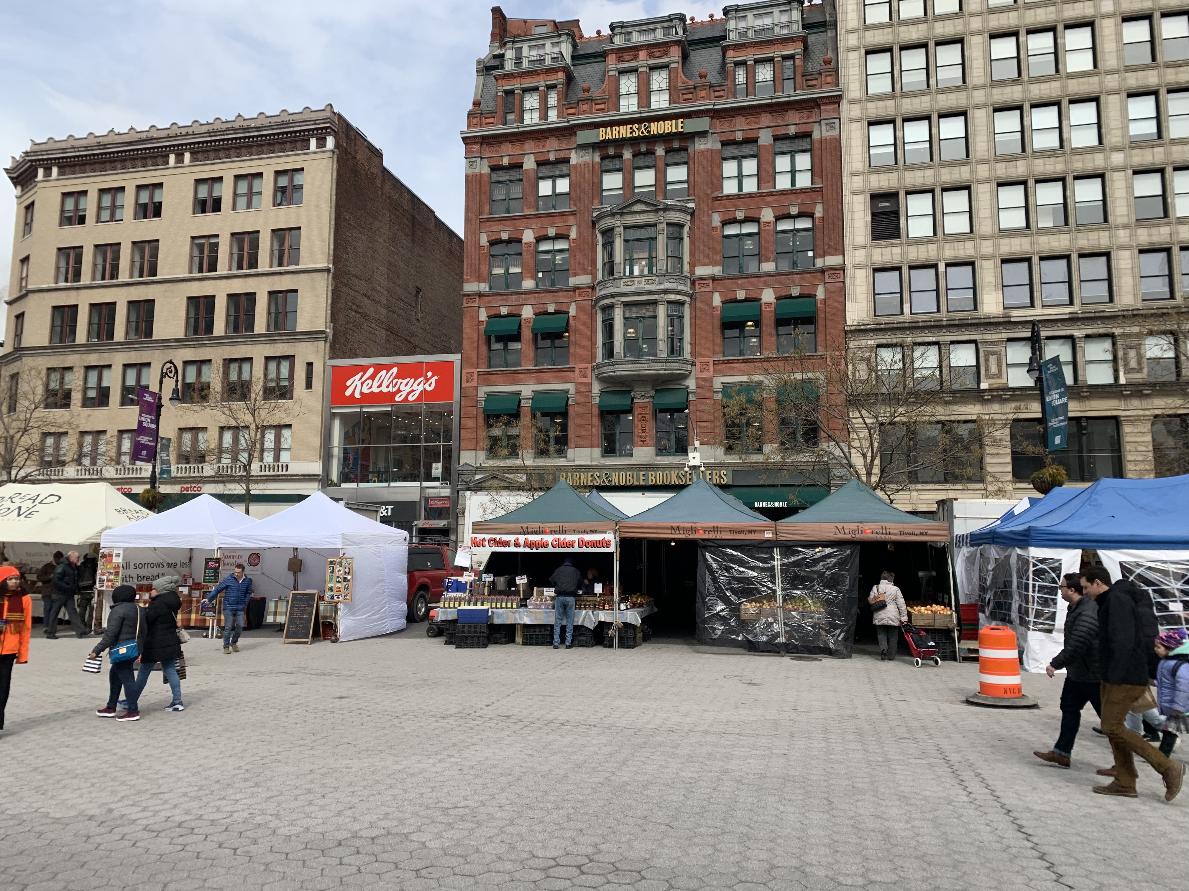
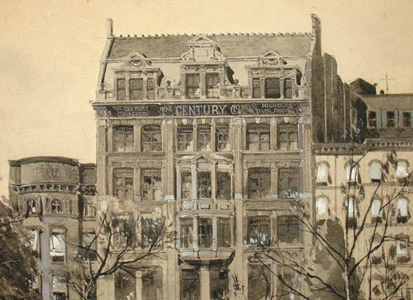
Site Photos

Slide 6
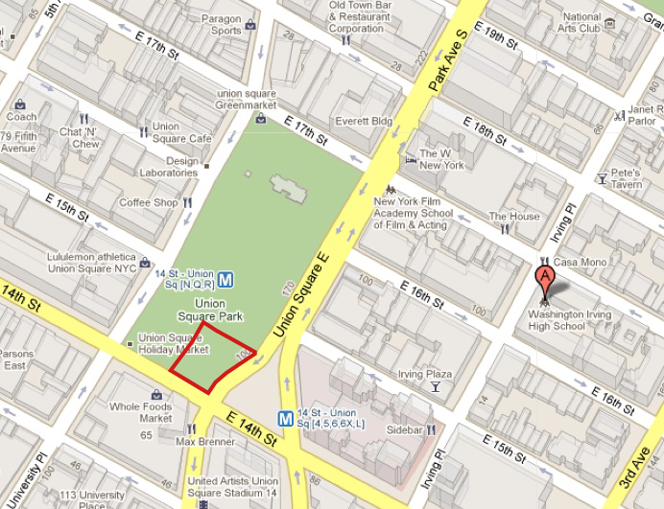
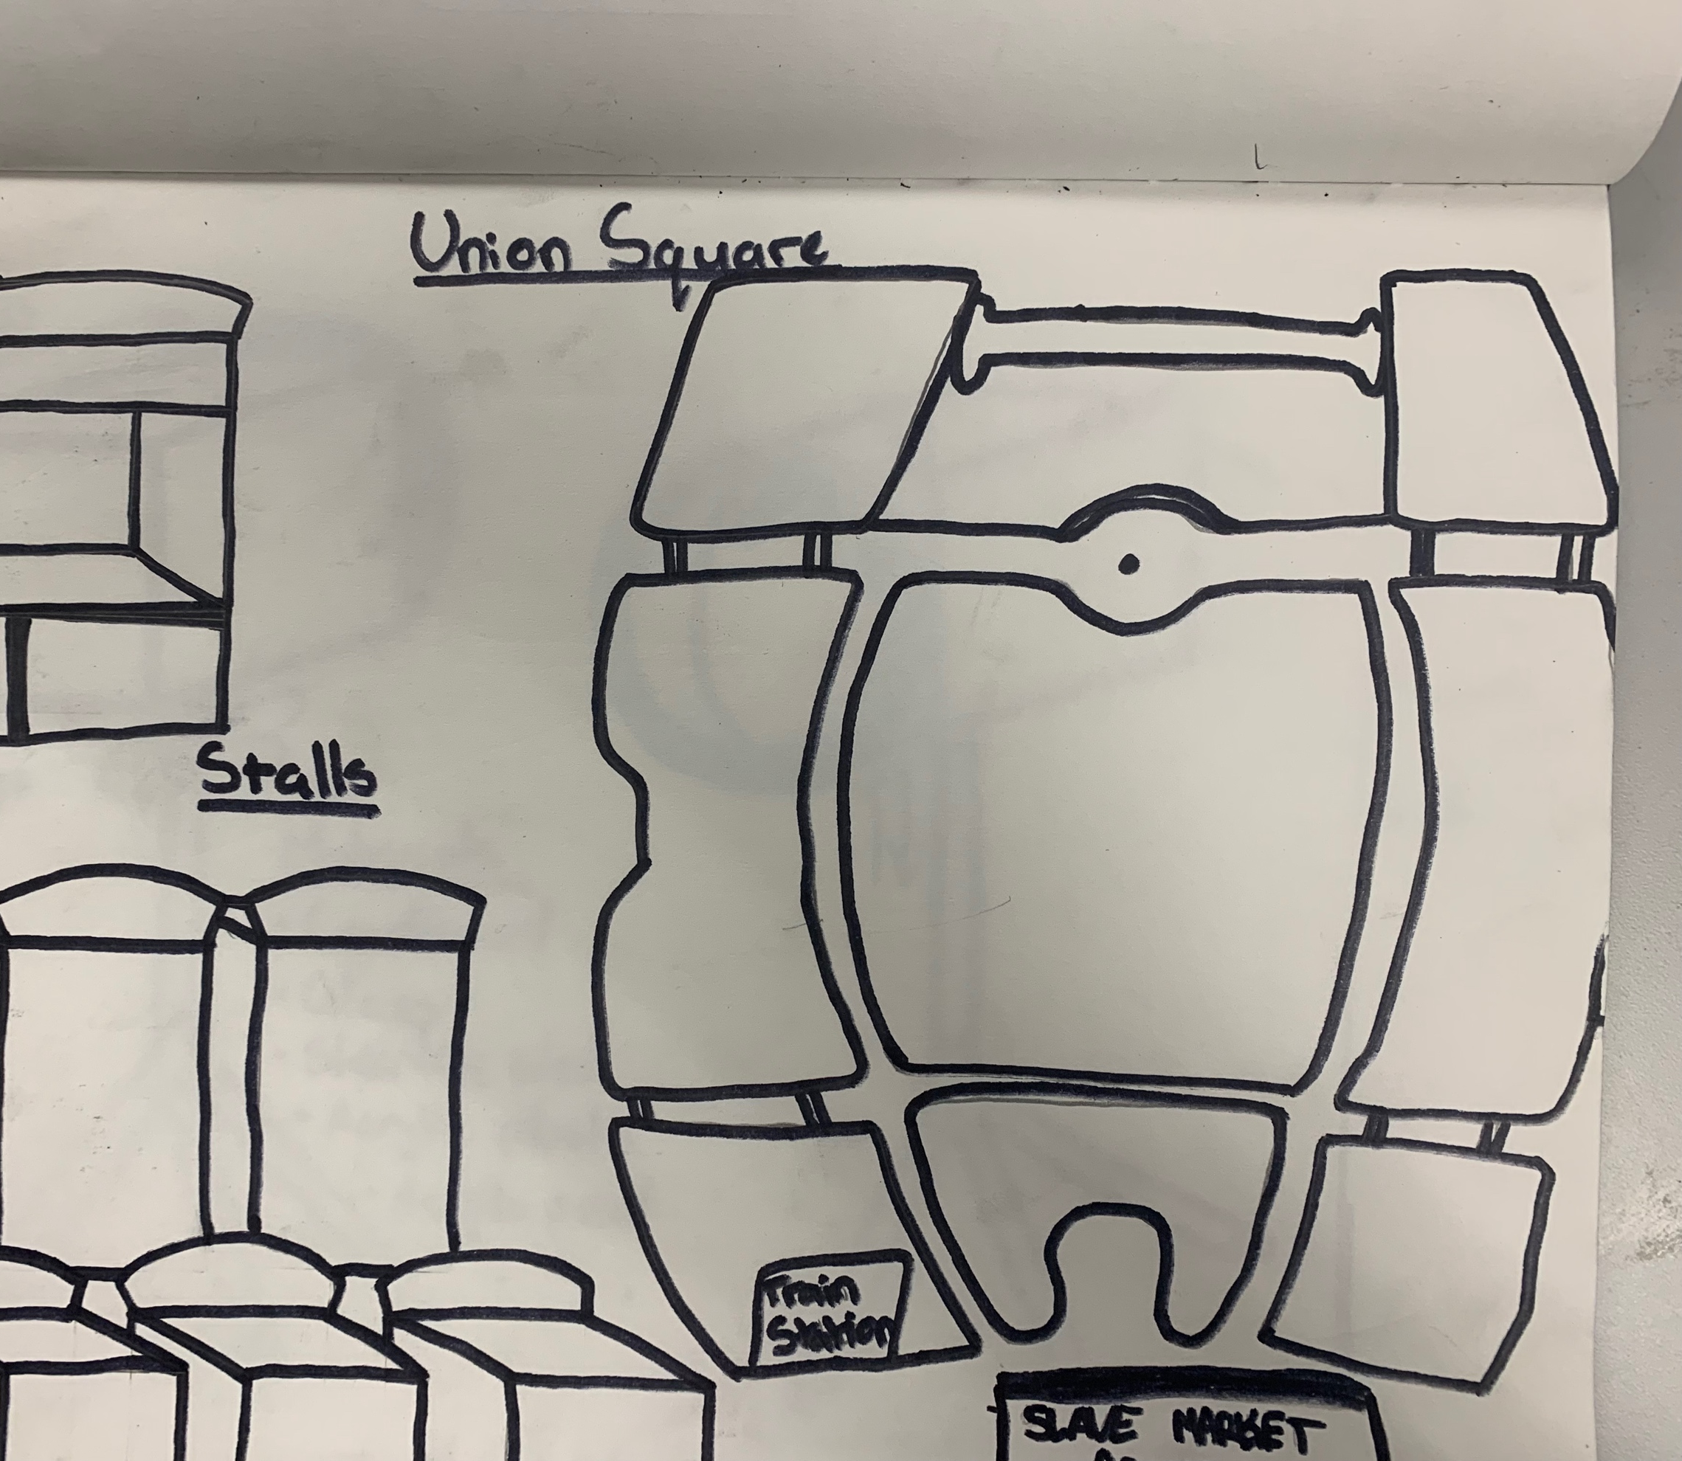
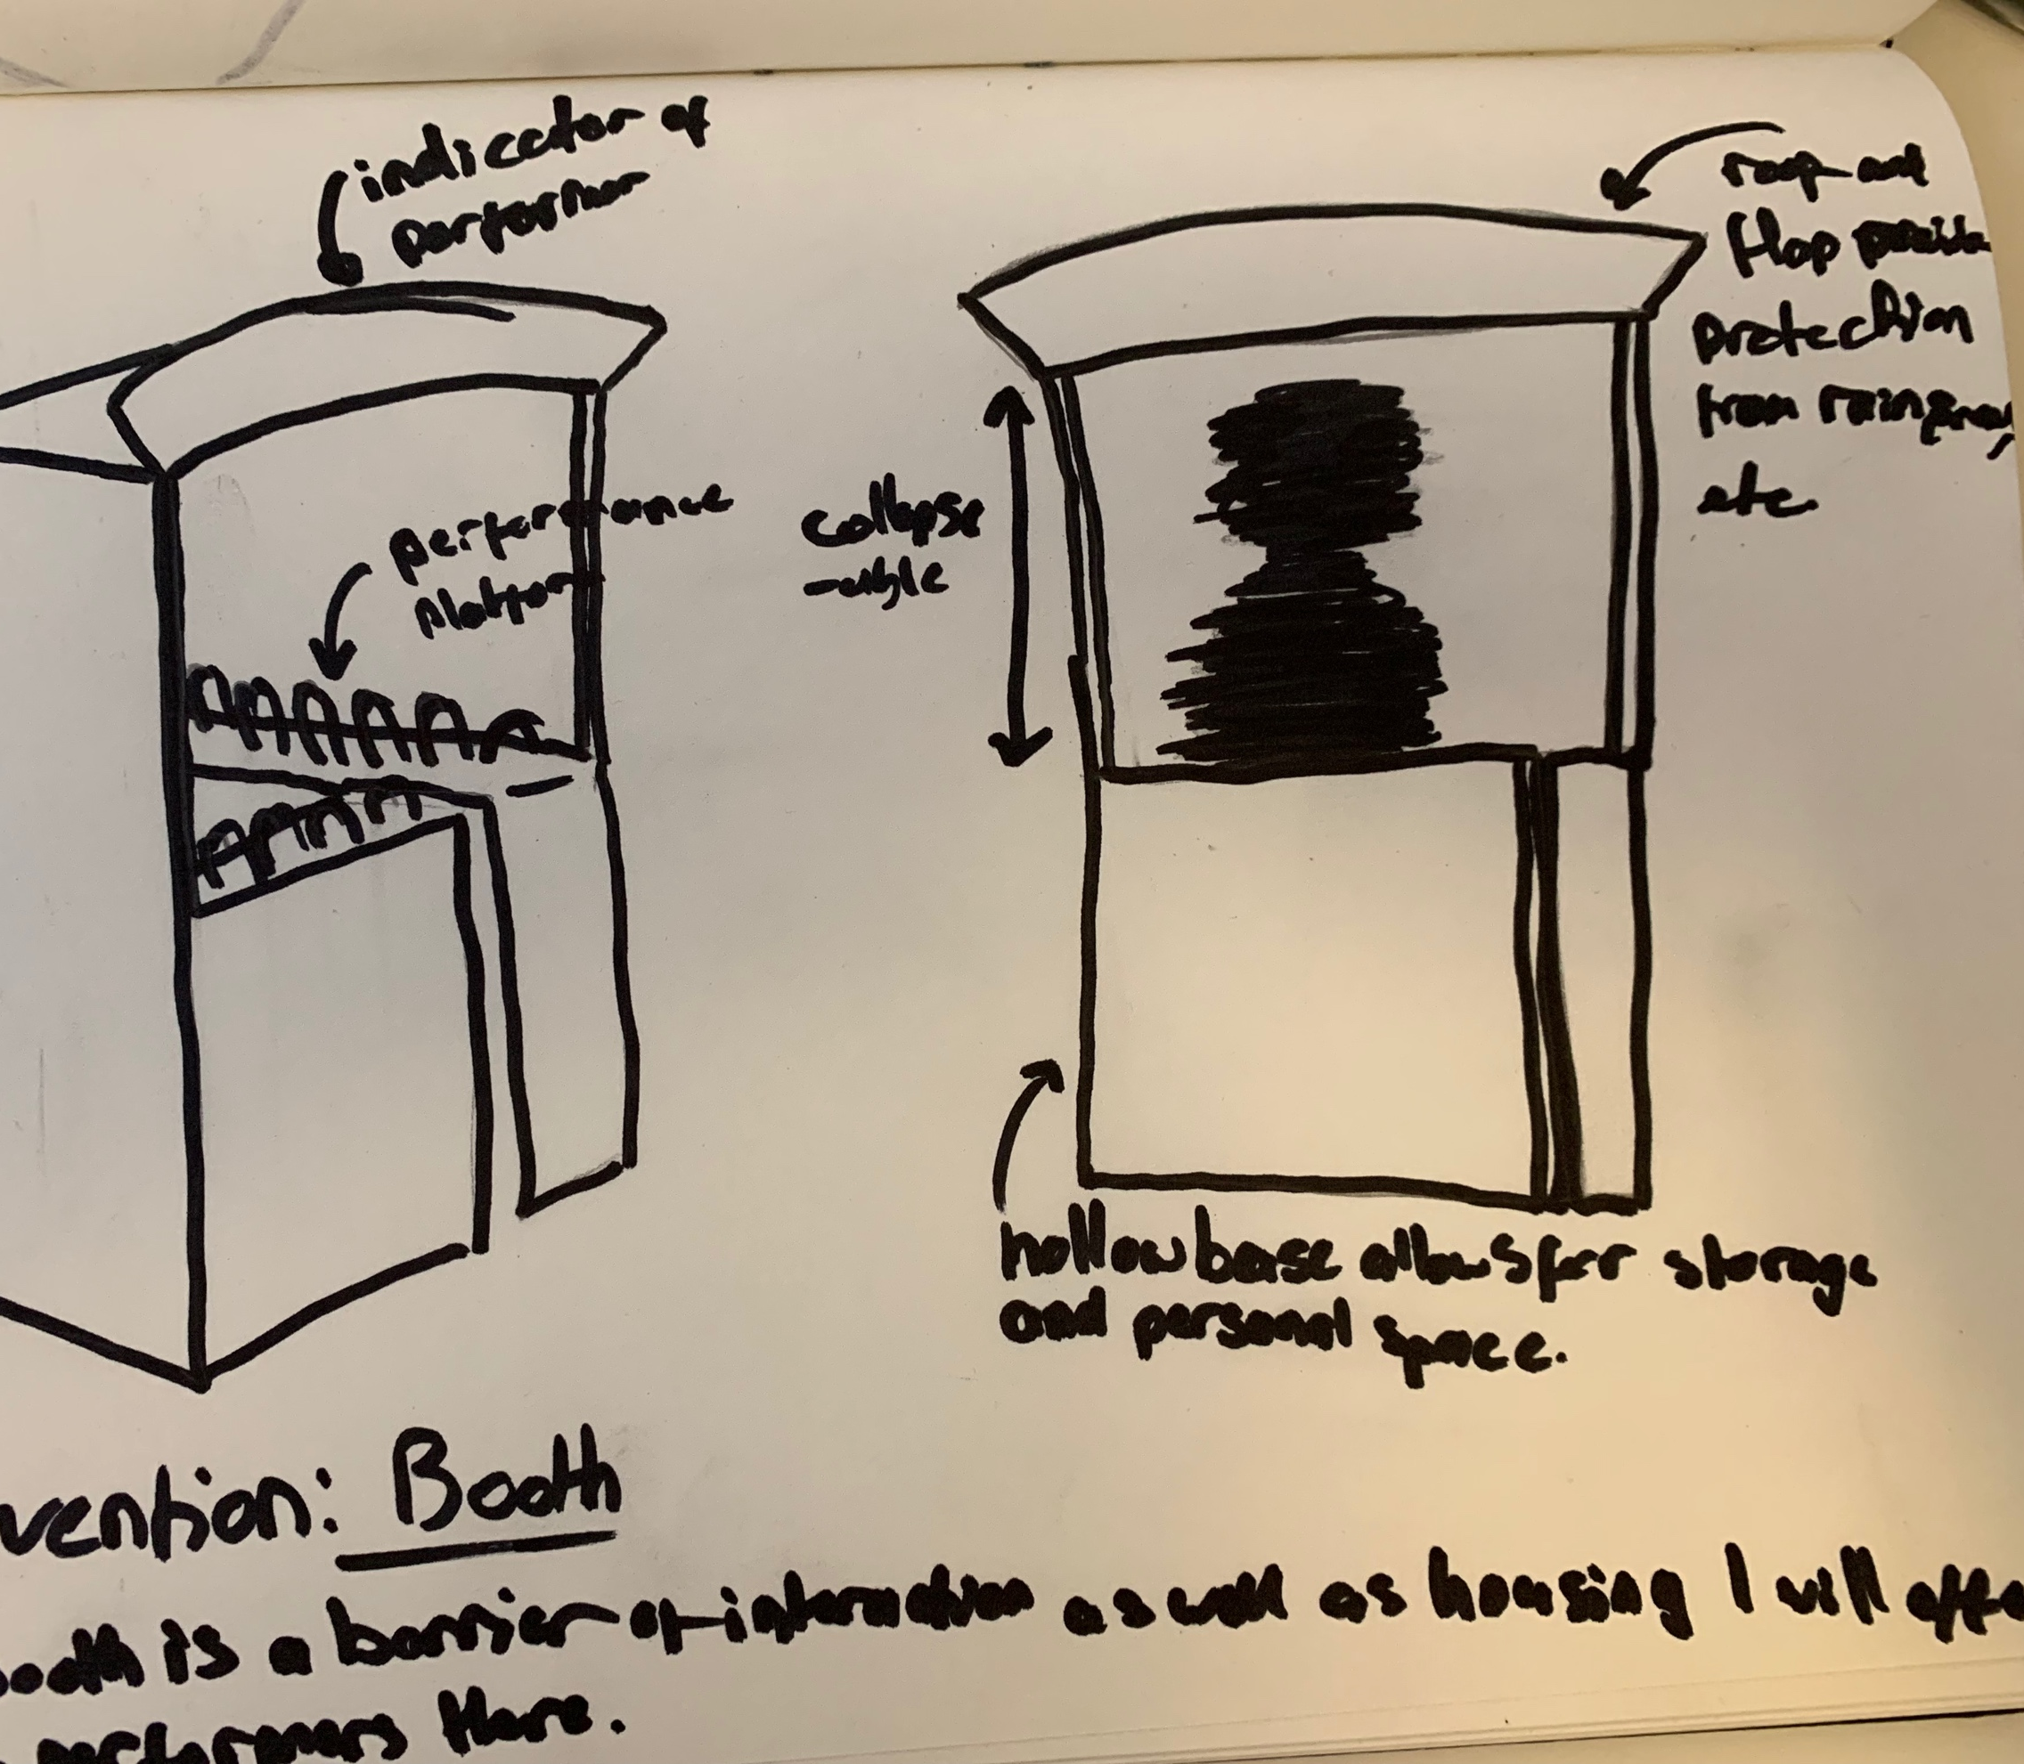
First Iteration
Historical link to Union Square “Slave Market”
Initially blamed street performers for crimes of assault
Provide incentive to leave people alone for shelter
Idea of booth, stall, or tent – Separate performers from pedestrians

Slide 7
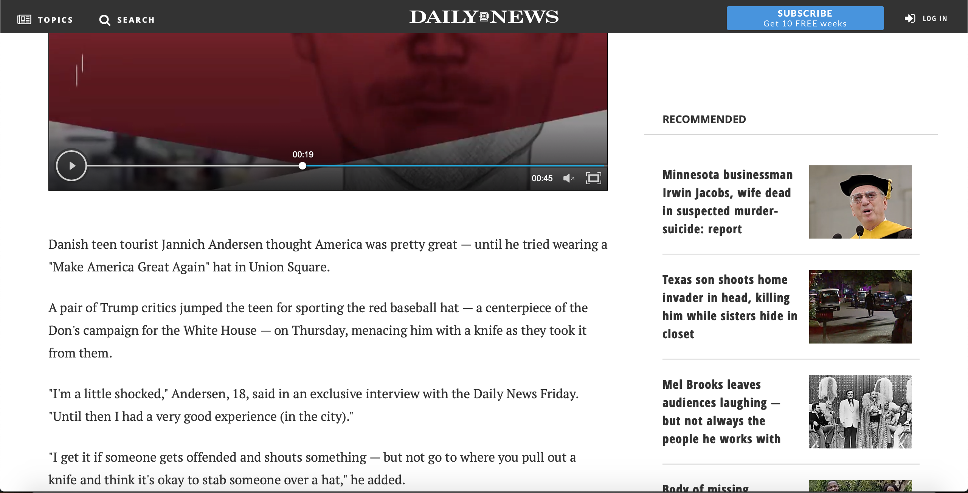
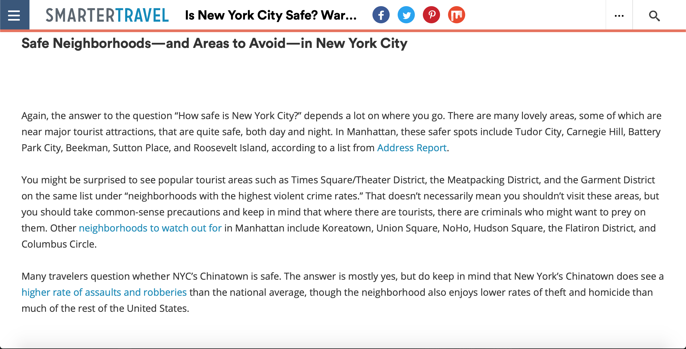
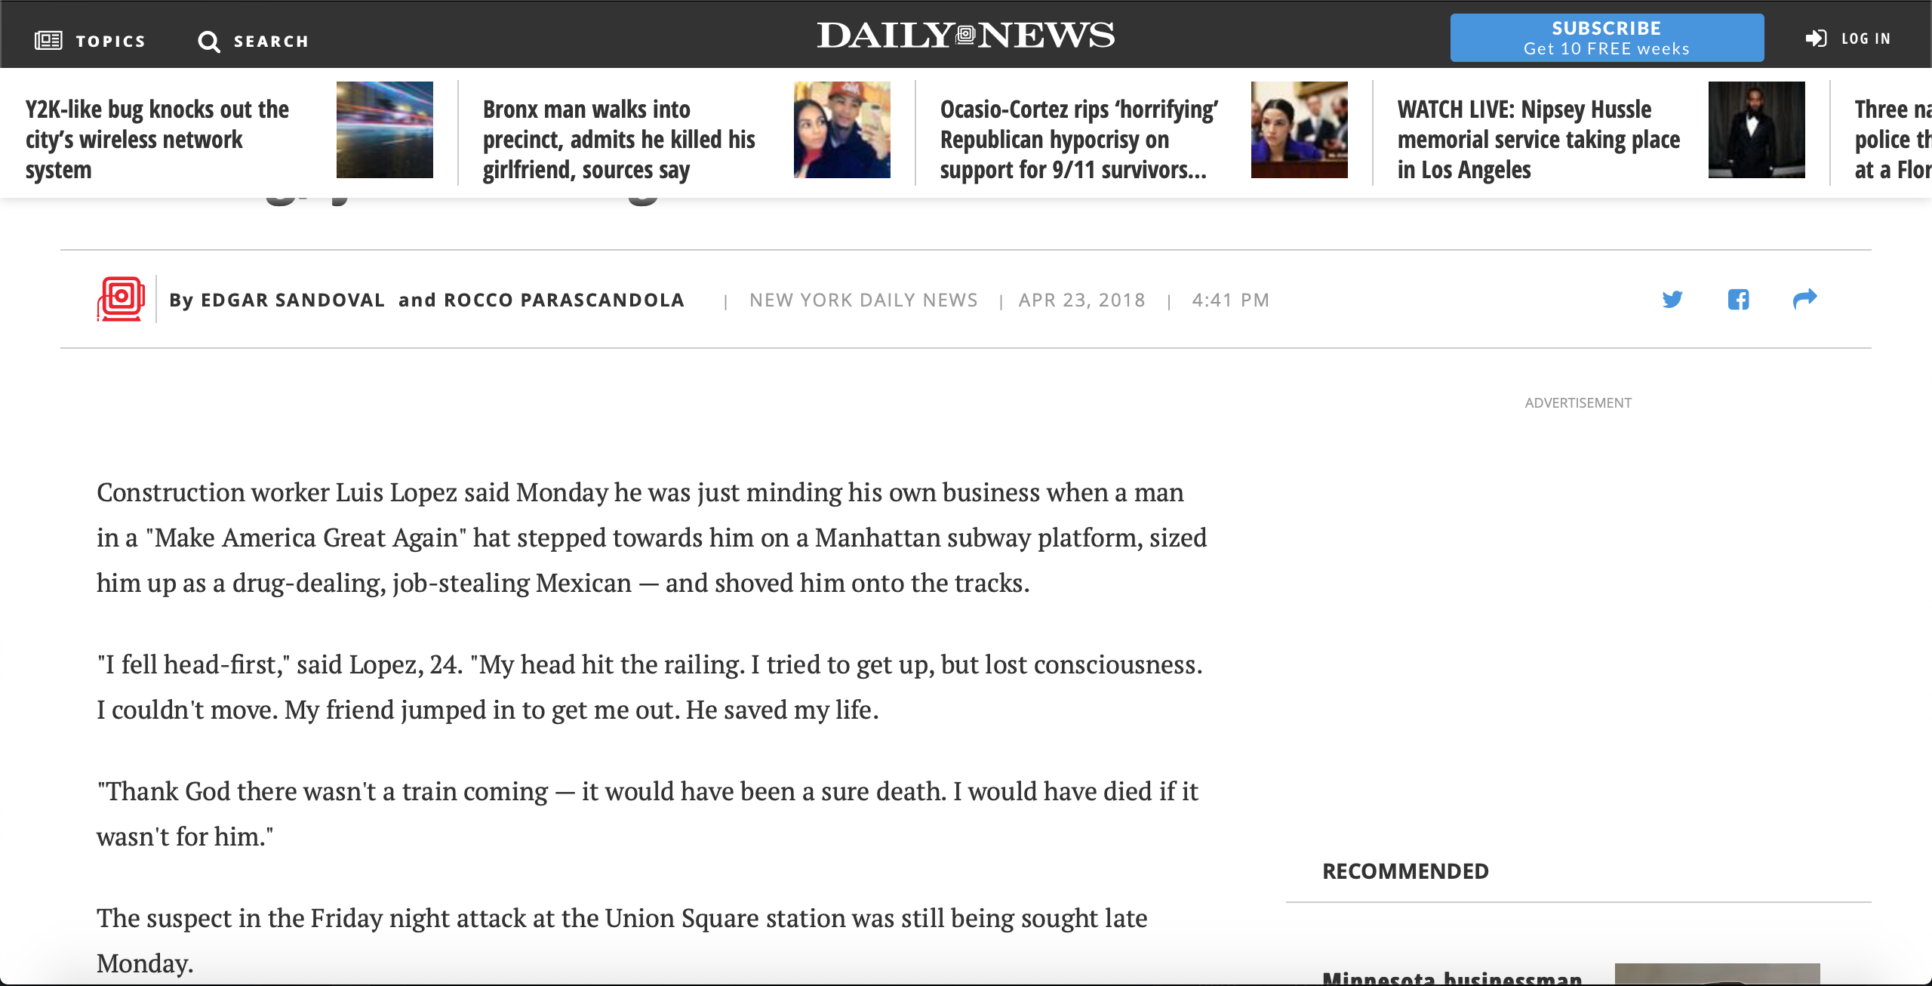
Research Findings

Slide 8
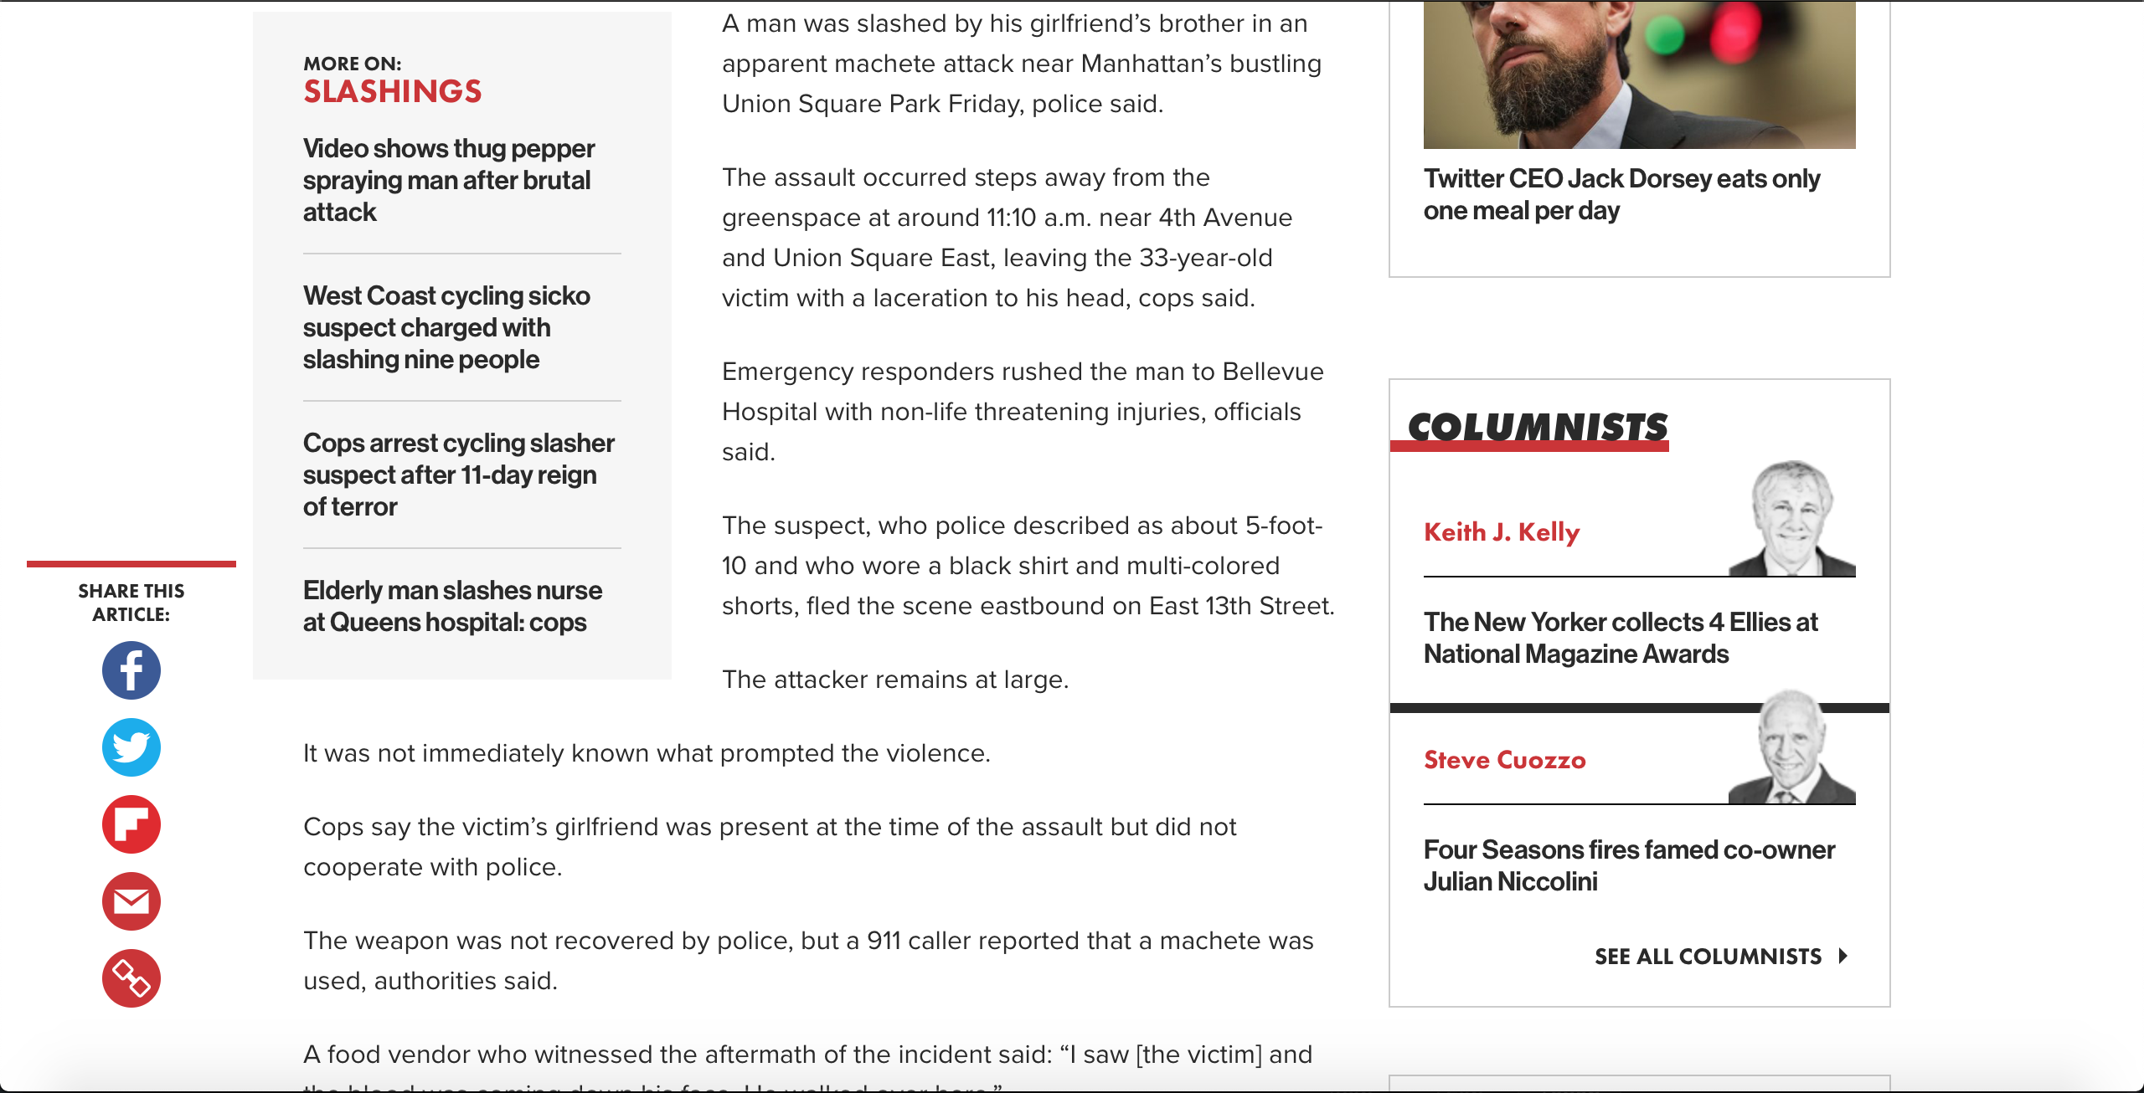
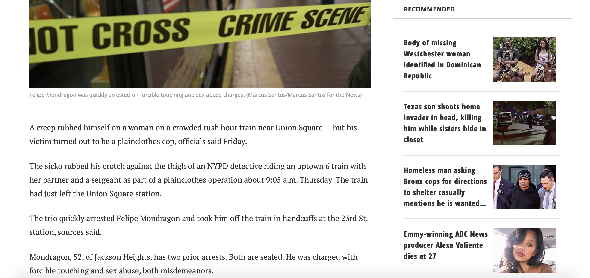

Slide 9
Research Findings
Crime is random and violent crime is not committed by street performers
The locations of these crimes are at areas of high congestion or train platforms
The crimes do not appear to be premeditated
Men are the more common perpetrators
Therefore
The booth intervention fails
Project needs to intervene directly at the crime
Must be long lasting

Slide 10
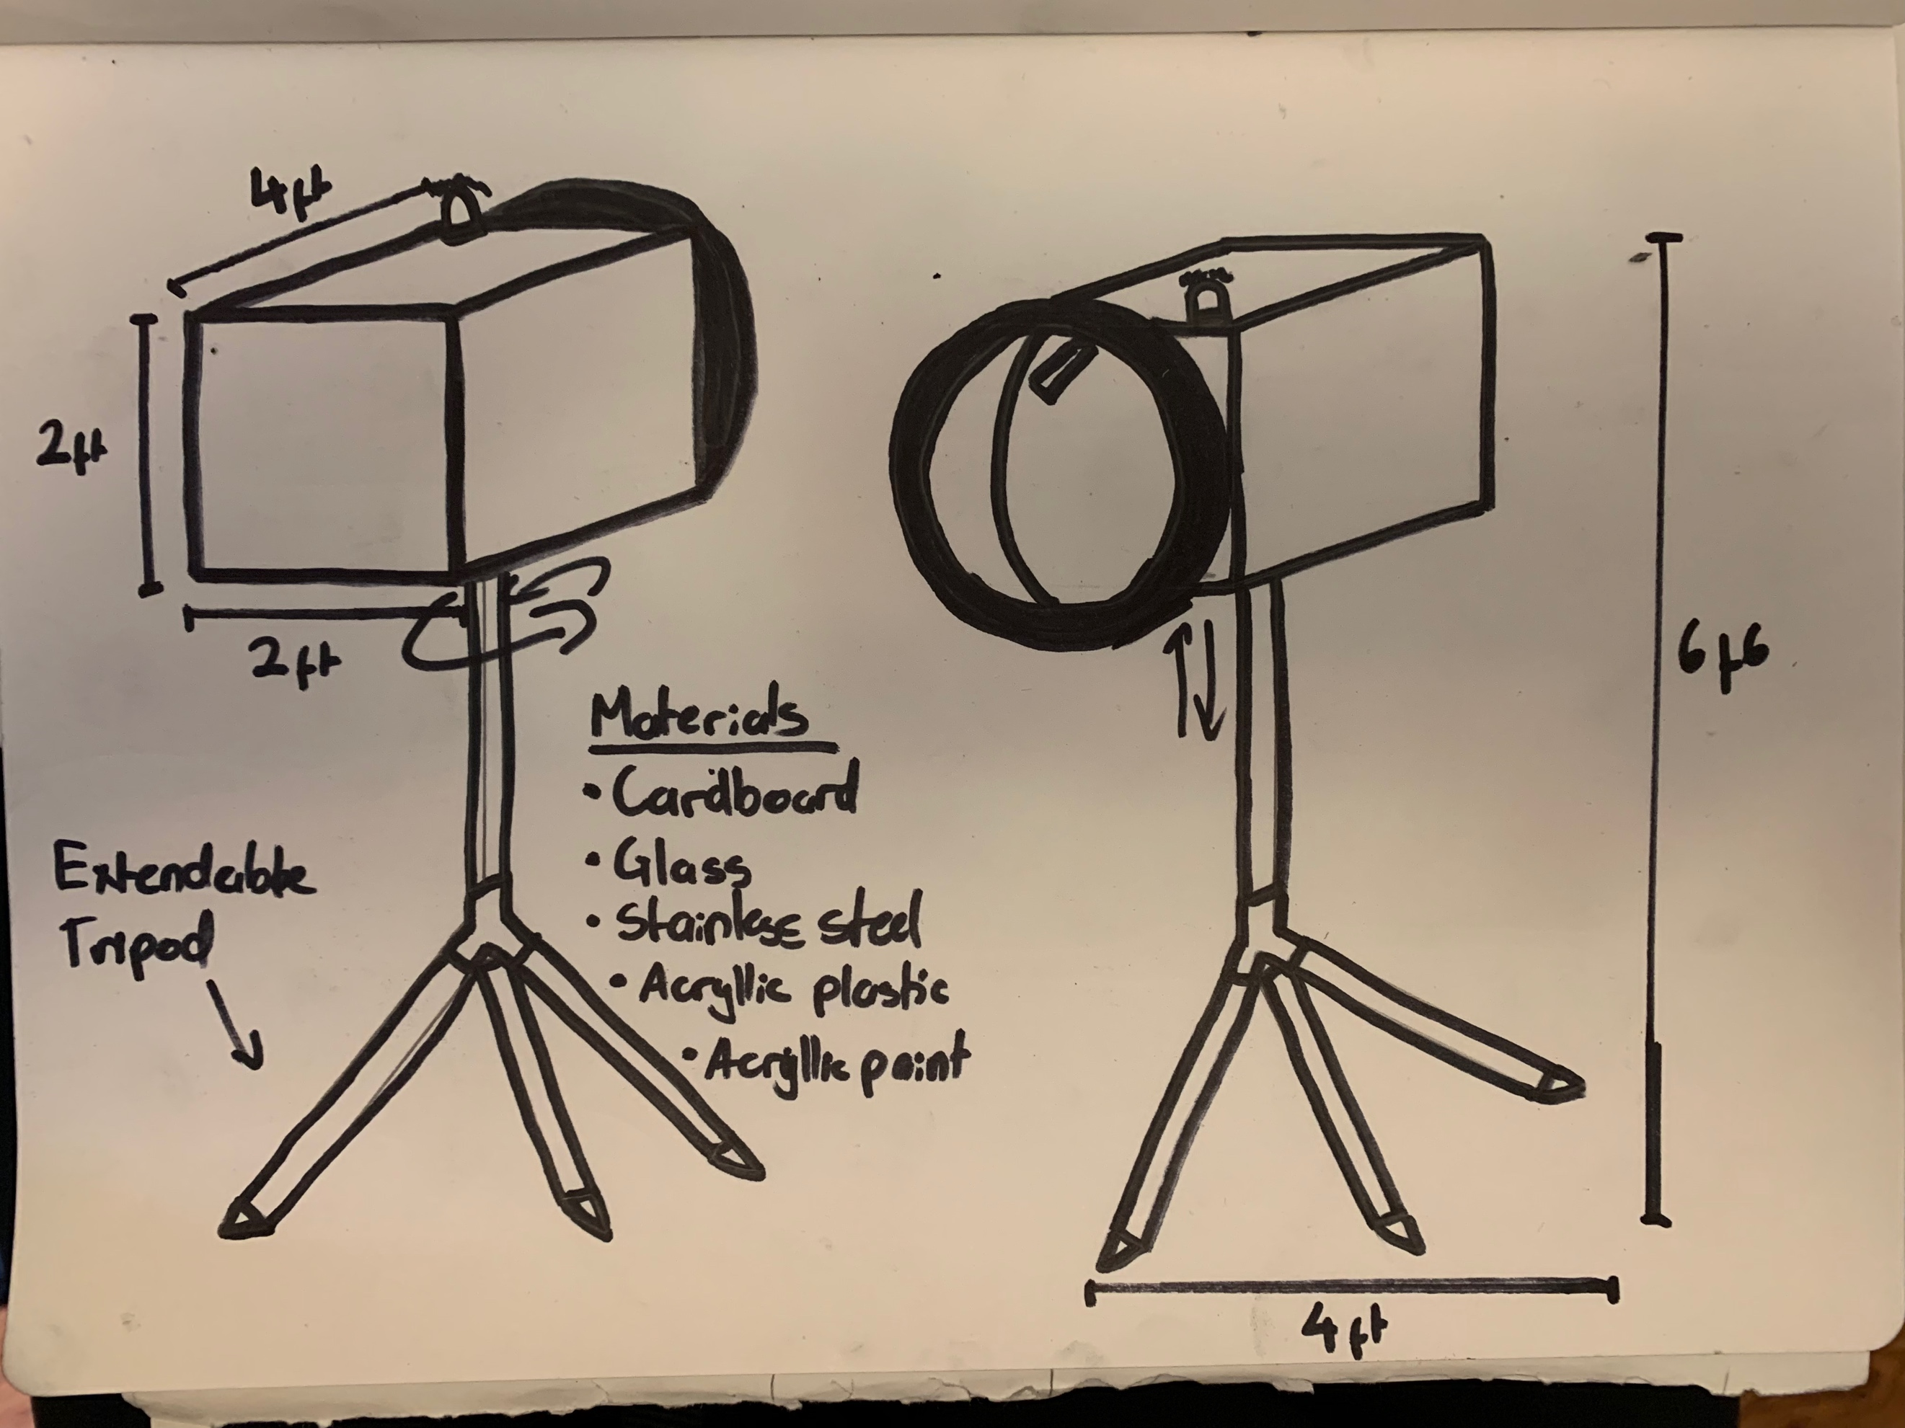
Final Iteration
Build an exaggerated camera to discourage crime throughout the subway
The camera must not record to avoid legal issues
Must be obvious in design to be easily seen and obviously recognized as a camera

Slide 11
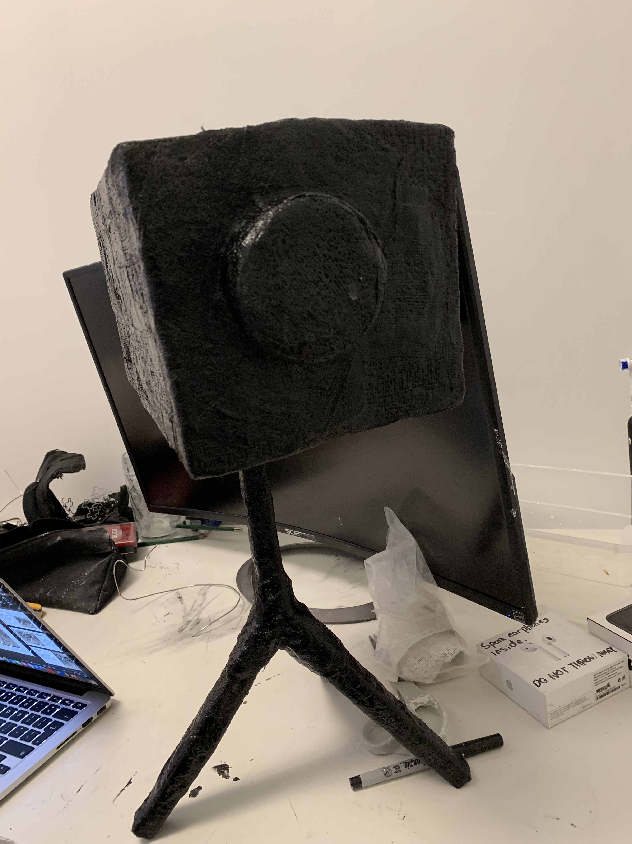
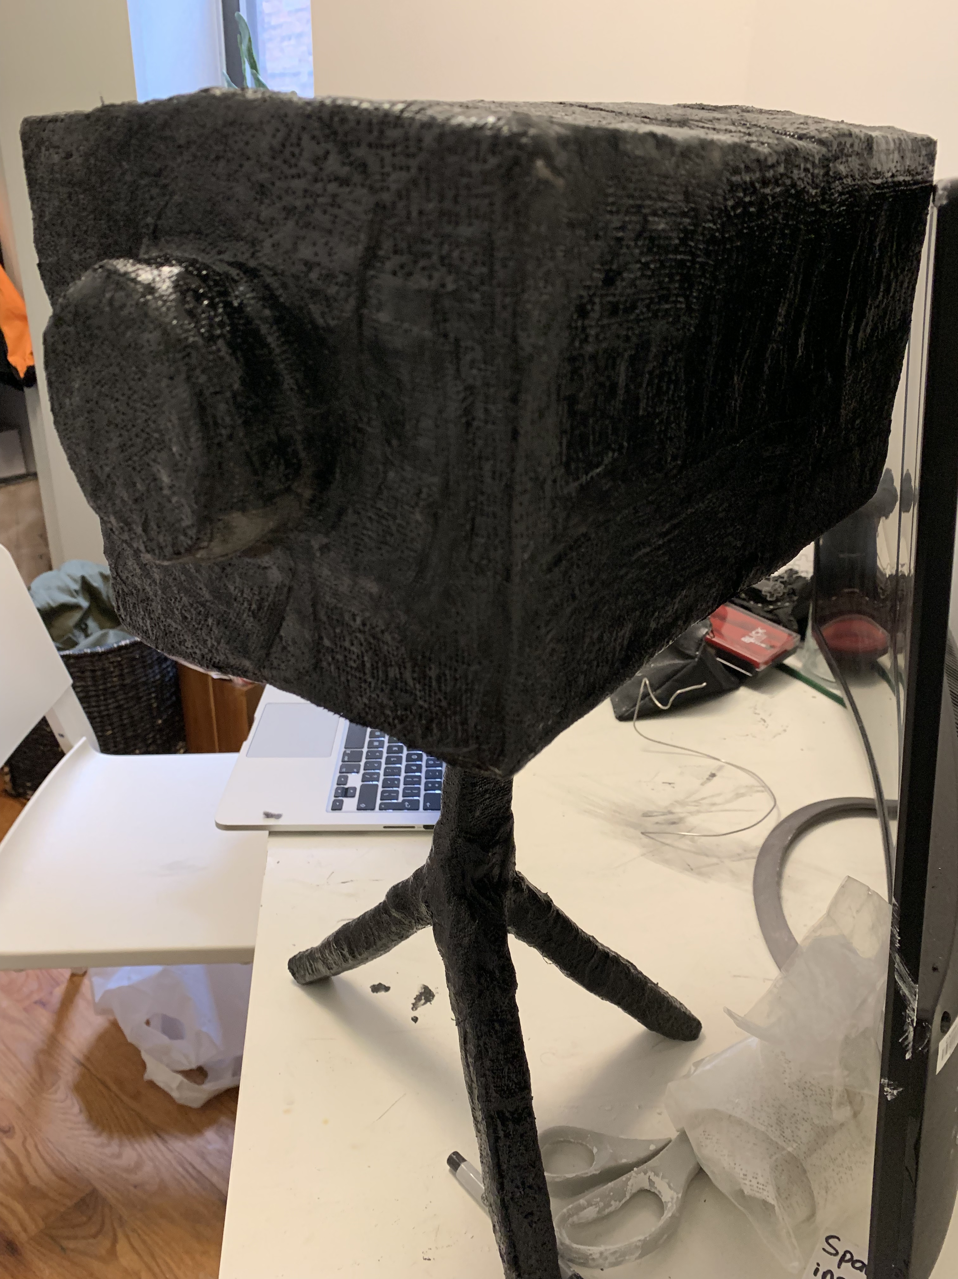
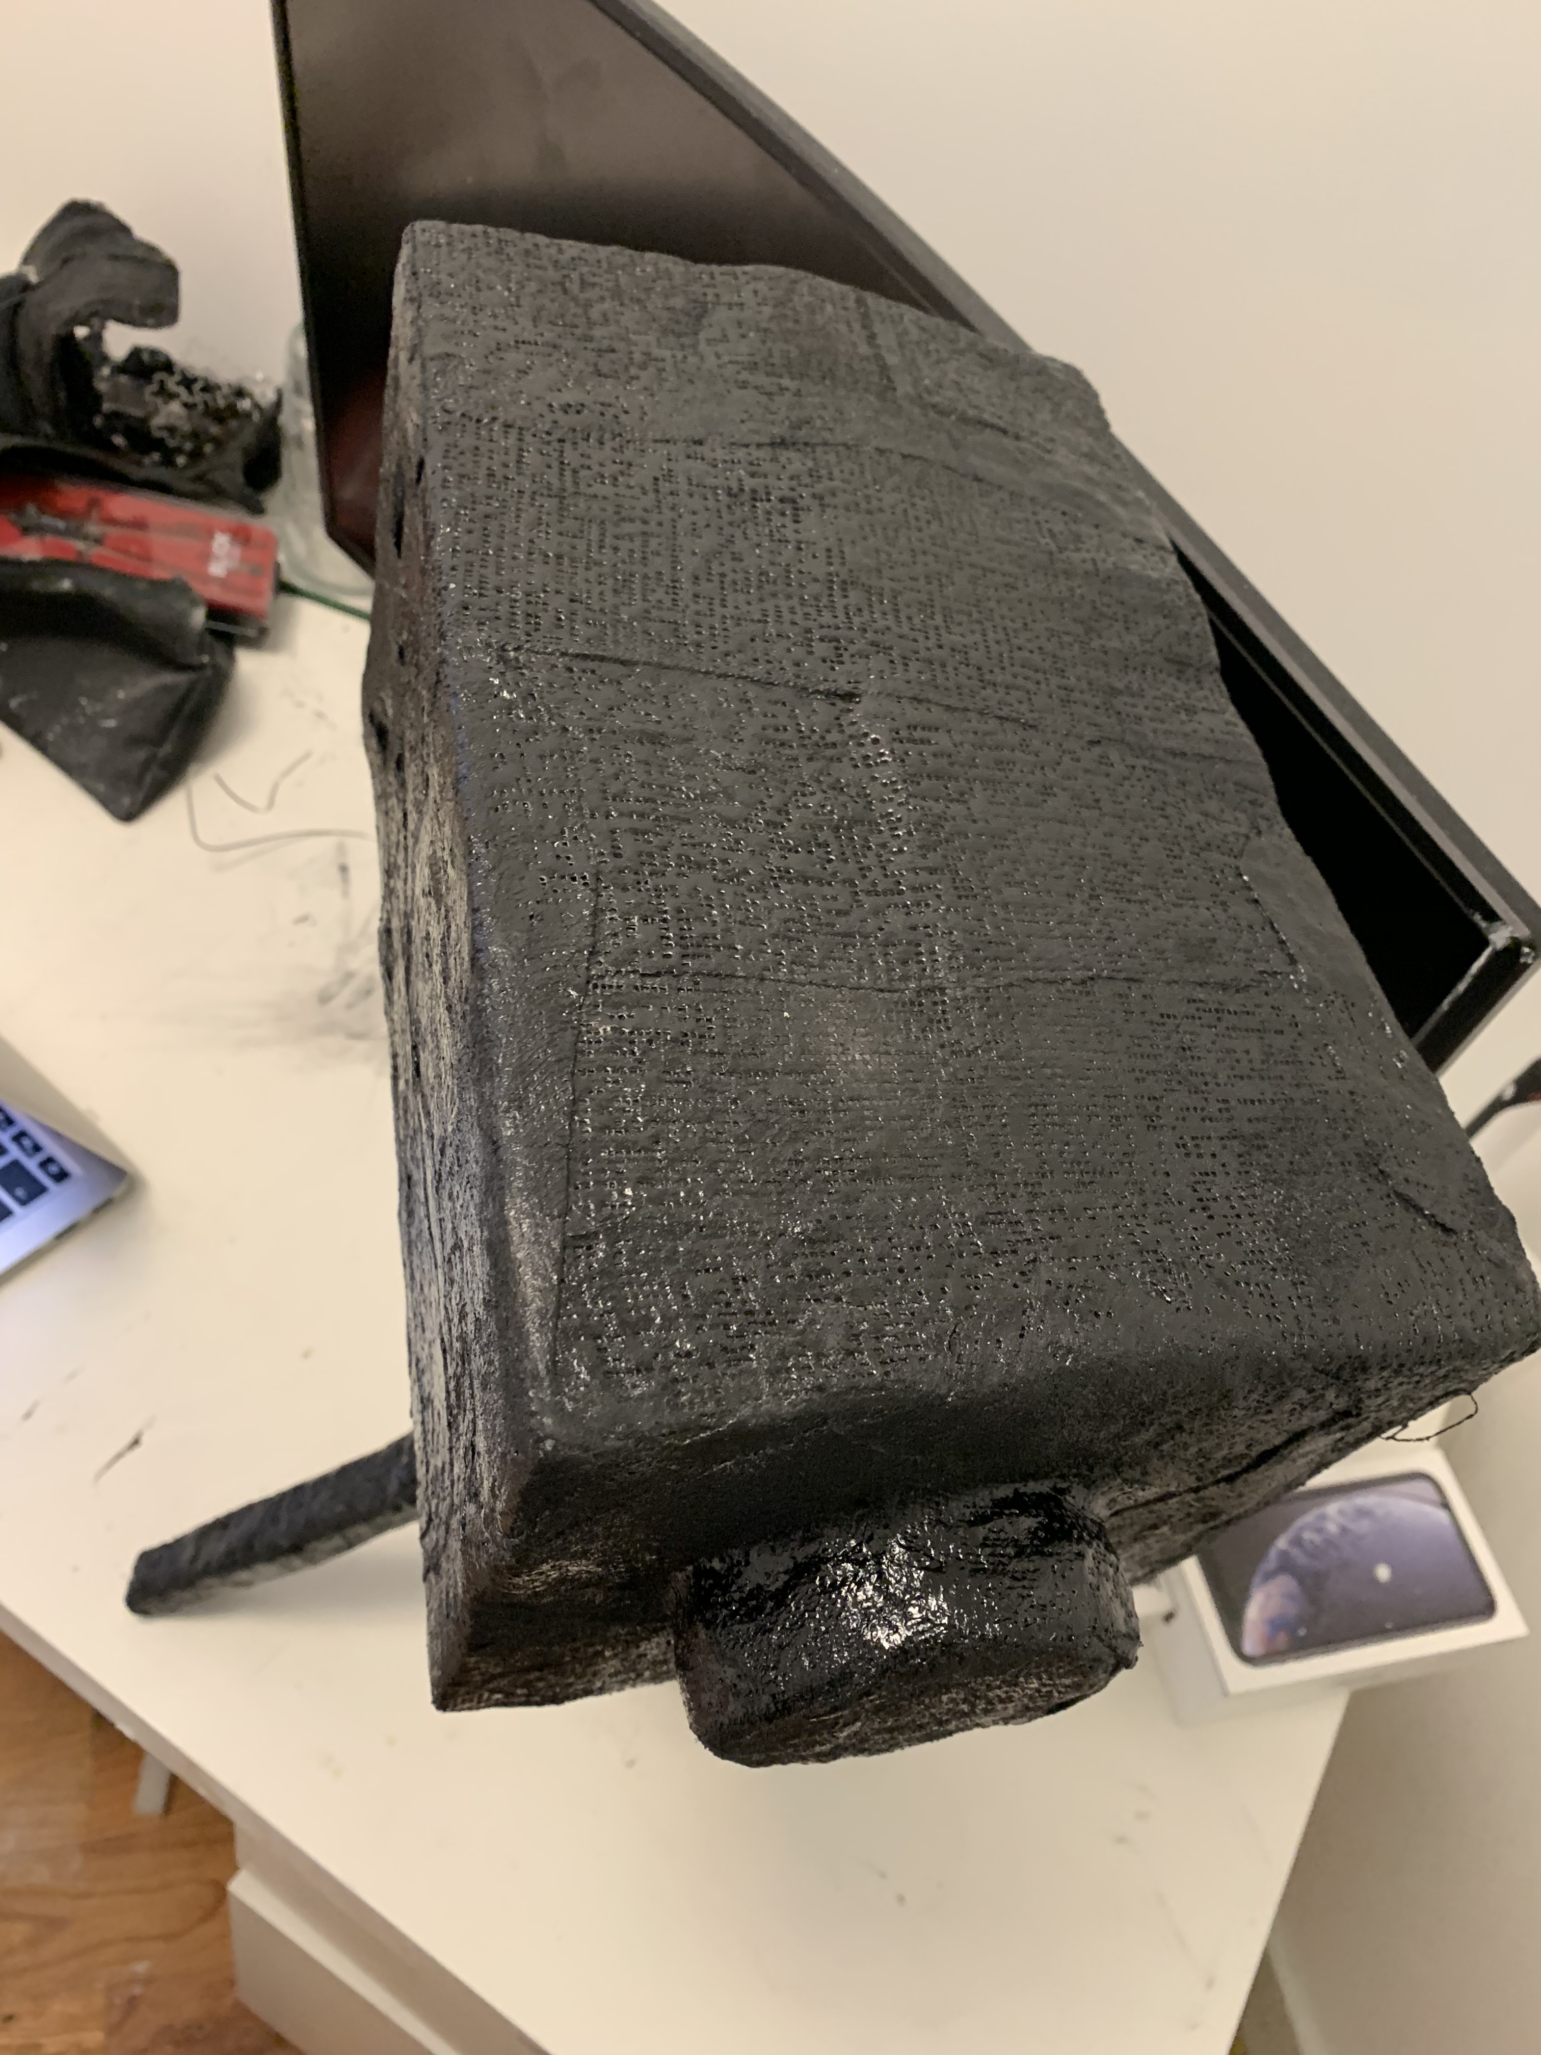
Final Model

Slide 12
Bibliography
https://www.smartertravel.com/tips-new-york-city-warnings-dangers-stay-safe/
https://nypost.com/2018/08/17/man-slashed-with-machete-in-union-square-park/
https://www.nydailynews.com/new-york/nyc-crime/sicko-grinds-crotch-plainclothes-nypd-manhattan-subway-article-1.3593649
https://www.nydailynews.com/new-york/manhattan-high-schooler-rapes-16-year-old-classmate-stairwell-article-1.3678700
https://www.nydailynews.com/new-york/nyc-crime/woman-pushes-man-union-square-subway-tracks-warning-article-1.3905535
https://www.nydailynews.com/new-york/nyc-crime/police-reform-activist-pushing-nypd-broken-windows-article-1.3802092
https://www.nydailynews.com/new-york/nyc-crime/danish-tourist-wearing-maga-hat-robbed-union-square-article-1.3931901
https://www.nydailynews.com/new-york/nyc-crime/maga-loving-attacker-judged-victim-job-stealing-mexican-article-1.3950335

