Slide 1
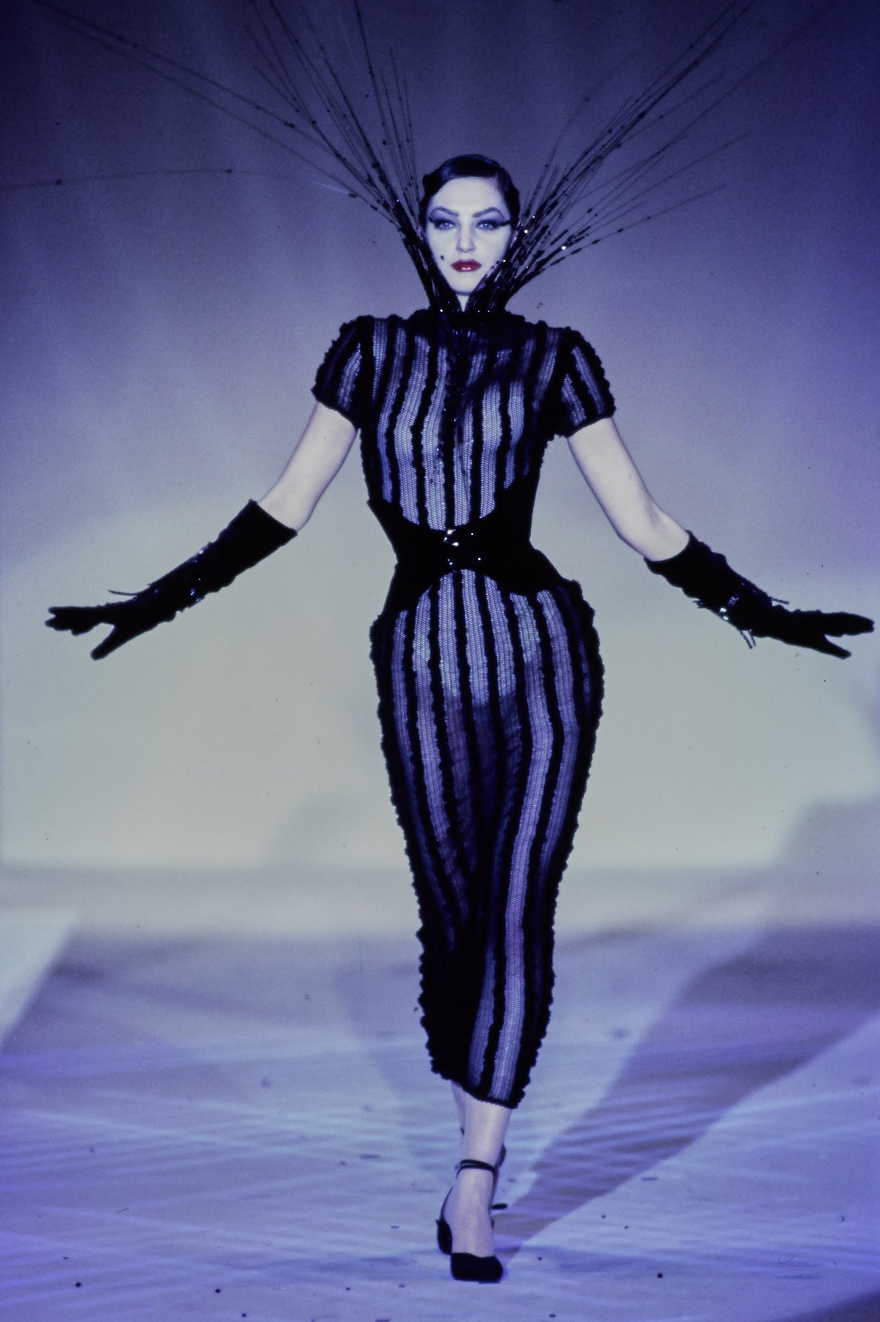
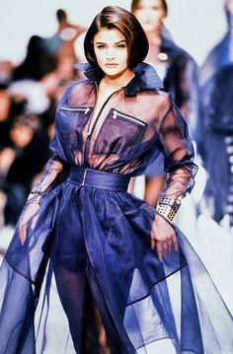
Thesis
To what extent did the influence of fetish and clubwear have over Thierry Mugler and Claude Montana and how did this translate into their fashion?

Slide 2
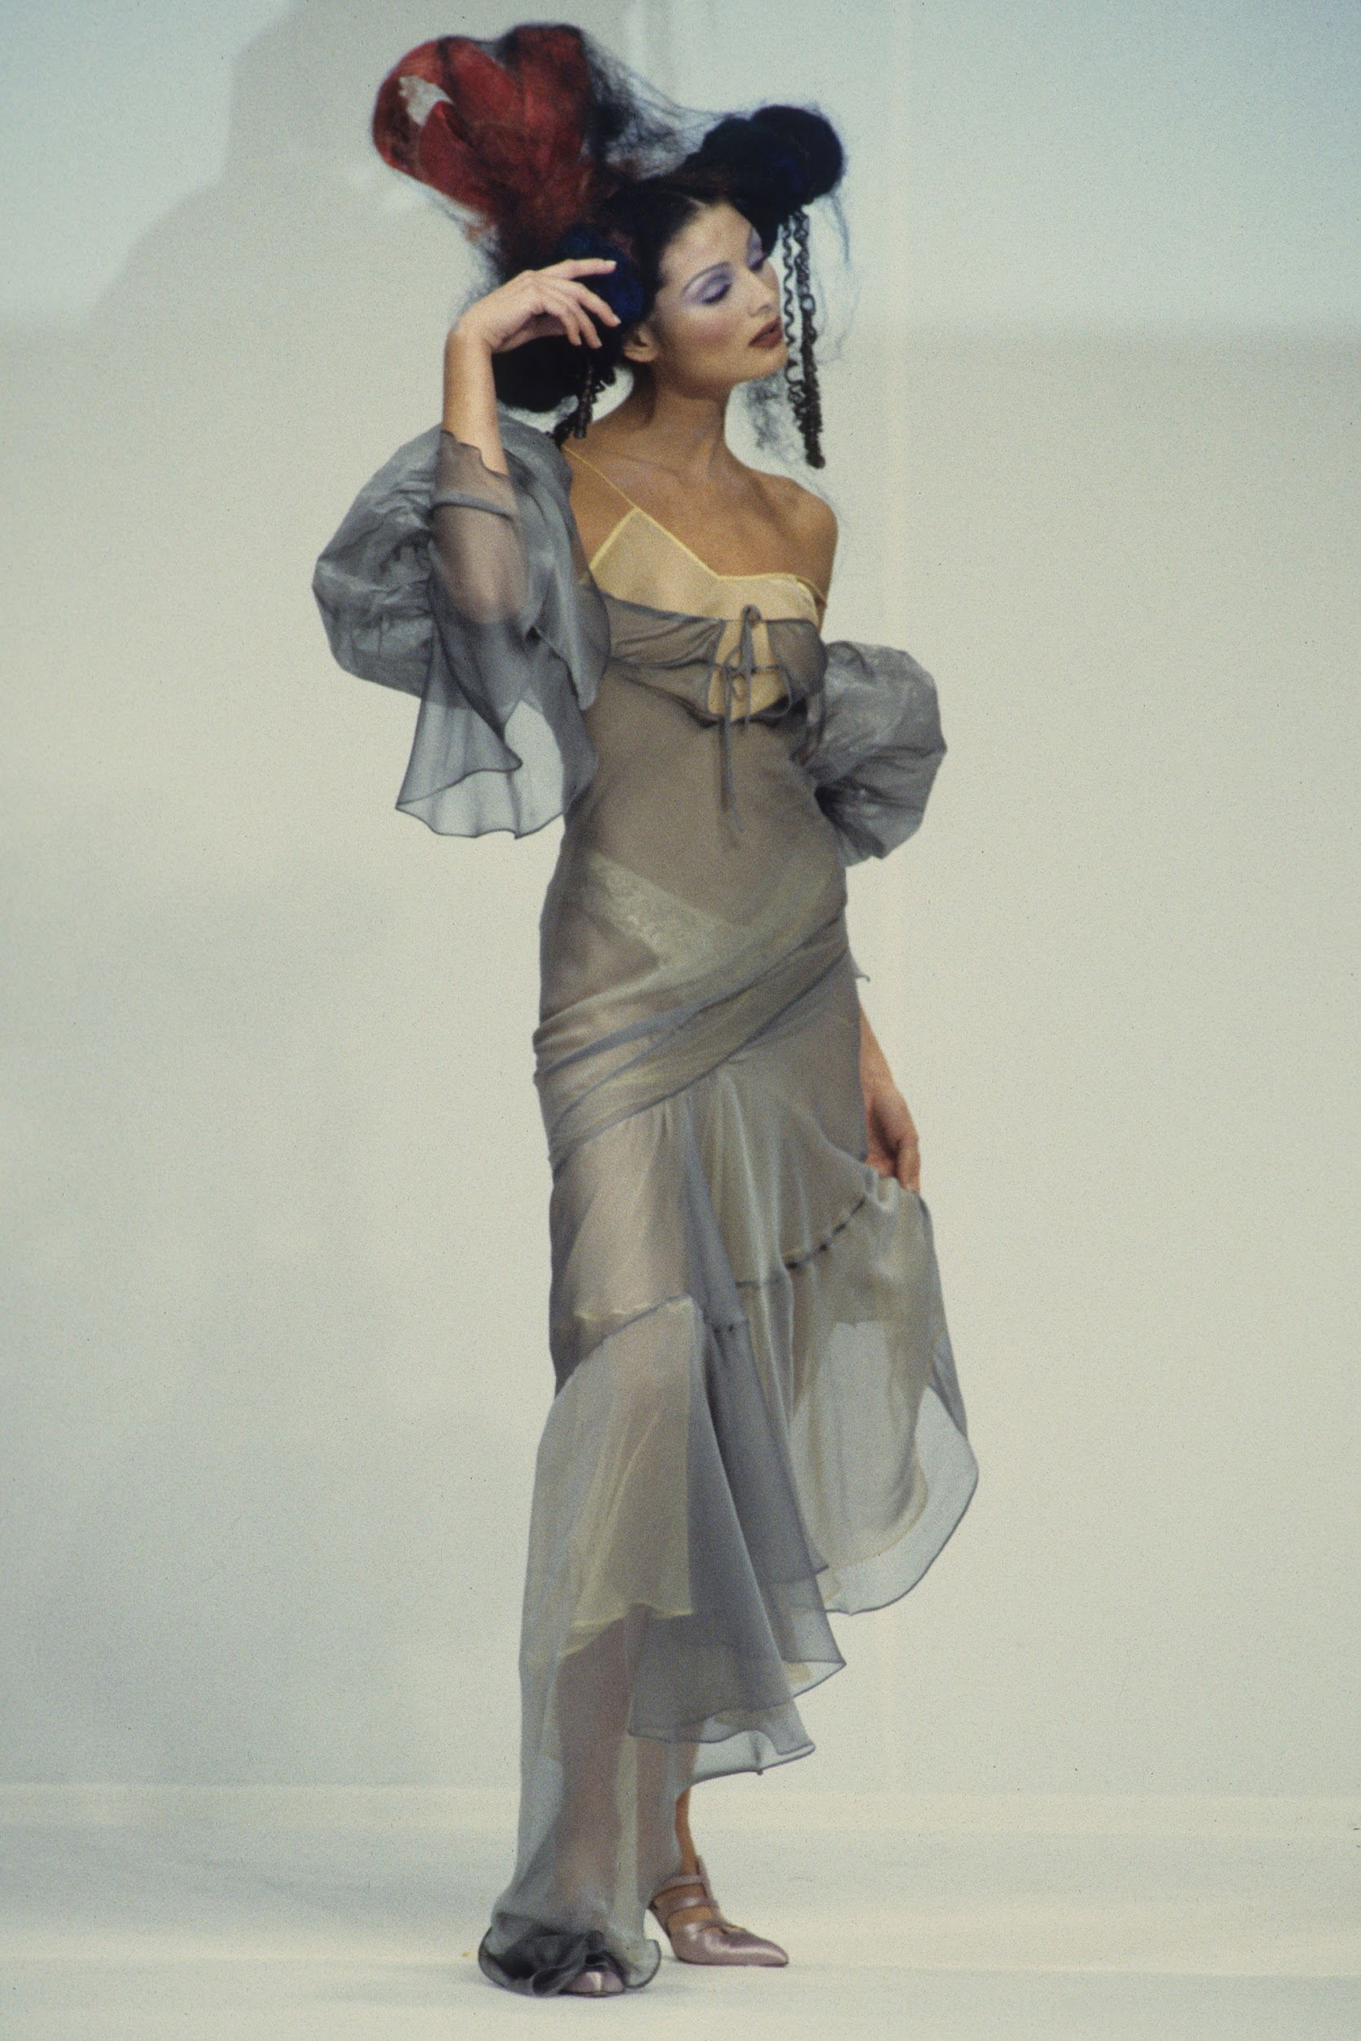
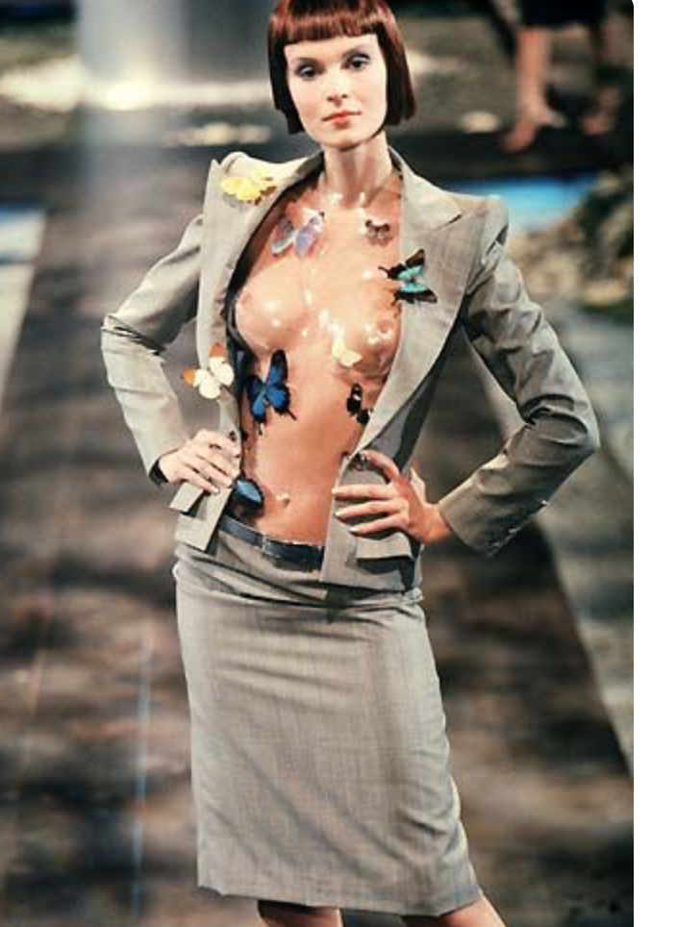
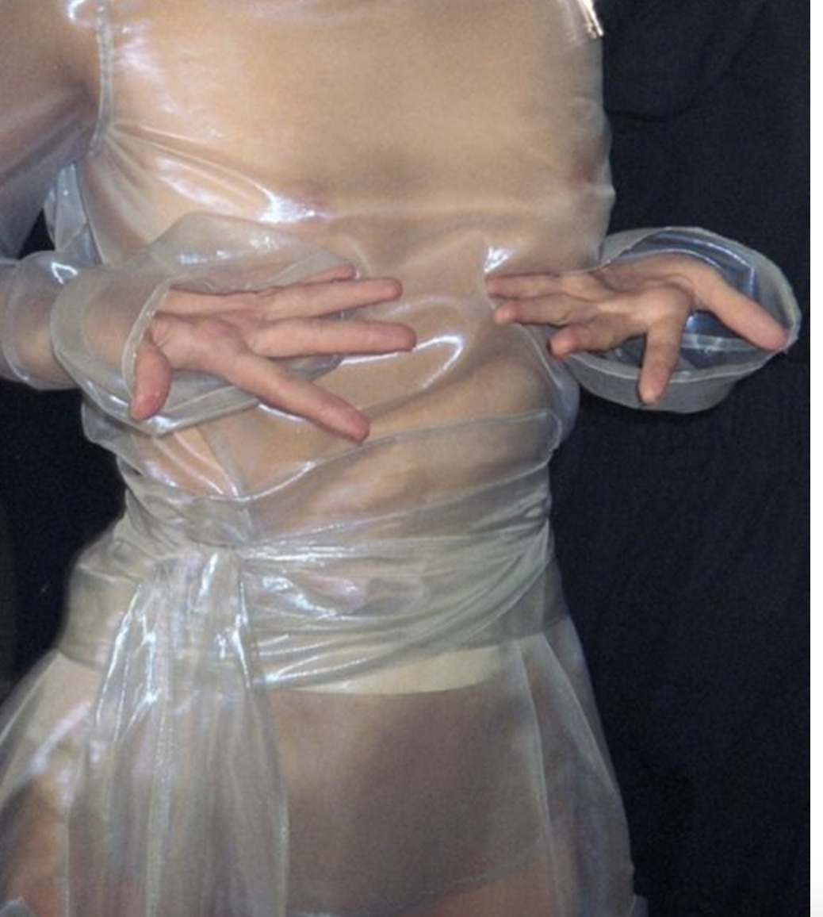
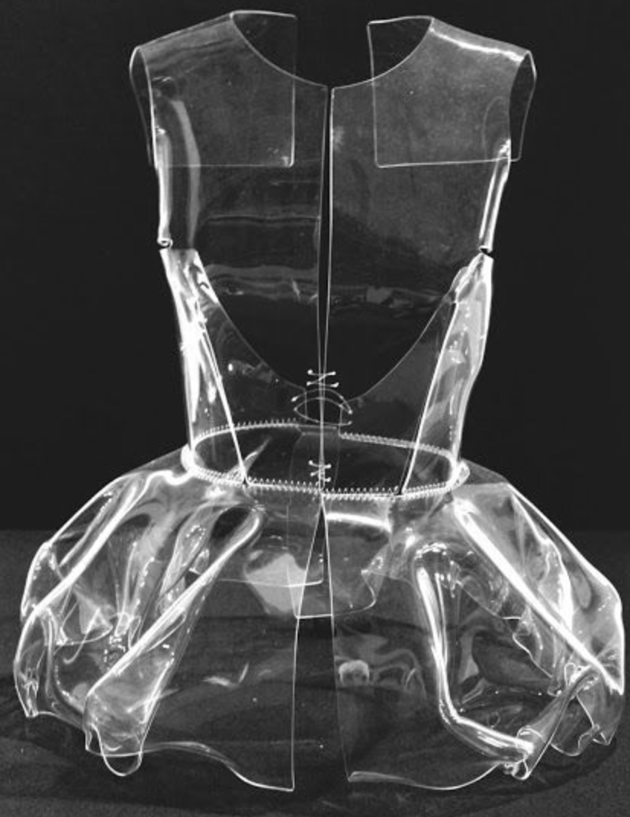
Inspiration

Slide 3
steps
Cut and fit pattern
Bond plastic using parchment paper and iron
add buttons
Cinch waist with zip ties

Slide 4
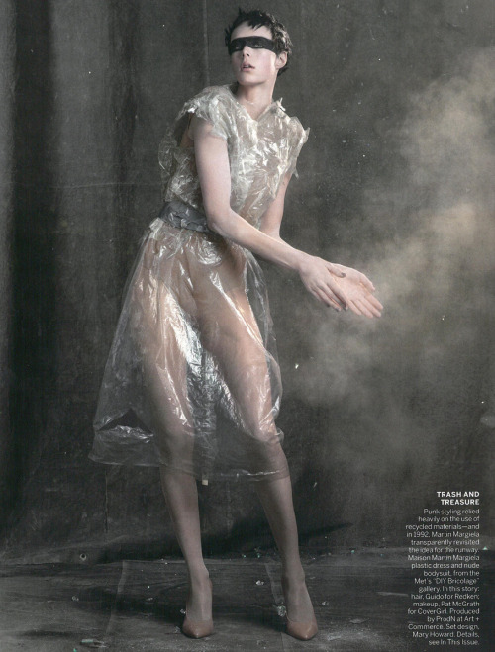
Research tools
http://www.hexjam.com/uk/style/how-to-make-a-dress-out-of-plastic

Slide 5
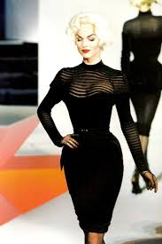
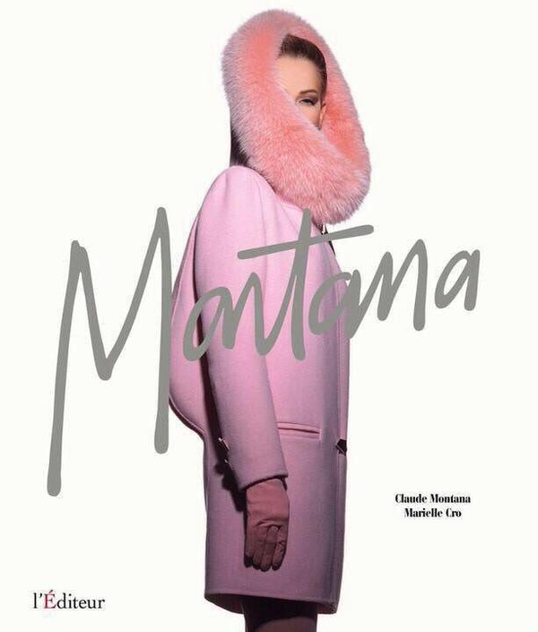
Supporting facts
-Both french and Born out of the club scene
-both championed bold shapes and color
-where the second generation of french ready to wear designers

Slide 6
Conclusion
To be determined

Slide 7
Reference
Fraser-Cavassoni, Natasha, and Jonathan Becker. "The Disappearing Designer: What Happened to Claude Montana, the Lost King of Paris Couture?" Vanities. January 29, 2015. Accessed March 14, 2017. http://www.vanityfair.com/style/2013/09/claude-montana-king-paris-couture.
"Fashion: Montana's Modern Edge." Vogue Dec 01 1986: 256,256, 257, 258, 259. ProQuest. 14 Mar. 2017
Concepts and Practices of the Underground. (2013). In Lindner C., Hussey A., Lindner C., & Hussey A. (Eds.), Paris-Amsterdam Underground: Essays on Cultural Resistance, Subversion, and Diversion (pp. 13-20). Amsterdam University Press. Retrieved from http://www.jstor.org/stable/j.ctt6wp6td.5
Wilson, Elizabeth. "Deviant Dress." Feminist Review, no. 35 (1990): 67-74. doi:10.2307/1395401.

