Slide 1
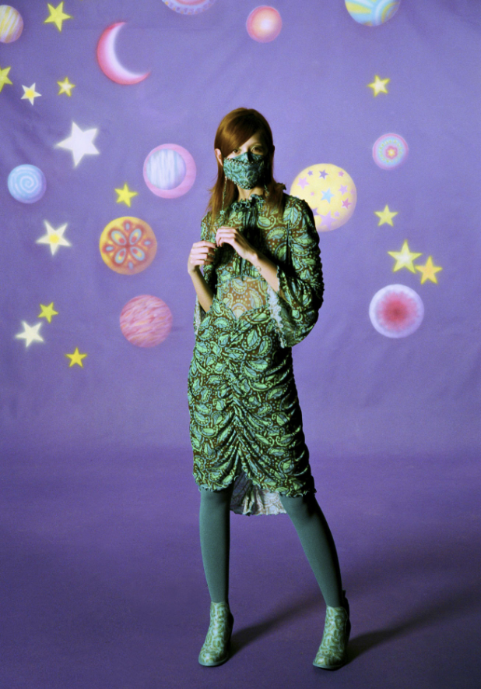
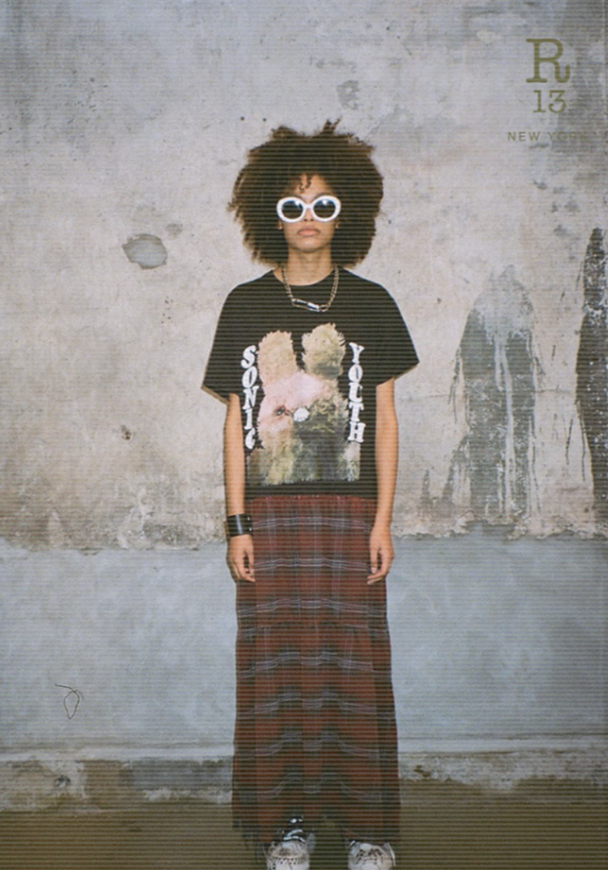
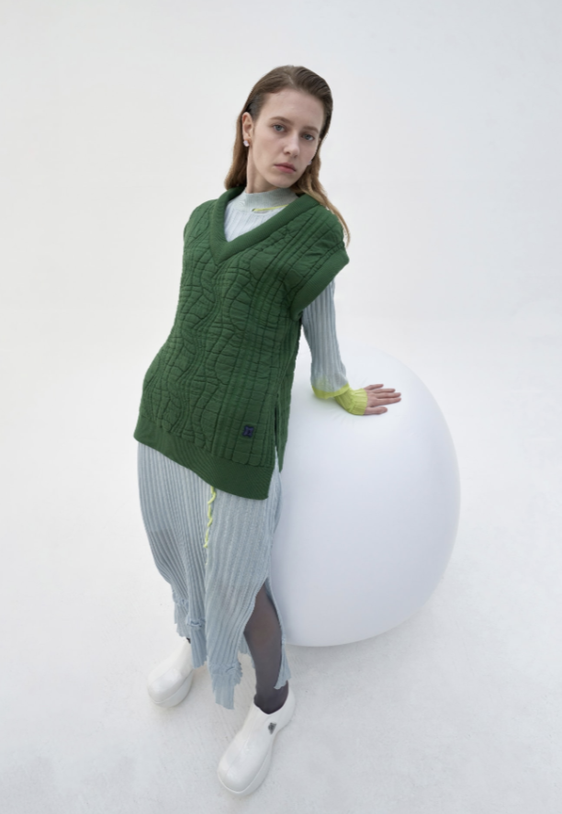
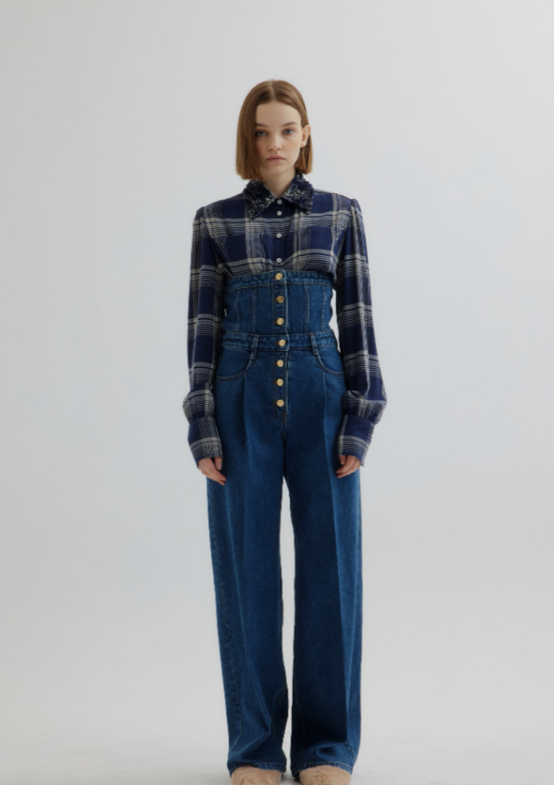
#NYFW Part 2
Fashion Public Relations
Vanessa Nefve

Slide 2
Table of Context
Slide 2- Trend 1
Slide 4- Trend 2
Slide 6- Trend 3
Slide 8- Trend 4
Slide 10- Editors Chart Page One
Slide11- Editors Chart Page Two
Slide 12- Editors Chart Page three
Slide 13- Editors Chart Page Four

Slide 3
Trend One

Slide 4
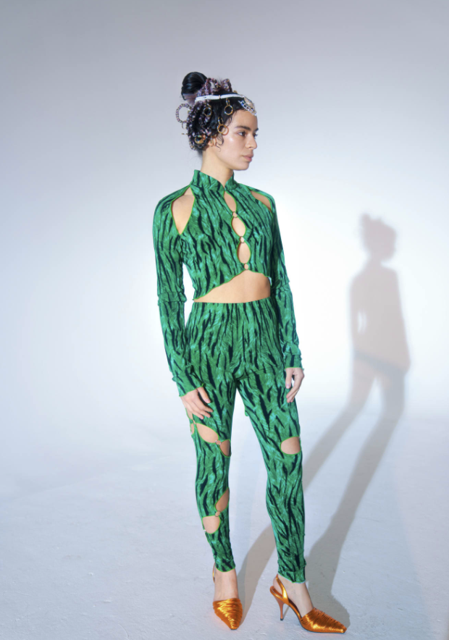
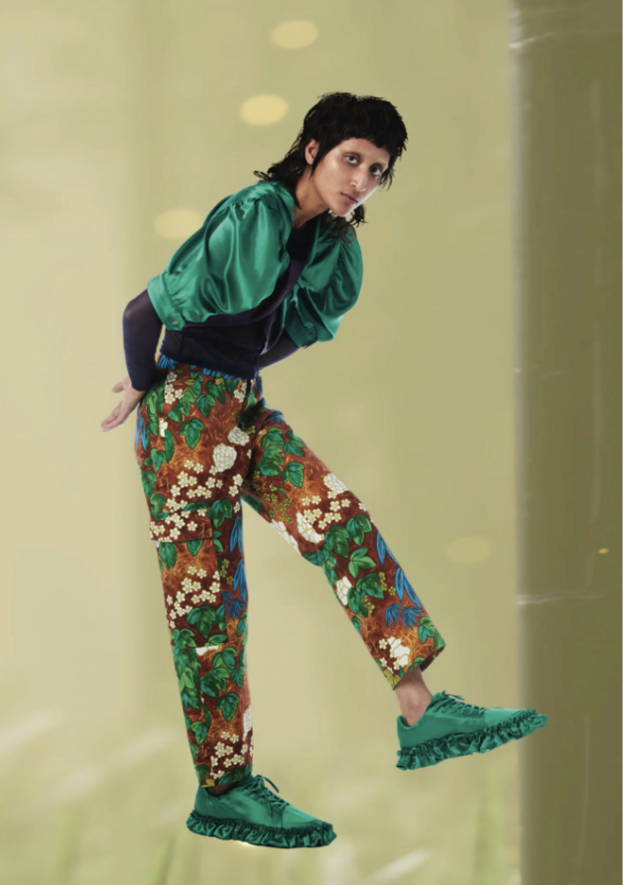
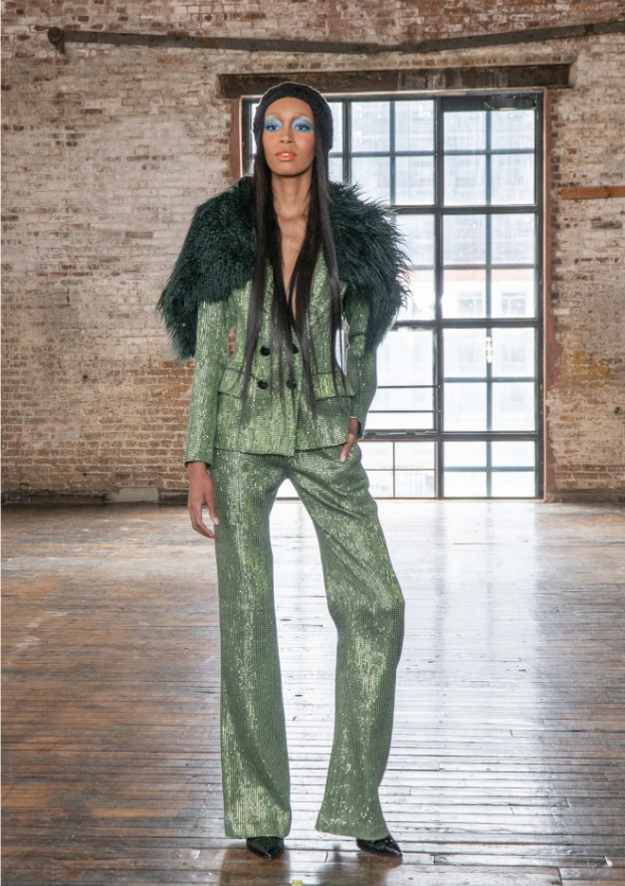
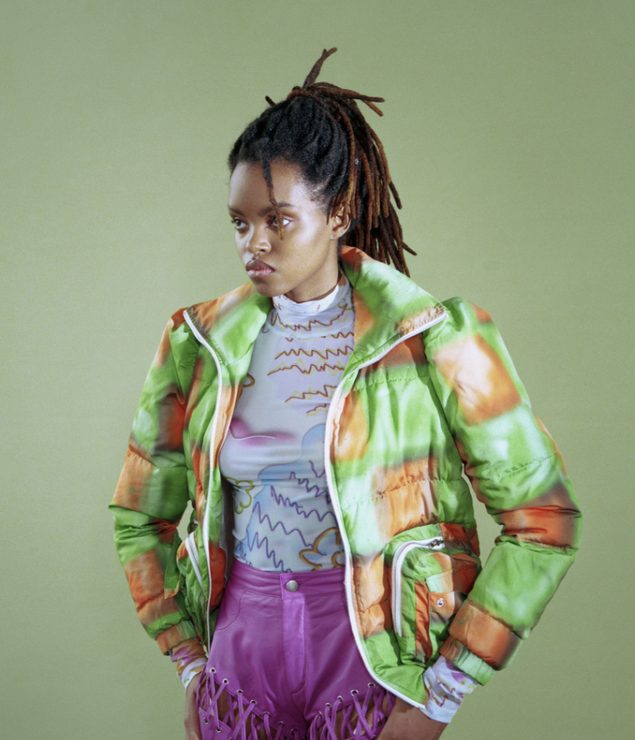
Psychedelic greens

Slide 5
Trend Two

Slide 6
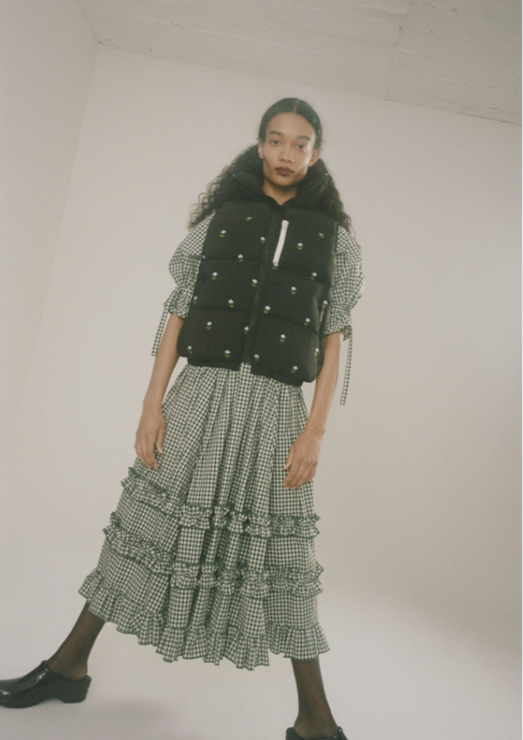
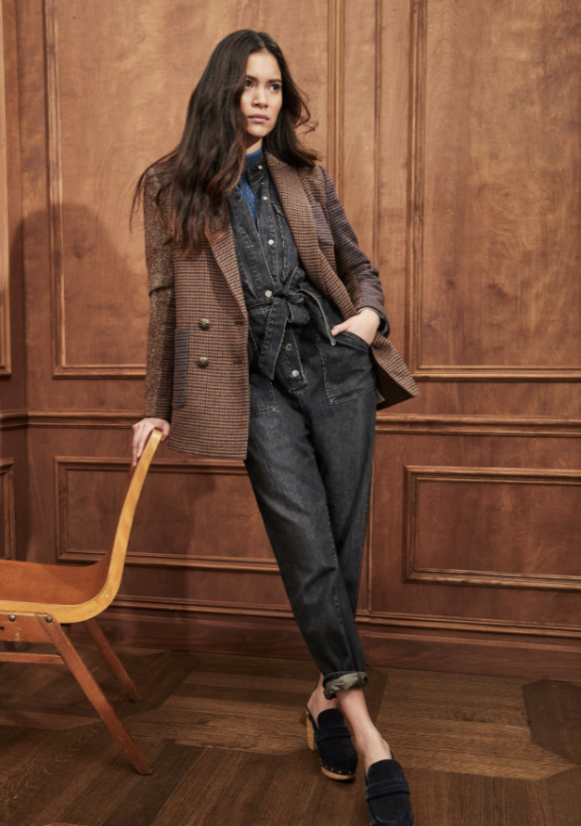
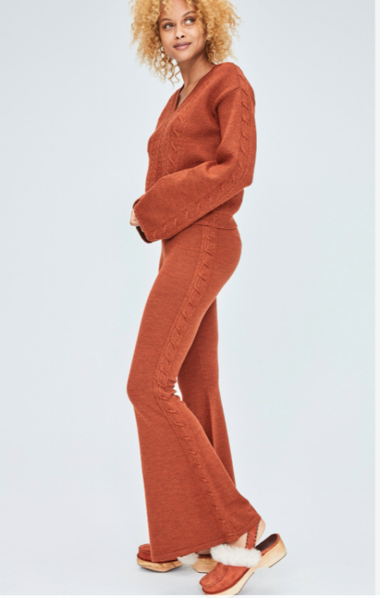
Did someone say clogs?

Slide 7
Trend Three

Slide 8
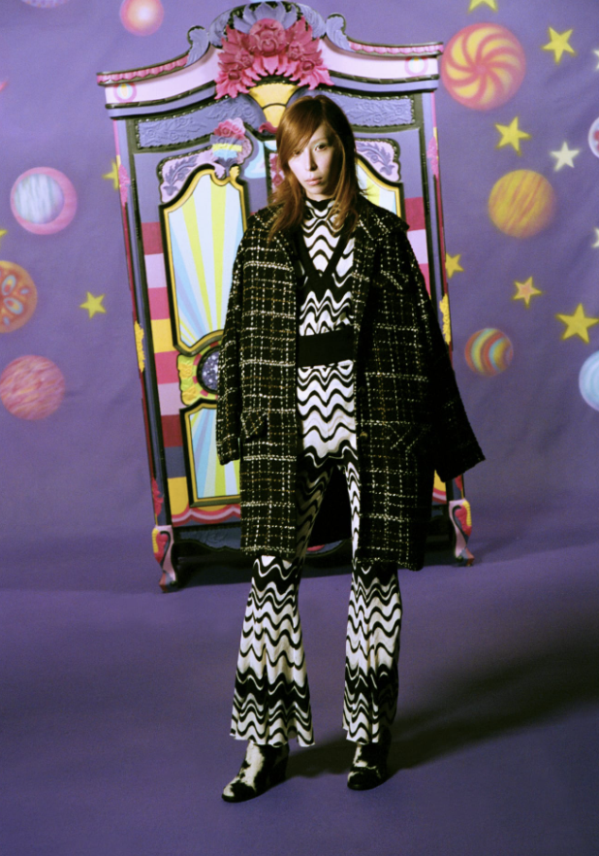
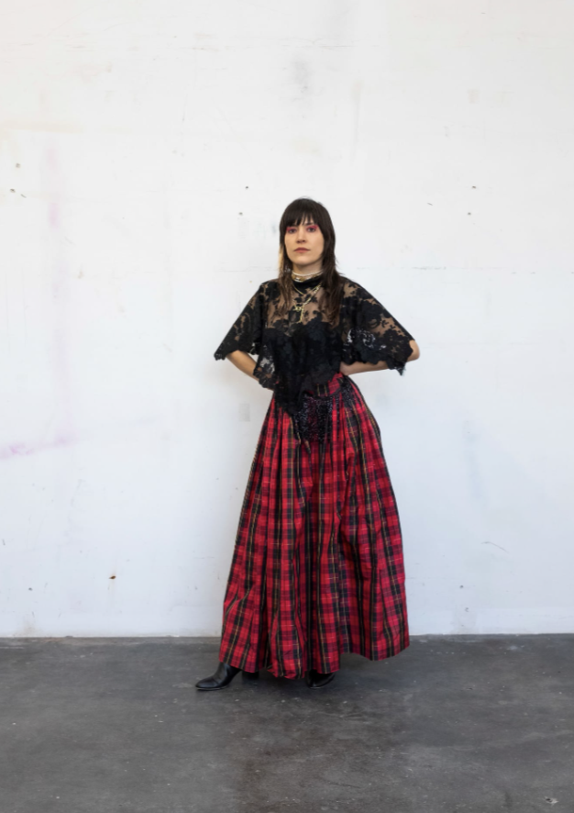
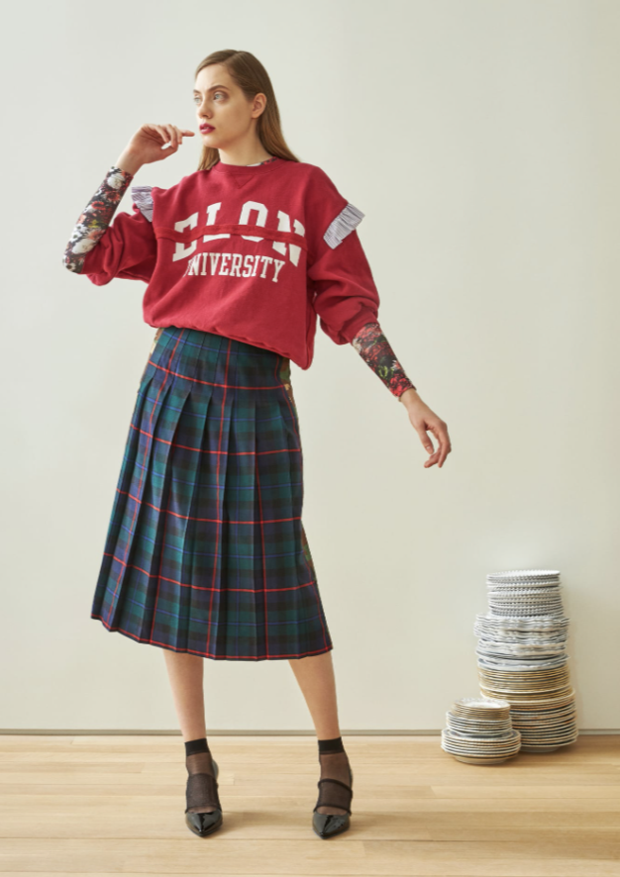
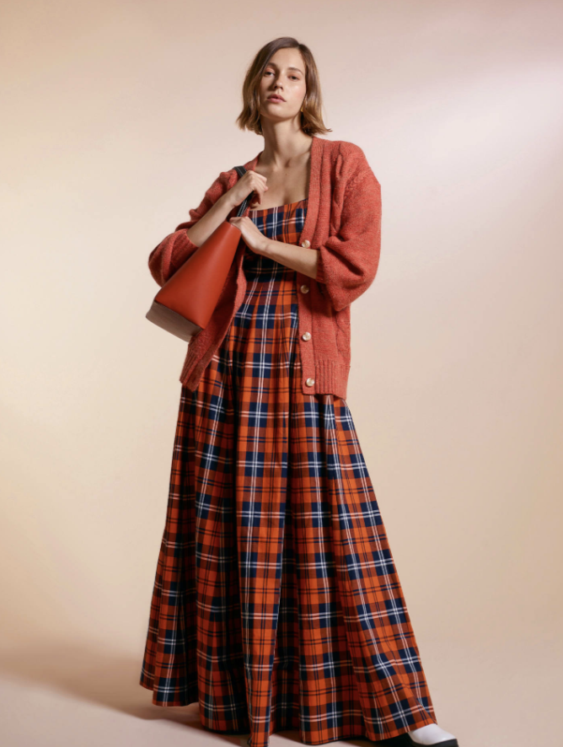
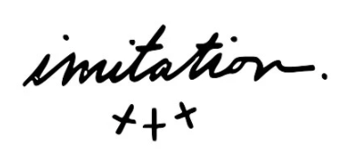
Modern Grunge

Slide 9
Trend Four

Slide 10
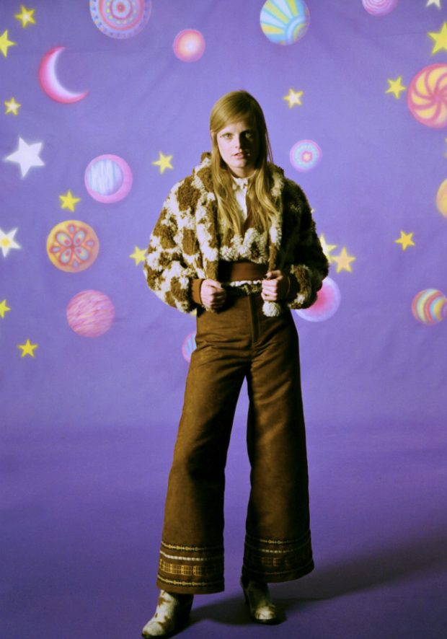
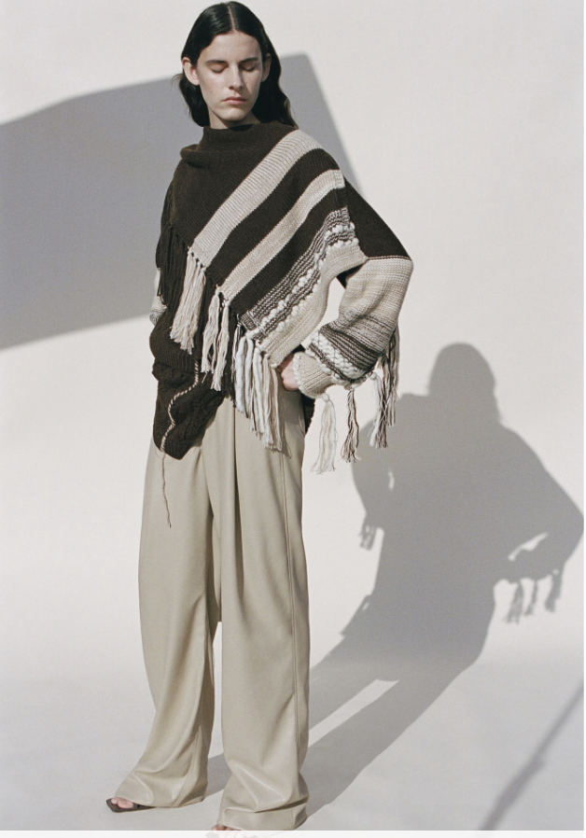
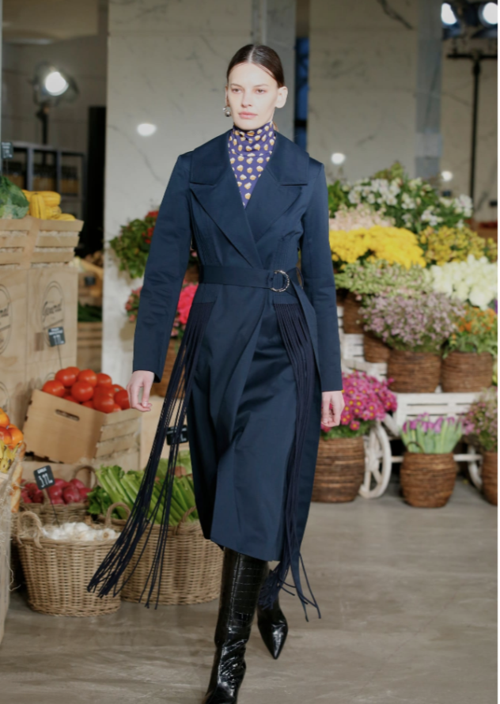
Let’s get Western

Slide 11
Editors Chart

Slide 12
Editors | Monday | Tuesday | Wednesday | Thursday | Friday
Lockwood, Lisa | Business- Racial Equality | Business- Sak’s Champaign | Business- Banana Republic | Fashion- Fashion equality | Fashion- Diversity Fashion Council
Moore, Booth | Fashion- NYFW Chaos
Feitelberg, Rosemary | Eye (on Fashion) -Pantone | Fashion Scoops- Al Weiwei | Business- Stormy Weather | Fashion- Peter Som | Fashion- Black in Fashion
Moin, David | Fashion- Rita Ora | Exclusive- Century 21 |  | Business- Winter conditions
Zhang, Tianwei | Fashion- China Gala |  |  | Accessories- Sneaker Exhibition | Ones to watch- LFW
Manso, James | Beauty- trends insight | Beauty- Vergara Beauty Line
Weil, Jennifer | Beauty- Dior’s ’Nose’ |  | Beauty- Asias Shoppers | Business- Paule Ka

Slide 13
Editors | Monday | Tuesday | Wednesday | Thursday | Friday
Spencer, Mimosa | Exclusive- Ami Collection | Textiles- Paris Digital Shows
Anyanwu, Obi | Accessories- Adelente opening
Zargani, Luisa | Accessories- Moon Boots | Sustainability-Ocean Education | Fashion- Marina Rinaldi |  | Business- E-Comm & China
Socha, Miles | Fashion- Digital Fashion | Fashion- upscale Eyewear | Fashion- Haider Ackermann |  | Exclusive- Montblanc Creative Director
Nordstrom, Leigh | Eye (on fashion)- Taylor Momsen |  |  |  | Eye (on Fashion)- Free Britney
Carrera, Martino | Fashion Scoops- Armani | Fashion- Milan Textiles | Business- GCDS |  | Business- Red Bull Showroom
Chikhoune, Ryma | Fashion Scoops- Louis Vuitton | Fashion Scoops- Emma Chamberlain

Slide 14
Editors | Monday | Tuesday | Wednesday | Thursday | Friday
Palmieri, Jean E | Fashion Scoops- Jennifer Lopez | Business- ‘Diddy” lawsuit | Men’s- Nautica Release |  | Business- Virtual NYFW
Diderich, Joelle | Fashion Scoops- Influencers Matter | Fashion- PFW Schedule | Fashion Scoops- Kenzo Takada | Business- Kering & Gucci
Hopkins, Katherine | Fashion Scoops- Staff Cuts | Fashion Scoops- Covid Love |  | Memo Pad- Walstreet
Conti, Samantha |  | Business- Valentino & Dr. Martins | Business- London Post-Pandemic |  | Memo Pad- Ella Emhoff
Huntington, Patti |  | Fashion- Australian Designers Funding
Sundwar, Sindhu |  | Business-Congress Clauses | Business- Walmart | Business- Amazon Lawsuit | Business- Walmart highes
Natalie Theodosi |  | Fashion- McQueen & Vestiaire | Fashion- Mario Swab

Slide 15
Editors | Monday | Tuesday | Wednesday | Thursday | Friday
Saliban, Sandra |  | Fashion- Digital Test |  | Fashion Scoops- China Growth | Fashion- Formula one
Meyers, Tracey |  | Textiles- Eco-textiles
Tauer, Kristen |  | Eye (on Fashion)- Kasama | Eye (on Fashion)- Omar Douglas | Eye (on Fashion)- Danielle Fuller
Theodosi, Natalie |  | Fashion Scoops- Helping Students |  |  | Business- Brexit & Fashion
Kellie Ell |  |  | Business- Target | Exclusive- Agent Provocateur | Business- Private Equity
Tietjen, Alexa |  |  | Beauty- Bobbi Brown
Conti, Samantha |  |  | Beauty- British Government | Business- Belstaff Menswear | Exclusive- Brexit

